Slide 1
Fostering US-International Collaboration
Plenary Session 5
October 10, 2018

Slide 2
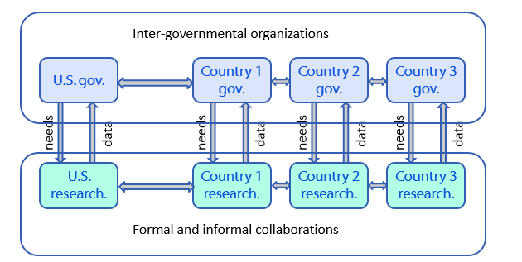

Slide 3
Plenary Questions
What are the challenges and opportunities for U.S.-international collaborations in exposure assessment for nanomaterials?
How can collaborations between exposure projects funded in different countries/regions be improved?
How can the communication between regulators and researchers be improved to ensure that the research on exposure to nanomaterials is most useful for risk assessments?
How can activities in inter-governmental organizations be improved to facilitate integration of exposure into nanomaterial risk evaluations?

Slide 5
QEEN 2 Wrap-Up

Slide 6
Thank you

Slide 7
Where we began . . .
Notes:
All these methods require data

Slide 8
What were the key questions
Unique size and structure – will the effects be unique?
What is the appropriate metric for evaluating nanomaterials?
Will we need new assays to evaluate the toxicity?
Can we develop the appropriate tools to evaluate exposure?
Do we need to develop an entirely new risk assessment paradigm to evaluate nanomaterials?

Slide 9
Applications and Implications of Nanomaterials

Slide 10
Building Communities of Research and Practice

Slide 11
What have we learned
A lot actually
But there’s always room for improvement and more we need to know

Slide 12
Where do we go from here. . .
Continue to build the communities of research and practice
Refine our techniques
Communicate our findings

Slide 13
Thank you

