Slide 1
Next-Generation Governance Challenges for Engineered Nanomaterials
Benjamin Trump, Igor Linkov
US Army Engineer Research and Development Center
QEEN-II

Slide 2
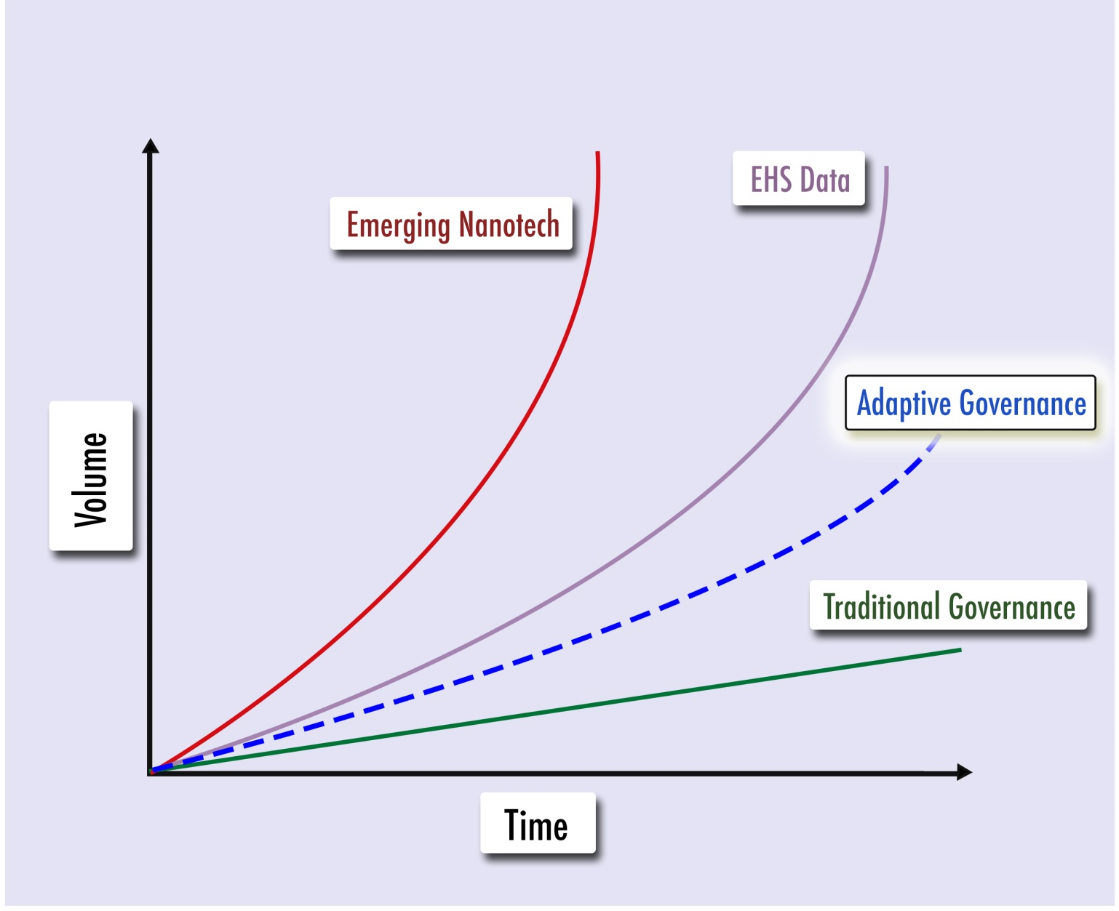
“The Pacing Problem” of Technology Governance
No matter how sophisticated risk assessment becomes, a gap will always exist between new material introduction and risk characterization & management.
Adaptive Governance:
Iterative improvements to governance of materials or activities as more information becomes available

Slide 3
Further Complications – Decision Making & Regulation Under Uncertainty?
We’ve learned quite a bit about engineered nanomaterials and their exposure pathways over the past 20 years, but challenges remain:
Filling knowledge gaps for nanomaterial exposure scenarios
Prioritizing and utilizing available data to inform risk – especially when that information is incomplete
What can we do about these challenges?
Bottom-up approaches: Lab experimentation to evaluate specific material
Top-down approaches: Decision support tools to fit stakeholder needs

Slide 4
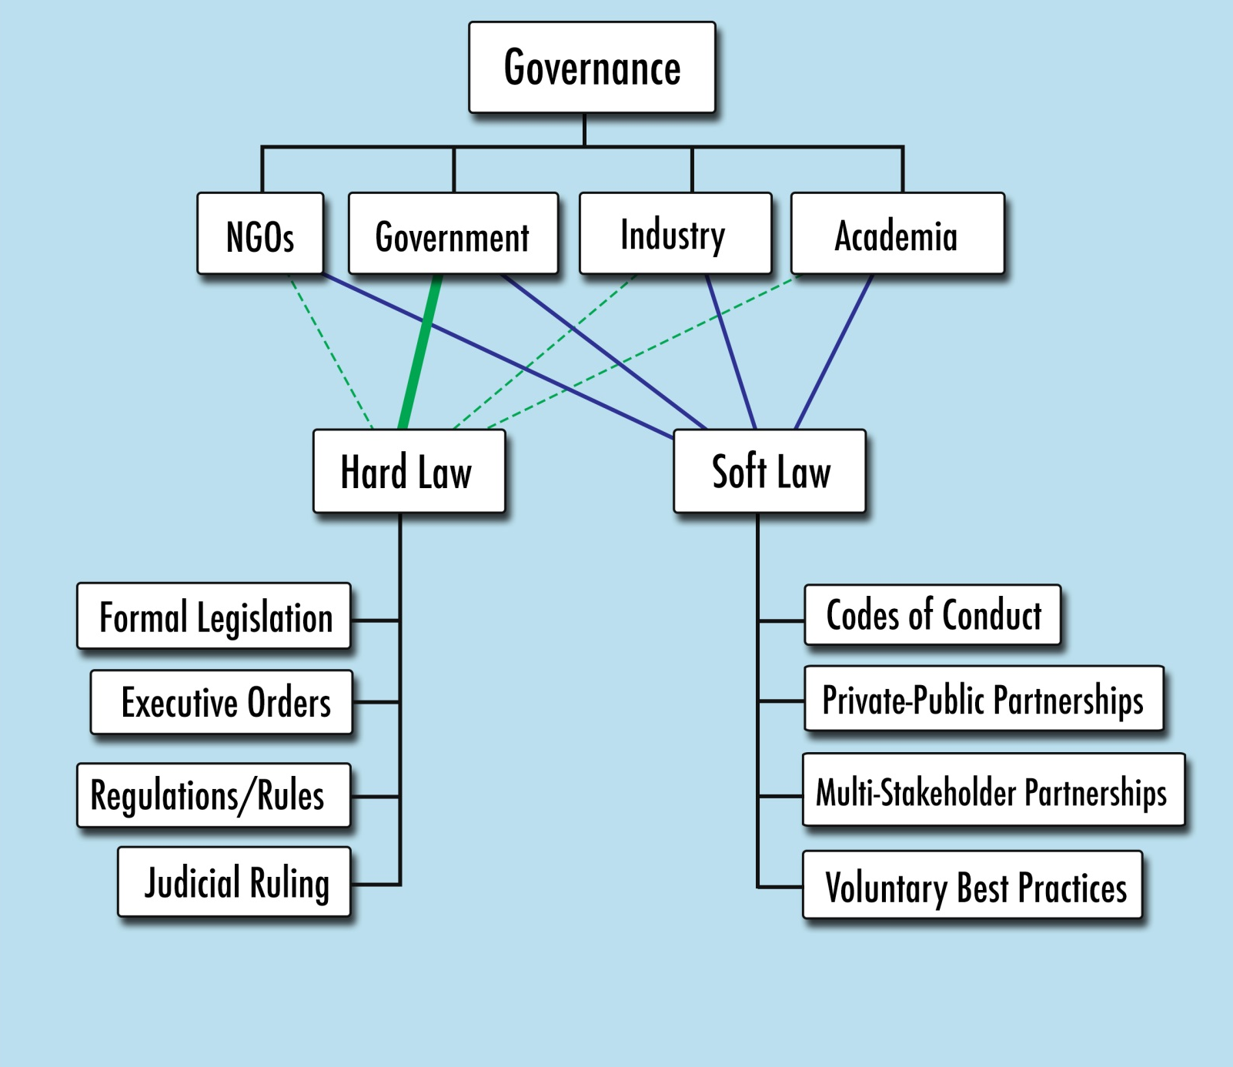
Drivers of Governance

Slide 5
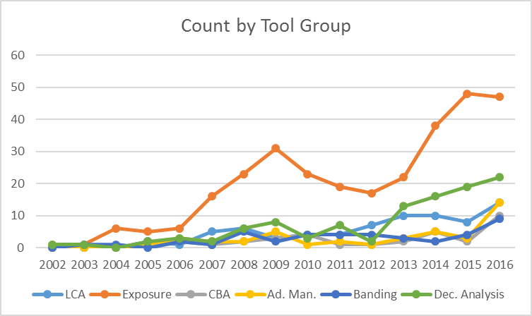
A Survey of Nano Tools: 2002-2016

Slide 6
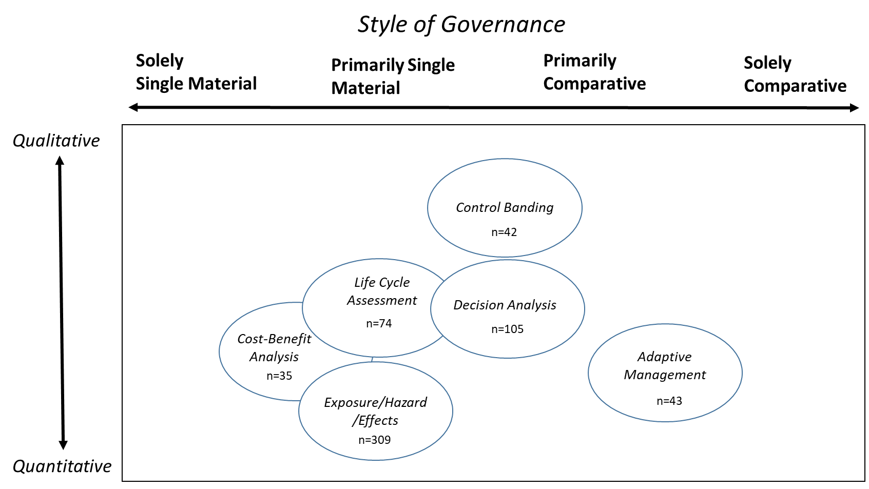
Tools are helpful, but not necessarily “Good” Governance
Quantitative methods and tools help drive risk assessment
However, data on hazard, exposure, and effects is not always readily available for the exact material in question
Also need to consider non-risk considerations of cost, societal benefit, ethics, implications, etc.
Challenging via Frank Lautenberg amendments to TSCA in 2016
Consider all elements of risk governance to drive “good” governance

