Slide 1
Young Nanoscientists Group
Lila Thornton
Information and invitation

Slide 2
What is it?
Initiative to create a network of nano-scientists in early stages of their careers
Who can join?
PhD students
Post-docs
Notes:
Here the idea is to describe (quickly) what the group is and who can join. You can just read the sentence in the slide.
In who can join you can also add: and anyone that could help us to push this initiative.

Slide 3










Who is already there?
Around 60 people
  Ecotoxicity
  Fate
  Exposure
  …
Notes:
For the first time we can say: with people from both EU and USA.
The topics that YNS study are currently focused in Nanosafety because the initiative started in a Nanosafety project (NANOFASE), but it can be widespread in the future.

Slide 4

Goals
Support each other:
Networking
Promote cooperation
Notes:
Networking: stay in contact with researchers in the same career stage and working on similar topics
Usually, young researcher are not able to travel as much as senior researchers, for this reason is more difficult to create a strong network. However, a strong network in an early stage of our careers is very important, that’s why this initiative started.
Once the network is created we can use it to help each others. Sharing different information, which can be more general (as job positions) or more detailed (as lab protocols). This will be explained in the next slide.

Slide 5
Activities
Meetings (via webinars)
  Exchange information
  Practice talks & scientific discussions
Introduction videos
  Formal CV
  Informal presentation of working facilities
Organizing events
Notes:
Exchange info: conferences etc.
Practice talks: before conferences, can lead to scientific discussions if you want to share your difficulties or doubts
Introduction videos: self-explanatory
Organizing events: Conferences, for example Marta Baccaro participated in the organisation of the 3d Young Nanoscientists’ Forum (see next slide)

Slide 6
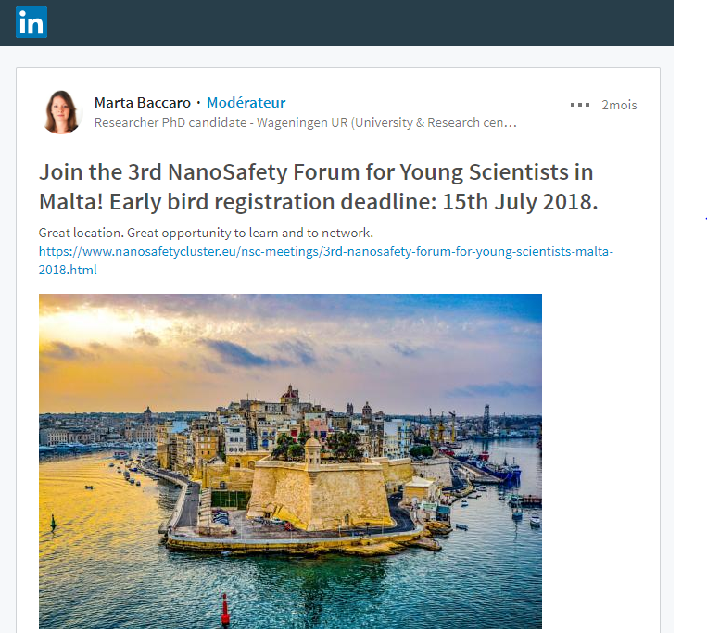
Activities

Slide 7


Activities
Video tutorials
  Coding
  Software
  Lab tools
?
Notes:
Video tutorials: can be on different topics
Made by ourselves for our community: focused on what we need (coming soon, first one will be on R programming)

Slide 8

Activities
Open to suggestions!

Slide 9
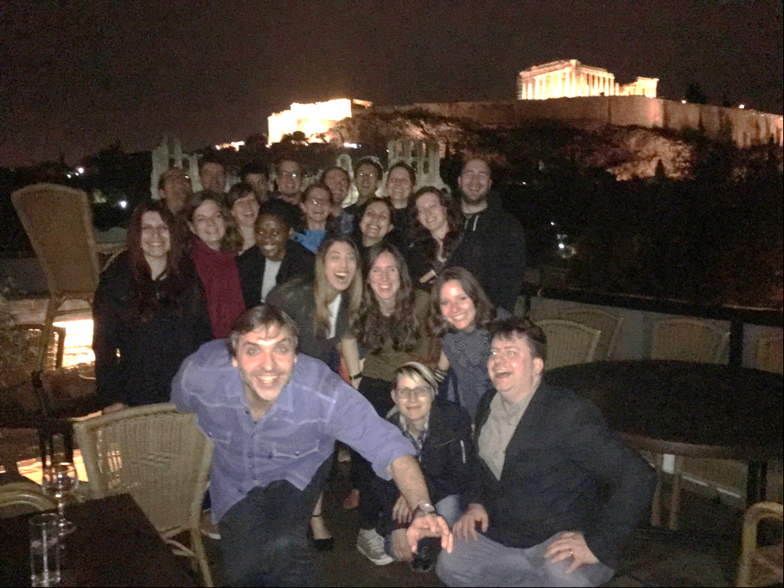
… And having fun!
Notes:
This picture was taken at the NanoFase meeting in Athens, in March, after a very nice meal ;)

Slide 10
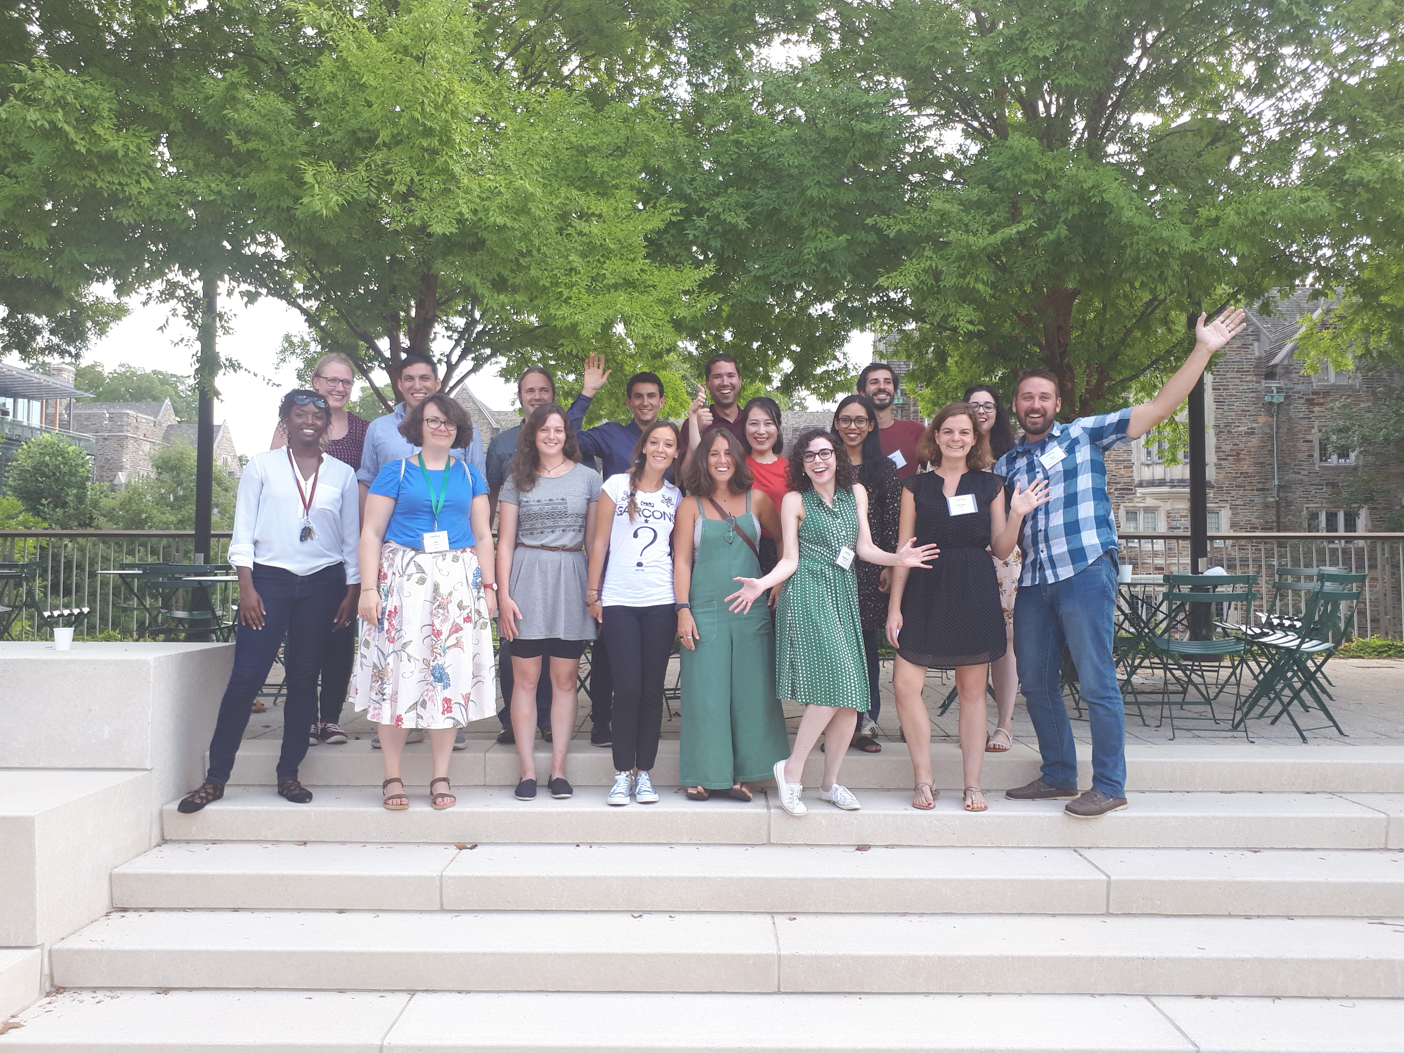
… And having fun!
Notes:
…And this one with the US crew! ;)

Slide 11


Join us:
If you are interested write us an email to:
young_nanoscientists@nanofase.eu
You can also find us in social media:
“Young NanoScientists”
OR JUST MEET US DURING THE BREAKS!!

