Slide 1
Queen II Session 2D
Emerging technologies and advance materials: stakeholder perspectives on exposures, hazard, and risk assessment
Use of nanomaterials in 3D printed consumer products
Treye A. Thomas, Ph.D
October 9, 2018

Slide 2
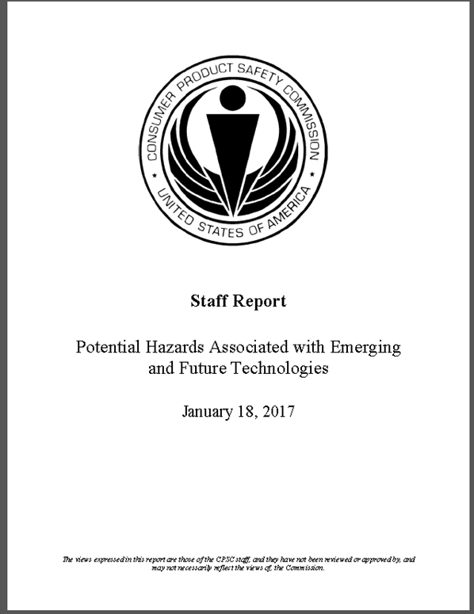
CPSC Report on Emerging Consumer Products
Released January 2017
Brief overview of potential emerging consumer products and technologies
Technological and societal trends likely to influence marketplace for consumers
Potential consumer safety issues
  Opportunities for enhancing product safety

Slide 3
Emerging and Future Products
Emerging and future consumer products and technologies identified in this report include:
  • 3D Printers and the printed products;
  • Internet-home based smart technologies;
  • Software as a component part;
  • Wearable products and technologies;
  • New materials, including nanomaterials;
  • Virtual reality (VR) and augmented reality (AR) games;
  • Personal transportation products;
  • High capacity energy storage and energy generation;
  • Robotics, including robotic products to assist older adults; and
  • Brain-machine interface/implantable technologies.

Slide 4
Estimating Exposure and Health Risks From 3D Printing
Consumer at-home use of 3D printing is increasing rapidly and is expected to reach USD 30 billion by 2022.
  Adult hobbyists and home-based manufacturers account for most home use
    Some 3D printers are being marketed for use by children.
Broad range of filaments available such as:
  acrylonitrile butadiene styrene (ABS), high impact polystyrene (HIPS), polylactic acid (PLA), thermoplastic elastomer (PCTPE), transparent polycarbonate, nylon
Consumers can also make their own filaments using blended materials and home filament extruders.
Nanomaterials may be used in these filaments
  CNTs

Slide 5
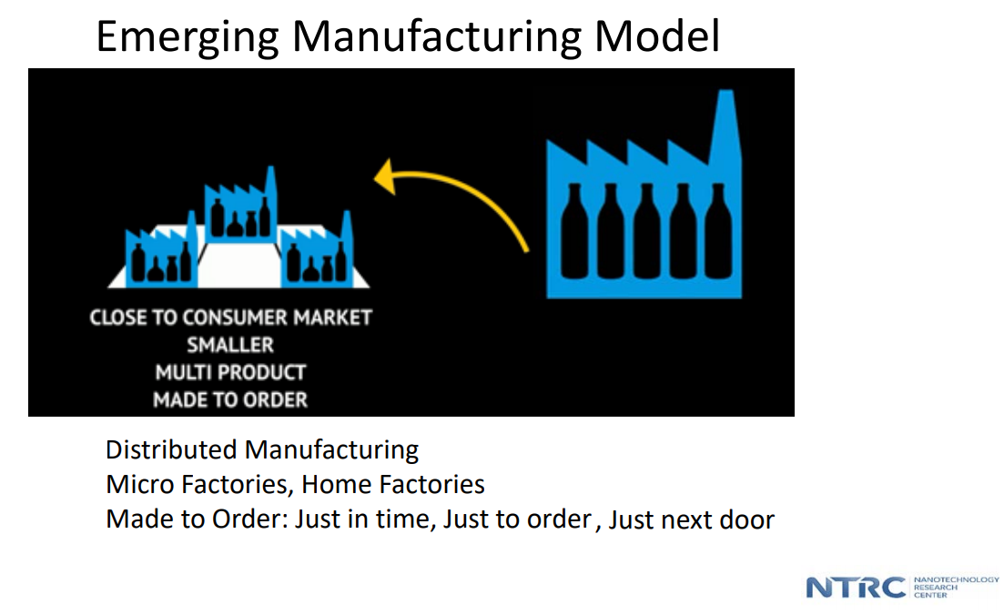
3D Printing of Products
Distributed manufacturing
  Business developed in the home environment to “manufacture” products
  Larger and more advanced devices
  Multiple printers and products
Safety
  Engineering controls
  Personal protective equipment (PPE)
  Storage of materials
    Accessibility to children and pets
Source: C. Geraci, NIOSH

Slide 6
Health Implications 3D Printing
What is released during 3D printing?
  Printing may take several hours
  High heat ~200 – 250 C filament extrusion
  Minimal to no engineering controls
  Accumulation in the indoor environment
Advanced versions of 3D printers involve powders
Exposures across the lifecycle
  Durability of 3D printed versus traditionally manufactured products

Slide 7
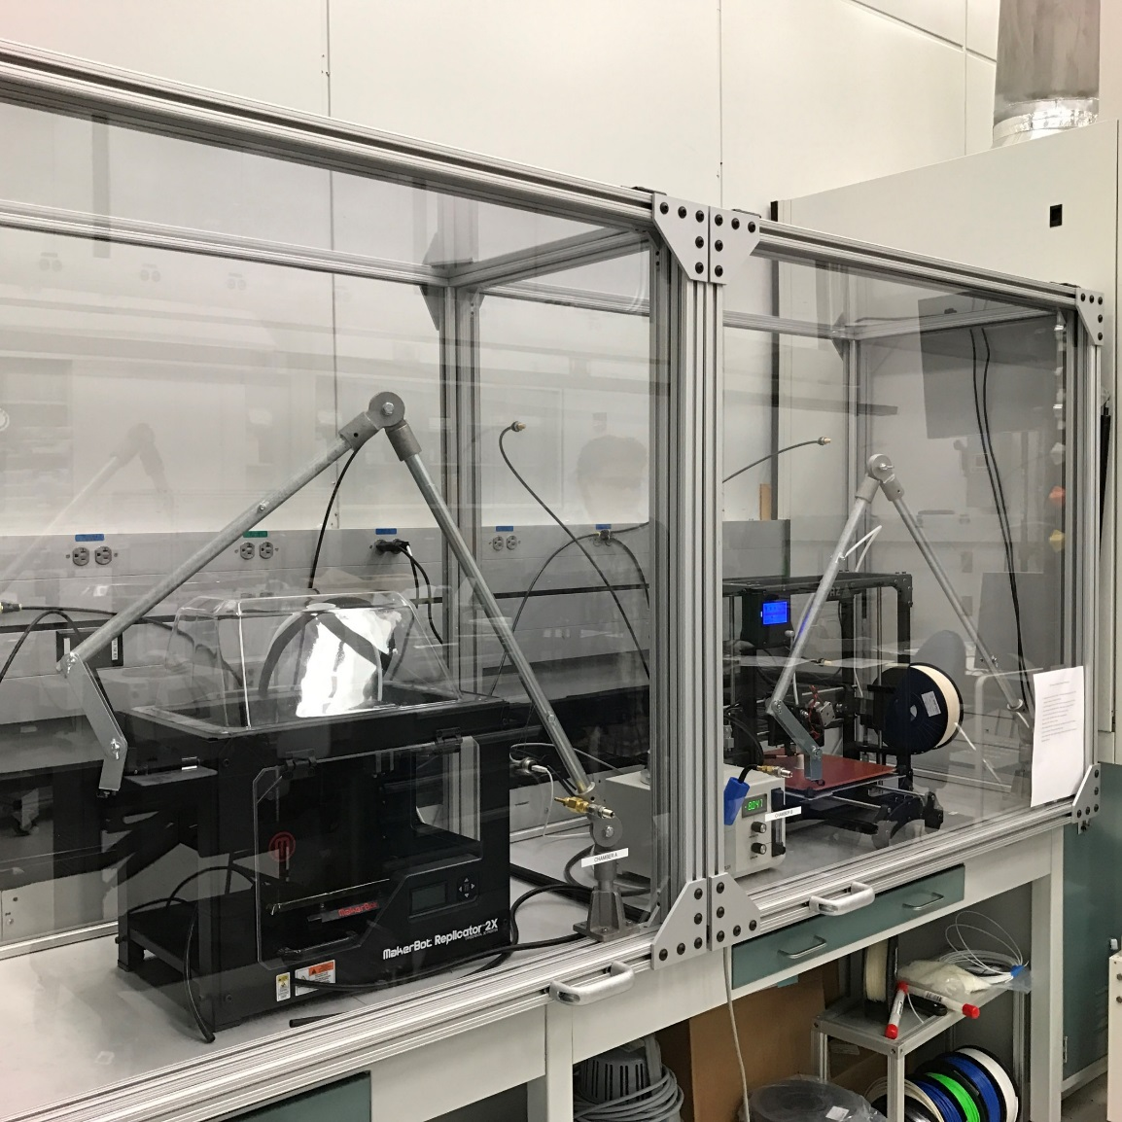
CPSC-NIST Chamber Testing - Nanomaterials Releases During 3D Printing
Source: K Scott, NIST
2 separate sampling chambers for 2 different printers

Slide 8
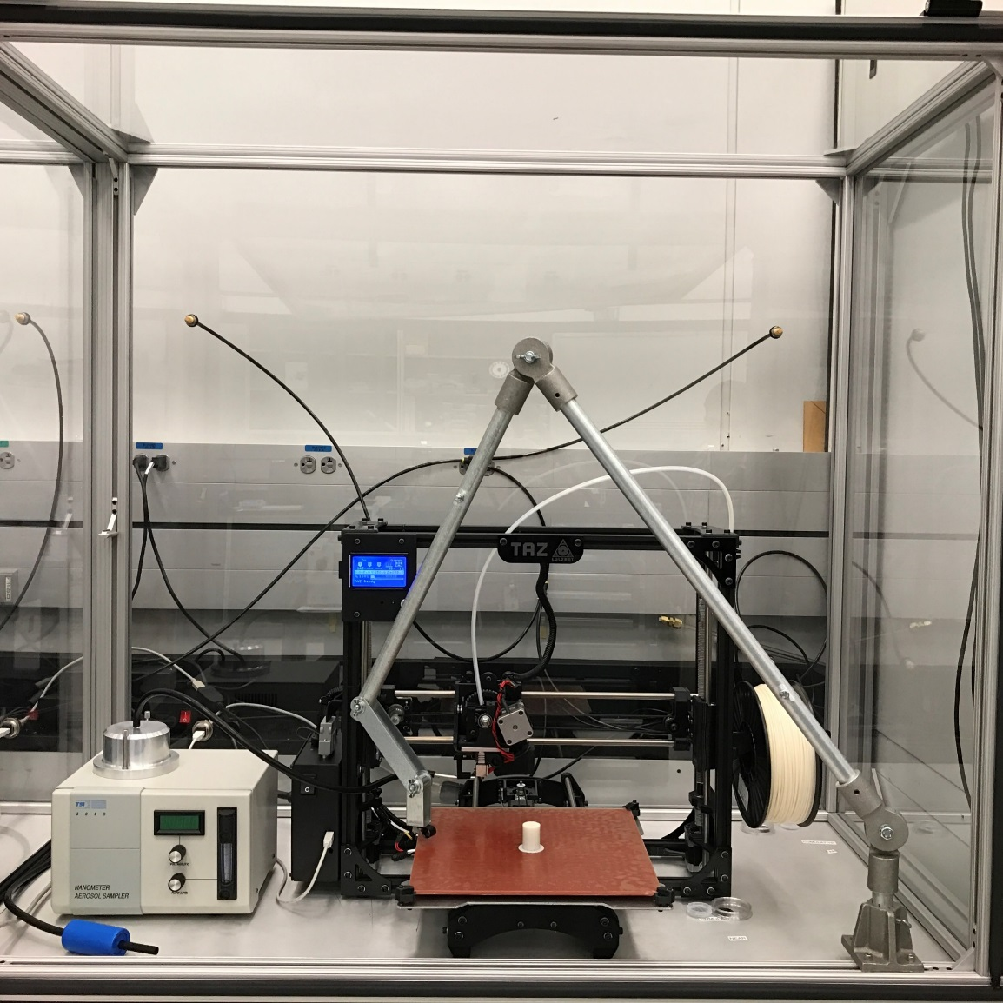
CPSC-NIST Study of 3D Printer Air Emissions
Adjustable sampling port positions
Electrostatic precipitator based particle collection
Carbon nanotube ABS filament

Slide 9
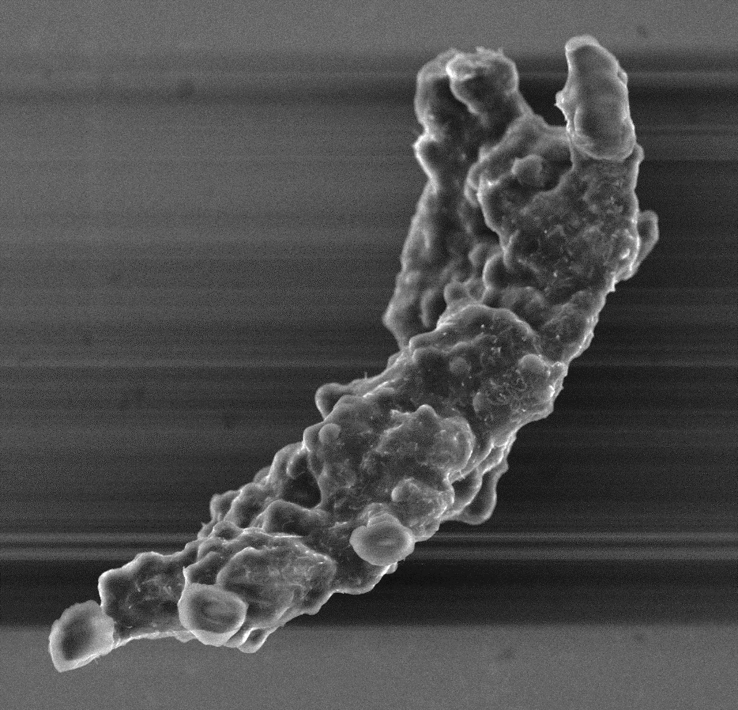
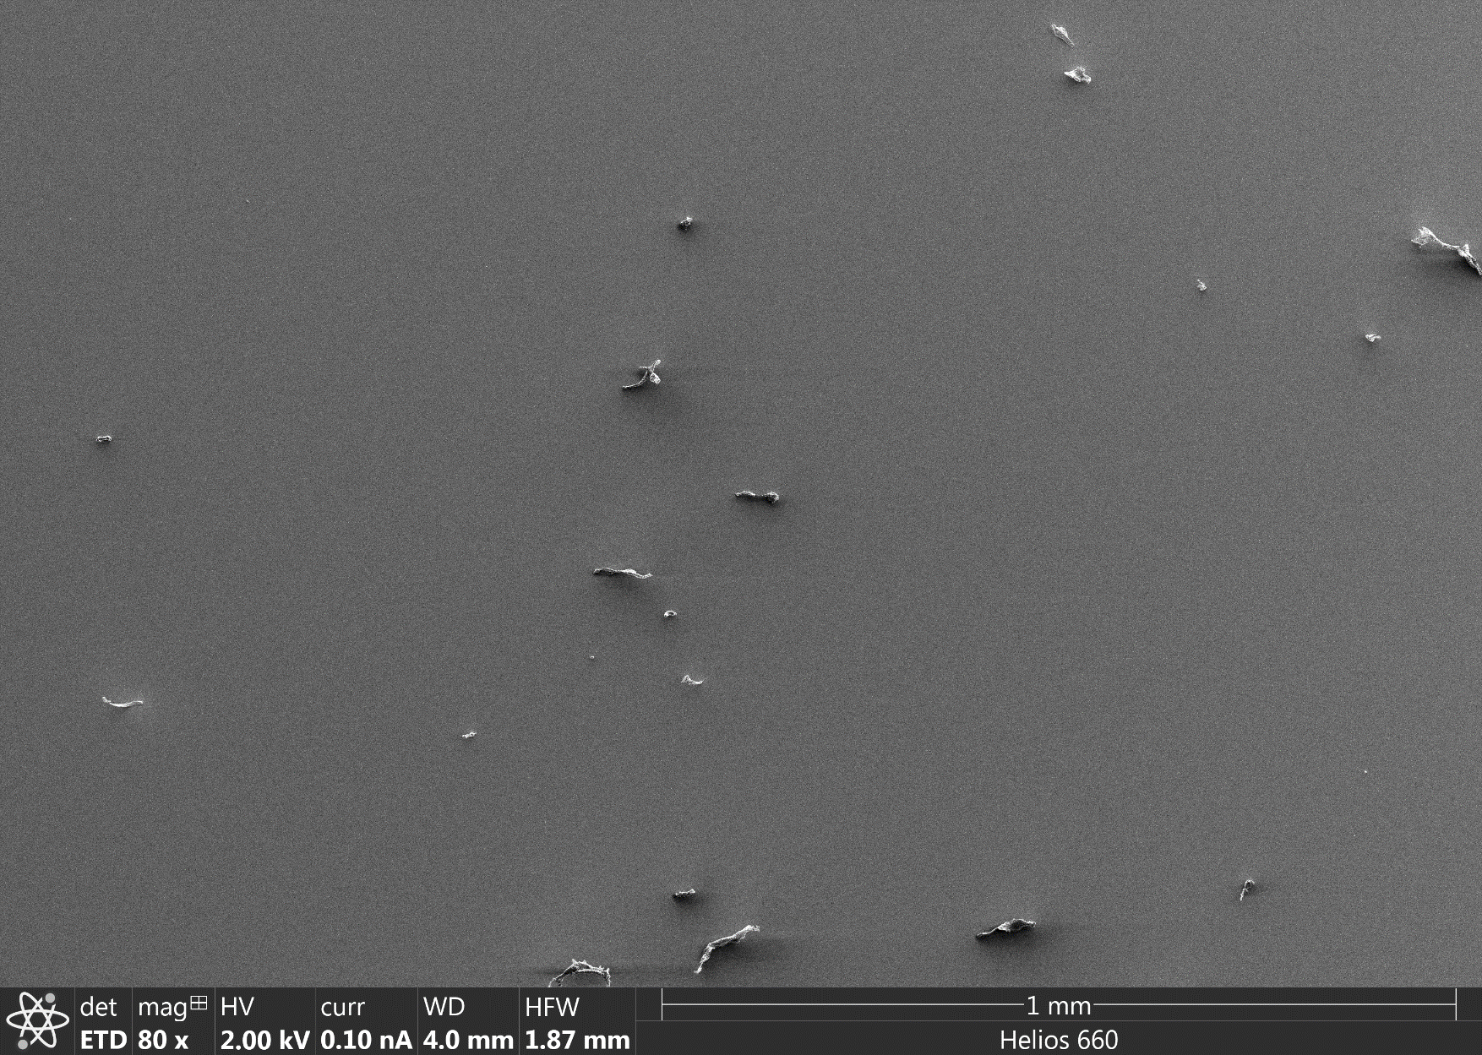
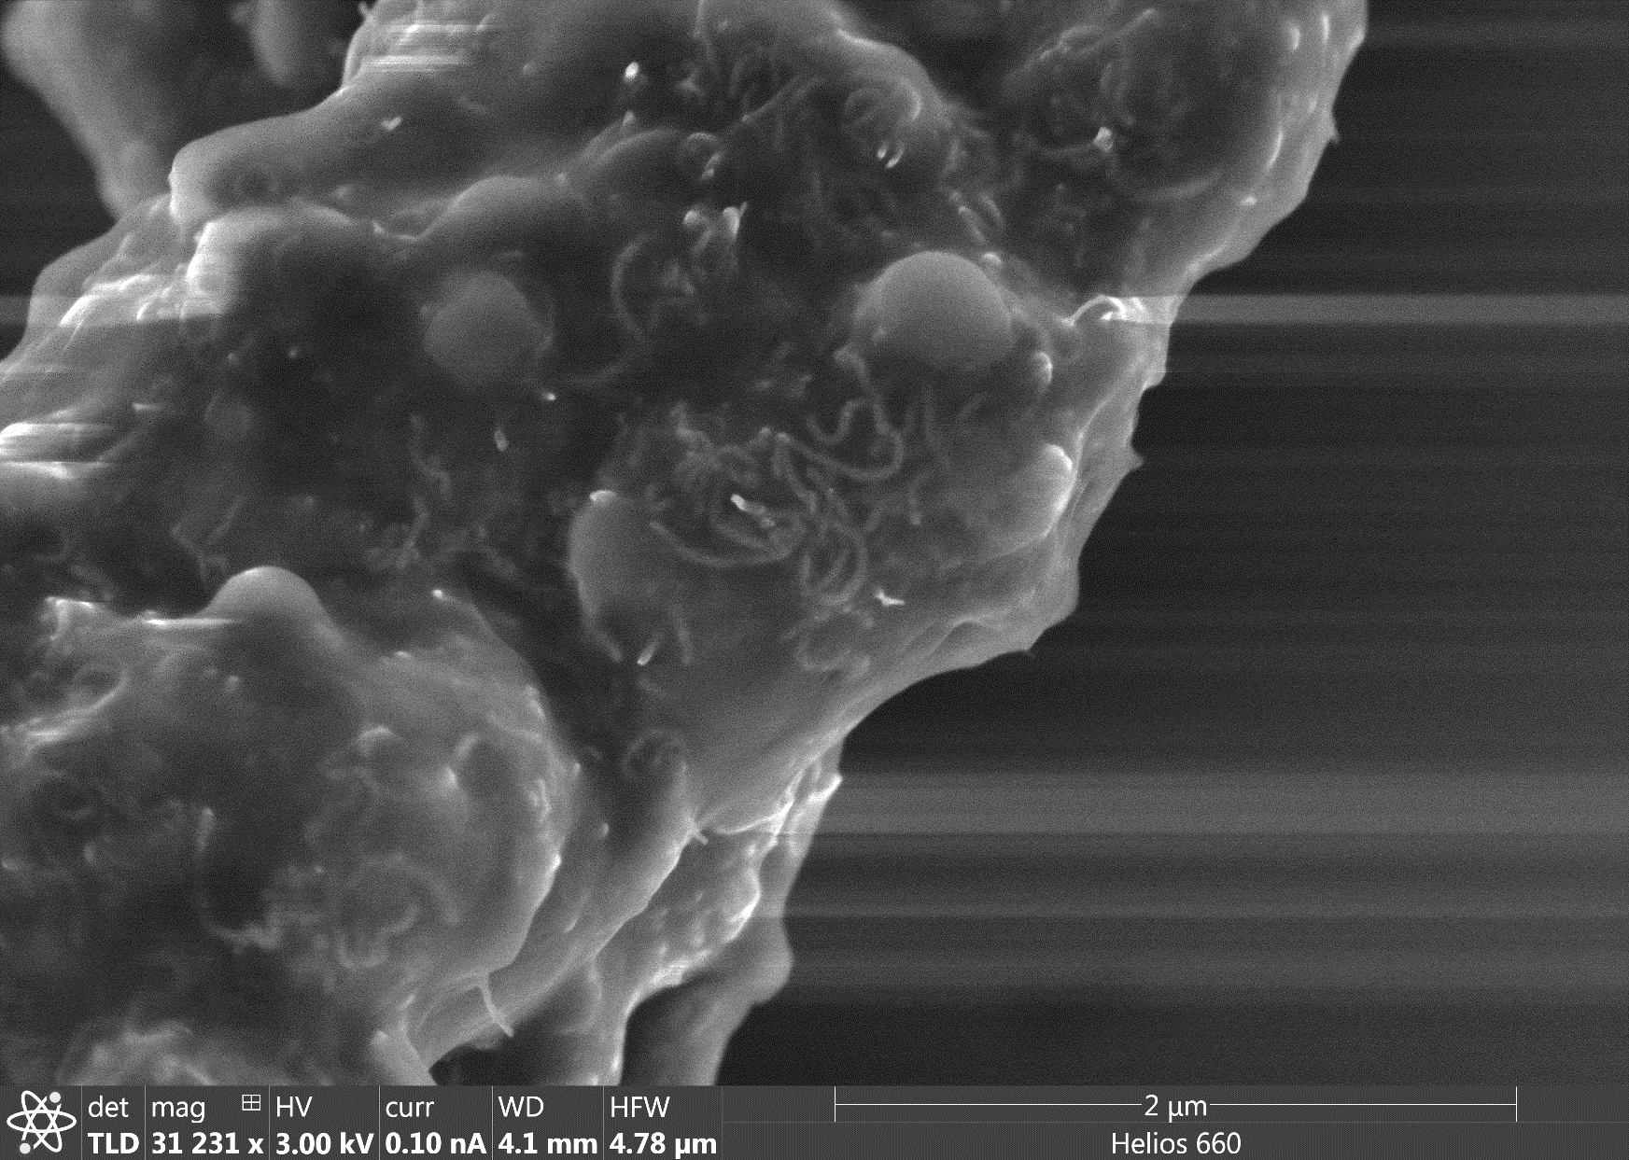
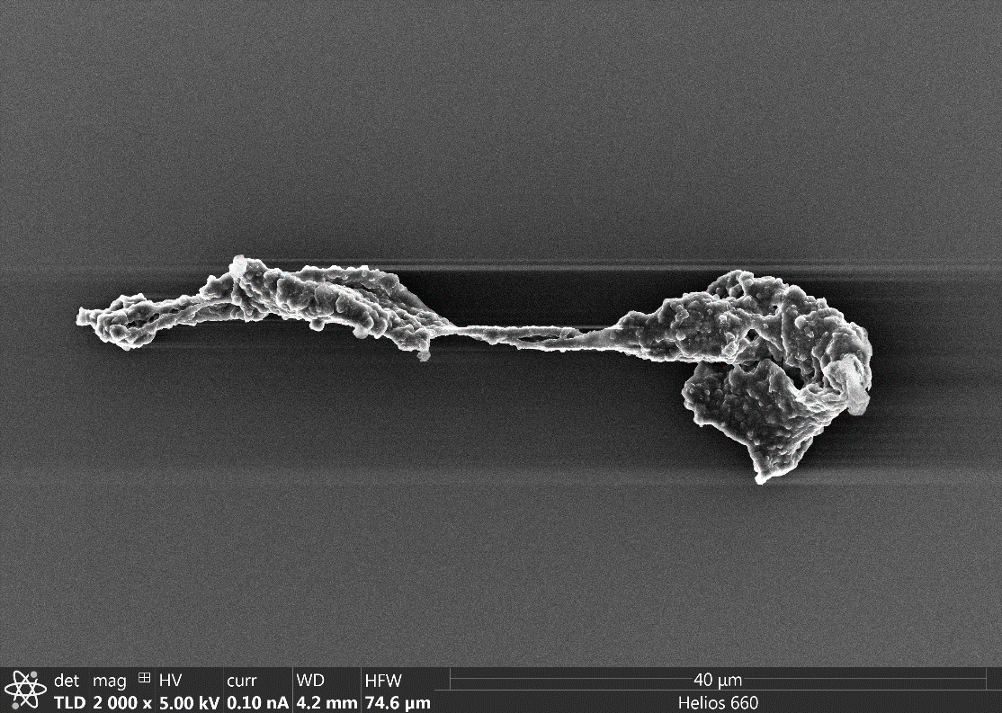
Particles released during 3D printing with MWCNT ABS filaments
Particles collected on the sampling wafer.
5 μm
Many of the particles exhibit twisted morphology shown in this particle.
Many MWCNTs are protruding out from the polymer surface.
White spaghetti like inclusions are MWCNTs.
Source: Keana Scott et al., NIST

