Slide 1
Advancing Sustainable Nanotechnology through Life Cycle Assessment
Wu-Sheng Shih, Ph.D.
QEEN II: 2nd Quantifying Exposure to Engineered Nanomaterials from Manufactured Products Workshop
October 9, 2018

Slide 2
What Happened?

Slide 3
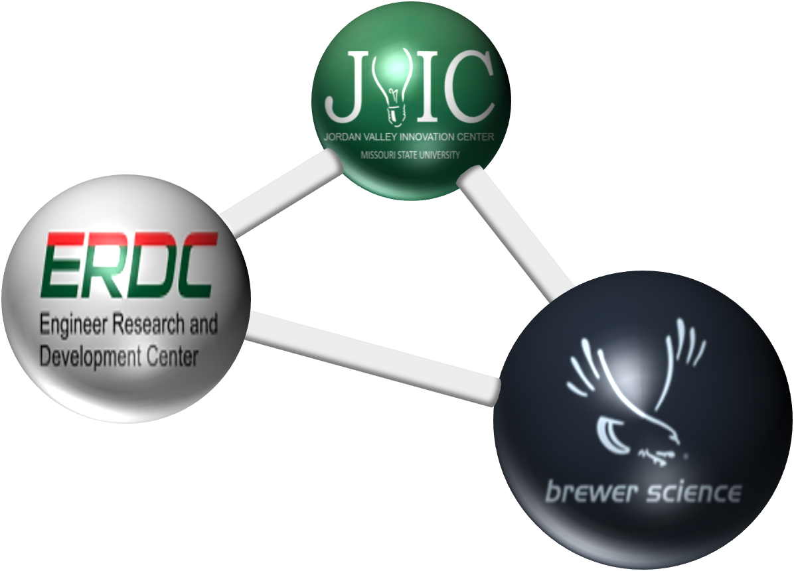
EHS-Inspired Nanotechnology Development
ACADEMIA
A PUBLIC-PRIVATE PARTNERSHIP
GOVERNMENT AGENCY
INDUSTRY
Promoting Safe, Rapid Commercialization of Nanotechnology-Enabled Products
Inspired by “Safety by Design” and “EHS Impact Reduction”
Start from the Very Beginning

Slide 4
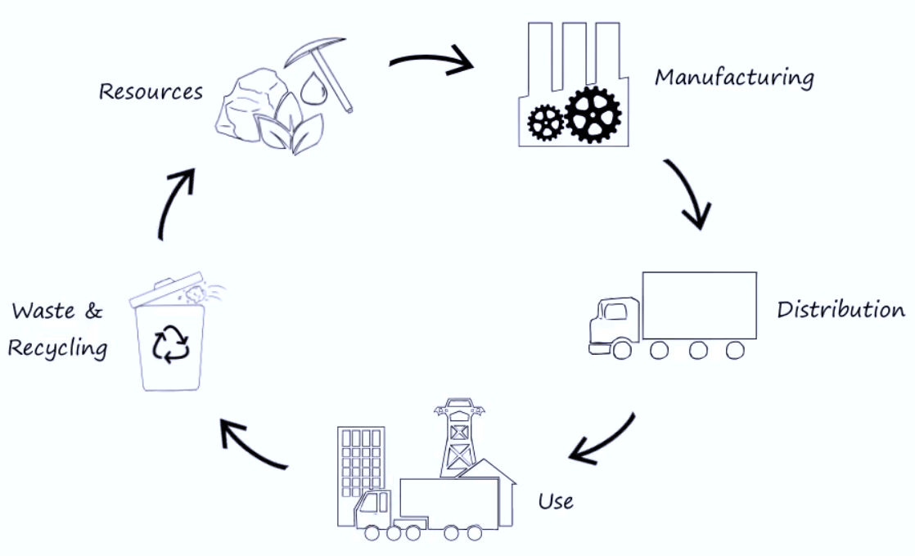
EHS-Inspired Nanotechnology Development
“CRADLE-TO-GRAVE” LCI & LCA
Assisting development of technology in an efficient manner by allowing for more informed decision making, which can lead to lower costs, reduced EHS risk, minimized carbon footprint, and business growth.
Cradle
Raw Materials
Materials Processing
Product Manufacturing
Use
Disposal
Grave

Slide 5

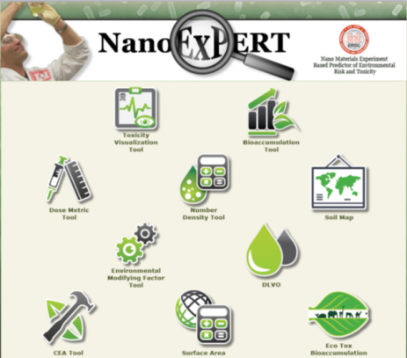
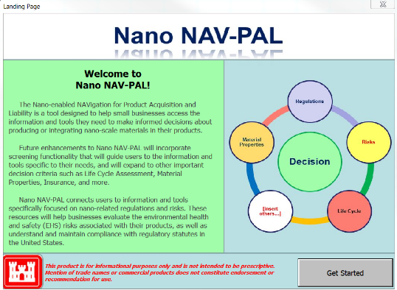
EHS-Inspired Nanotechnology Development
NanoEHS TOOL DEVELOPMENT
https://nano.el.erdc.dren.mil/
POC: Al Kennedy, 601-634-3344
Alan.J.Kennedy@usace.army.mil

Slide 6
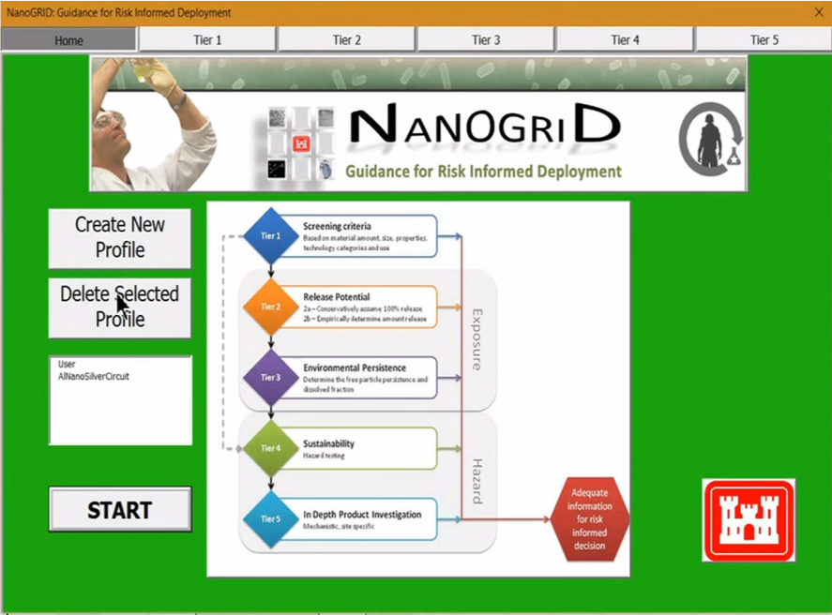
EHS-Inspired Nanotechnology Development
NanoEHS TOOL DEVELOPMENT
Incorporation Into DoD Systems Acquisition (OSD) Guidance Document
https://nano.el.erdc.dren.mil/
  Collier et al., Journal of Nanoparticle Research, 2015. 17(3):155
POC: Al Kennedy, 601-634-3344
Alan.J.Kennedy@usace.army.mil

Slide 7
EHS-Inspired Nanotechnology Development
Productivity
Improve
> 10X Production Throughput
> 5X Material Performance
> 5X Product Shelf Life
Reduce
Waste Water: >95%
Energy Consumption: > 50%
Identified EHS Impact Categories : > 90% (per
Unit Production)
EHS Impacts

Slide 8
EHS-Inspired Nanotechnology Development
Productivity
Improve
Manufacturing Efficiency
Performance
Time to Market
Reduce
True Technology Cost
Environmental Cost
Societal Cost
Economical Cost
EHS Impacts

Slide 9
Dr. Wu-Sheng Shih
wshih@brewerscience.com
573-364-0444 X2922
QEEN II: 2nd Quantifying Exposure to Engineered Nanomaterials from Manufactured Products Workshop
Washington, DC 2018
October 09, 2018

