Slide 1
Assessing exposure and health effects for nanomaterial workers: Epidemiologic and biomarker approaches
Paul A. Schulte, Ph.D.
Centers for Disease Control and Prevention
National Institute for Occupational Safety and Health
Cincinnati, OH USA
The findings and conclusions in this report are those of the author and do not necessarily represent the views of the National Institute for Occupational Safety and Health.

Slide 2
Increasing and coalescing evidence from animal studies of some engineered nanomaterials
Studies of experimental animals show cancer, pulmonary fibrosis, cardiovascular effects
Consistent patterns of toxic effects related to oxidative stress
Variability due to contaminants and physico-chemical parameters
Effects seen after relatively short exposure and low doses

Slide 3
Epidemiologic issues
Not intrinsically different from studies in other industries
Inherent characteristics of nanoparticles and contemporary workplaces present difficulty
Uncertainties in hazards and disease endpoints

Slide 4
Critical issues
Heterogeneity of nanoparticles
Identification of study population
Temporal factors
Exposure characterization
Disease endpoints
Design and analysis

Slide 5
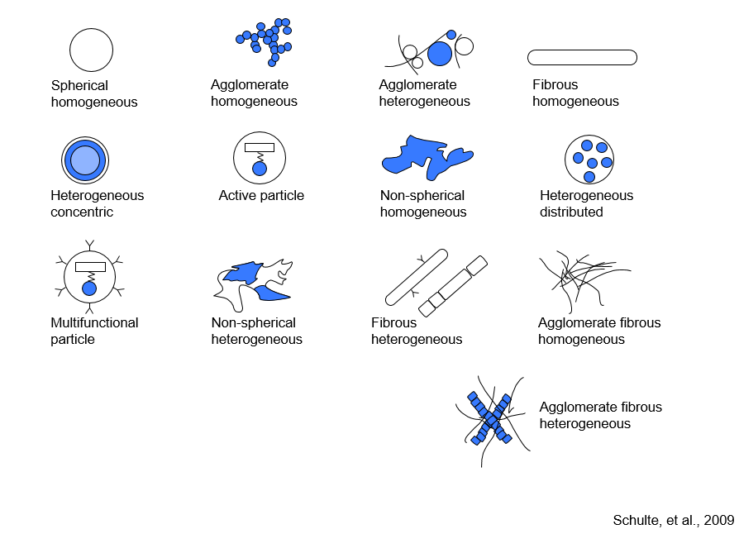

Slide 6
Critical issues
Heterogeneity of nanoparticles
Identification of study population
Temporal factors
Exposure characterization
Disease endpoints
Design and analysis

Slide 7
Transport
Research Laboratories
Academic
Commercial
Warehousing/Maintenance
Waste Handling
Start Up/Scale Up Operations
Transport
Warehousing/Maintenance
Manufacturing/Production
Warehousing/Maintenance
Transport
Waste Handling
Incorporation in Products
Maintenance of Products
Manipulation of Products
Application of Products - Medical Delivery
Disposal / End of Life
Recycling

Slide 8
etc.
Sector: Food
Sector: Electronics
Sector: Medicine
Sector: Energy
Sector: Materials
Nanomaterial Type
Carbon
Metal
Dendrimers
Fullerenes
Workplaces
Nanotubes
Oxides
Metal Nanomaterials
Nanowires
Nanostructured Metals
Nanoporous Materials
Nanoscale Encapsulation
Laboratory
Research
Start up/Pilot
Manufacturing
Production
Disposal

Slide 9
Critical issues
Heterogeneity of nanoparticles
Identification of study population
Temporal factors
Exposure characterization
Disease endpoints
Design and analysis

Slide 10
Dilemmas in identifying workers exposed to engineered nanoparticles
Number of Workers Exposed
10,000,000
1,000,000
Global employment est.
USA employment est. (Roco & Bainbridge, 2005)
100,000
Estimated number of workers actually exposed to engineered nanoparticles
?
?
10,000
?
?
1000
1959
1990’s
2000
2010
2015
2025
Feynman’s vision
Beginning of commercialization
Schulte, 2009

Slide 11
Critical issues
Heterogeneity of nanoparticles
Identification of study population
Temporal factors
Exposure characterization
Disease endpoints
Design and analysis

Slide 12
Exposure characterization
Metrics
Sufficiency of exposure
Differential exposure
Levels by jobs and process

Slide 13
Disease endpoints
Acute
Chronic
Distinguish from effects of air pollution and other industrial exposures

Slide 14
Design issues
Sample size
Retrospective vs. cross-sectional vs. prospective
Biomarkers

Slide 15
Exposure registry
A system for collecting and maintaining in a structured record, information on persons with known or suspected occupational or environmental exposure to a hazardous substance.

Slide 16
Exposure registry (cont.)
Used in public health for over 50 years
May serve as a societal response to hazardous exposures
May serve as preparatory step for epidemiological studies
May allow for risk communication

Slide 17
Questions about exposure registries
Who would fund/manage them?
What data would be collected?
Who would have access to the data?
Could any investigator with a research proposal have access to the registry?
Are there non-research implications and responsibilities for those who manage registries?
Are there expectations for those who participate in them?

Slide 18
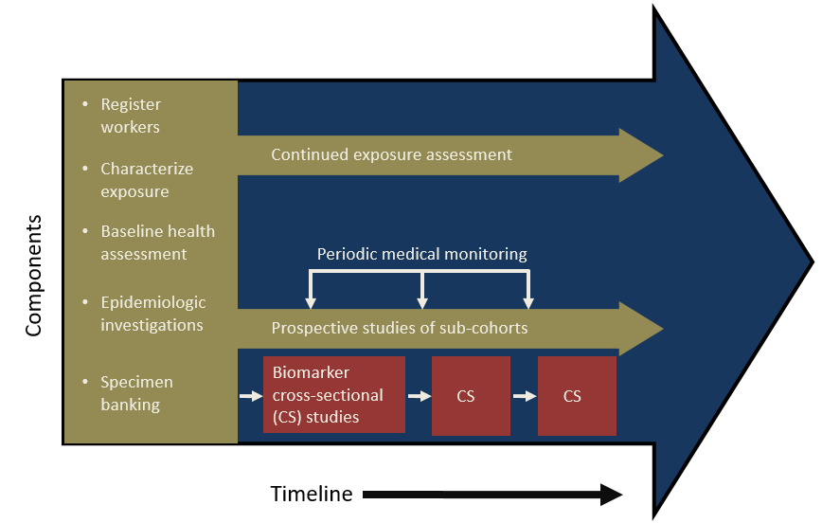
Model for a Nanomaterials Worker Health Study

