Slide 1
Application of X-ray Absorption Spectroscopy for Monitoring Transformation of Nanomaterials
Kirk Scheckel

Slide 2
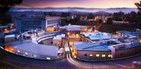
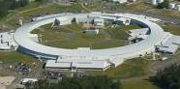
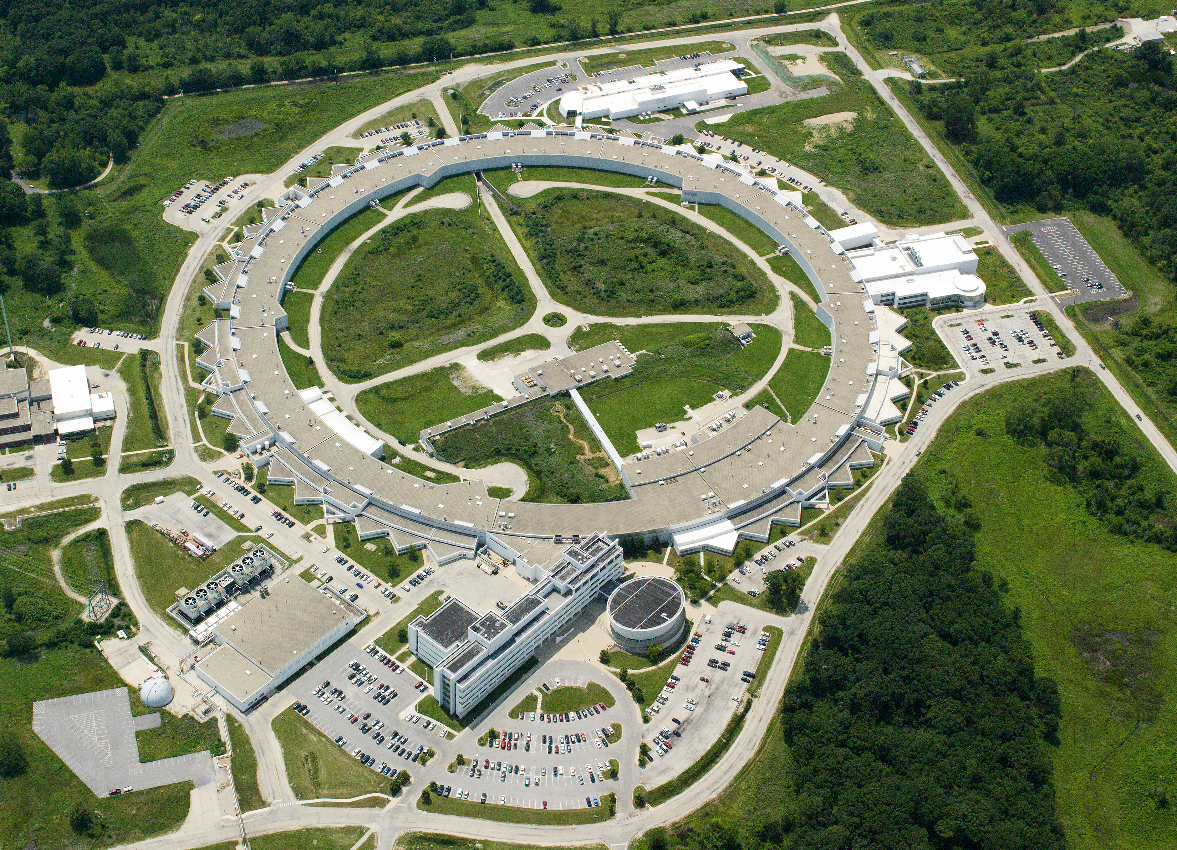
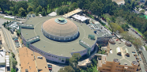
Spectroscopic Transformation of Nanomaterials
U.S. Department of Energy Office of Science X-ray Light Sources
Linac Coherent Light Source and Stanford Synchrotron Radiation Light Source at SLAC National Accelerator Laboratory
National Synchrotron Light Source II at Brookhaven National Laboratory
Advanced Photon Source at Argonne National Laboratory
Advanced Light Source at Lawrence Berkeley National Laboratory

Slide 3
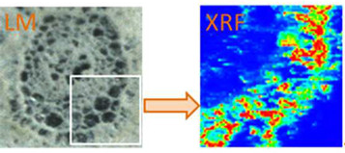
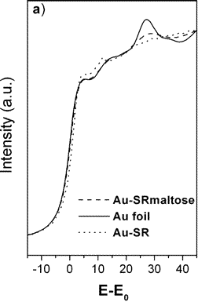
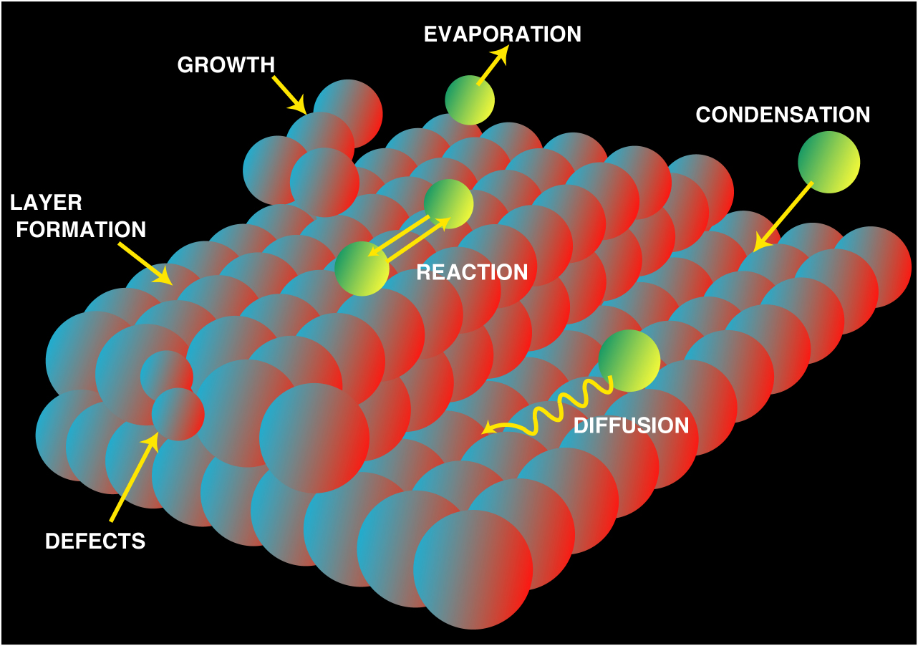
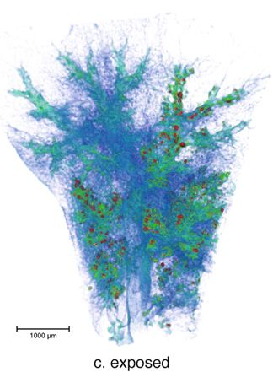
Spectroscopic Transformation of Nanomaterials
CeO₂ Uptake in Cucumber
X-ray Fluorescence (XRF): chemical composition (quantification, mapping)
X-ray Absorption Spectroscopy (XAS): chemical speciation (oxidation state, coordination, nearest neighbors)
Surface Scattering and Diffraction: surface structure, sorption processes
Microtomography: 3D imaging of internal microstructure (porosity, fluid flow, composition)
Au NPs with different
capping agents
Surface Reactions
TiO₂ in
mouse lung

Slide 4
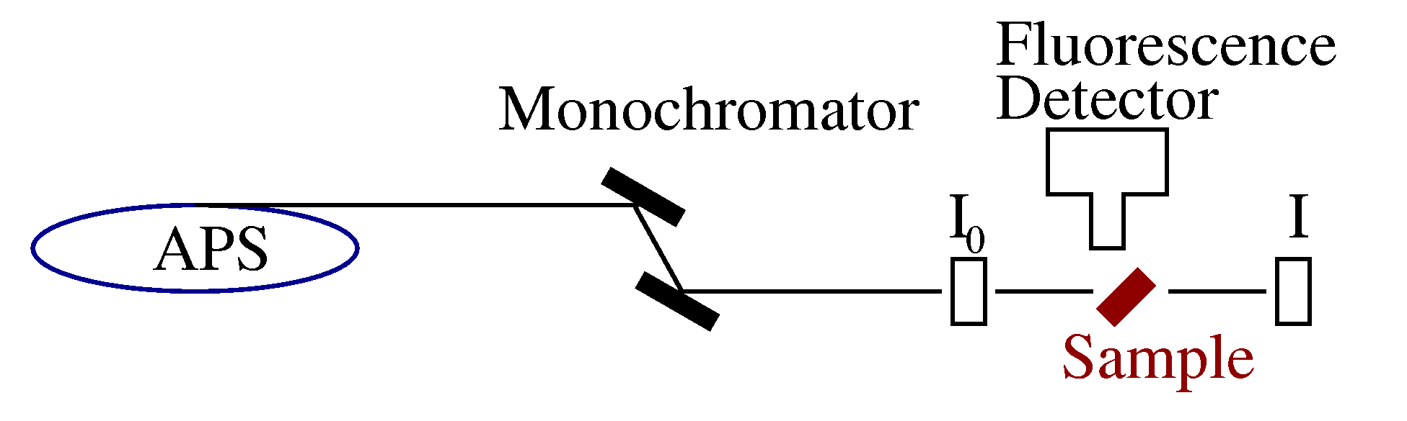
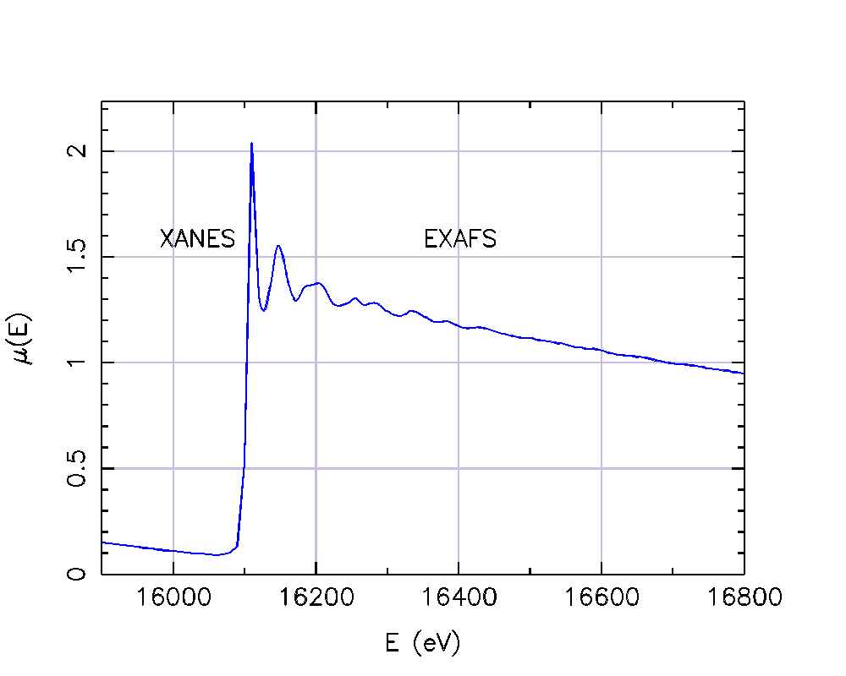
Spectroscopic Transformation of Nanomaterials
X-ray Absorption Spectroscopy: Measure energy-dependence of the x-ray absorption coefficient μ(E) [either log(I₀ /I) or (I_{f} / I₀ )] of a core-level of a selected element
Element Specific: Elements with Z>20 (5) can be examined.
Valence Probe: XANES gives chemical state and formal valence of selected element.
Local Structure Probe: EXAFS gives atomic species, distance, and number of near-neighbor atoms around a selected element..
Low Concentration: concentrations down to 1 ppm for XANES, 10 ppm for EXAFS.
Natural Samples: samples can be in solution, liquids, amorphous solids, soils, aggregates, plant roots, surfaces, etc.
Small Spot Size: XANES and EXAFS measurements can be made on samples down to 50 nm in size.
XANES = X-ray Absorption Near Edge Structure
EXAFS = Extended X-ray Absorption Fine Structure

Slide 5



Spectroscopic Transformation of Nanomaterials
Wastewater Anaerobic digestion Biosolids 50-yrs in soil
Ag NPs
Ag₂S
Ag₂S
Transformation of Four Silver/Silver Chloride Nanoparticles during Anaerobic Treatment of Wastewater and Post-processing of Sewage Sludge. E. Lombi, E. Donner, S. Taheri, E. Tavakkoli, Å. Jamting, S. McClure, R. Naidu, B.W. Miller, K.G. Scheckel and K. Vasilev. 2013. Environ. Pollut. 176: 193-197.
Non-labile Silver Species in Biosolids remain Stable throughout 50 Years of Weathering and Ageing. E. Donner, K.G. Scheckel, R. Sekine, R.S. Popelka-Filcoff, J.W. Bennett, G. Brunetti, R. Naidu, S.P. McGrath, E. Lombi. 2015. Environ. Pollut. 205: 78-86.

Slide 6
Spectroscopic Transformation of Nanomaterials
Wastewater Anaerobic digestion Biosolids
2 months simulated
composting
Zn Sulfide
Zn-P
Zn-FeOH
Fate of Zinc Oxide Nanoparticles during Anaerobic Digestion of Wastewater and Post-treatment Processing of Sewage Sludge. E. Lombi, E. Donner, E. Tavakkoli, T. Turney, R. Naidu, B.W. Miller and K.G. Scheckel. 2012. Environ. Sci. Technol. 46: 9089-9096.

Slide 7
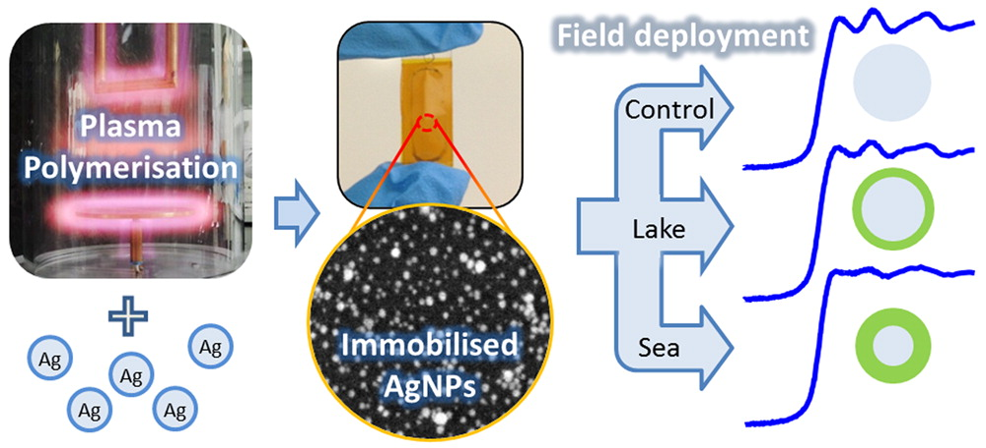
Spectroscopic Transformation of Nanomaterials
Surface Immobilization of Engineered Nanomaterials for in-situ Study of their Environmental Transformations and Fate. R. Sekine, M. Khaksar, G. Brunetti, E. Donner, K.G. Scheckel, E. Lombi and K. Vasilev. 2013. Environ. Sci. Technol. 47: 9308-9316.

Slide 8
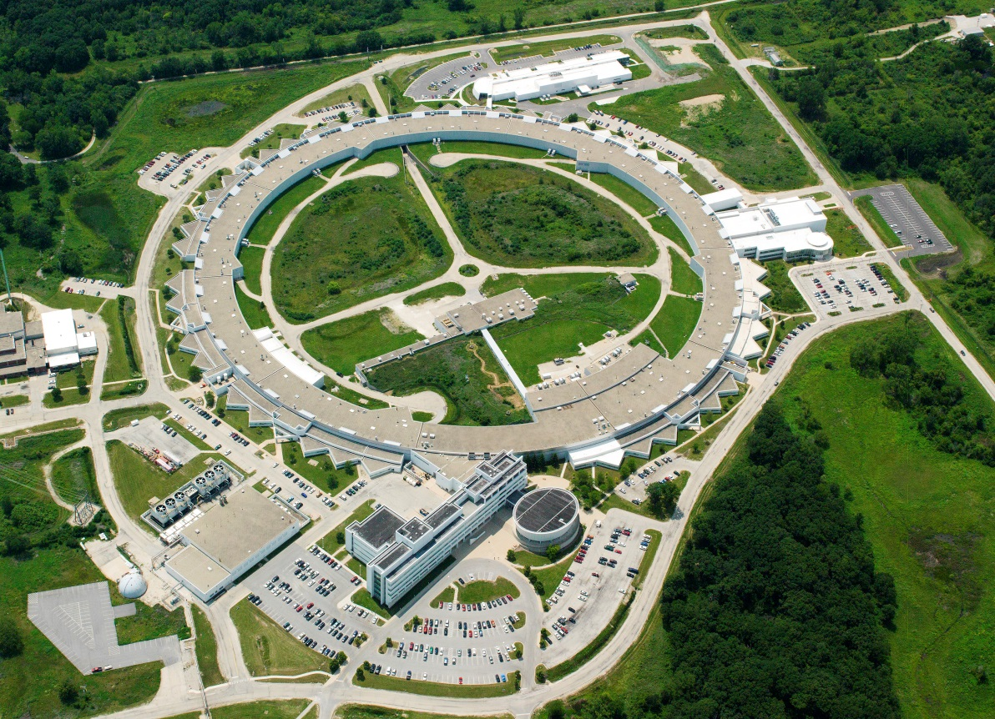
Spectroscopic Transformation of Nanomaterials
The Advanced Photon Source (APS) at the U.S. Department of Energy Office of Science’s Argonne National Laboratory provides this hemisphere’s most brilliant high-energy x-ray beams for research in almost all scientific disciplines.

Slide 9
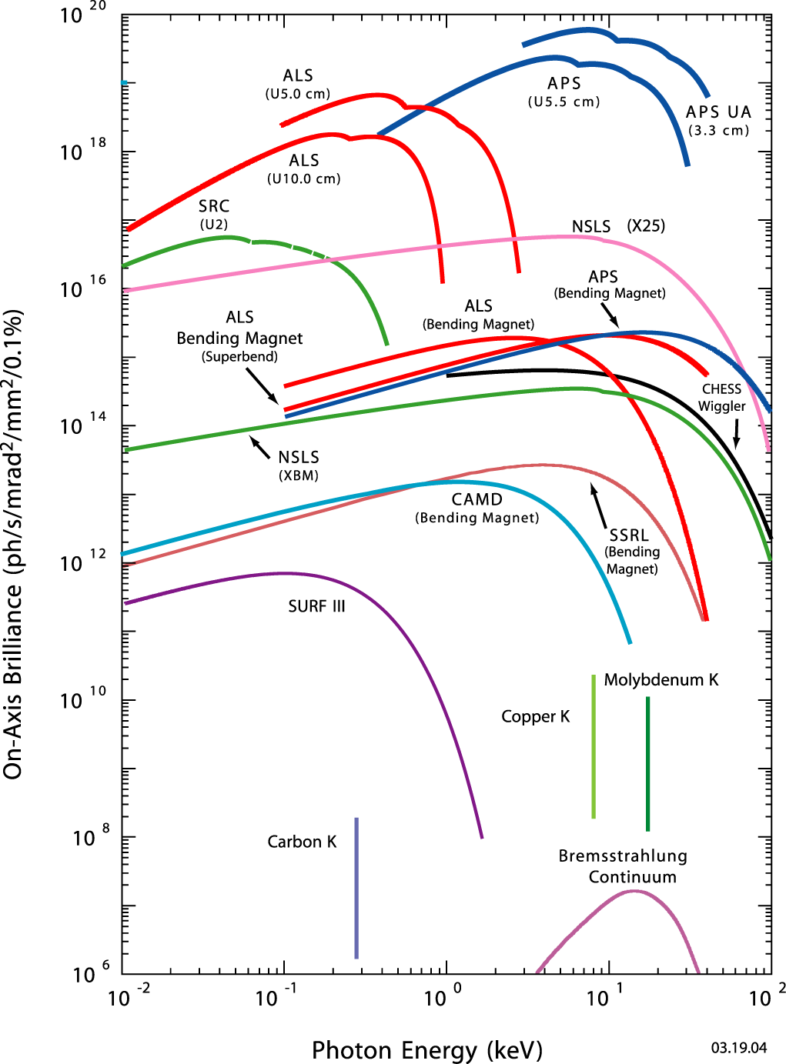
Spectroscopic Transformation of Nanomaterials
Orders of magnitude higher brilliance than tube source
Translates into major improvements in sensitivity and spatial resolution for x-ray analyses
Makes some spectroscopic techniques (XAFS) feasible
On-Axis Brightness (ph/s/mrad²/mm²/0.1%

