Slide 1

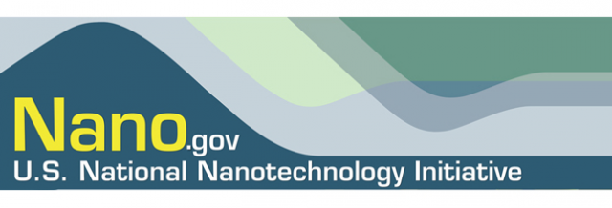



QEEN II: 2nd Quantifying Exposure to Engineered Nanomaterials from Manufactured Products Workshop
Session B. Consumer Exposure: Food, Food Contact, and Personal Care Products
Cytotoxicity, hemotoxicity, and in-vivo toxicity of surface modified PLGA nanoparticles
Cristina M. Sabliov, LSU Alumni Professor
Washington DC, October 8-10

Slide 2
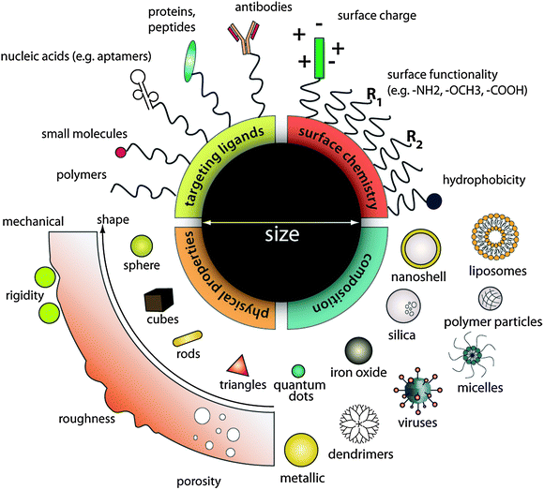
Engineered nanoparticles
Chou, L. Y. T, K. Ming and W. C. W. Chan. 2011. Chem. Soc. Rev. 40, 233-245.

Slide 3
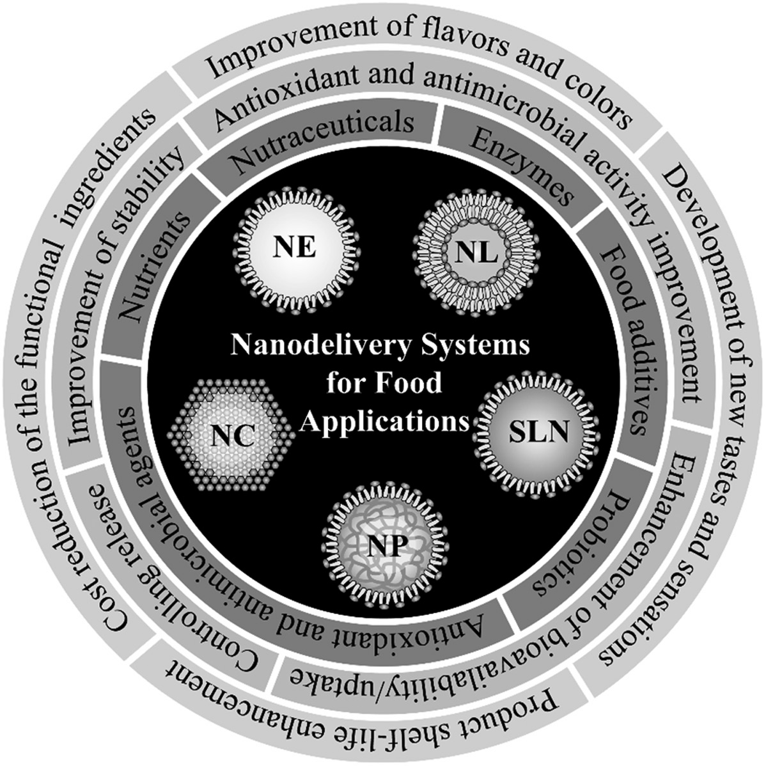
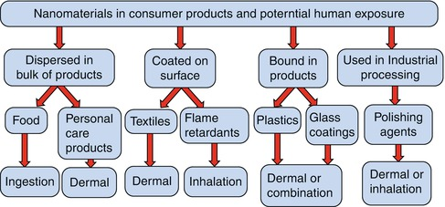
Intentional exposure
  Fortified foods
Unintentional exposure
  Packaging
  Agrochemical nanodelivery systems
Exposure
Yu Yang, Paul Westerhoff. 2014. Nanomaterial Impacts on Cell Biology and Medicine, pp 1 – 17. Part of the Advances in Experimental Medicine and Biology book series (volume 811).

Slide 4
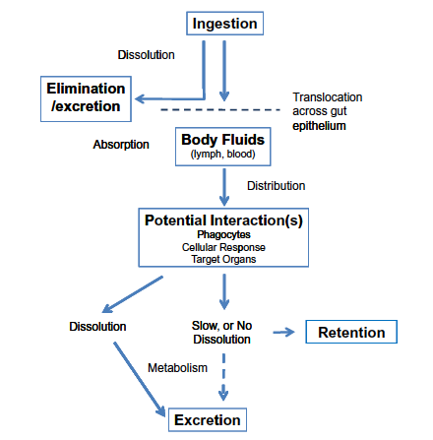
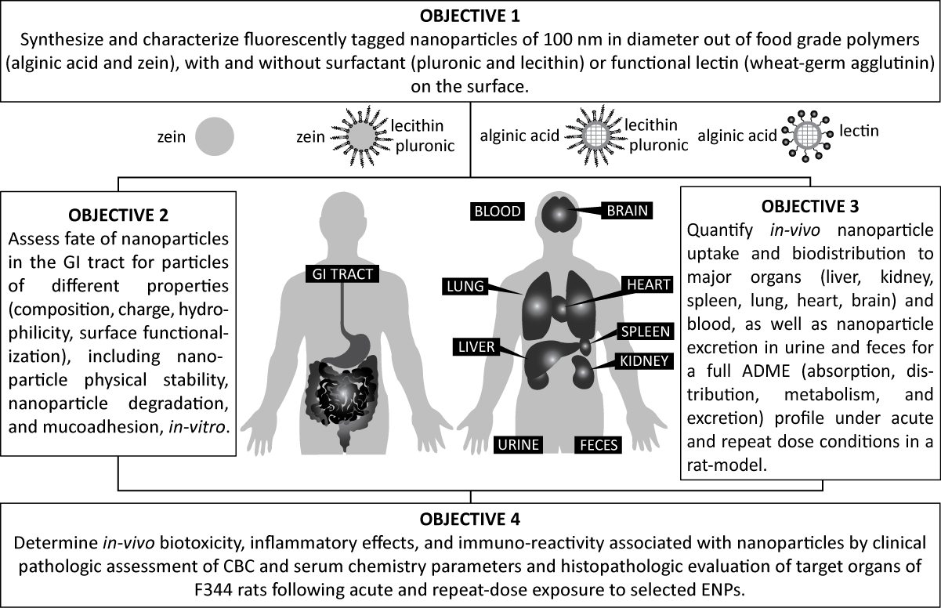
Particle ADME profile
Picture drawn by Thanida Chuacharoen
Cockburn et al., 2012

Slide 5
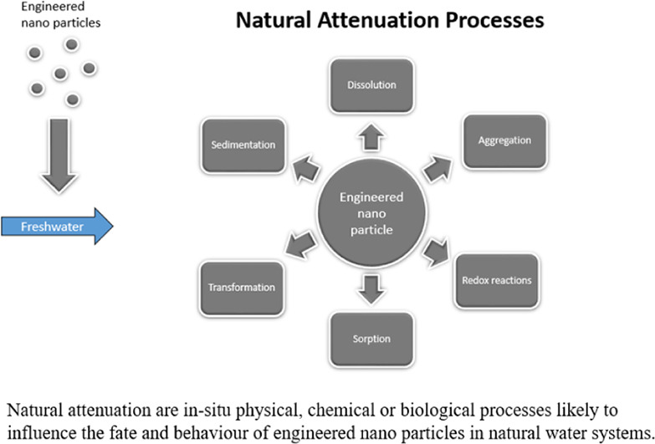
Particle Biotransformation
D.Shevlin, N.O'Brien, E.Cummins. 2018. Science of the Total environment. April, 2018.

Slide 6
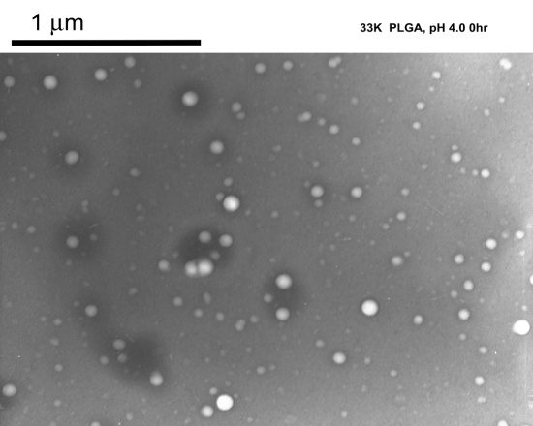
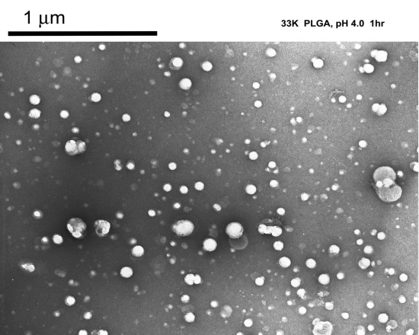
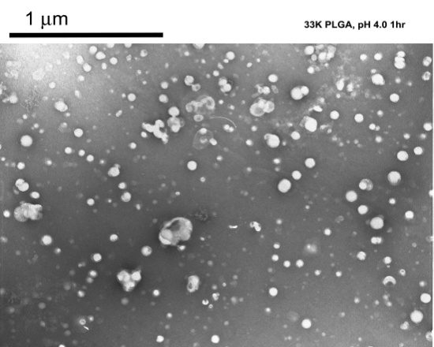
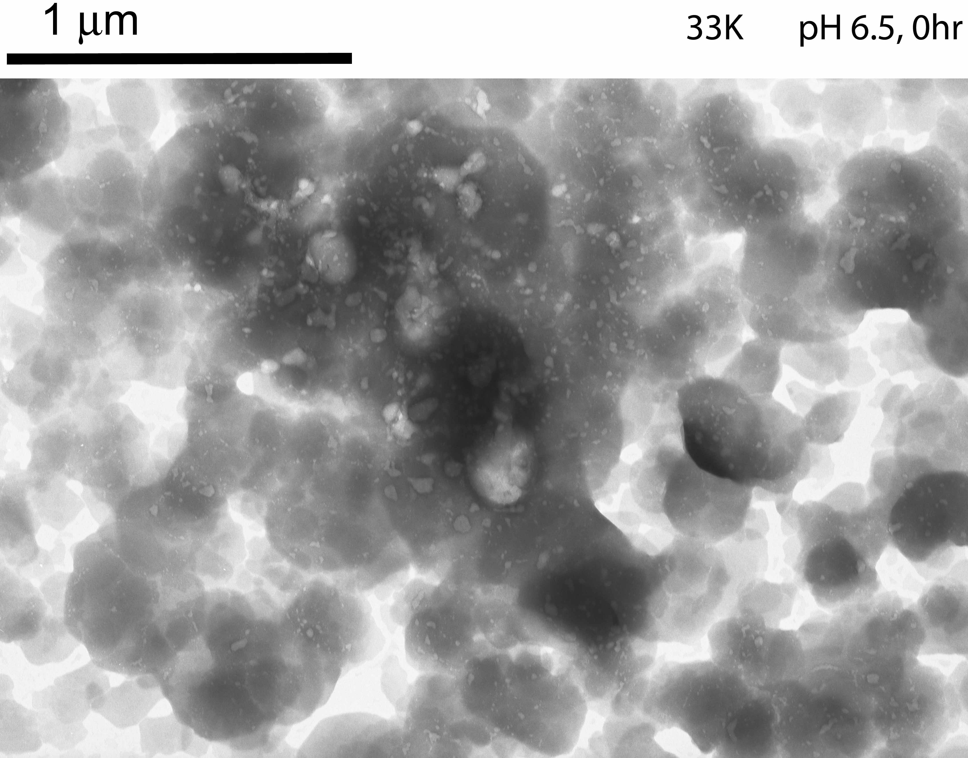
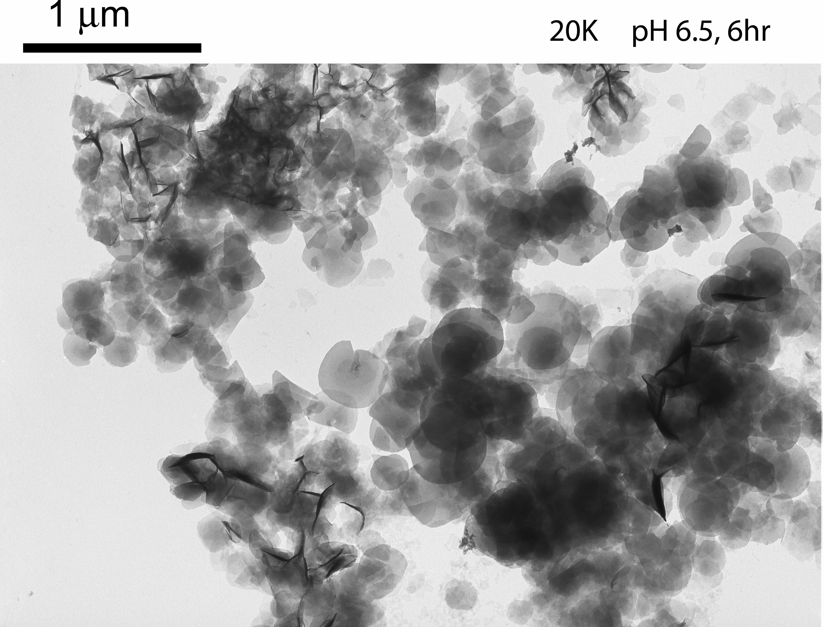
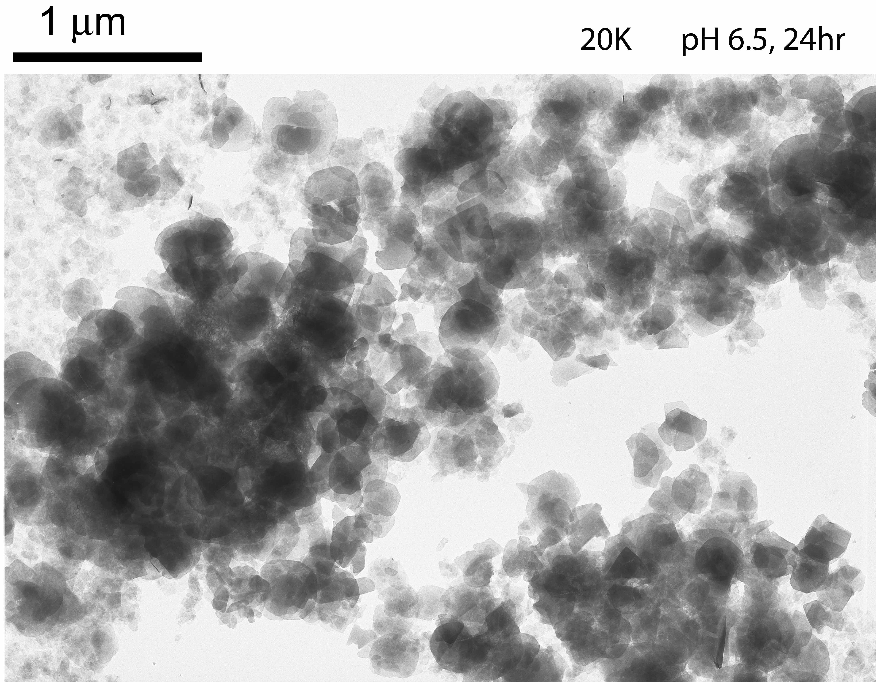
pH stability (pH=6.5)
PLGA
33K
pH 6.5
0 hrs
6 hrs
24 hrs
PLGA-Chi
20 K & 33K
pH 6.5
Murugeshu, A., C. E. Astete, C. Leonardi, and C. M. Sabliov. 2011. Nanomedicine Vol. 6, No. 9, Pages 1513-1528.

Slide 7
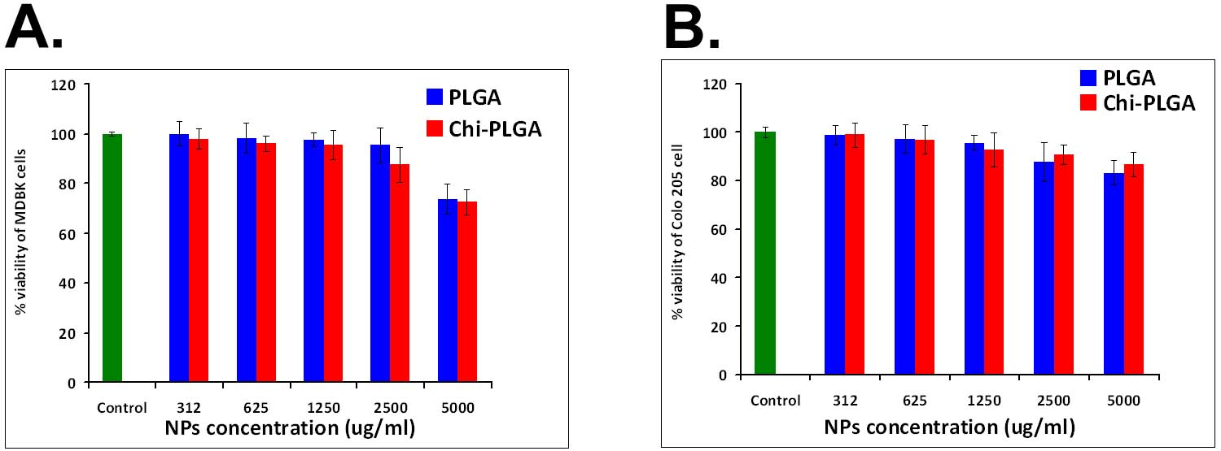
Cytotoxicity
Trif, M, P. E. Florian, A. Roseanu, M. Moisei, O. Craciunescu, C. E. Astete and C. M. Sabliov. 2015. Journal of Biomedical Materials Research Part A. 103(1):3599-3611
Alqahtani, S., L. Simon, C. E. Astete, A. Alayoubi, P. W. Sylvester, S. Nazzal, Y. Shen, Z. Xu, A. Kaddoumi, C. M. Sabliov. 2015. Journal of Colloid and Interface Science. 445: 243-251.

Slide 8
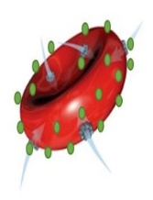
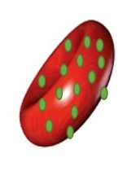
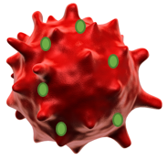
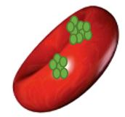
Red blood cells with 2mg/ml NPs
Red blood cells with 3mg/ml NPs
Untreated red blood cells
Red blood cells with 10mg/ml NPs
Red blood cells with 50mg/ml NPs
Nanoparticles RBC Association (SEM Image)

Slide 9
Hemotoxicity
Association
Hemolysis

Slide 10
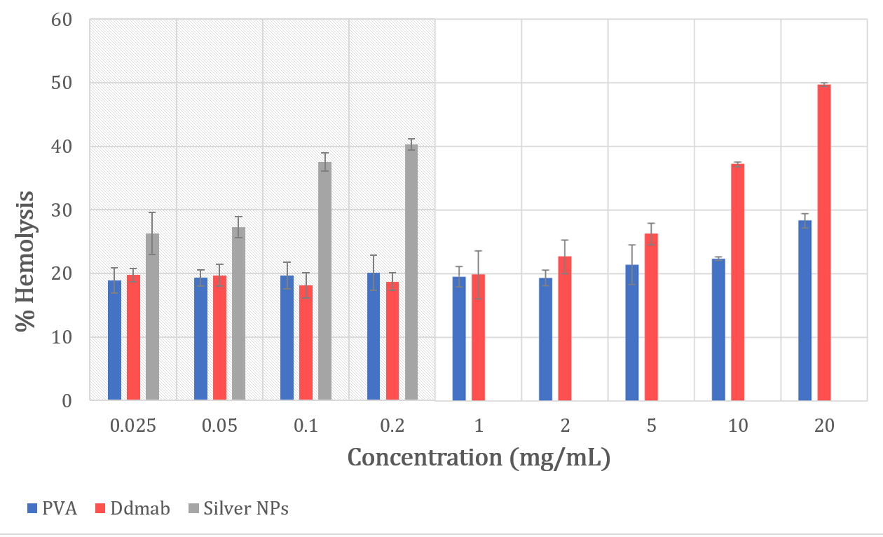
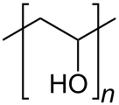
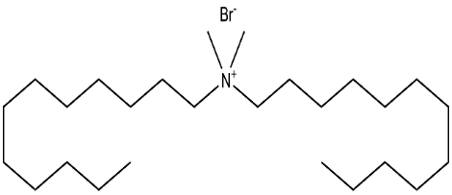

Slide 11
In-vivo biodistribution
PLGA | PLGA-Chi
7 days
14 days
21 days
Navarro, S. T. Morgan, C. E. Astete, R. Stout, D. Coulon, P. Mottram and C. M. Sabliov. 2016.. Nanomedicine.11(13):1653-1669. (doi: 10.2217/nnm-2016-0022)

Slide 12
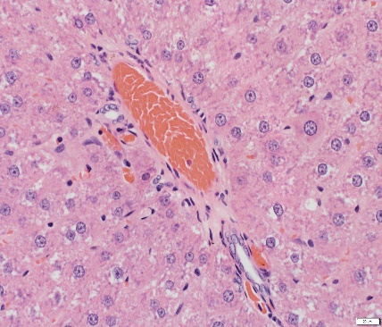
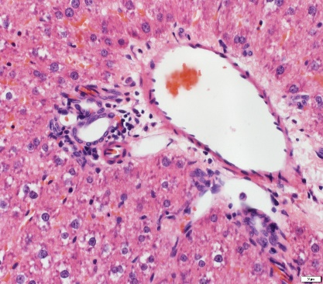
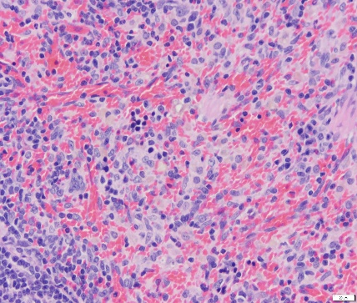
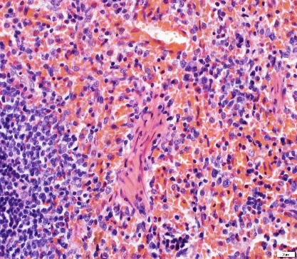
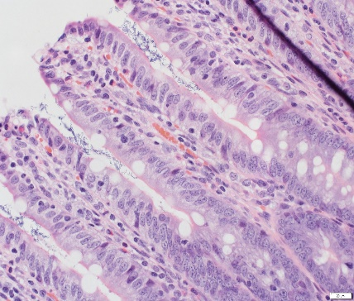
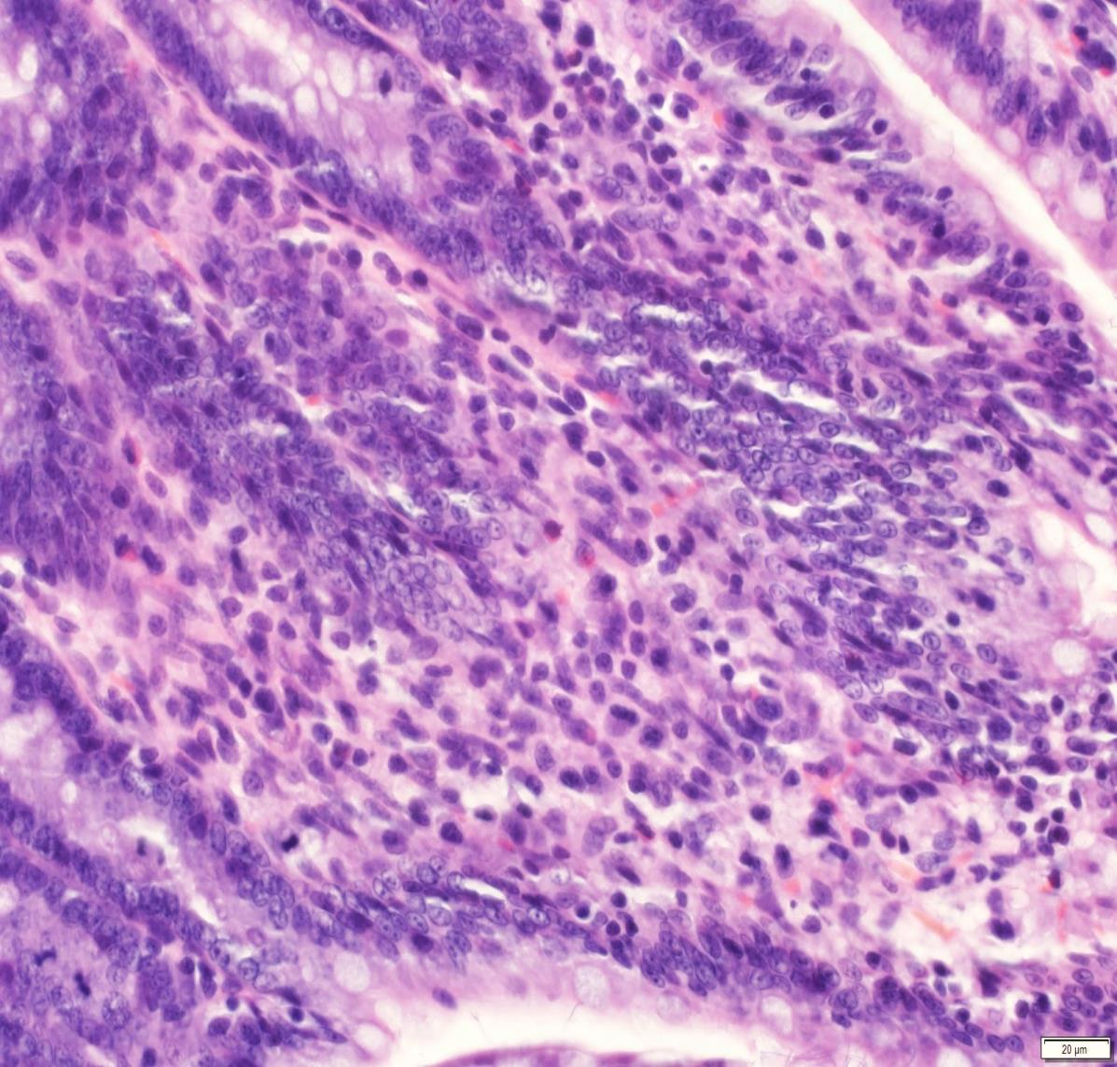
Control
PLGA NPs
Liver 14 days PLGA treatment shows increased numbers of lymphocytes, plasma cells (black arrow) and occasional mast cells (white arrow).
No significant lesions have been observed in spleen.
Intestine villi show the presence of scattered lymphocytes (blue arrow), plasma cells (red arrow) and histiocytic cells (white arrow) in the lamina propria.
Arrows indicate scattered mitotic figures (black arrows). Increased hyperplasia of intestinal crypt cells indicated increased intestinal mucosal epithelial cell turnover.
Liver
Spleen
Intestinal
villi
Intestinal
crypts

Slide 13

Conclusions
PLGA NPs were not cytotoxic, except at high concentration (>5 mg/ml)
Interaction between PLGA nanoparticles and RBCs was concentration dependent
PLGA nanoparticles associated with RBC membrane and had no hemotoxic effect at concentrations lower than 5 mg/ml (>5% increased over negative control), and was dependent on the surfactant
Minimal inflammatory changes were observed in the hepatic portal regions of the liver and the lamina propria of the small intestine in PLGA and PLGA-Chi dosed rats versus controls
The intestine had mild crypt hyperplasia, indicative of an increased intestinal mucosal epithelial turnover rate
No significant histologic lesions were seen in the lung, kidney, spleen, or brain in PLGA or PLGA-Chi dosed rats versus controls

Slide 14
THANK YOU!
Properties of nanomaterial still important and should be documented
Nanomaterial biotransformation is key to in-vivo behavior
Toxicity work is mainly focused on inorganic, metal and metal oxides nanoparticles
Interest is growing in biodegradable particles
Methods of detection of biodegradable particles in complex media need to be developed
Toxicity testing needed for long term, small concentration exposure is needed

