Slide 1
The Fate of Nanoparticles in Food Packaging
Maria Rubino, PhD
Professor
School of Packaging
East Lansing, MI

Slide 2
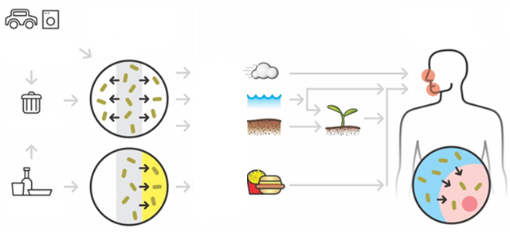
Public concerns
Routes of human exposure to nanoparticle (from nanocomposites) → interaction with biological systems
Human
exposure
to ENPs
ENP
Release from
polymers
Consumer
goods
Air
Water
Disposal
Soil
Food
Packaging
Interaction with cells

Slide 3
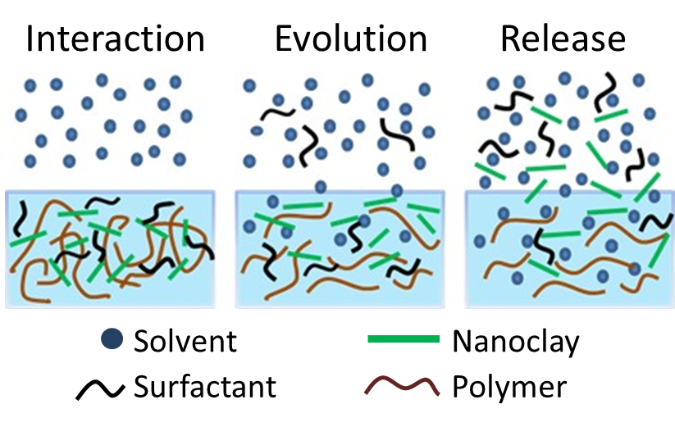
Hypothesis

Slide 4
Fluorescent labeling and tracking of nanoclay Diaz, Xia, Rubino, Auras, Jayaraman, Hotchkiss. Nanoscale 2013. 5:164-168
Notes:
So a nanocomposite of PP and Nylon with 3% labeled nanoclay was produced
Two labels were considered in case of interference
The label withstand the processing

Slide 5
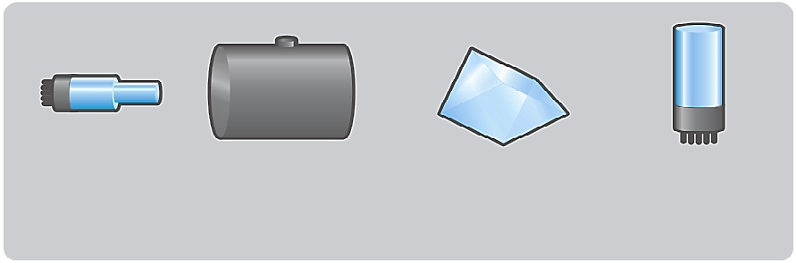
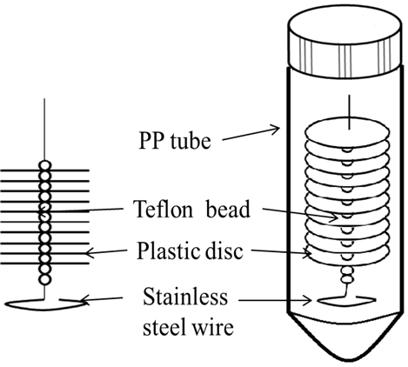
Instrumental analysis for Nanoclay Xia Y, Rubino M, Auras R. 2013. Detection and quantification of montmorillonite nanoclay in water-ethanol solutions by graphite furnace atomic absorption spectrometry Food Addi. Cont. 30: 2177-2183.
Si & Al
ASTM D4754-11
Light Source
Graphite Furnace
Monochromator
Detector
Graphite Furnace Atomic Absorption Spectrometry (GFAAS)
Instrumental conditions
Stability test
Correlation
Calibration curve & quantification limit
Effect of solvent & surfactant on dispersion
Si & Al contents
in the nanoclay
Internal validated by X-Ray Fluorescence(XRF)
Limit of quantification : 0.03 mg L⁻¹ (Si) and 0.01 mg L⁻¹ (Al)

Slide 6
Release of Nanoclay at 22, 40 & 70 ºC Xia Y, Rubino M, Auras R. 2014. Release of Nanoclay and Surfactant from Polymer−Clay Nanocomposites into a Food Simulant. Environ. Sci. Technol. 2014, 48, 13617−13624
Release from PP-clay
Release from PA6-clay
(a)
(b)
A small amount of nanoclay was released (0.1~0.2%)
More nanoclay release from PP-clay than from PA6-clay
Depending on the polymer-clay interaction

Slide 7
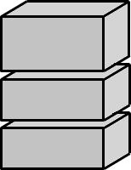

Instrumental analysis for Surfactant Xia Y, Rubino M, Auras R. 2015. Release of surfactants from organo-modiﬁed montmorillonite into solvents: Implications for polymer nanocomposites. Applied Clay Science 105-106 (2015) 107–112 Xia Y., Rubino M, Auras R. 2016 Modeling of surfactant release from polymer-clay nanocomposites into ethanol Polymer Testing 60, 57-63
HPLC
Ion source
First
mass filter
Collision
cell
Second
mass filter
Detector
ASTM D4754-11
Liquid Chromatography-Tandem Mass Spectrometry (LC-MS/MS)
Instrumental conditions
Sample preparation
Calibration curves
Temperature
Quantification limit
Sonication
Composition
Solvent type

Slide 8
Release of surfactant at 22, 40 & 70 ºC Xia Y, Rubino M, Auras R. 2014. Release of Nanoclay and Surfactant from Polymer−Clay Nanocomposites into a Food Simulant. Environ. Sci. Technol. 2014, 48, 13617−13624

Slide 9
Further Assessment from the release study from nanocomposite: Xia Y, Rubino M, Auras R. 2015. Release of surfactants from organo-modiﬁed montmorillonite into solvents: Implications for polymer nanocomposites. Applied Clay Science 105-106 (2015) 107–112
TEM images of released nanoclay particles from the PP−clay films and the corresponding EDS analysis for the particle in image (a). The structures (multiple parallel lines) shown within the circles exhibit a stack of clay layers. Scale bar: 50 nm for image a, 200 nm for images b and c.

Slide 10
Final comments:
1 Assessment of nanoparticles requires:
New ways to assess the results
New methodologies need to be developed for assessing nanoparticles release from nanocomposite.
2. It is very important to elucidate what is the best approach to measure nanoparticles interaction with polymers and their release under different conditions before evaluating exposure and safety.

