Slide 1



Making newly-developed nanoanalysis tools (spICP-MS, FFF-ICP-MS) more readily utilized for exposure studies
James F Ranville
Department of Chemistry
Colorado School of Mines
Golden, CO 80401
Presented at QEEN II
Characterization Discussion
October 10, 2018
RD83558001

Slide 2
Recognize What Does single-element spICP-MS tells us (and what it doesn’t)
PE Syngistix Software used
Graphs prepared with OriginPro
Raw Water Sample
Particle # = 2564
Mean Peak Area = 205 counts
Average Size = 98 nm
“Dissolved” = 6.1 ppb
5 sec out of 60 sec total

Slide 3
Raw Water Sample
0.02 filtered Water Sample
“Dissolved”
6.1 ppb
0.8 ppb
Non-Resolved NPs = 5.3 ppb mass concentration
# = unknown
Particle # = 178
Mean Peak Area = 28 counts
Average Size = 54 nm
Particle # = 2564
Mean Peak Area = 205 counts
Average Size = 98 nm

Slide 4
< 5 Micron Settled Water Sample
(70 min)
Raw Water Sample
Form is not measured
Particle # = 1752
Mean Peak Area = 144 counts
Average Size = 85 nm
Particle # = 2564
Mean Peak Area = 205 counts
Average Size = 98 nm
68 % as many NPs as raw
70 % less mass (intensity) per NP
Average Size 15 % smaller
Why does 5 micron settling affect < 100 nm sized NPs?
Heteroaggregates
or
Minor amounts of Zn in > 5 micron particles

Slide 5
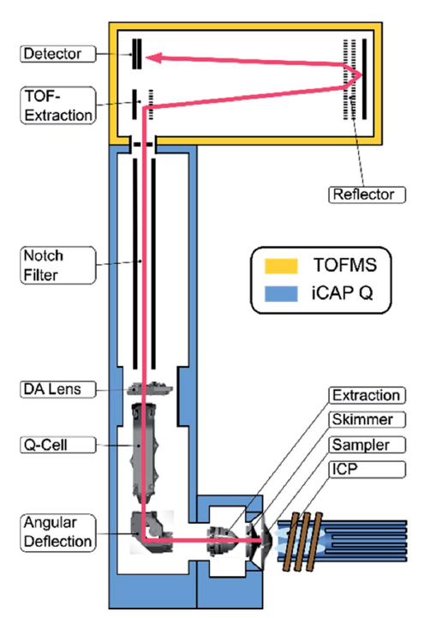
ICP-time-of-flight-Mass Spectrometry : More Info on Form
ICP-TOF-MS detects all elements quasi-simultaneously
A full mass spectrum is collected every dwell time (46μs)
Could potentially be used to examine elemental ratios on a particle-by-particle basis
Montaño, M. et al., 2017
Hendriks, L. et al. Journal of Analytical Atomic Spectroscopy, 2017

Slide 6
spICP-MS: Plus, minus, and opportunities
There are reasonably low barriers to increased application but:
- reasonable expectations need to be set
- inherent limitations must be accepted
Single-Element
Multi-Element (TOF-MS)
ICP-QMS instruments are common
Versatility make them cost-effective ($150 K)
spICP-MS software widely-available
Gives # concentration
But data interpretation requires some specialized training
ICP-TOF MS instruments are not common (yet)
Still expensive ($500 K)
Limited sensitivity means not all (or any) of the nano-range can be measured (lets not forget importance of colloids though)

Slide 7
Inherent spICP-MS Limitations
Instrument range (theoretical)
At 0.1 msec
2 count/dwell equals 20,000 cps
1500 counts/dwell equals 15 million CPS
Range of 750 in counts (mass) translates to 9 x range in diameter (cube root function)
Typical observation 20 -200 nm
Instrument range influences our perception of size distributions
Particle Number Distribution
Pareto’s Law
Log # versus log size (slope about 3)
10x more 10 nm than 100 nm
10x more 1nm than 10 nm
Typical Observed particle numbers in the low thousands
Example: 900 1nm, 90 10nm, 9 100nm
Poor counting statistics in upper range
Background high at size DL
Influences our perception of size distributions

Slide 8
Field Flow Fractionation with ICP-MS detection
Provides sizing
(hydrodynamic radius)
with quantitative multi-element analysis.
Applicable down to about 1-2 nm
FFF recently had its 50th birthday, coupled with ICP-MS 25 years ago
From NanoDefine (FP-7)

Slide 9
Co-elution of elements suggests co-existence in NPs but independent, same-sized particles would also co-elute.
Turning field off allows analysis (but not sizing) of large particles (non-nano) that are outside separation range (colloids).
Javid et al, 2017

Slide 10
FFF-ICP-MS: Plus, minus, and opportunities
There are unfortunately still moderate barriers to increased application
Challenge
Two instruments needed
FFF less versatile than ICP-MS and expensive $75-120K
Size separation only over about a 10-20 fold range in a given run
Slow - run time up to one hour depending on size range
Technique can be unforgiving
- poor recovery (nothing comes out) usual biggest issue
Opportunity/Needs
Need more Labs (academic/ Gov/Commercial) with equipment and expertise. COLLABORATE!
Over 85 FFF sold in NA over past decade (< 15 for Env) so expertise exists.
Will likely remain superior to sp ICP-MS for < 5-10 nm NPs
Other online detectors give additional information (DOC,etc)

Slide 11
Risk Exposure Hazard
Advanced Analytical Methods for Exposure Assessment
Number Concentration
Mass Concentration
Available Surface Area
Predict/Prevent Adverse Effects
Understand and mitigate real-world health effects
Functional Assays for Environmental Adverse Effects
Biological markers of stress
Environmental products of NP exposure (ROS, etc)

