Slide 1
QEEN II
Washington D.C.
October 9-10, 2018
Fostering U.S. -International Collaboration in Integrating Exposure
in Nanomaterial Risk Evaluation
Global Collaborations in Regulatory Science and Standards Development
Anil K. Patri, Ph.D.
U.S. Food and Drug Administration
Disclaimer: The views expressed are of the presenter and should not be considered
as the official position or policy of U.S. FDA

Slide 2
Globalization
Production of FDA-regulated goods and materials outside of the U.S. has exploded over the last decade.
FDA-regulated products originate from more than:
150 countries
130,000 importers
300,000 facilities outside of the U.S.
Drugs and Devices
Today, nearly 40 percent of finished drugs and 50 percent of medical devices used by Americans are made elsewhere
Approximately 80 percent of the manufacturers of active pharmaceutical ingredients (APIs) used in the U.S. are located abroad.
Increase in FDA Registered Drug Facilities – Global trends
Reference: https://www.fda.gov/internationalprograms/fdabeyondourbordersforeignoffices/default.htm
Notes:
Keeping with the theme of globalization, here is how they stack up by the numbers

Slide 3
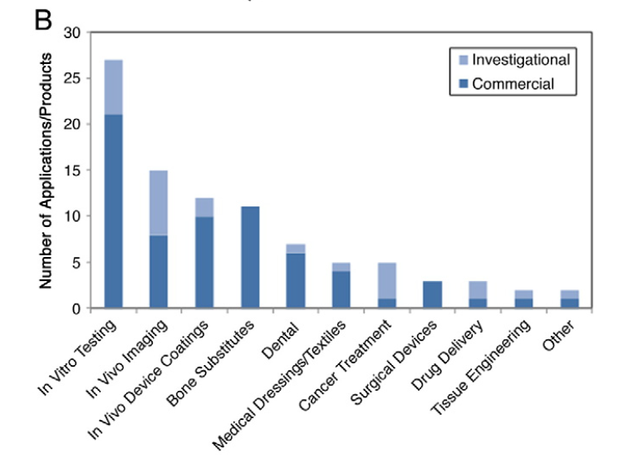
FDA Landscape of drug products and devices
Drug products containing Nanomaterial
Nanotechnology in medical devices
D’Mello, S. R. et. al. Nature Nanotechnology, 2017
DOI: 10.1038/NNANO.2017.67
Data from CDRH/FDA
Increase in the submissions and complexity of drug products
containing nanomaterials
Standards facilitate regulatory review and approval

Slide 4
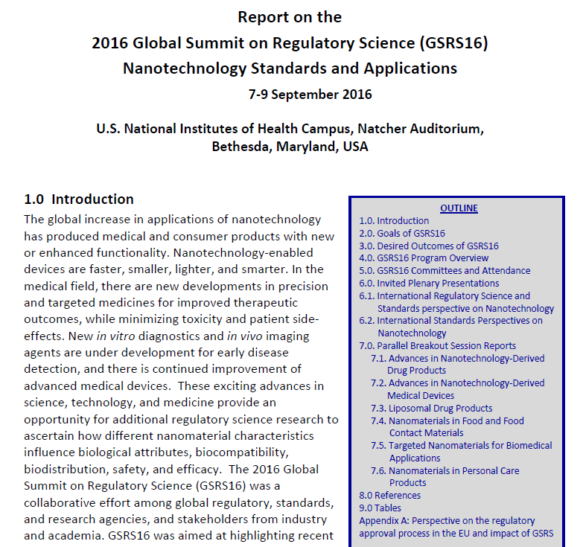
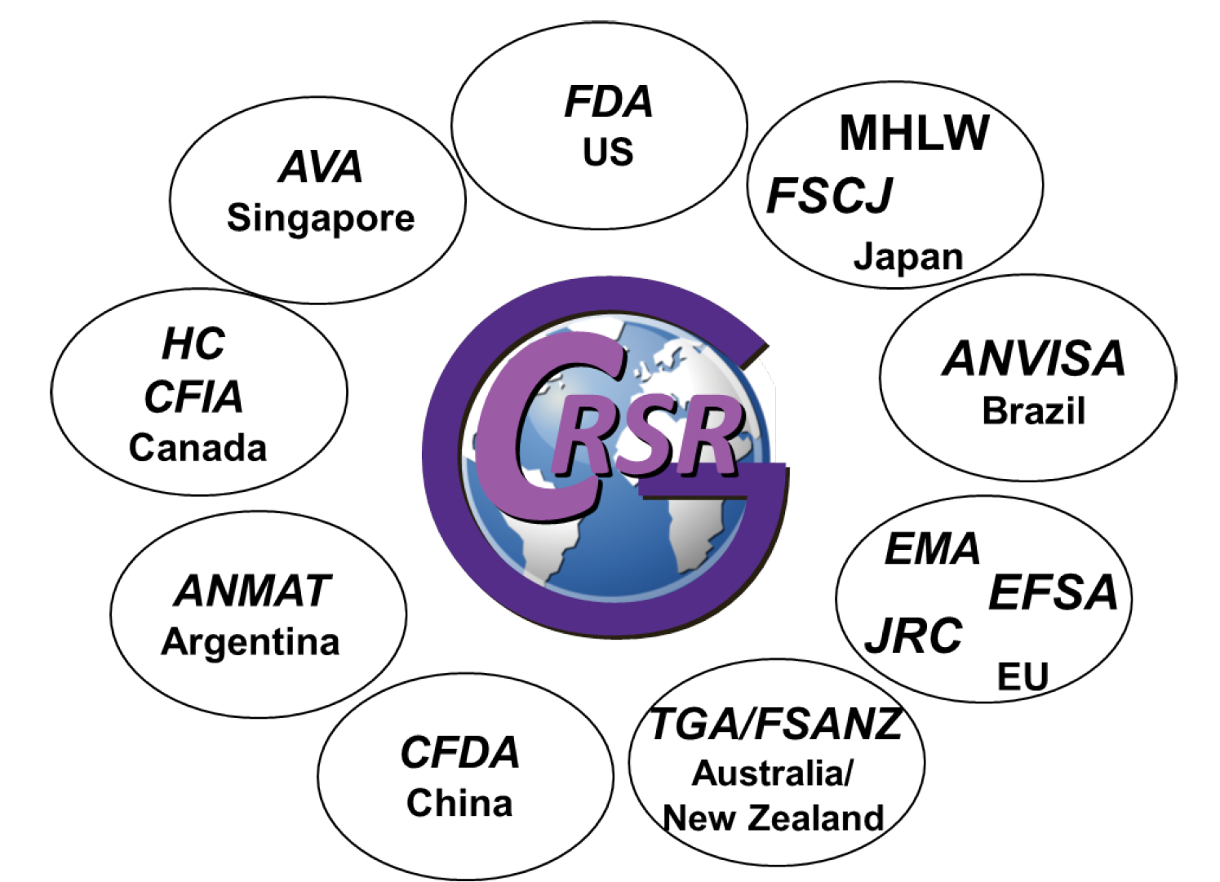

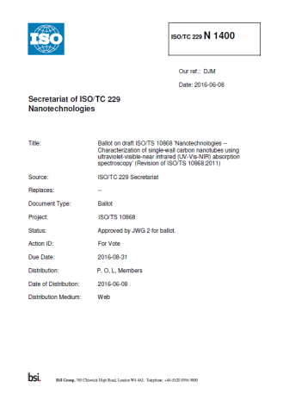
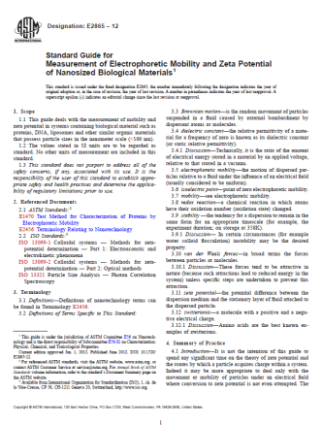
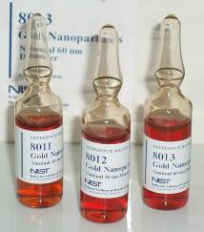
International Coordination & Collaboration
Global Summit on Regulatory Science – Nanotechnology Working Group
GSRS16 – Nanotechnology Standards and Applications (2016)
Global Regulatory, Research, SDOs; 20 countries
Prioritized list of standards – white paper
GSRS19 – Nanotechnology Summit at JRC in Ispra, Italy, September 2019.
International Pharmaceuticals Regulators Program (IPRP) – Nano Working Group
Non-confidential information sharing
Regulatory harmonization & collaboration
Standards
Training
US-EU Communities of Research
Nanomedicines CoR (New)
Standards development
ISO TC229
ASTM E56
Health Canada, Canadian Food Inspection Agency, FDA
Regulatory training, standards
Indo-US Science and Technology Forum (IUSSTF) (FDA, CPSC, NIH with DBT, DST, CDSCO, ICMR)
Indo-US Regulatory Science Symposium (2018)
Nanobiotechnology
Regulatory research capacity building

Slide 5
Challenges
Communication – Nanotoxicology vs Nanomedicine community
Development of appropriate standards with regulatory relevance
Fit for purpose – RMs & Documentary
Differences in regulations across the globe – Harmonization
Definition of Nanotechnology/Nanomaterial
Capacity building

Slide 7
Global Coalition for Regulatory Science Research (GCRSR)
Is an international coalition of global regulatory bodies
Facilitates and promotes the development of regulatory science research as a tool for advancing regulatory science applicable to the public health impacts of safe food and medical products
Established in 2013
Working Groups
Established working groups to address specific areas of need for translation of emerging technologies for global regulatory application:
Nanotechnology WG
Bioinformatics WG
Emerging technologies WG
Cross-training WG

Slide 8
Nanomedicines Working Group
Objectives:
Non-confidential information sharing, regulatory harmonization or convergence focused on nanomedicines / nanomaterial in drug products and borderline and combination products.
Regulatory cooperation, including work-sharing, in specific areas (see work plan) of nanomedicines / nanomaterial in drug products with other related international bodies.
Collaboration of training organization between international regulators
Promotion of potential consensus finding on standards
• Africa
• ANVISA
• China
• COFEPRIS
• EMA
• EU/JRC
• FDA
• Health Canada
• HSA
• MFDS
• MHRA
• MHLW / PMDA
• NAFDAC
• RIVM
• Swissmedic
• TFDA
• TGA
https://www.i-p-r-f.org/index.php/en/working-groups/nanomedicines-working-group/

Slide 9
US-EU Communities of Research
The US-EU dialogue, bridging nanoEHS research, has three goals
Engage in an active discussion about environmental, health, and safety questions for nano-enabled products;
Encourage joint programs of work that would leverage resources; and
Support the Communities of Research.
Databases and Computation Modeling for NanoEHS
Characterization
Human Toxicity
Risk Management & Control
Exposure through Product Life
Risk Assessment
Ecotoxicity
Nanomedicine
Wednesday afternoon session at CLINAM
https://us-eu.org/

Slide 10
Standards Development Organizations
ASTM Internation E56
18 Published Standards
7 New work items
Subcommittees
E56.01 Informatics and Terminology
E56.02 Physical and Chemical Characterization
E56.03 Environment, Health and Safety
E56.04 Intellectual Property issues
E56.05 Liaison and International Cooperation
E56.06 Nano-Enabled Consumer Products
E56.07 Education and Workforce Development
E56.08 Nano-Enabled Medical Products
ISO TC 229 Nanotechnologies
65 Published Standards
43 Standards under development
Working Groups
WG1: Terminology and nomenclature
WG2: Measurement and Characterization
WG3: Health, Safety and Environmental
WG4: Material specifications
WG5: Products and applications
https://www.iso.org/committee/381983.html
https://www.astm.org/COMMITTEE/E56.htm

Slide 11
Consensus Standards Recognized by FDA/CDRH
Publication of Recognized Standards in Federal Register (FR) recognizing all or part of appropriate standards
Currently 1200 recognized standards from CDRH
8 standards recognized by CDRH under Nanotechnology
CDRH Database http://www.accessdata.fda.gov/scripts/cdrh/cfdocs/cfStandards/search.cfm

Slide 12
Summary
Global increase in FDA regulated products & registered facilities
Gradual Increase in drug products containing nanomaterial
Increase in complexity
International collaborations in regulatory science and cross training are key for harmonization
Development of relevant standards enable clinical development of nanomaterial

Slide 13
A list of Standards Needs: Conclusions from GSRS15, October 2015, Parma
Participants: FDA, NIST, EMA, EFSA, ECHA, OECD, NMI, EC, NanoReg, JRC
Pristine Nanomaterials
Reference Materials
Liposomes
Quantitative surface coatings (species, coverage)
Number concentration in aqueous solution
Multi-modal by size (same nanomaterial)
Shape (needs to be specified)
Documentary Standards
DLS standard test method with specifications for regulatory use
Surface coating: composition and stability measurement method
Surface coating: zeta potential measurement method
Guidance document for tiered approach for methods to measure size and size distribution
Asymmetric Flow/Sedimentation Field Flow Fractionation (ISO/PWI, Japan)
Electron microscopy technical specification: SEM (ISO/PWI 19749 USA); TEM (ISO/PWI USA/Japan); cryogenic TEM; and low-voltage TEM
Other needs
Updated public database of reference materials: hosted by BAM or NIST?

Slide 14
A list of Standards Needs: Conclusions from GSRS15, October 2015, Parma
NMs in Complex Matrices
Reference Materials
Simulated body fluids (no nanomaterials)
(Specific) nanomaterial in (specific) media
Controlled agglomeration nanomaterial
Documentary Standards
Drug substance release rate from a liposome
Quantitation of nanomaterials in blood
Quantitation of NMs in tissue
Guide for sample preparation for variety of methods, e.g., SEM, TEM, ICP-MS (will be material-dependent)
Speciation: relative and total concentrations (e.g., ions, complex NMs)
Migration of nanomaterials in food packaging materials
Guideline for harmonization performance criteria

Slide 15
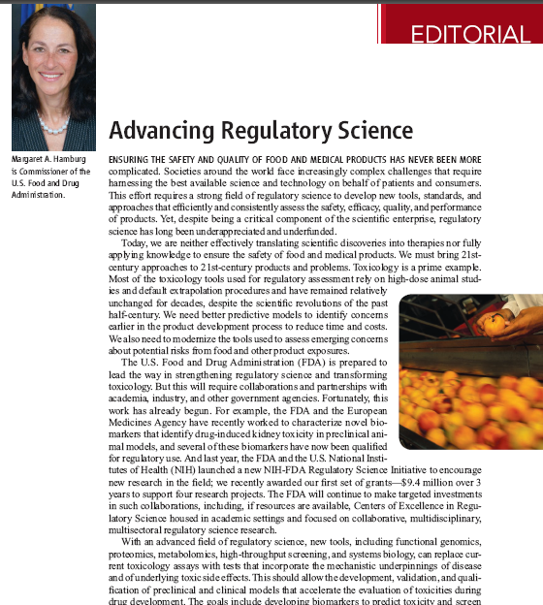
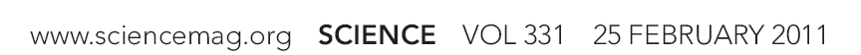
Today, we are neither effectively translating scientific discoveries into therapies nor fully applying knowledge to ensure the safety of food and medical products. We must bring 21st century approaches to 21st century products and problems.
We need better predictive models to identify concerns earlier in the product development process to reduce time and costs.
But this will require collaborations and partnerships with academia, industry, and other government agencies.
15

Slide 16




















FDA Registered Drug Facilities 2011
6,877 FACILITIES
1,042 FACILITIES
454 FACILITIES
European Union
435 FACILITIES
United States
China
India
Reference: Califf - Assuring drug quality int. agreements; For a current listing of registered facilities see: https://www.fda.gov/Drugs/InformationOnDrugs/ucm135778.htm

Slide 17
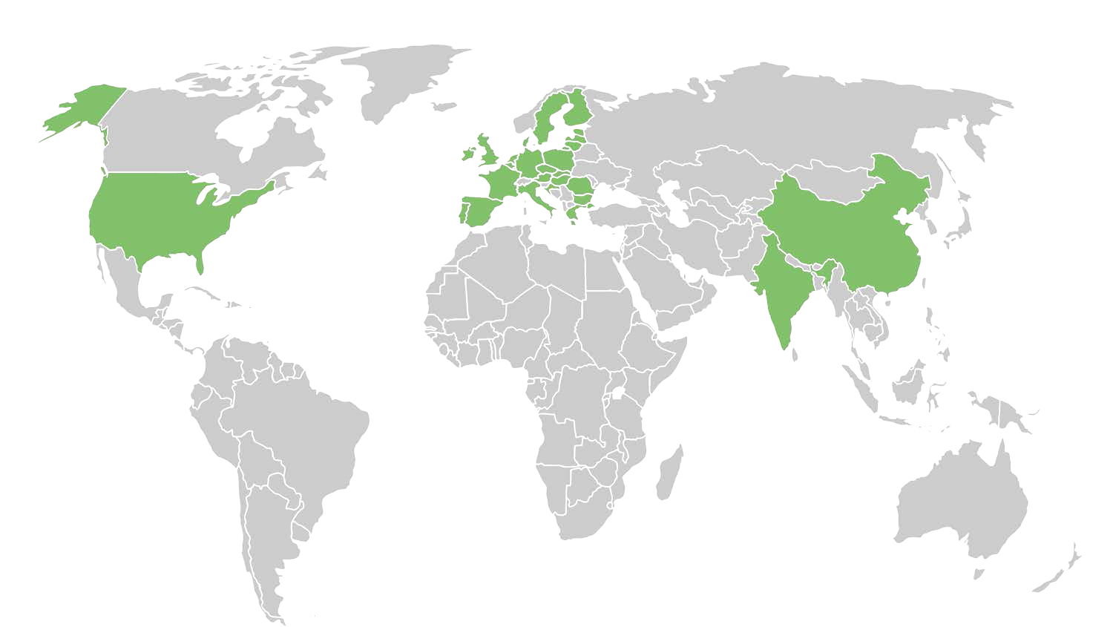

























FDA Registered Drug Facilities 2015
European Union
16%
63%
3%
United States
55%
China
India
Reference: Califf - Assuring drug quality int. agreements; For a current listing of registered facilities see: https://www.fda.gov/Drugs/InformationOnDrugs/ucm135778.htm
Notes:
In 2017, there are 9,759 registered drug facilities in the US and 711 drug facilities are registered by the US within India

Slide 18
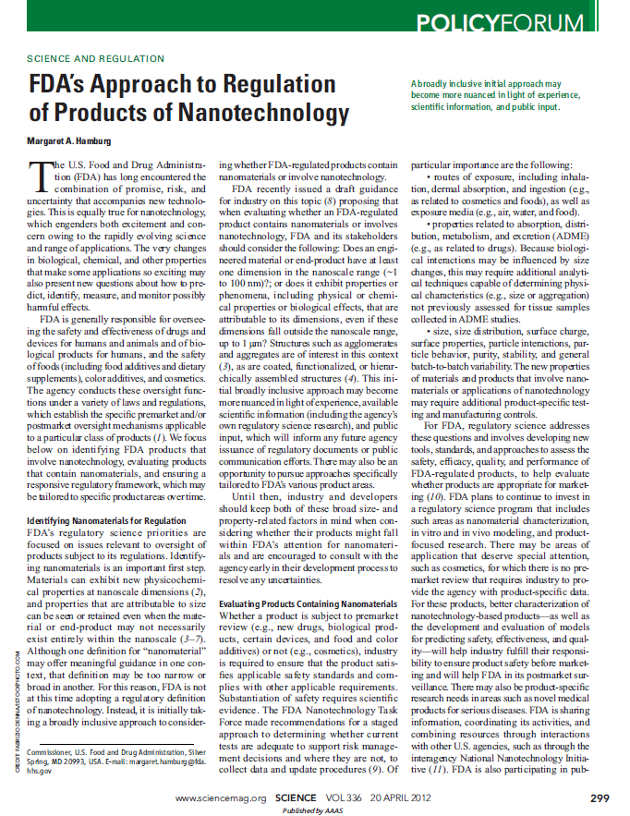
FDA’s Approach to Regulation of Products of Nanotechnology
Continue post-market monitoring
Industry remains responsible for ensuring that products meet all applicable requirements, including safety standards
Encourage early industry consultation
Collaborate, as appropriate, with domestic and international regulatory counterparts and other stakeholders
Offer technical advice and guidance, as needed, to help industry meet its statutory obligations.
Hamburg, 2012. Science 336: 299-300.
18

