Slide 1
Emerging techniques in nanoparticle analysis
Jana Navratilova, PhD
National Research Council Fellow at U.S. EPA, RTP

Slide 2
Techniques available
Light scattering based techniques:
Widely used however severe limitations
Difficulties with polydisperse samples (high PDI, PDI is representative of the particle size distribution width)
Sensitive to matrix components
Not element specific
Imaging techniques:
Formation of artefacts, matrix effects

Slide 3
Demands
Particle size
Particle number concentration
Elemental composition
Differentiation between natural and engineered nanoparticles
High throughput and robustness

Slide 4
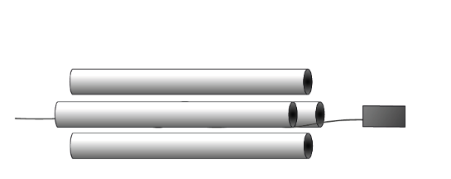
spICP-QMS
great potential for the characterization of inorganic nanoparticles (NPs) at relevant concentrations (ppt)
enables the measurement of individual particles (PNC)
analysis of more complex multi-component particles, which are more realistic case, another mass analyzer is required
Limitations
Quadrupole
Only two elements at the individual particle

Slide 5
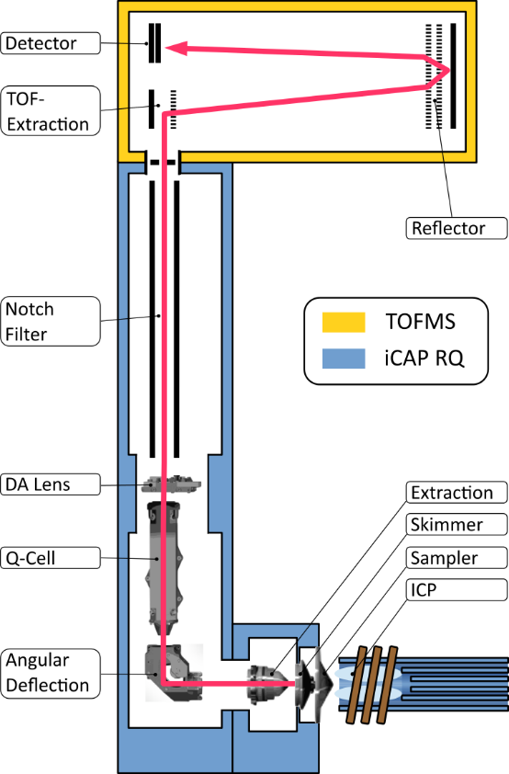
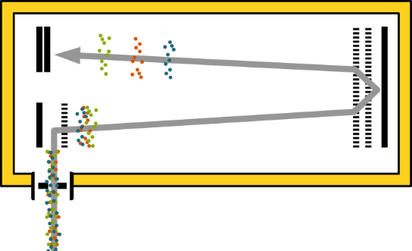
spICP -TOF- MS
Time-of-flight
Complete elemental mass spectra for individual NPs
All isotopes from an individual particle
Complex particles, complex samples
The most important feature in regard to single particle analysis is simultaneous detection and speed

Slide 6
Example
Complex environmental samples
CeO₂, TiO₂, SiO_{2,} Al₂O₃, CuO, ZnO
Elements are present in the environment at high concentrations
Engineered particles at very low levels
Lack of techniques to discriminate
Solution
Single particle fingerprinting

