Slide 1
Fostering U.S.-International Collaboration in Integrating Exposure in Nanomaterial Risk Evaluation
Vladimir Murashov, PhD
QEEN II, Washington, DC
October 10, 2018

Slide 2
Risk characterization
Hazard
Exposure
Risk

Slide 3
Collaborations on nanomaterial exposure for risk characterization
U.S. gov.
Country 1
gov.
Country 2
gov.
Country 3
gov.
needs
data
needs
data
needs
data
needs
data
U.S. research.
Country 1 research.
Country 2 research.
Country 3 research.

Slide 4
Collaborations on nanomaterial exposure
Inter-governmental organizations
U.S. gov.
Country 1
gov.
Country 2
gov.
Country 3
gov.
needs
data
needs
data
needs
data
needs
data
U.S. research.
Country 1 research.
Country 2 research.
Country 3 research.
Notes:
There are bi-lateral and multi-lateral collaborations at the government level.

Slide 5
Inter-Organization Programme for the Sound Management of Chemicals (IOMC)
FAO
OECD
WHO
UNEP
UNITAR
ILO

Slide 6
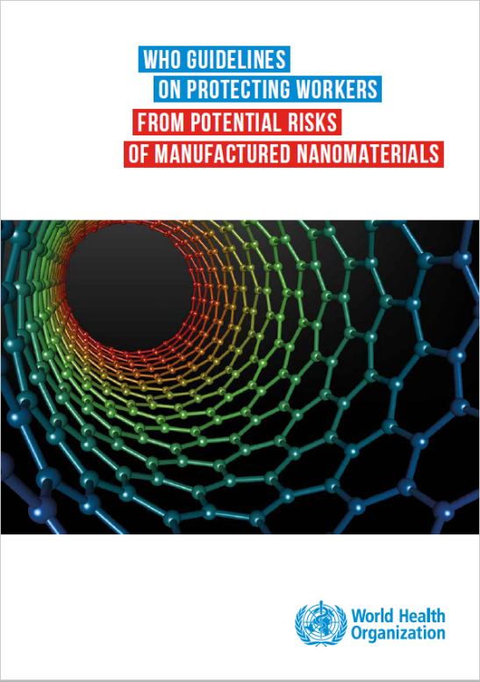
WHO Guidelines on Protecting workers from potential risks of manufactured nanomaterials
Assess workers’ exposure in workplaces with methods similar to those used for the proposed specific occupational exposure limit (OEL) value of the MNM.
Assess whether workplace exposure exceeds a proposed OEL value for the MNM. A list of proposed OEL values is provided in Annex 1 of these guidelines.
If specific OELs for MNMs are not available in workplaces, use a stepwise approach for inhalation exposure. For dermal exposure assessment, there was insufficient evidence to recommend one method of dermal exposure assessment over another.
Notes:
Exposure recommendations

Slide 7
OECD PROGRAMME ON NANOSAFETY
REGULATORY
PERSPECTIVE
TESTING AND ASSESSMENT
to assess the applicability and accuracy of existing test methods and to identify where technical adaptation were needed.
RISK ASSESSMENT
Guidance for risk assessors & address challenges different jurisdictions are facing with respect to regulating nanomaterials
ENV. SUSTAINABLE USE OF MN
life cycle assessment
EXPOSURE MEASUREMENT AND MITIGATION
Workplace
Consumer
Environmental exposure
Notes:
Presently the work of OECD program on nanosafety is organized into four areas: testing and assessment; risk assessment; exposure measurement and mitigation and environmentally sustainable use of nanomaterials.

Slide 8
OECD Report ENV-JM-MONO(2017)32
Theme 1 encompasses projects related to the development and use of exposure models for manufactured nanomaterials. This includes information on production/import quantities, exposure pathways, and exposure measurement in the environment, for consumers and of emissions from consumer articles and products
Theme 2 encompasses projects on issues related to environmental behaviour and transformation, and includes information on nanomaterials released from the use of articles and products to the environment
Theme 3 encompasses projects related to the material characterization of manufactured nanomaterials and includes data on the physical form of nanomaterials in products. Material characterization of nanomaterials is integral to many exposure issues and is expected to be critical for any future projects undertaken by OECD

Slide 9
Collaborations on nanomaterial exposure
Inter-governmental organizations
U.S. gov.
Country 1
gov.
Country 2
gov.
Country 3
gov.
needs
data
needs
data
needs
data
needs
data
U.S. research.
Country 1 research.
Country 2 research.
Country 3 research.
Formal and informal collaborations

Slide 10
Collaborations on nanomaterial exposure
Public sector
(governments)
Researchers

Slide 11
Collaborations on nanomaterial exposure
Public sector
(governments)
Private SDOs
(ISO, ASTM, etc)
Researchers

Slide 12
Current work in ISO TC229 Nanotechnologies pertaining to exposure
ISO/TS 12025 Rev - Nanomaterials -- Quantification of nano-object release from powders by generation of aerosols
ISO/TS 16195 Rev - Nanotechnologies -- Guidance for developing representative test materials consisting of nano-objects in dry powder form
ISO/DTS 21361 - Identification and quantification of airborne nano-objects in a mixed dust industrial environment
ISO/DTR 22293 - Evaluation of methods for assessing the release of nanomaterials from commercial, nanomaterial containing polymer composites

Slide 13
Collaborations on nanomaterial exposure
Public sector
(governments)
Private SDOs
(ISO, ASTM, etc)
Researchers

Slide 14
Coordination among public and private internat. organizations
IOMC
FAO
OECD
(WPMN)
WHO
UNEP
UNITAR
ILO
Liaison A
ISO
(TC229)
Notes:
“A” liaisons have the right to reciprocally participate in meetings and to comment on drafts, but they cannot vote.
14

Slide 15
Collaborations on nanomaterial exposure
Public sector
(governments)
Private SDOs
(ISO, ASTM, etc)
Researchers

Slide 16

Researcher participation in TC229
Direct
Leading a project
Expert participation in a project group
Review comments at different stages of standard development
Indirect
Publication of research results and review papers

Slide 17
Collaborations on nanomaterial exposure
Public sector
(governments)
Private SDOs
(ISO, ASTM, etc)
Researchers

Slide 18

Direct contributions of researchers in WPMN
Appointed experts to Steering Group on Exposure Measurement and Exposure Mitigation
Communities of Practice
In WPMN CoP were established to resolve technical issues impeding research work conducted under the sponsorship program
Include contributor scientists working on the testing of nanomaterials and invited scientific experts
Generation of required knowledge through targeted grants from delegations to OECD WPMN
Addressing specific end-points in the sponsorship program for testing of nanomaterials
Notes:
18

Slide 19
Direct contributions of researchers in WPMN
Open workshops and panels in conjunctions with scientific conferences
Combination of experts nominated by delegations to OECD WPMN and participants of scientific conferences
Exposure Assessment and Mitigation workshops (August, 2018, Ottawa, Canada in conjunction with Int Soc Exp Sci)
Expert consultations and meetings
Nominations of experts by delegations to OECD WPMN
Expert meeting on Phys-chem Properties of Nanomaterials (September, 2018, Paris, France)
Notes:
19

Slide 20
Challenges
How can coordination of activities in nanomaterial exposure be further improved at each level?
How can these activities be better integrated into nanomaterial risk characterization?

Slide 21
Thank you!

