Slide 1

Measurement of engineered nanomaterial exposure in microorganisms using direct and indirect methods
Monika Mortimer, Timnit Kefela, Ying Wang, Dong Li, Naresh Devarajan, Patricia A. Holden
University of California, Santa Barbara
QEEN II: 2nd Quantifying Exposure to Engineered Nanomaterials from
Manufactured Products Workshop
October 9, 2018

Slide 2

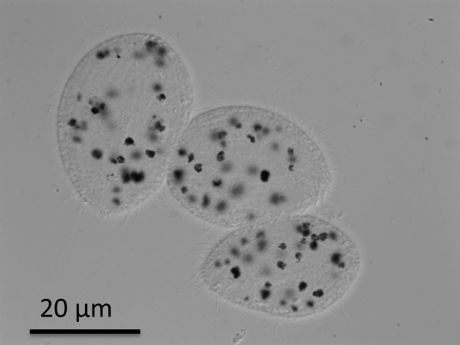
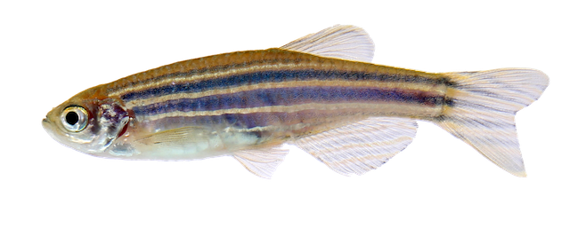
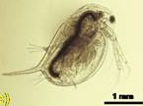
Bioaccumulation – an important exposure-related parameter
Uptake &
depuration rate
Longer residence time in the organism
Higher potential for trophic transfer
Higher potential for harmful effects
&
Carbon nanotubes
20 µm
Protozoa Tetrahymena thermophila exposed to multiwall carbon nanotubes

Slide 3
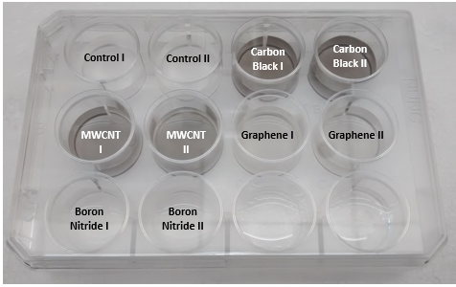
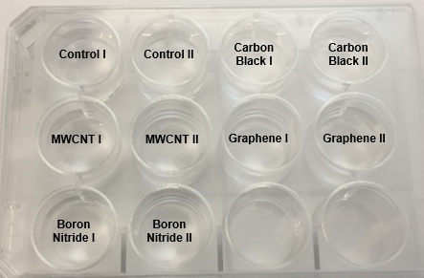
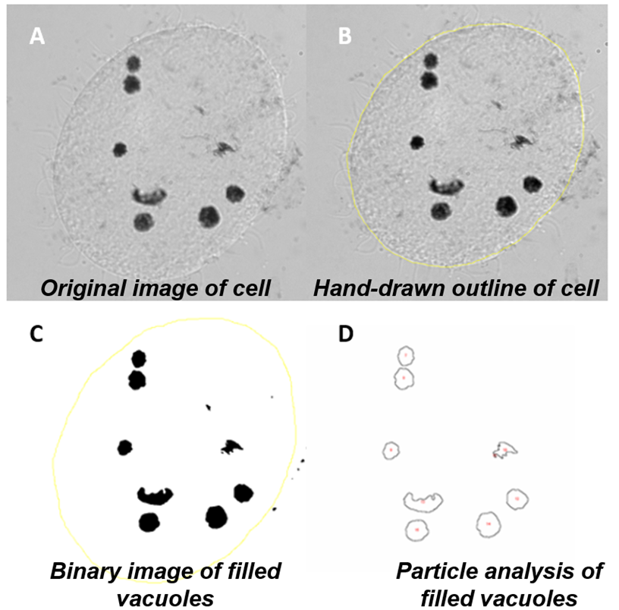
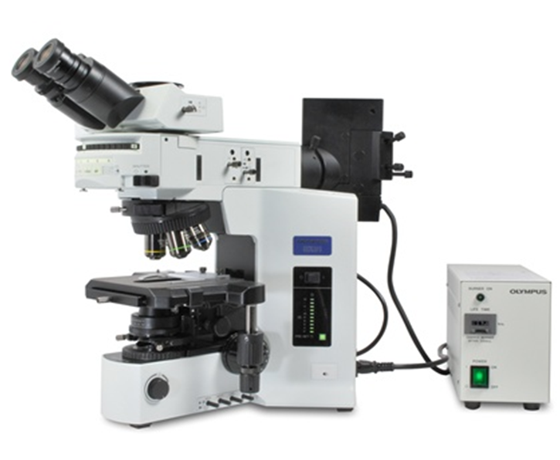
Microscopy and image analysis for measuring ENM uptake and depuration kinetics
Exposure to 10 mg/L of nanomaterials (uptake)
Depuration
Protozoa transferred to fresh medium
Sampling for microscopy
Image analysis

Slide 4
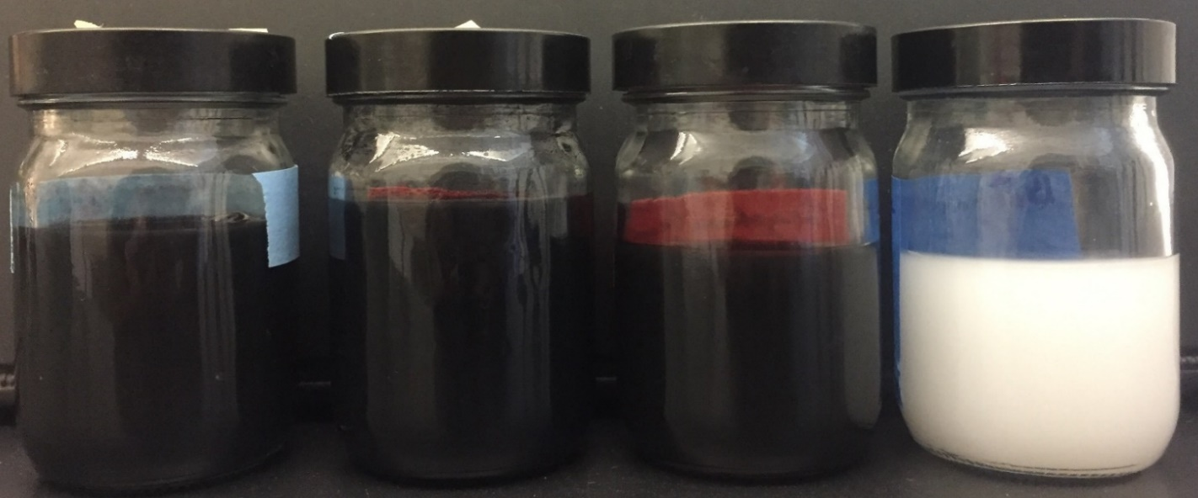
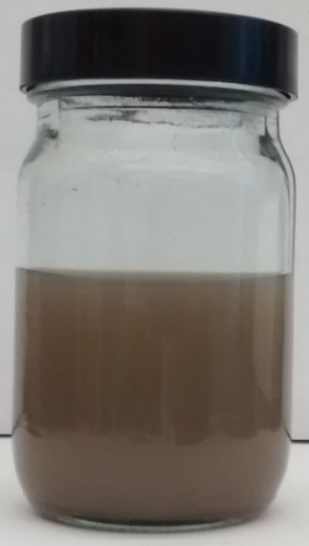





How do shape and chemistry affect ENM uptake and depuration rates?
Carbon black
MWCNT
Graphene
Boron nitride flakes
Boron nitride nanotubes
Nanomaterials (200 mg/L) were dispersed in Nanopure water with 400 mg/L alginic acid by probe sonication
Carbon black
Multiwall carbon nanotubes (MWCNTs)
Graphene
Boron nitride flakes
Boron nitride nanotubes (BNNTs)

Slide 5
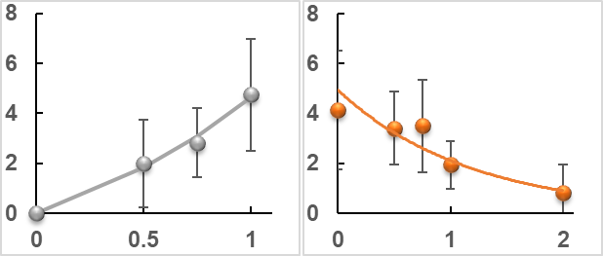
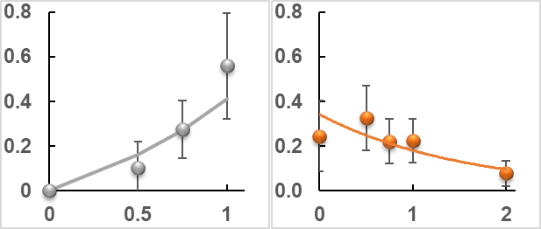
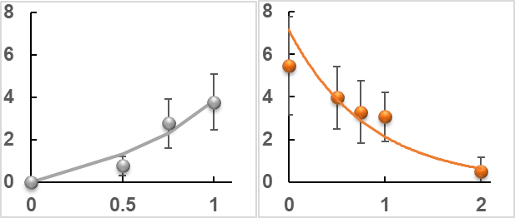
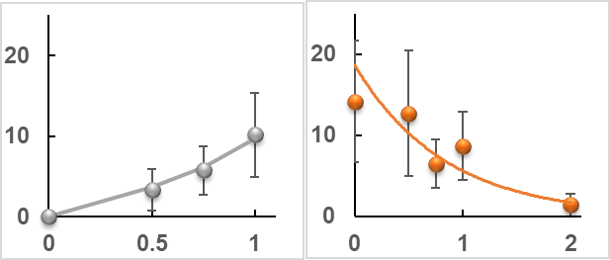
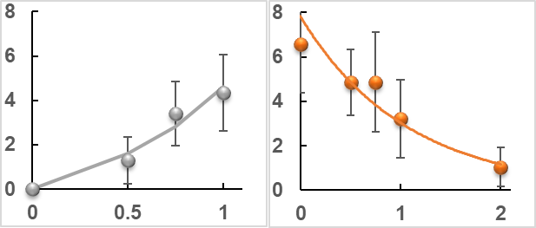
Uptake and depuration kinetics results
Multiwall carbon nanotubes (MWCNTs)
Boron nitride nanotubes (BNNTs)
k₂= 1.1 ± 0.5 h⁻¹
k₂= 0.9 ± 0.5 h⁻¹
Graphene
Boron nitride flakes
y-axis: ENM concentration in protozoa, mg kg⁻¹ dw x 10³
k₂= 1.6 ± 0.7 h⁻¹
k₂= 1.5 ± 0.9 h⁻¹
Carbon black
k₂= 1.5 ± 0.9 h⁻¹
x-axis: Time (h)

Slide 6

ENM shape-dependent depuration
Carbon black
Multiwall carbon nanotubes (MWCNTs)
Graphene
k₂= 1.5 ± 0.9 h⁻¹
k₂= 1.5 ± 0.9 h⁻¹
k₂= 1.1 ± 0.5 h⁻¹
Spherical food vacuoles
Polygonal food vacuoles
Fractal dimension:
1.020 ± 0.05
Fractal dimension:
1.064 ± 0.07
Fractal dimension:
1.096 ± 0.05

Slide 7
Advantages of microscopy-based approach
Easy quantification of phagocytosed carbon-based ENMs
Robust comparison of uptake and depuration of different ENMs
Acquisition of both single-cell and population level information
Do not require ENM extraction from cells prior to quantification

Slide 8
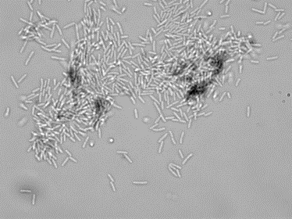
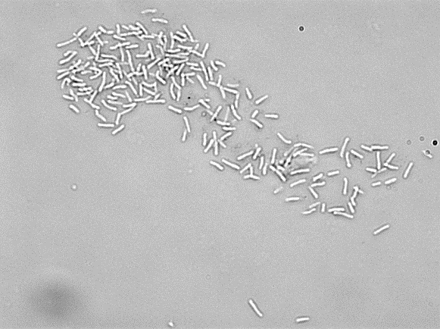
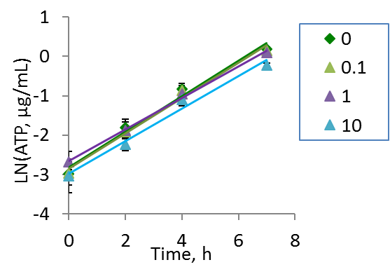
Indirect measurement of ENM exposure
Carbon nanotubes
20 μm
20 μm
Pseudomonas aeruginosa exposed to 10 mg/L MWCNTs
Bradyrhizobium diazoefficiens exposed to 10 mg/L MWCNTs
MWCNTs did not inhibit bacterial growth or induce significant membrane damage
Concentration, mg/L
MWCNT concentration, mg/L | Specific growth rate, h⁻¹
0 | 0.46±0.02
0.1 | 0.45±0.03
1 | 0.40±0.03
10 | 0.41±0.05

Slide 9

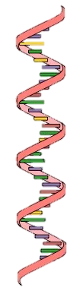
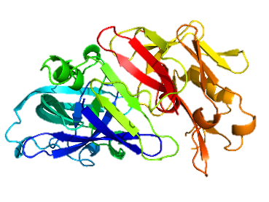
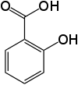
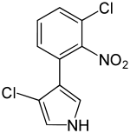
Omics-Based Approaches in ENM Exposure Assessment
Central dogma of biology
‘Omics’ approaches
DNA
Genomics
transcription
mRNA
Transcriptomics
translation
proteins
Proteomics
metabolites
Metabolomics

Slide 10
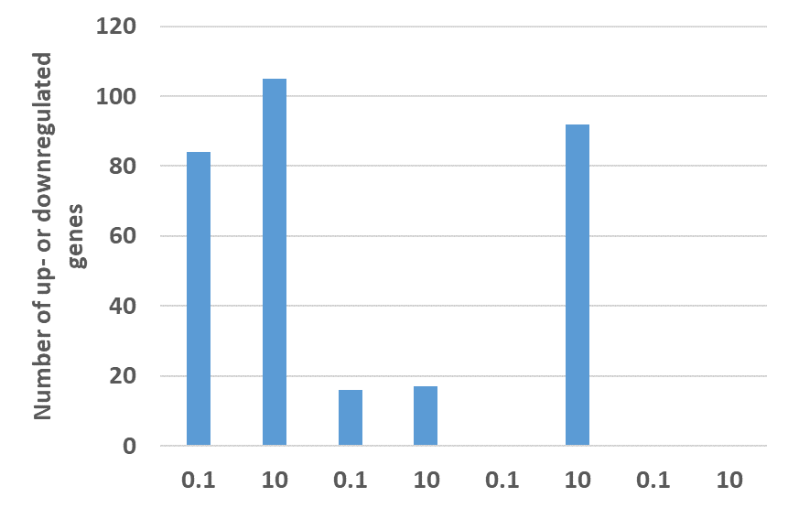
Global transcriptomic response to ENMs at non-growth-inhibitory concentrations
Baceria B. diazoefficiens were grown in ENM-amended medium and gene expression was quantified using RNA sequencing
mg/L
MWCNTs
Graphene
CeO₂ NPs
Carbon black

Slide 11
Summary
Microscopy-based approach enabled easy and robust measurement of ENM uptake and depuration kinetics.
Tubular ENMs had longer residence times in protozoa, thus may have a higher potential for harmful effects and trophic transfer.
Non-targeted ‘omics approaches are promising in developing biomarker-based methods for indirect ENM exposure assessment.

Slide 12
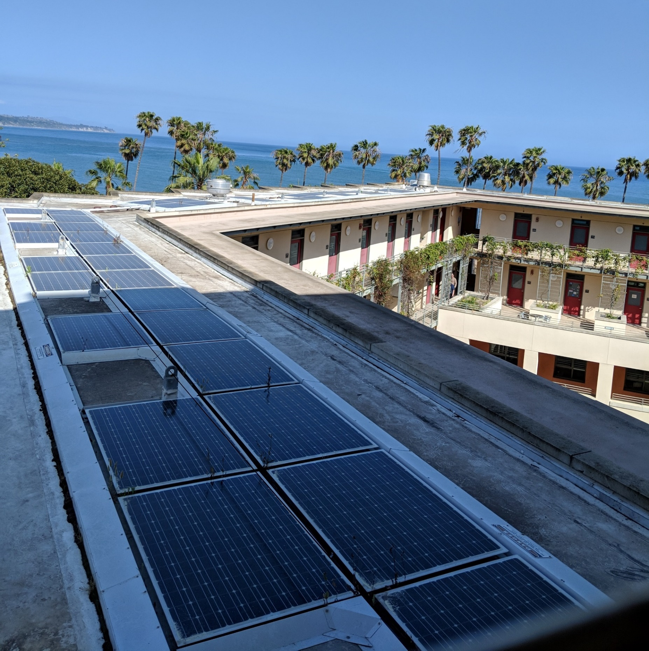





Acknowledgements
Prof. Patricia Holden (UCSB) &
the Holden Lab members:
Timnit Kefela, PhD student
Anne Trinh, undergrad. student
Ying Wang, PhD candidate
Dr. Dong Li
Dr. Naresh Devarajan
Bren School of Environmental Science & Management, UCSB

