Slide 1
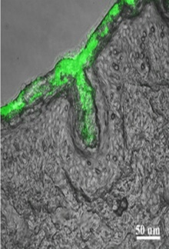
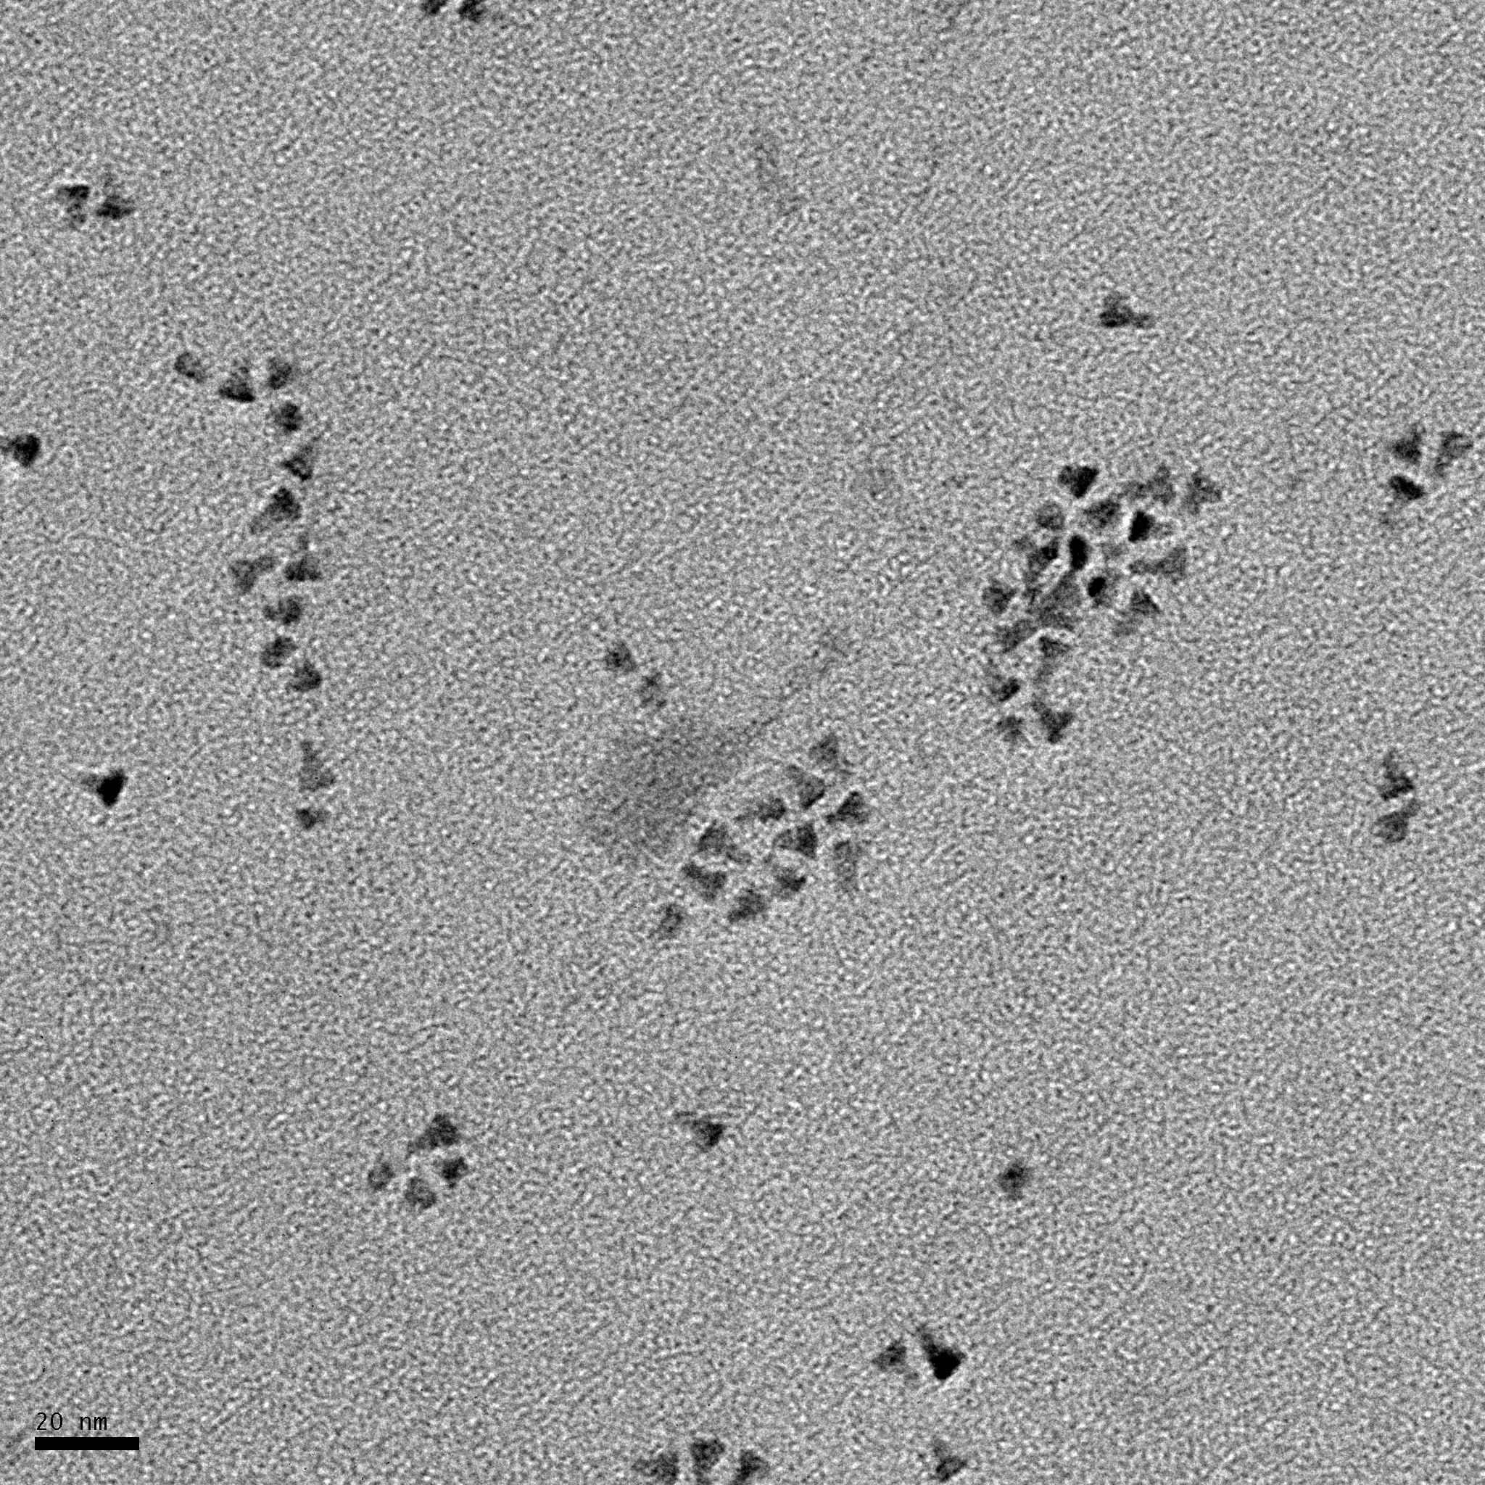
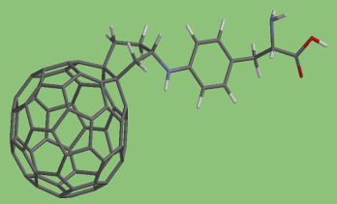
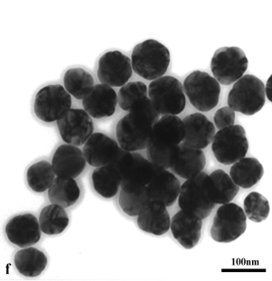
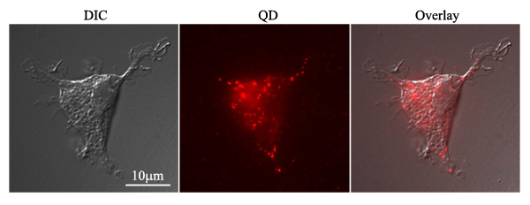
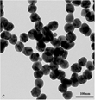
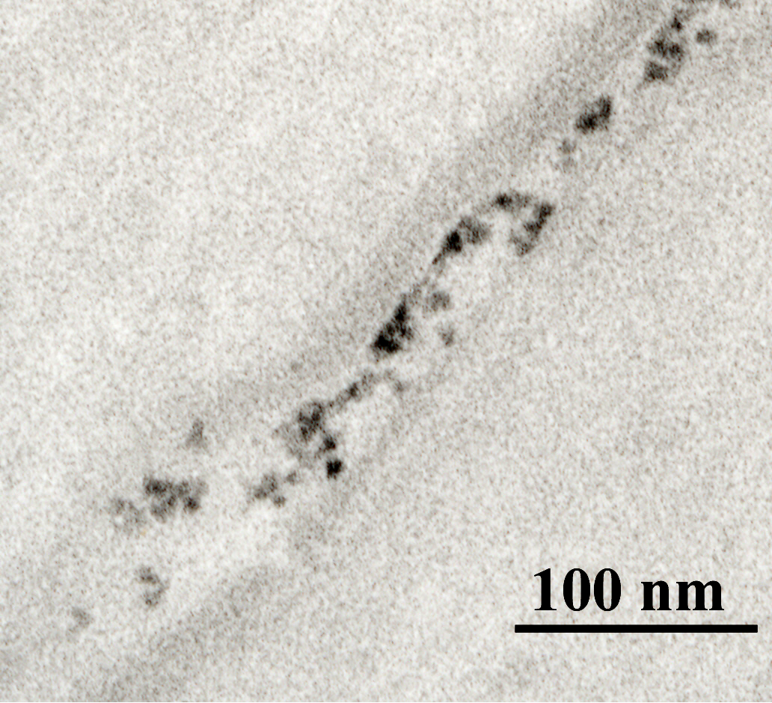
Perspectives on a Nano Career
Nancy A. Monteiro-Riviere, PhD, ATS
University Distinguished Professor of Toxicology and Regents Distinguished Scholar Emerita
Former Director, Nanotechnology Innovation Center of Kansas State (NICKS)
Kansas State University, Manhattan, KS nmonteiro@ksu.edu
&
Professor of Investigative Dermatology and Toxicology Emerita
North Carolina State University, Raleigh, NC monteiro@ncsu.edu

Slide 2
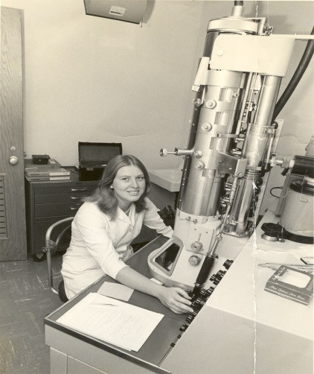
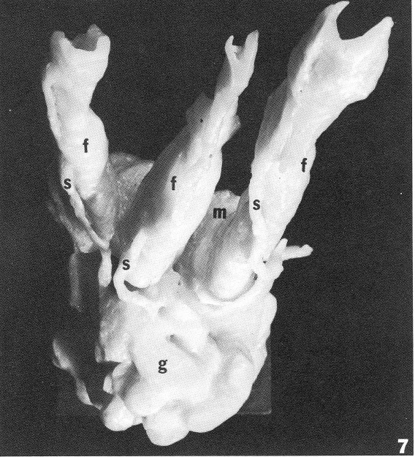
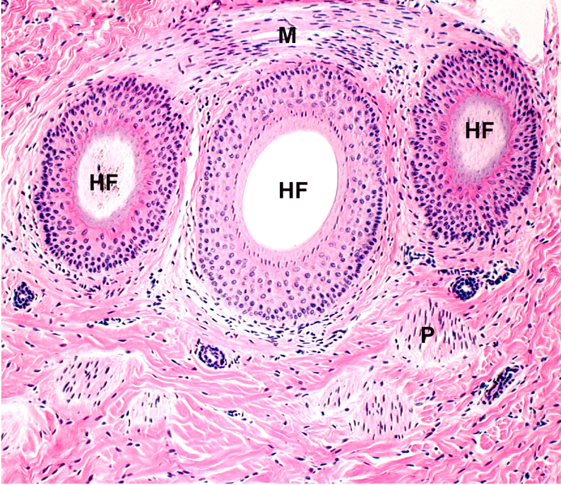
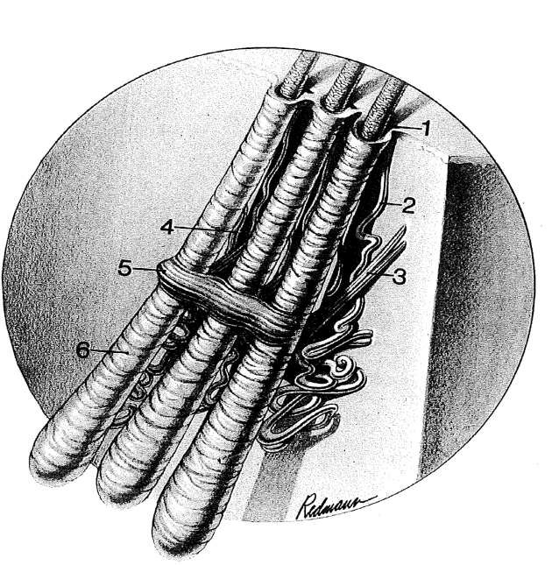
Background
PhD in ultrastructural anatomy and cell biology (Skin)-Purdue University, West Lafayette, Indiana My Goal: "Best Comparative Anatomist”
Interfollicular smooth muscle in skin
Anatomical Record 201: 455-462, 1981

Slide 3
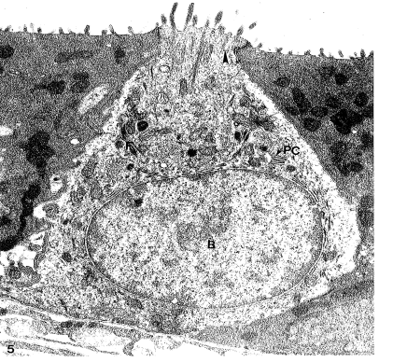
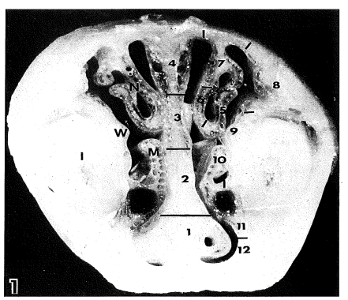
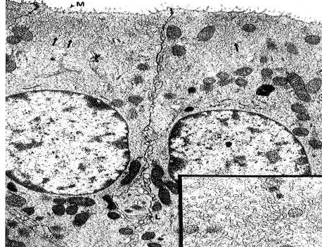
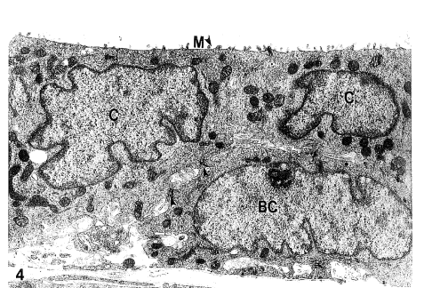
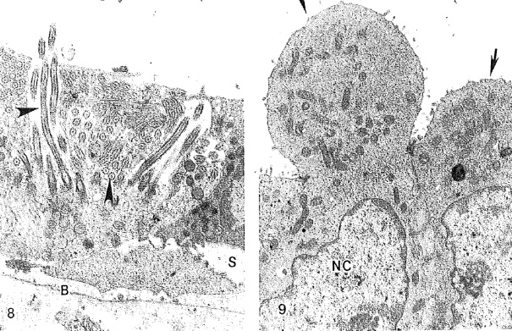
Background
Postdoctoral Fellowship in Toxicologic Pathology at the Chemical Industry Institute of Toxicology (CIIT), Research Triangle Park, NC (Formaldehyde inhalation)
Discovered 3 new cell types in rat nasal mucosa: nonciliated columnar, cuboidal and brush cells.
Monteiro-Riviere NA and Popp JA. Ultrastructural characterization of the nasal respiratory epithelium in the rat. American Journal of Anatomy 169:31-43, 1984.
Ultrastructural evaluation of acute nasal toxicity in the rat respiratory epithelium in response to formaldehyde gas. Fundamental Applied Toxicology 6:251-262, 1986.

Slide 4
Background
Assistant, Associate and Full Professor of Investigative Dermatology and Toxicology at North Carolina State University, Department of Clinical Sciences & Joint UNC/NCSU Biomedical Engineering for 28 years. Appointment at UNC Chapel Hill School of Medicine in Dermatology
Research focus: skin absorption & toxicity - in vivo and in vitro models, in vitro models-cell culture, diffusion cells, IPPSF. Studied cutaneous toxicants ranging from chemical warfare agents, vesicants, iontophoresis, transdermal drug delivery systems, microneedle delivery.
Research funded by NIEHS, NIOSH, DoD-USAMRDC,US-AFOSR,EPA Star and numerous drug companies and industries.

Slide 5
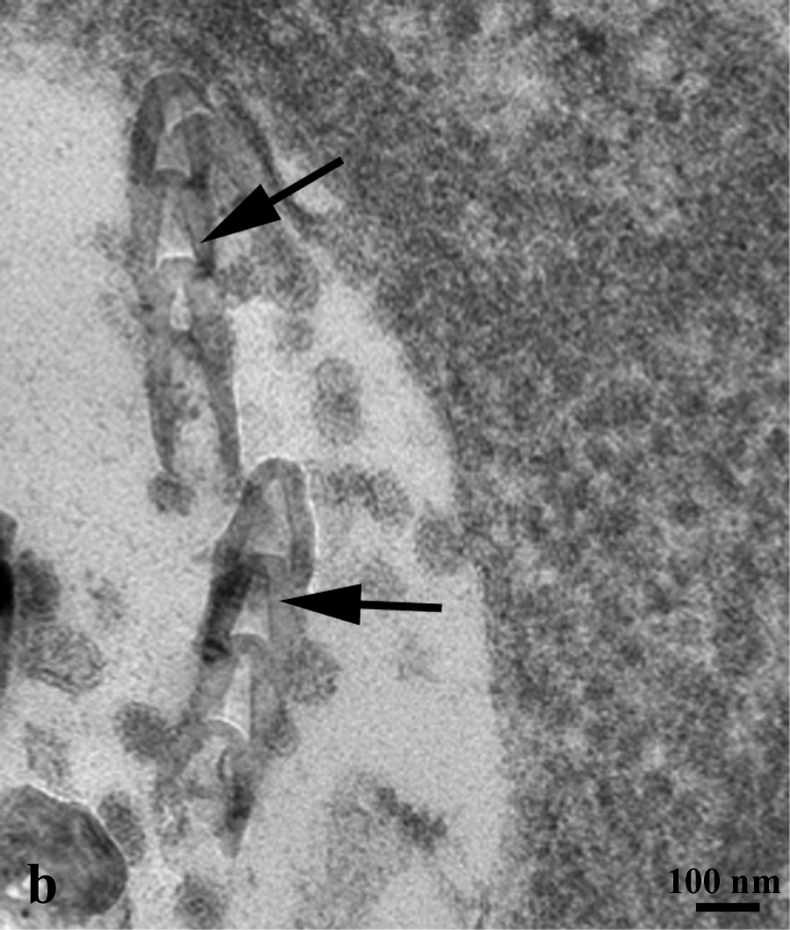
Monteiro-Riviere et al., Science, 306,p. 2164, 2004
Monteiro-Riviere NA, Nemanich RJ, Inman AO, Wang YY, Riviere JE: Multi-walled carbon nanotube interactions with human epidermal keratinocytes. Toxicology Letters 155:377-384, 2005

Slide 6
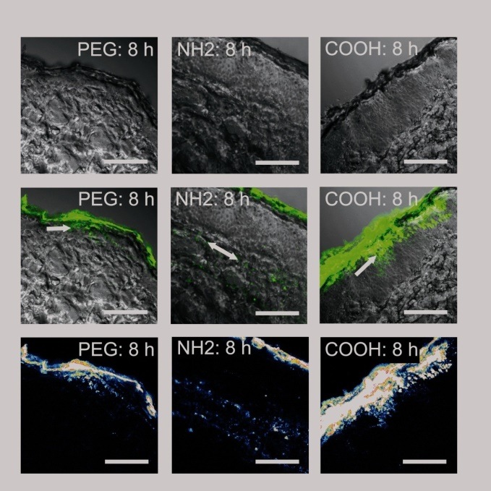
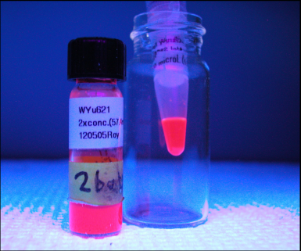
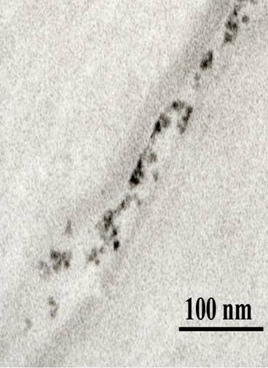
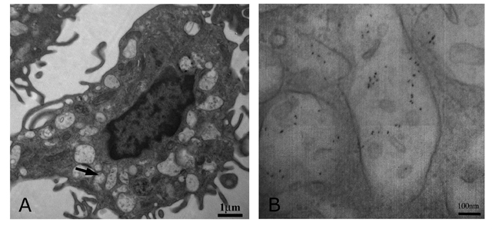
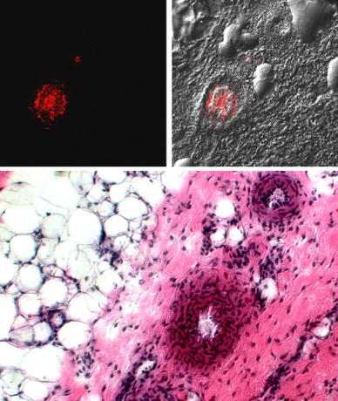
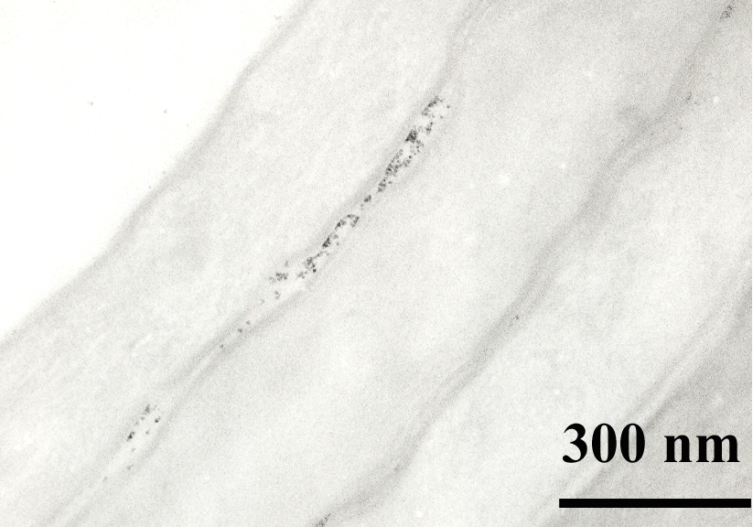
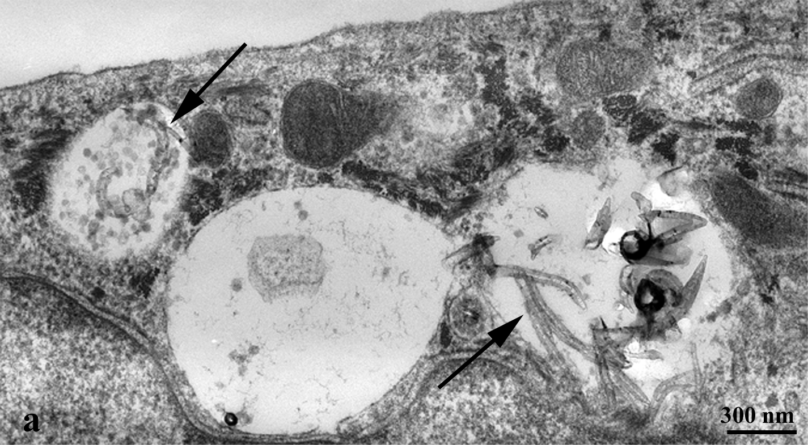
QD 565, 655, 621,

Slide 7

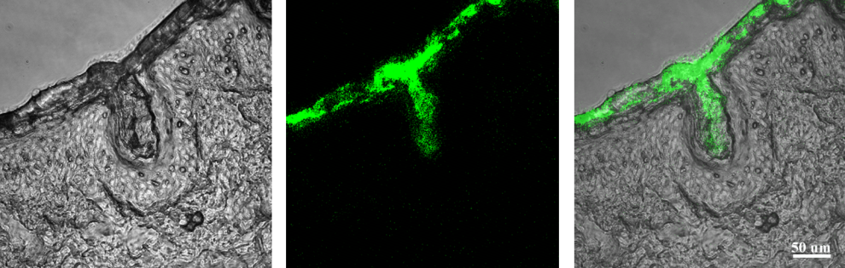
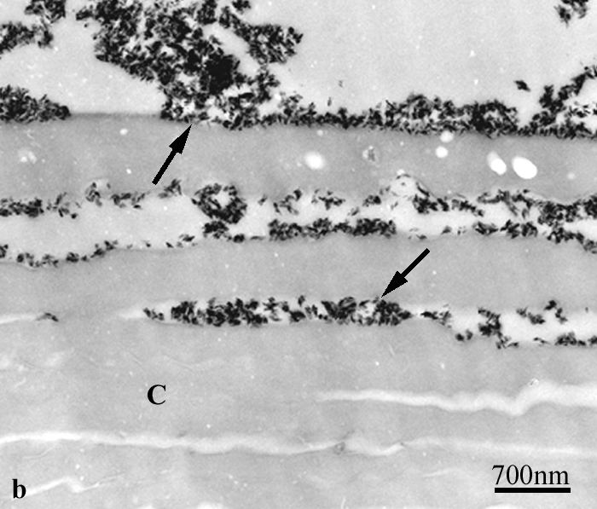
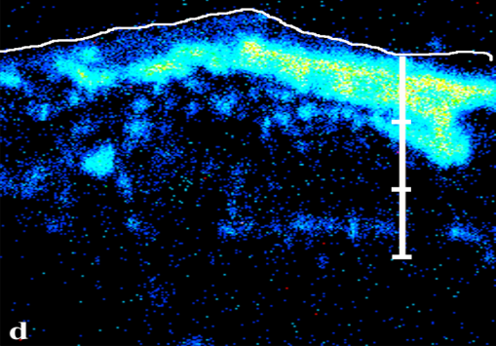
Topical skin : occupational and consumer products
Monteiro-Riviere, Wiench, Landsiedel, Schulte, Inman, Riviere. Safety evaluations of sunscreen formulations containing titanium dioxide nanoparticles in UVB sunburned skin: An in vitro and in vivo study. Toxicological Sciences 123:264-280, 2011.
Time of Flight SIMS

Slide 8
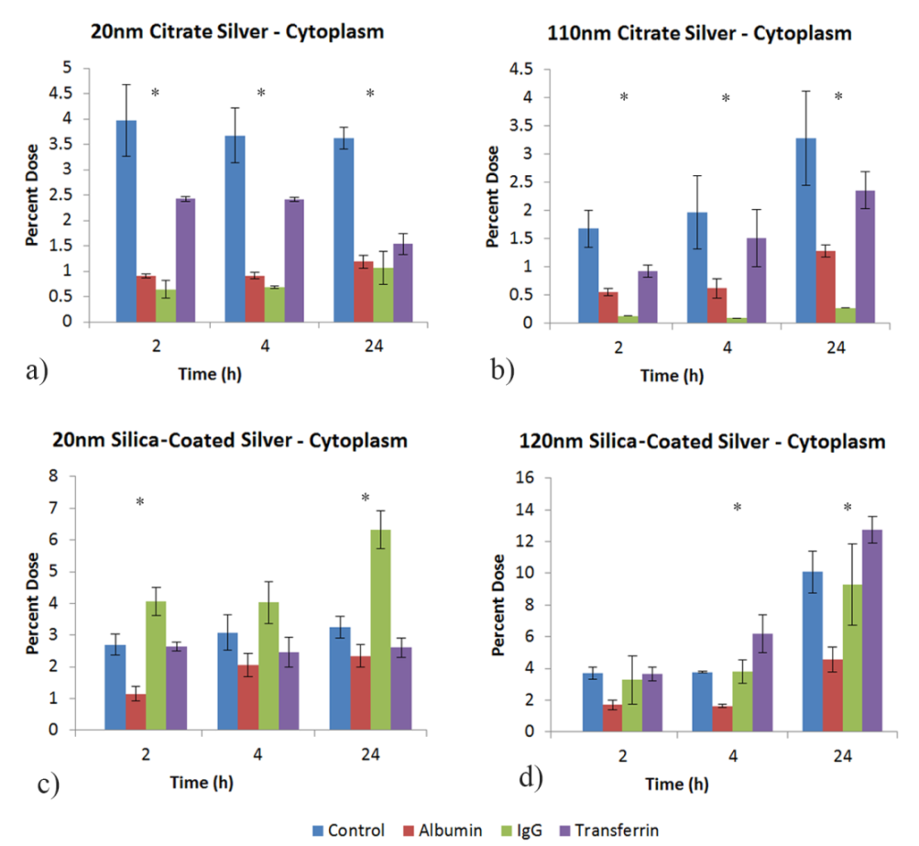
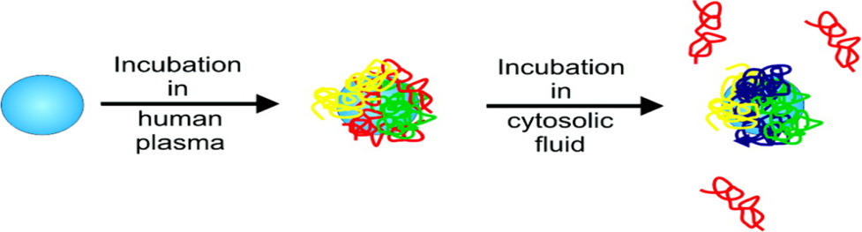
Biocoronas modulate cellular uptake of AgNP with two coatings pre-incubated with three different proteins
Monteiro-Riviere, et al., Protein binding modulates the cellular uptake of silver nanoparticles into human cells: Implications for in vitro to in vivo extrapolations? Toxicology Letters 220:286-293, 2013.

Slide 9
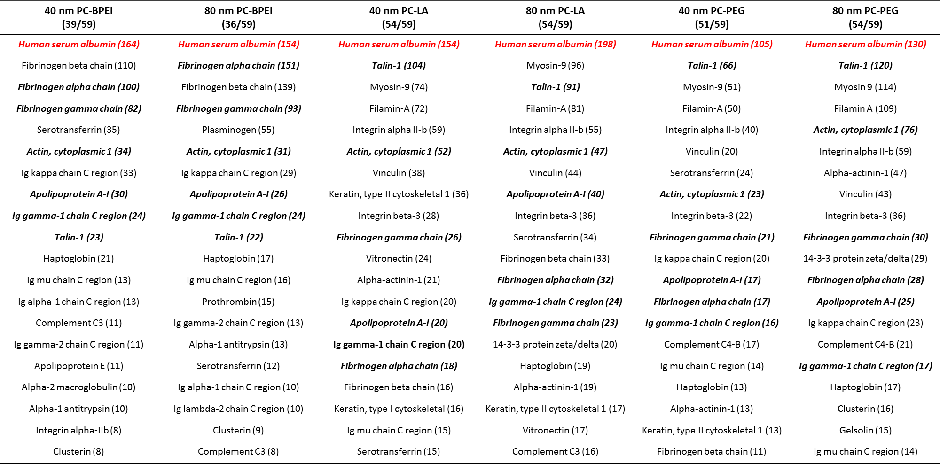

Slide 10





Gene Expression
126 genes for bare and plasma corona at nontoxic and toxic dose were affected out of 370 genes
25 µg/ml 40 nm BPEI AuNP
Bare
27 3 = 30 genes changed
8/30 DNA Damage & Repair pathway (27%)
6/30 Heat Shock Response (20%)
Plasma Corona
1 3 = 4 genes changed
No major pathways were involved
75 µg/ml 40 nm BPEI AuNP
Bare
66 14 = 80 genes changed
16/80 DNA Damage & Repair (20%)
14/80 Heat Shock Response (18%)
8/80 Mitochondrial energy metabolism (10%)
Plasma Corona
2 47 = 49 genes changed
10/49 Phospholipidosis (20%),7/49 Apoptosis (14%), 6/49 Immunotoxicity (12%),
5/49 Cholestasis (10%),
Chandran,Riviere,Monteiro-Riviere.Surface chemistry of gold NP determines the biocorona composition impacting cellular uptake, toxicity, and gene expression profiles in human endothelial cells. Nanotoxicology 11:4, 507-519, 2017.

Slide 11
Assessment of Nine Different Viability Methods with Five Different Types of Nanomaterials in a Human Cell Line
Dye-based assays used to determine cell viability may produce invalid results due to the interactions of carbon nanomaterials (CNM) with the dye and/or CNM adsorption of the dye/dye products. Also, true for cytokines, essential nutrients, etc.
To evaluate & compare 9 different viability assays on HEK cells treated with 5 NM (carbon and non-carbon based) to determine the best assay that would provide accurate results to elucidate the mechanism of toxicity.
Monteiro-Riviere NA, Inman AO: Challenges for assessing carbon nanomaterial toxicity to the skin. Carbon 44:1070-1078, 2006.
Zhang L, Zeng L, Barron AR, Monteiro-Riviere NA: Biological interaction of functionalized single-walled carbon nanotubes in human keratinocytes. International Journal of Toxicology 26:103-113, 2007.
Monteiro-Riviere NA, Inman AO, Zhang LW. Limitations and relative utility of screening assays to assess engineered nanoparticle toxicity in a human cell line. Toxicology & Applied Pharmacology 234:222-235, 2009.

Slide 12
Nanomaterials Interfere with Viability Assays
Carbon Black
SWCNT
C60
nC60
QD655
Monteiro-Riviere NA, Inman AO, Zhang LW. Limitations and relative utility of screening assays to assess engineered nanoparticle toxicity in a human cell line. Toxicology & Applied Pharmacology 234:222-235, 2009.
Notes:
12

Slide 13
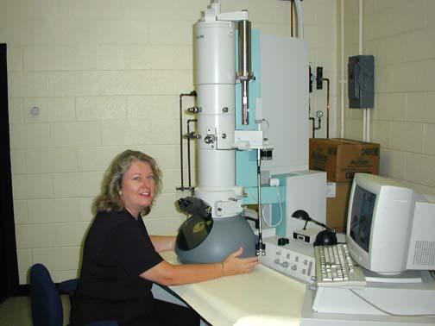
Perspectives
I got involved in nanotoxicology based on my background in EM and skin uptake and toxicity research after attending the National Academy of Sciences Keck Future Initiatives Conference on “Designing Nanostructures at the Interface between Biomedical and Physical Systems” in June 2004.
This one meeting established a network of interdisciplinary collaborators that persist to this day and even provided seed funding to foster our collaborative collaborative research ideas.

Slide 14
Perspectives
I made every effort to attend nanoscience meetings to learn about this emerging field and to expand my network of collaborators.
As my research continued and became recognized, I was invited to numerous workshops and served on numerous national and international nanotoxicology related panels.
We all learned that there are unique issues in studying nanotoxicology versus small molecule toxicology (physical chemical characterization, protein coronas, assay interference, etc).

Slide 15
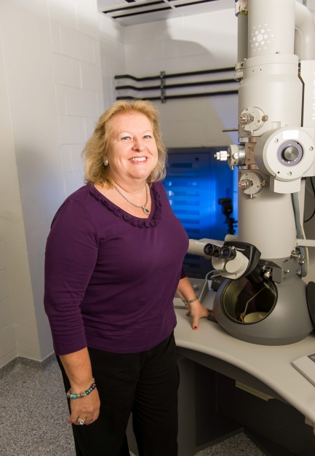
The Future
Despite our experience, senior scientists need to make room for new young investigators.
We can take on new roles by offering valuable contributions and advice on research directions and career pathways.
Young investigators have to make the effort to contact and interact with those with theoretical and practical experience in the field.

Slide 16
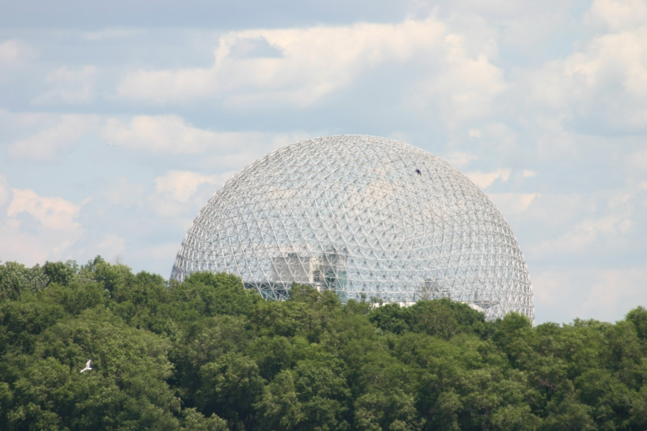
THANK YOU

