Slide 1


Exposure Assessment for Ambient Nano-Particles
Michael J. Kleeman, Department of Civil and Environmental Engineering, University of California Davis

Slide 2
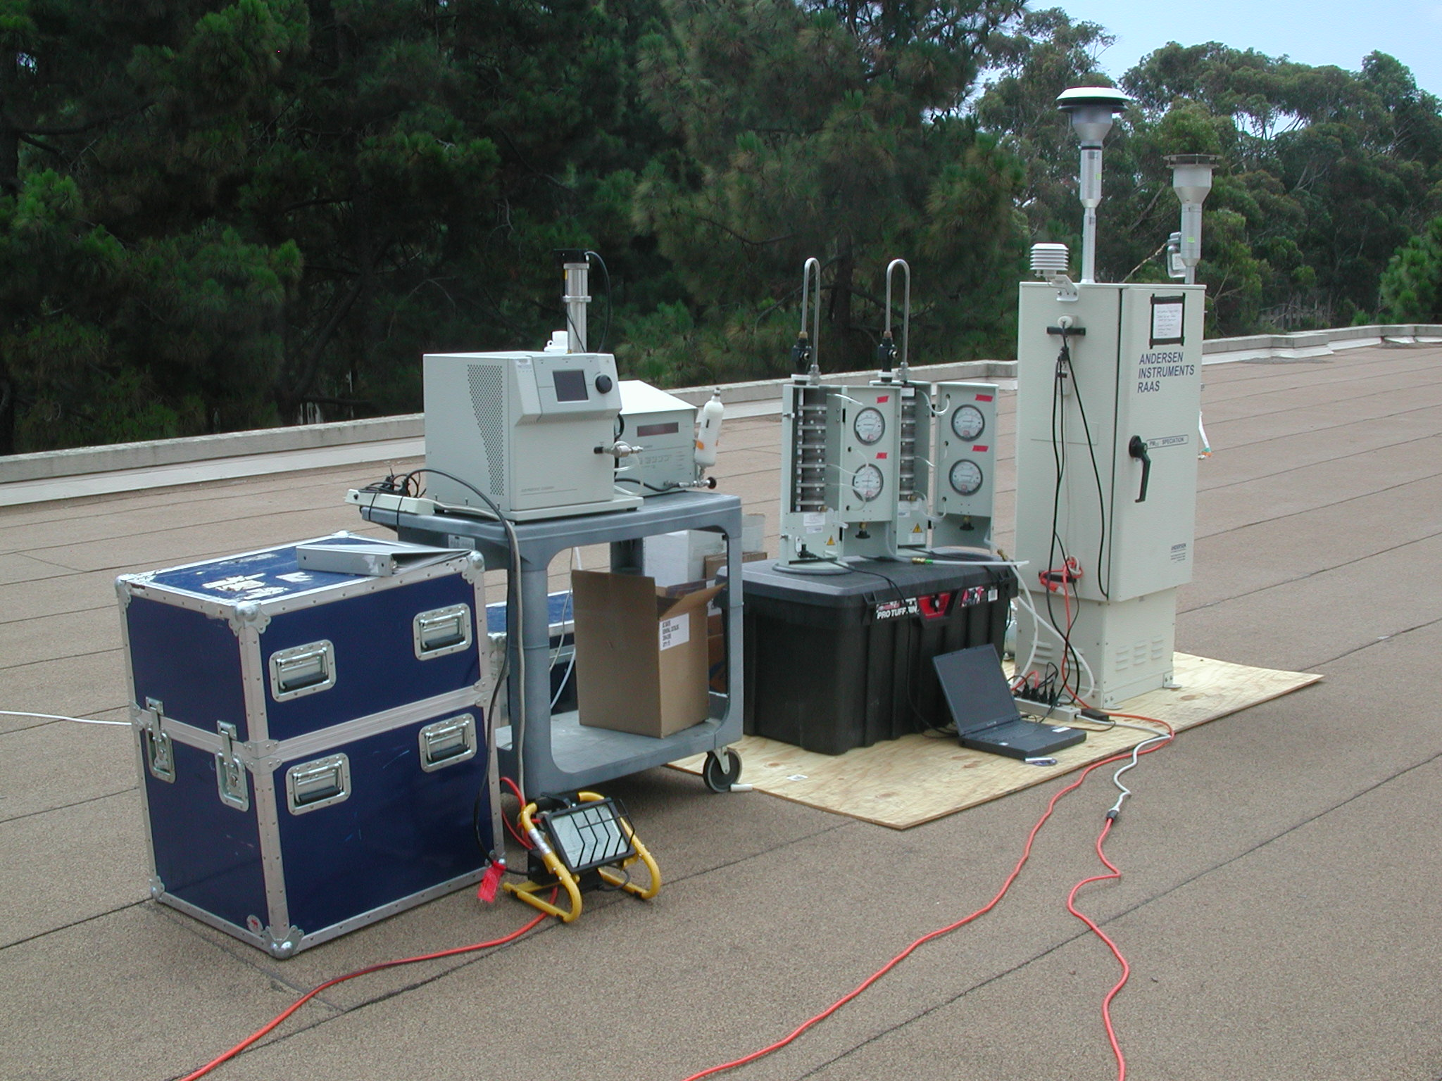
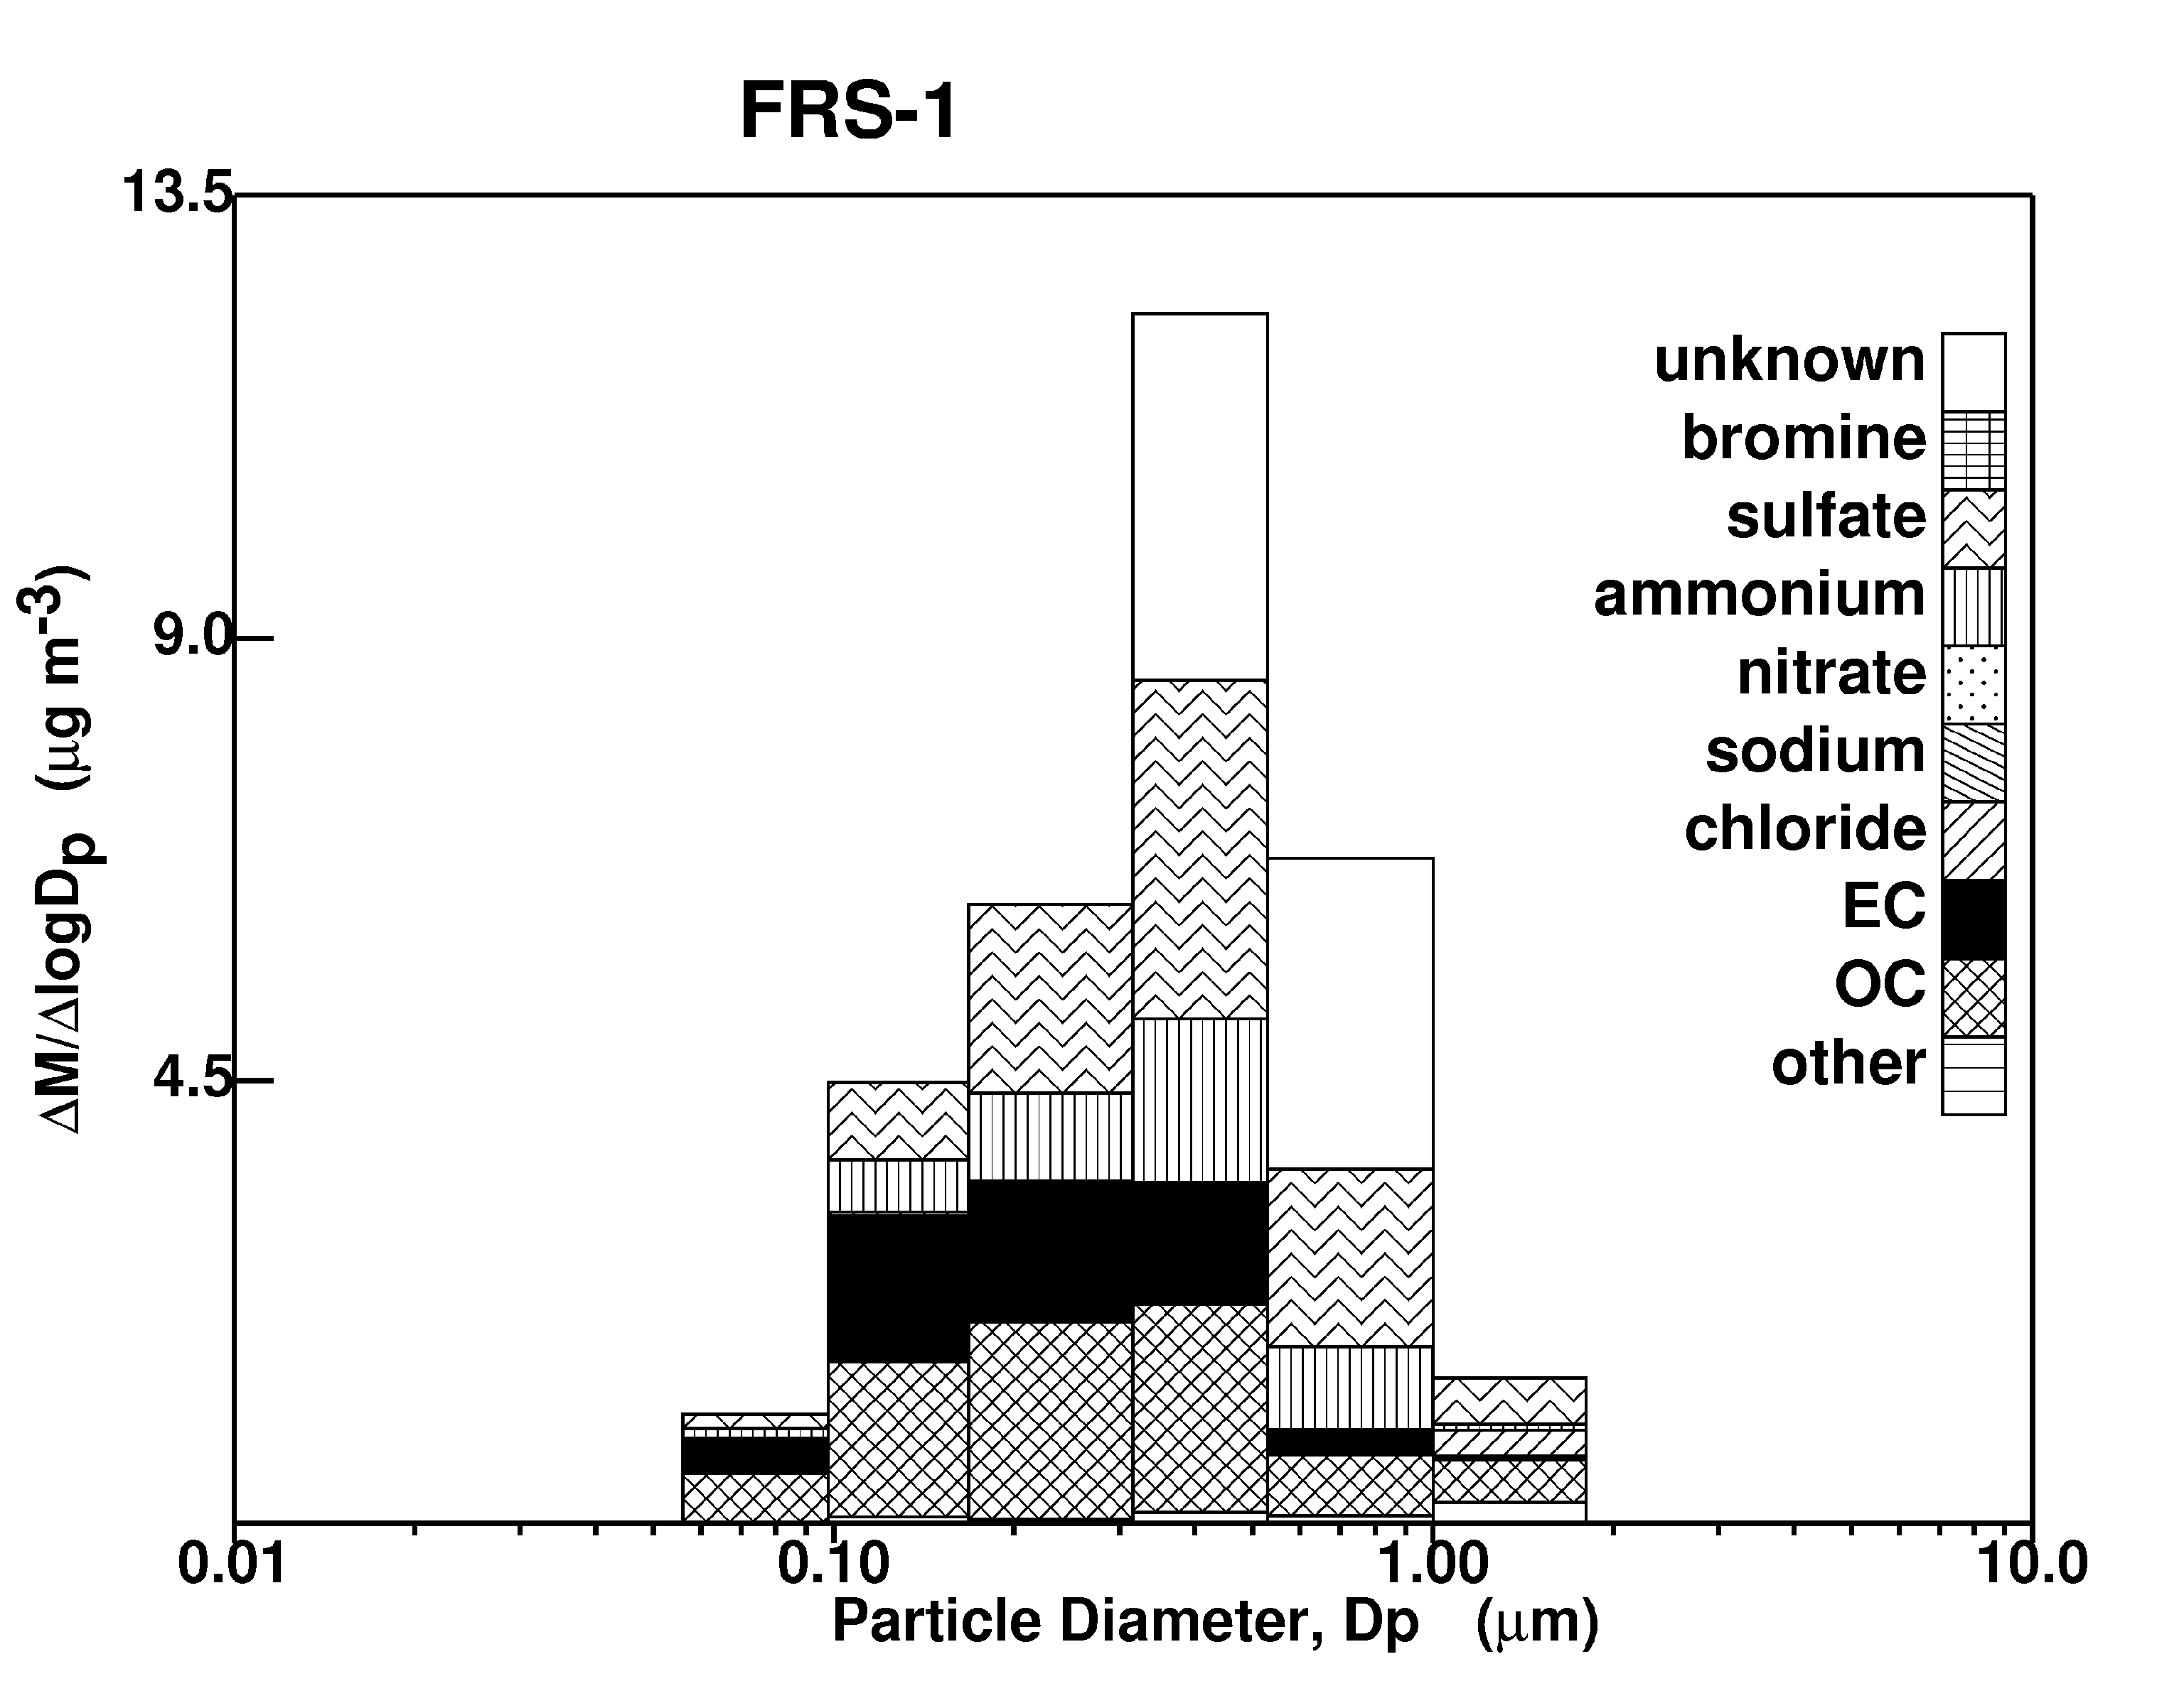
Typical Atmospheric Aerosol Size Distribution below 1 μm Measurements from Fresno CA

Slide 3
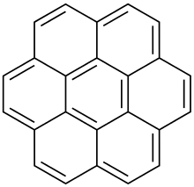
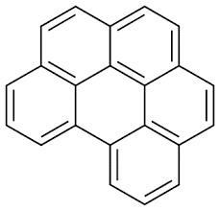
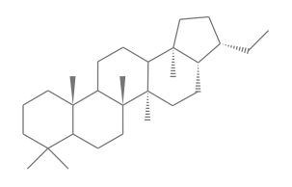
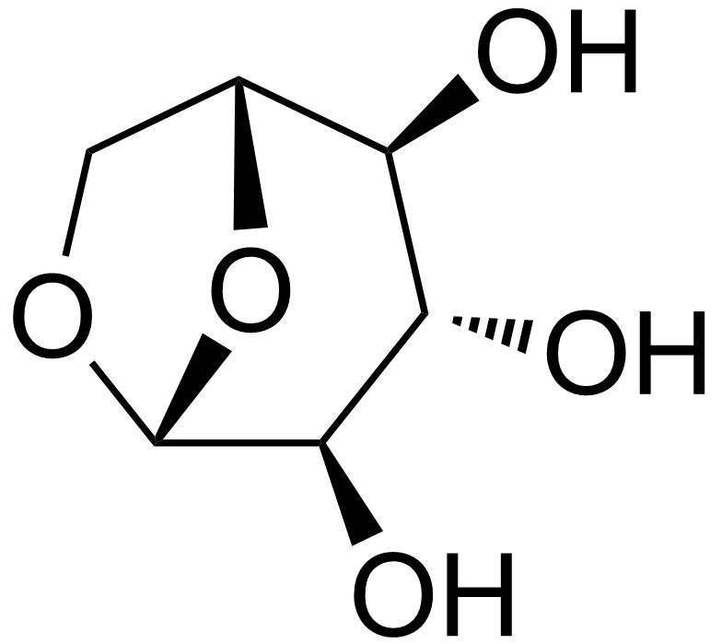
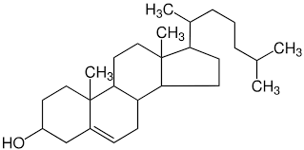
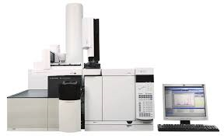
Molecular Markers for Particles < 100 nm
coronene
benzo(ghi)perylene
17α21β-norhopane
levoglucosan
cholesterol

Slide 4
PM0.1 Chemical Mass Balance Source Apportionment Results in 2016

Slide 5
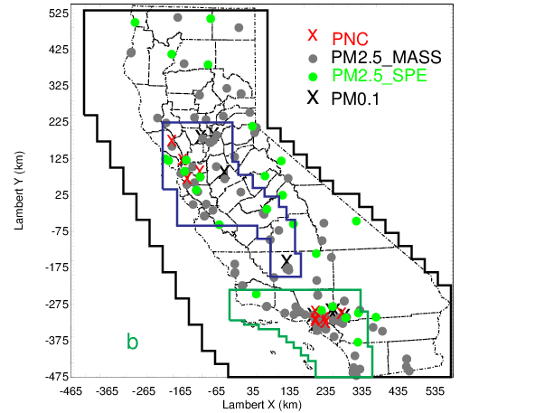
PM0.1 Regional Chemical Transport Models
$$\left.\frac{∂C_{i}}{∂t}+∇∙uC_{i}=∇K∇C_{i}+E_{i}−S_{i}+R_{i}^{gas}\left(C\right)+R_{i}^{part}\left(C\right)+R_{i}^{phase}(C\right)$$
UCD/CIT air quality model
SAPRC11 chemistry
2-product SOA
ISORROPIA thermodynamics
WRF meteorology
CARB Emissions Inventory
MEGAN biogenic emissions
GFED wildfire emissions
2000-2016
4km spatial resolution
Hourly time resolution

Slide 6
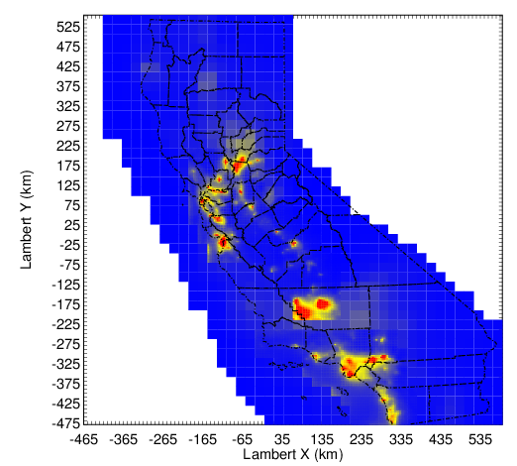
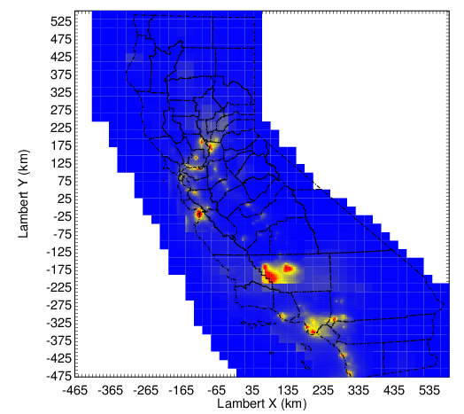
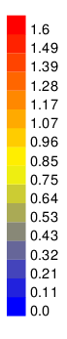
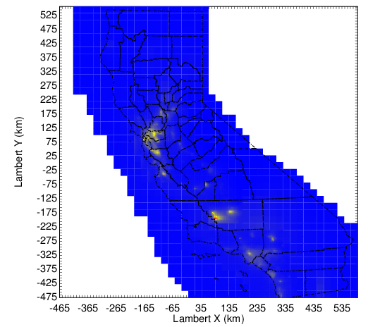

PM_{0.1} OC (µgm⁻³)
2000
2005
2015
2010
2015

Slide 7
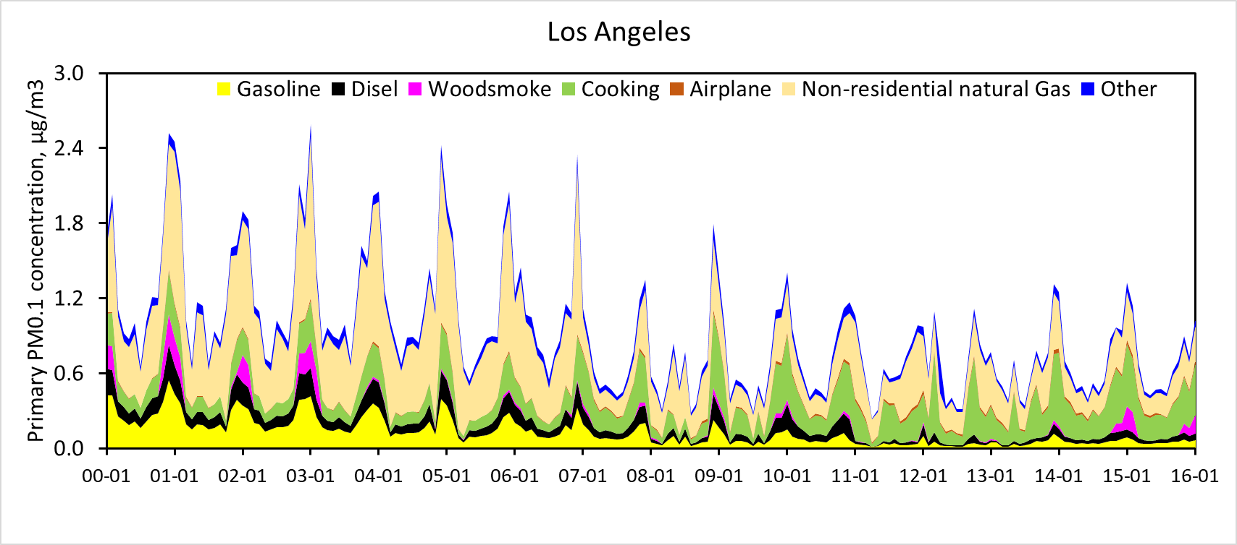
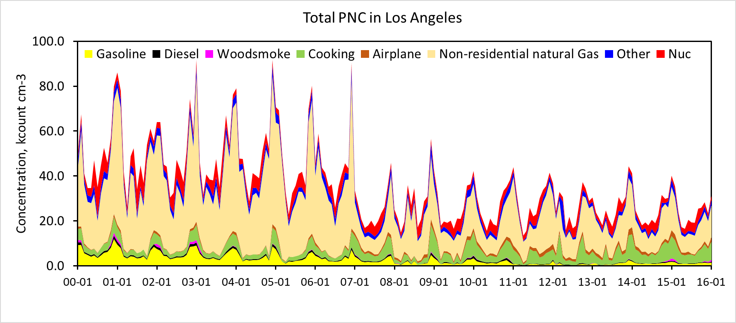
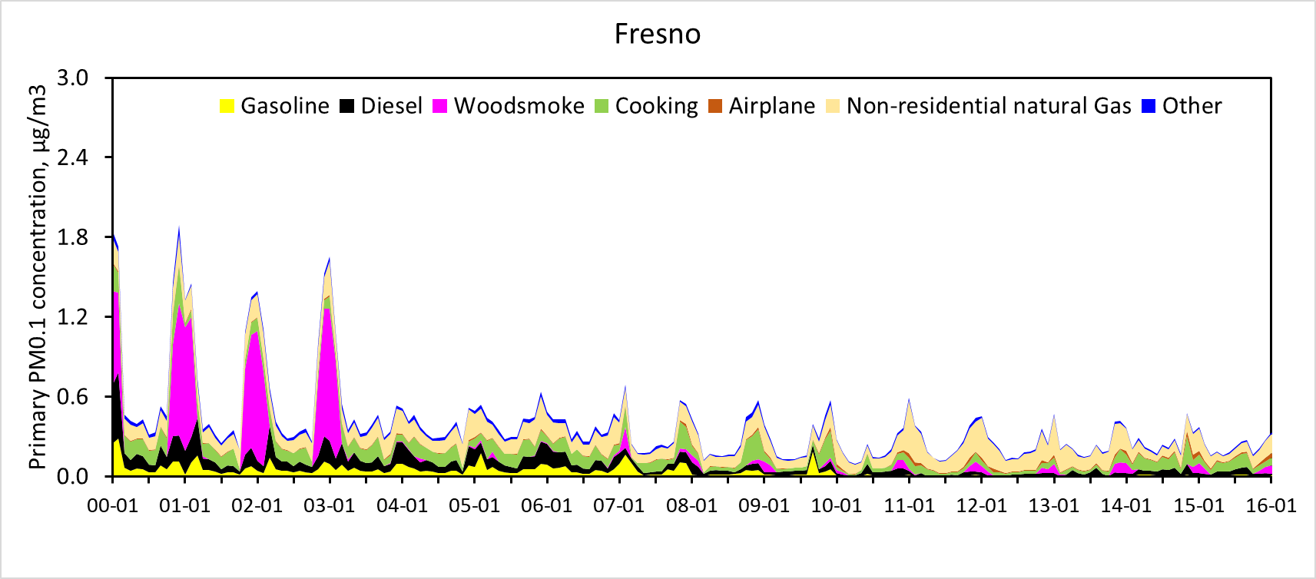
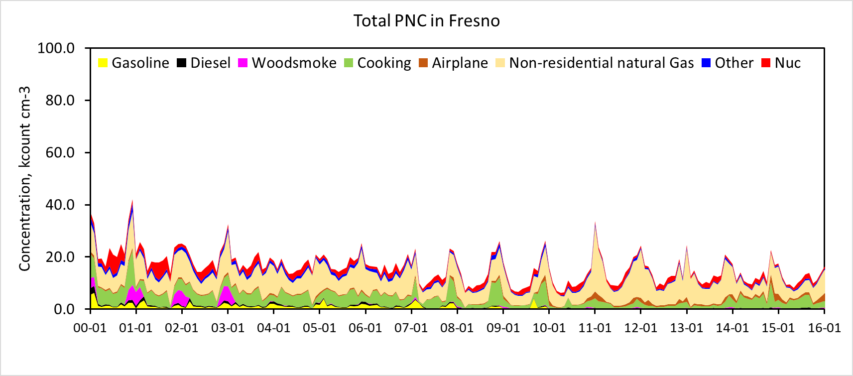
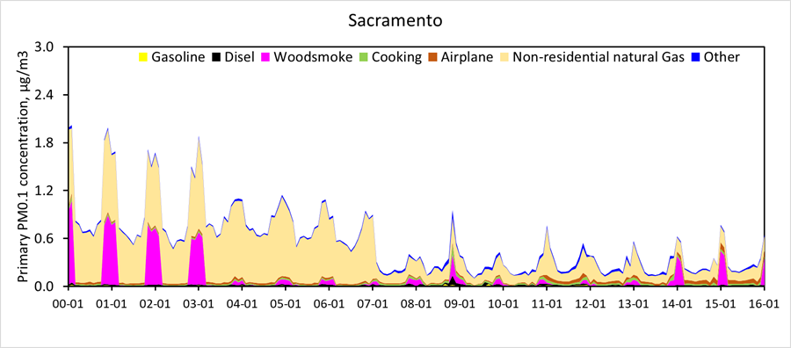
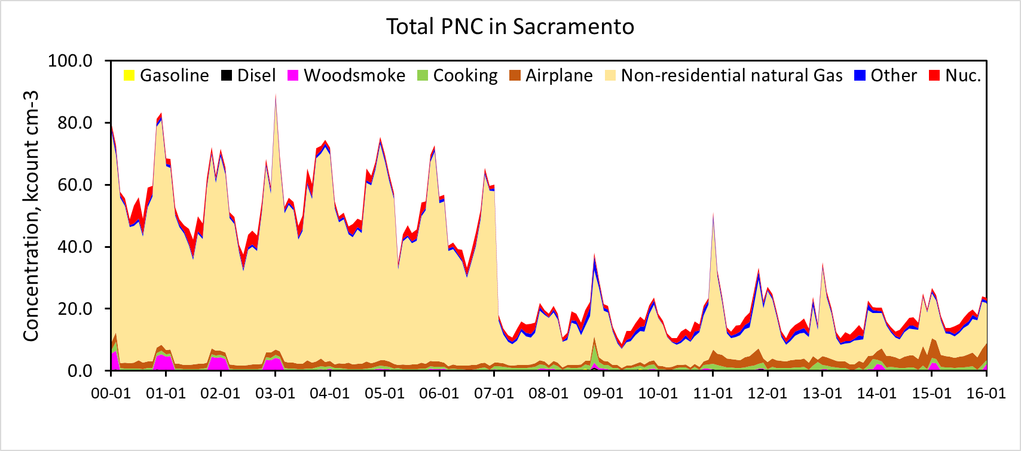
Predicted source contributions to PM_{0.1} and
Particle Number Concentration from 2000-2016
PM0.1 (μg m⁻³)
PNC (k# cm⁻³)

Slide 8
Initial Epidemiological Results: Hazard ratios (HR) and 95% CI for IQRs of association of PM0.1 with Ischemic Heart Disease Mortality
Analysis also indicates that PM0.1 mass and each constituent and source provides better fit of the data than does corresponding PM2.5
Source:2015 B. Ostro, J. Hu, D. Goldberg, P. Reynolds, A. Hertz, L. Bernstein, and M.J. Kleeman. Long-term exposures to fine and ultrafine particles, species and sources: Results from the California Teachers Study Cohort. Environmental Health Perspectives, 123(6), pp549-556.

