Slide 1

The U.S. Department of Energy’s Engineered Nanomaterial Worker Registry: Policy and Challenges
Robin M. Keeler, CIH
United States Department of Energy
Office of Worker Safety and Health Policy (EHSS - AU-11)
2nd QEEN Workshop
October 9, 2018
Notes:
When DOE established in 1977, the Department was responsible for long-term, high-risk research and development of energy technology, federal power marketing, energy conservation, energy regulatory programs, a central energy data collection and analysis program, and nuclear weapons research, development and production.
The Department of Energy had 13,206 employees in 2015
94, 000 contractors

Slide 2
Today’s Talk:
DOE/DOE’s Nanotechnology Safety and Health Policies
Key Points in DOE’s Engineered Nanomaterial Order
The DOE Nano Worker Registry
Challenges
Notes:
DOE’s Role in Nanoscale Research/Adv Technologies
The US DOE is the Nation’s largest sponsor of research in the physical sciences and ranks third among all federal Agencies in support for basic research.

Slide 3
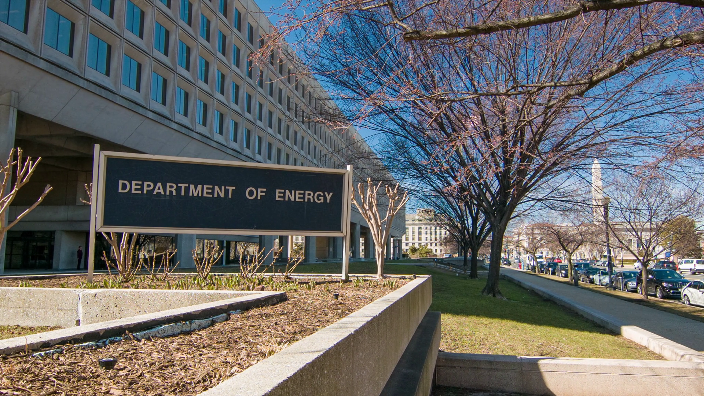
Notes:
Established 1977;
Mission
1. Energy
Catalyze the timely, material, and efficient transformation of the nation’s energy system and secure U.S. leadership in energy technologies.
2. Science and Innovation
Maintain a vibrant U.S. effort in science and engineering as a cornerstone of our economic prosperity with clear leadership in strategic areas.
3. Nuclear Safety and Security
Enhance nuclear security through defense, nonproliferation, and environmental efforts.
4. Management and Operational Excellence
Establish an operational and adaptable framework that combines the best wisdom of all Department stakeholders to maximize mission success.

Slide 4
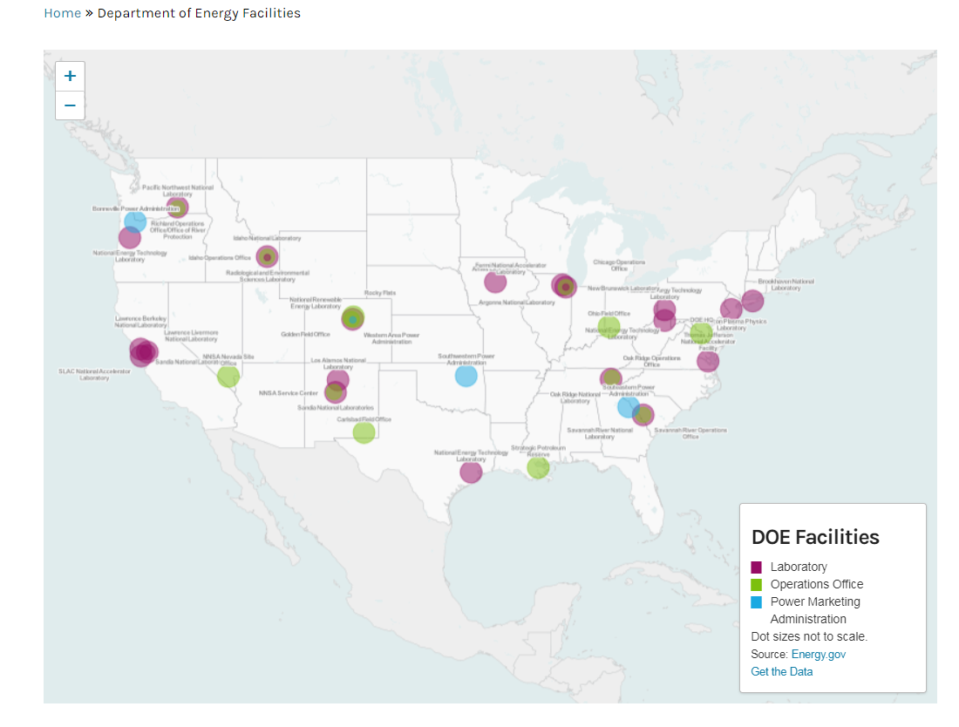
Advanced technologies/nanotechnology research takes place in most of DOE’s National Labs & 5 Nanoscale Science Research Centers
Notes:
DOE’s Role in Nanoscale Research/Adv Technologies
The US DOE is the Nation’s largest sponsor of research in the physical sciences and ranks third among all federal Agencies in support for basic research.

Slide 5
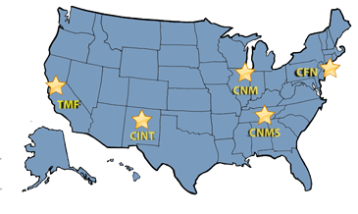
DOE’s Nanoscale Science Research Centers
Center for Functional Nanomaterials
at Brookhaven National Laboratory, New York
Center for Integrated Nanotechnologies
at Los Alamos & Sandia National Laboratories, New Mexico
Center for Nanophase Materials Sciences
at Oak Ridge National Laboratory, Tennessee
Center for Nanoscale Materials
at Argonne National Laboratory, Illinois
The Molecular Foundry
at Lawrence Berkeley National Laboratory, California
  https://science.energy.gov/bes/suf/user-facilities/nanoscale-science-research-centers/
Notes:
BNL: As a user-oriented research center, CFN has the dual mission of: 1) enabling external users to carry out top-quality nanoscience projects; and 2) conducting in-house research to discover, understand, and exploit energy-related nanomaterials. Crucial elements that help address the mission are the CFN’s synergy with National Synchrotron Light Source II (NSLS-II), which delivers world-leading photon brightness and intensity, and the CFN’s essential role in BNL’s Integrated Centers for Energy Science initiative, which enhance impact and effectiveness by integration of resources across BNL. The CFN’s capabilities, organized into seven facilities, allow CFN users and staff to create, characterize, and understand nanomaterials with the most advanced tools and techniques. Two groups address nanomaterials preparation and processing (Materials Synthesis and Nanofabrication), and four focus on advanced characterization and probing, either with electrons (Proximal Probes and Electron Microscopy) or photons (Advanced Optical Spectroscopy and Microscopy and Advanced UV and X-ray Probes). The seventh facility, Theory and Computation, contributes to the elucidation of the structure and properties of nanomaterials. est 2008
The Center for Integrated Nanotechnologies (CINT) began operations in 2006 and is jointly administered by Los Alamos National Laboratory and Sandia National Laboratories . This Center makes use of a wide range of specialized facilities including the Microsystems and Engineering Sciences Applications (MESA) at SNL and the National High Magnetic Field Laboratory at LANL. CINT’s vision is to become a world leading resource for developing the scientific principles that govern the design, performance, and integration of nanostructured materials into the micro and macroscale worlds. This differentiating focus on nanomaterials integration involves the experimental and theoretical exploration of behavior over multiple spatial and temporal length scales, the development of novel synthesis and processing approaches, and an understanding of emergent behavior and new performance regimes.
CINT focus areas are nanophotonics and nanoelectronics, complex functional nanomaterials, nanomechanics, and the nanoscale/bio/microscale interfaces. CINT has been especially successful in creating a growing number of Micro-Electro-Mechanical Systems (MEMS) – discovery science platforms that are readily delivered to users or employed in collaborations with CINT scientists.
Research at CINT over the next decade will support four scientific thrusts:
In-Situ Characterization and Nanomechanics
Brian Swartzentruber, Thrust Leader
Jim Werner, Thrust Co-LeaderDeveloping and implementing world-leading capabilities to study the dynamic response of materials and nanosystems to mechanical, electrical, or other stimuli.
Key integration science challenges include: 1) how defects and crystal distortions alter the electronic and/or mechanical properties in nanostructured materials; 2) how coupling between electronic and mechanical behaviors affect the functionalities of integrated nanostructures; and 3) How we understand and control energy transfer across interfaces and over multiple length scales.
Nanophotonics and Optical Nanomaterials
Steve Doorn, Thrust Leader
Igal Brener, Thrust Co-LeaderSynthesis, excitation, and energy transformations of optically active nanomaterials and collective or emergent electromagnetic phenomena (plasmonics, metamaterials, photonic lattices).
Key integration science challenges include: 1) chemical and physical synthesis of optical, electronic, and magnetic nanomaterials; 2) collective and emergent electromagnetic phenomena (plasmonics, metamaterials, photonic lattices, solitons); 3) multifunctional behavior in hybrid nanostructures comprising optical components; and 4) energy transformations on the nanoscale.
Soft, Biological, and Composite Nanomaterials
George Bachand, Thrust Leader
Peter Goodwin, Thrust Co-LeaderSynthesis, assembly, and characterization of soft, biomolecular, and composite nanomaterials that display emergent functionality.
Key integration science challenges include: 1) designing interfaces and controlling their interactions across multiple dimensions, length- and time-scales; 2) self- and active-assembly of soft and hybrid nanostructured materials; 3) developing new characterization tools and optical probes for detection and imaging; and 4) theory and simulation to understand and predict the behavior of hierarchical structure and dynamics of soft matter systems.
Quantum Materials Systems
Mike Lilly, Thrust Leader
Jinkyoung Yoo, Thrust Co-LeaderThis thrust focuses on understanding and controlling quantum effects of nanoscale materials and their integration into systems spanning multiple length scales.
Key integration science challenges include: 1) elucidating and utilizing interactions between quantum systems and the environment at multiple scales (e.g. quantum sensed nuclear spin resonance); 2) preparing quantum materials in a precisely controlled manner; 3) discovering emergent phenomena in quantum materials under various excitations; and 4) integrating quantum materials in solid-state architectures for application at the macroscale.
Key integration science challenges include: 1) elucidating and utilizing interactions between quantum systems and the environment at multiple scales (e.g. quantum sensed nuclear spin resonance); 2) preparing quantum materials in a precisely controlled manner; 3) discovering emergent phenomena in quantum materials under various excitations; and 4) integrating quantum materials in solid-state architectures for application at the macroscale.
The mission of the NSRCs is twofold: to enable the external scientific community to carry out high-impact nanoscience projects through an open, peer-reviewed user program, and to conduct in-house research to discover, understand, and exploit functional nanomaterials for society’s benefit. To fulfill this mission, the NSRCs house the most advanced facilities for nanoscience research and employ world-class scientists who are experts in nanoscience and enjoy working with external users.
NSRC Facilities The Centers are part of DOE’s contribution to the National Nanotechnology Initiative, and they form an integrated network. These facilities are designed to be the Nation’s premier user centers for interdisciplinary research at the nanoscale, serving as the basis for a national program that encompasses new science, new tools and new computing capabilities. Each Center will focus on a different area of nanoscale research, such as materials derived from or inspired by nature; hard and crystalline materials, including the structure of macromolecules; magnetic and soft materials, including polymers and ordered structures in fluids; and nanotechnology integration (BES).
The Nanoscale Science Research Center (NSRC) Program operates a system of five coordinated Centers located in U.S. Dept. of Energy national laboratories across the United States. Each Center contains laboratories for synthesis and nanofabrication, one-of-a-kind signature instruments, a suite of supporting instrumentation, and theory, modeling, and simulation expertise.

Slide 6




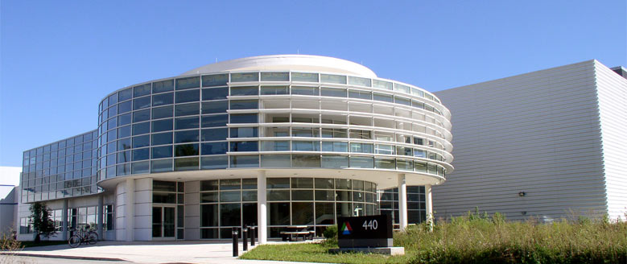
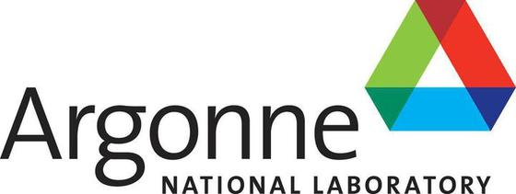


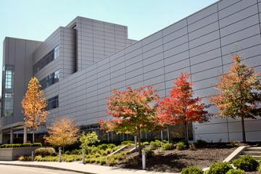

DOE has Five Nanoscale Science Research Centers
Notes:
OR: The Center for Nanophase Materials Sciences (CNMS) at Oak Ridge National Laboratory (ORNL) provides a national and international user community access to expertise and equipment for a broad range of nanoscience research, including nanomaterials synthesis, nanofabrication, imaging/microscopy/characterization, and theory/modeling/simulation. CNMS also acts as gateway for the nanoscience community to benefit from ORNL’s neutron sources (SNS and HFIR) and computational resources. All CNMS facilities and capabilities are accessible based on peer-reviewed proposals and are offered at no cost
ANL: The Center for Nanoscale Materials (CNM) is a DOE Office of Science Nanoscale Science Research Center dedicated to nanoscience and nanotechnology. It was constructed under a joint partnership between DOE and the State of Illinois, as part of DOE’s Nanoscale Science Research Center program.
Argonne’s Advanced Photon Source (APS) plays a key role in the shared CNM/APS Hard X-ray Nanoprobe Beamline, enabling unprecedented views deep within nanomaterials.

Slide 7
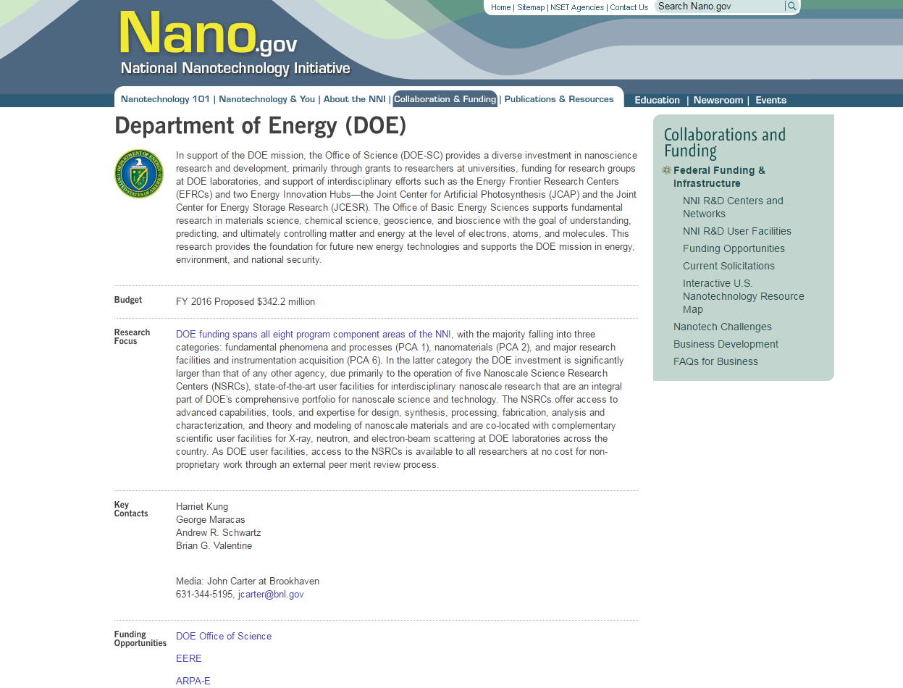
DOE’s Nano Research Budget
FY 2019: $324 million
FY 2000: $47 million
DOE is 3rd largest contributor to NNI budget
Notes:
DOE participates in the NNI, est. in FY 2001. DOE supports Nanoscale Science Research Centers (NSRCs), and has five. HHS(FDA, NIH, NIOSH)/NSF #1 and #2 $$ contributor before DOE
DOE has actively participated in the NNI since its inception. Twenty Federal departments, independent agencies, and commissions 3
FY 2016 Proposed $342.2 million Funding support for nanotechnology R&D stems directly from NNI member agencies, not the NNI.
The National Nanotechnology Initiative (NNI) is a U.S. Government research and development initiative involving the nanotechnology-related activities of 20 departments and independent agencies
DOE funding spans all eight program component areas of the NNI, with the majority falling into three categories: fundamental phenomena and processes (PCA 1), nanomaterials (PCA 2), and major research facilities and instrumentation acquisition (PCA 6). In the latter category the DOE investment is significantly larger than that of any other agency, due primarily to the operation of five Nanoscale Science Research Centers (NSRCs), state-of-the-art user facilities for interdisciplinary nanoscale research that are an integral part of DOE’s comprehensive portfolio for nanoscale science and technology. The NSRCs offer access to advanced capabilities, tools, and expertise for design, synthesis, processing, fabrication, analysis and characterization, and theory and modeling of nanoscale materials and are co-located with complementary scientific user facilities for X-ray, neutron, and electron-beam scattering at DOE laboratories across the country. As DOE user facilities, access to the NSRCs is available to all researchers at no cost for non-proprietary work through an external peer merit review process.

Slide 8
Examples of Nanotech Activities at DOE
R&D scale research projects with CNTs and CNFs
Synthesis of nonporous metal forms
Sample prep of nanomaterials by cutting, slicing, grinding, polishing, etching, etc.
Growth of palladium nanocatalysts
Synthesis of CNTs and metal oxide nanowires onto substrates (within a tube furnace)
Synthesis of aerogels and machining of aerogels for laser target assembly
Nanocrystal synthesis
Sample preparation for accelerator beam line exposure
Vanadium dioxide nanoparticles – windows
Notes:
ANL – window films for energy efficiency

Slide 9
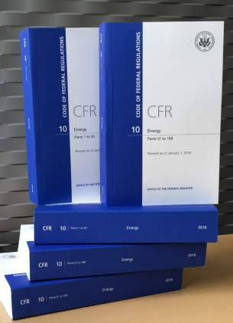
DOE Regulates Their Workers’ Safety and Health
Office of Workers Safety and Health Policy is responsible for the development of WS&H policy for the Department
Federal Rules (e.g., 10 CFR 851)
DOE Directives (Policies, Orders)
Notes:
DOE’s Role in Nanoscale Research/Adv Technologies
The US DOE is the Nation’s largest sponsor of research in the physical sciences and ranks third among all federal Agencies in support for basic research.
THE DOE began addressing work with nanomaterial in 2000; however, the office of WS&H Policy didn’t begin to assess the need for departmental policy until ~2004.
At that time we recognized that we needed to address the issue. As we began the process of developing policy, we met with some resistance for not developing policy.
- fear of developing regs w/o lab input
- no new directives
- adopt national stds as they are approved
- more $ to S&H and less for research
Secretary indicated he wanted Policy in place
We leveraged our stakeholders to utilize their knowledge of nanotech and what policy they felt should be put unto place. This lead to the Policy.
Dept. review and concurrence.

Slide 10
2004: DOE recognized the need to establish some expectations with regard to handling and use of engineered nanomaterials

Slide 11
In 2005:
DOE S&H Bulletin, Good Practices for
Handling Nanomaterials
2. DOE SECRETARIAL POLICY STATEMENT ON
NANOSCALE SAFETY – DOE must be
prudent and follow a cautious approach in
the production, use, and disposition of
nanomaterials

Slide 12
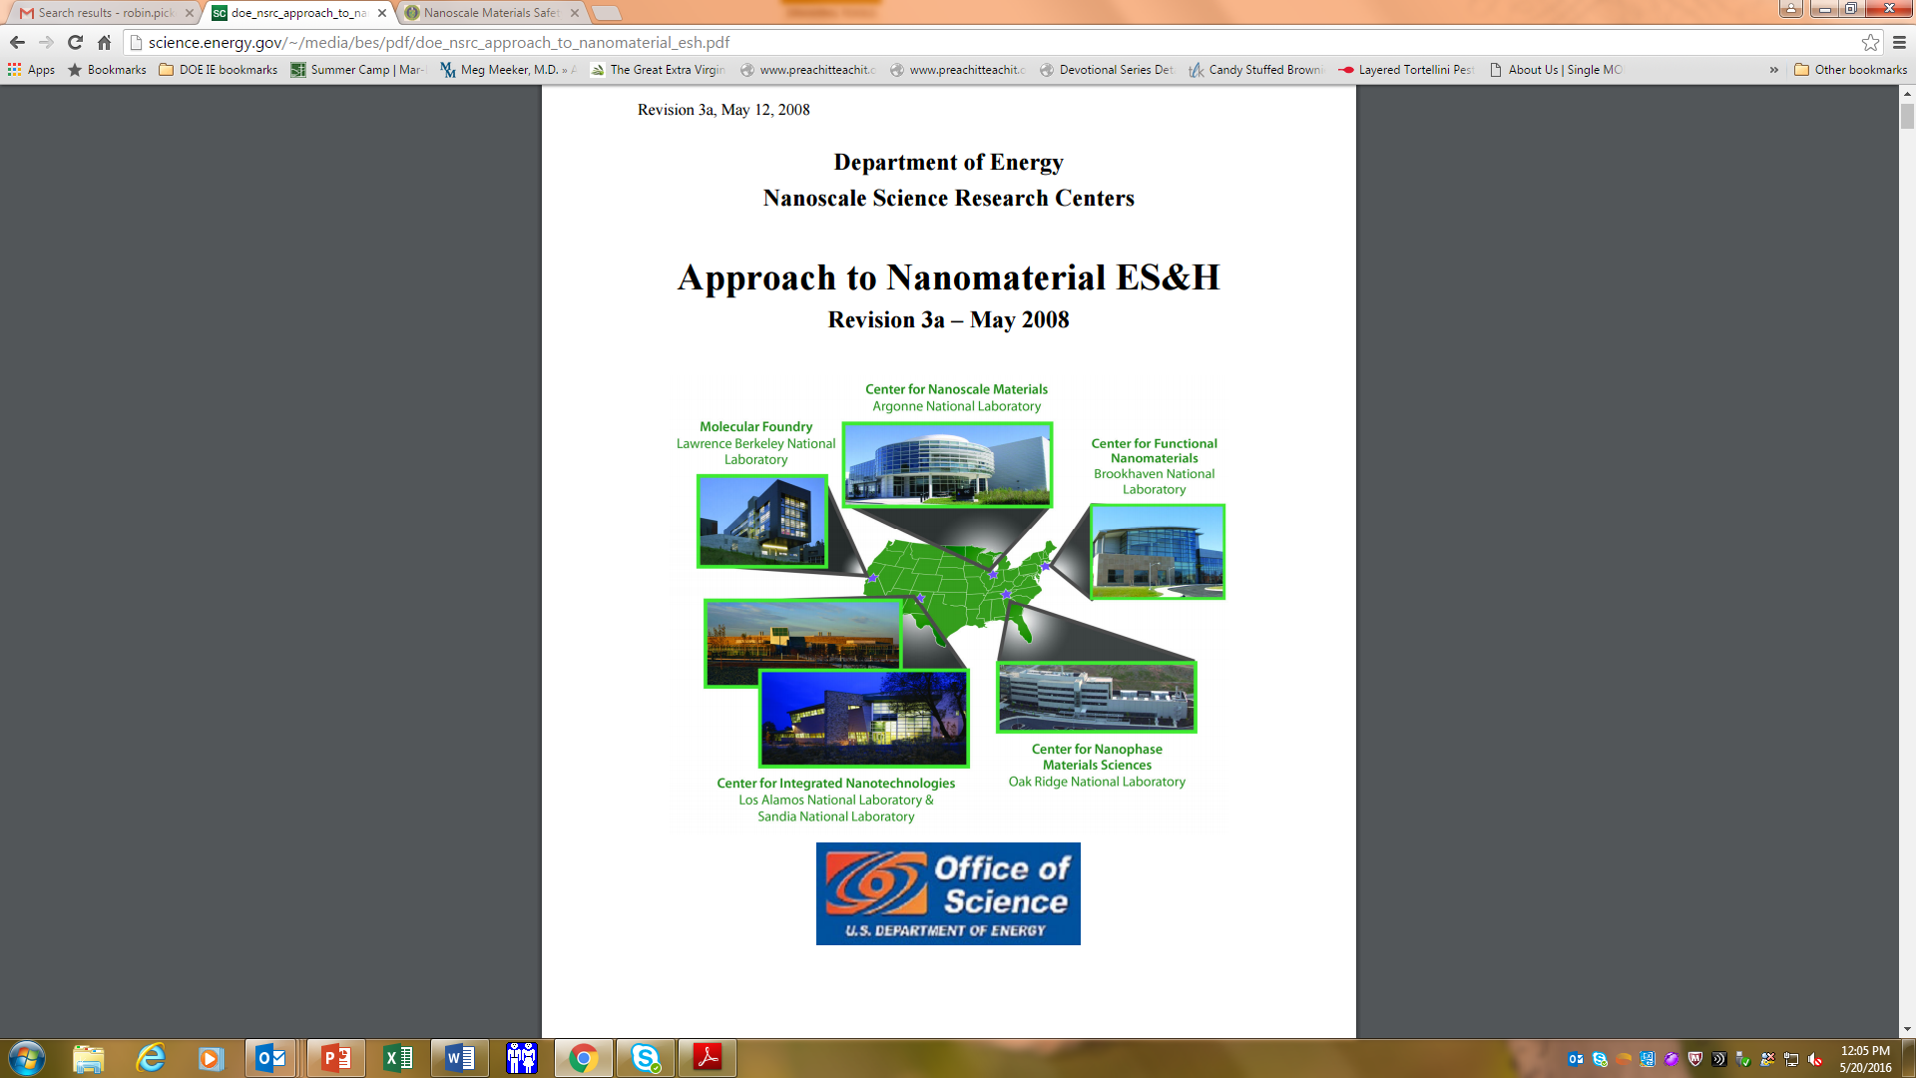
2006: DOE Publishes NSRCs Guidance Document: Approach to Nanomaterial ES&H
Notes:
Did recommend Iding NP workers
Provide baseline and periodic medical eval

Slide 13
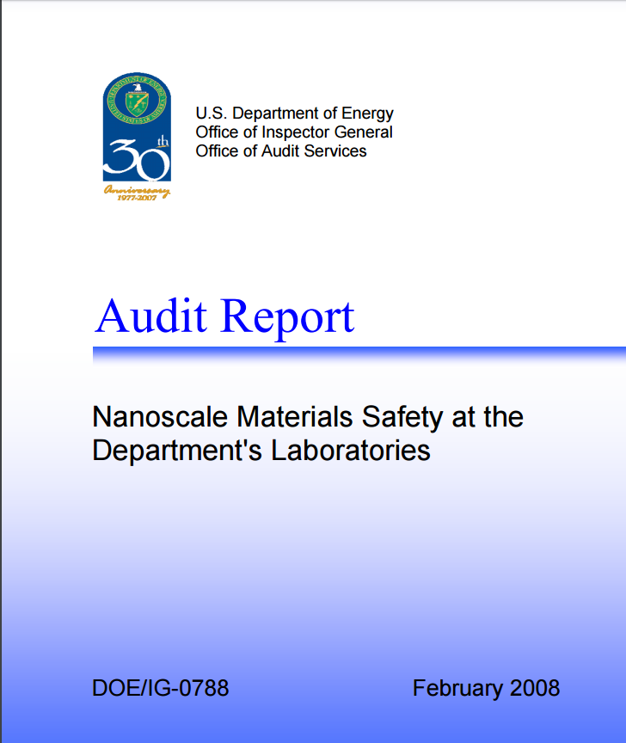
2008: Office of Inspector General Audit Report: DOE labs had not fully adopted nanoscale precautionary measures
The Department should establish clear expectations
for precautionary measures and also should establish
procedures in:
  Medical surveillance
  Exposure monitoring
  Worker training
  Engineering controls
Notes:
Areas of Focus:
Perform medical surveillance on individuals working with these materials;
Monitor the workplace environment for exposure to airborne nanoscale materials;
Provide specific training in the safe handling of nanoscale materials; and,
Require that nanoscale materials research be performed in facilities equipped with all of the suggested engineering health and safety controls
Each separate laboratory was expected by the Department to develop and implement nanoscale protective measures. IG concluded this was not working and that a comprehensive “guidance” across the department should be followed.
IG referenced the NSRC’s Approach to Nanomaterial ES&H, first created in 2006 as guidance
Then we have: DOE Policy (issued 9/15/2005) – recertified every four years, due this year.
DOE N 456.1 (Approved: 1-5-09 , expired one year later)
DOE Order 456.1 5/31/11; admin chg 2013
Revised 2016
Public Law 108-153, 21st Century Nanotechnology Research and Development Act, 15 U.s.c. 7501, assigns DOE the mission of providing the physics, chemistry, and computational tools needed to make nanotechnology possible. In keeping with this mission, DOE supports research activities spanning a broad range of nanoscale activities. These activities are carried out at the Department's five Nanoscale Science Research Centers, as well as at a number of other facilities throughout the complex. The work includes research sponsored directly by DOE, as well as work for others and research conducted by visiting scientists. Following the direction issued in a March 16, 2010, memorandum by Deputy Secretary Daniel B. Poneman in the Department's Safety and Security Reform Plan, the Office of Health, Safety and Security (HSS) established a working group composed of Federal and contractor managers and senior staff and began a review of DOE N 456.1. The recommended change from the Notice to an Order leverages current consensus standards and existing DOE guidance. In addition, the Order will include a strategy for assuming a conservative degree of risk for unknown nanoscale material hazards and will be modeled on Integrated Safety Management prinCiples.

Slide 14
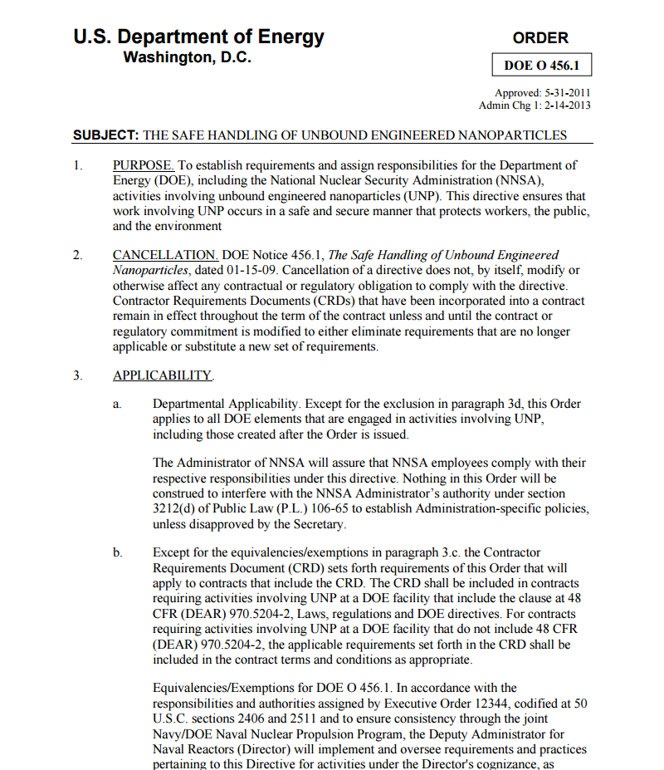
Consequently DOE published Order 456.1, The Safe Handling of Unbound Engineered Nanoparticles
Current Order available at: https://www.directives.doe.gov/directives-documents/400-series/0456.1-BOrder-a
Notes:
N456.1 2009
Order 456.1 2011
Administrative changes in February 2013
Revised 2016

Slide 15
Order 456.1A: Purpose
To establish requirements and assign responsibilities for activities involving unbound engineered nanoparticles (UNP).
This directive ensures that a precautionary approach is utilized to manage UNP whose hazards and exposure data have not been well-defined, and that work involving UNP occurs in a safe and secure manner that protects workers, the public, and the environment.
Notes:
Orders are mandatory, and are incorporated into DOE contracts (CRDs)

Slide 16
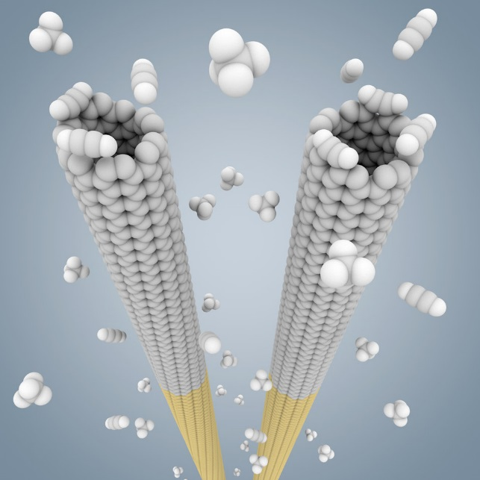
The Order’s Definition of “UNP”
Intentionally created (in contrast with natural or incidentally formed) material with one or more dimensions greater than 1 nanometer and less than 100 nanometers.
NIST
Notes:
ASTM and ISO definitions
Added relevant nanoscale particle types include intentionally produced fullerenes, nanotubes, nanowires, nanoropes, nanoribbons, quantum dots, nanoscale metal oxides, nanoplates, nanolayers, and other engineered nanoscale particles
American Society for Testing and Materials, is an international standards organization that develops and publishes voluntary consensus technical standards for a wide range of materials, products, systems, and services

Slide 17
The Order’s Definition of “UNP”
Nanoscale particles that are not contained within a matrix under normal temperature and pressure conditions;
Particles suspended as an aerosol would be “unbound”
Examples: intentionally produced fullerenes, nanotubes, nanowires, nanoropes, nanoribbons, quantum dots, nanoscale metal oxides, nanoplates, nanolayers, and other engineered nanoscale particles

Slide 18
UNP Worker:
Has the potential for inhalation or dermal exposure to UNP due to performing work with potential exposure to UNP;
Routinely spends time in an area due to performance of regular duties in which engineered UNP have the potential to become dispersed in the air or onto surfaces; or
Works on equipment that might contain or bear UNP and that could release UNP during servicing or maintenance

Slide 19
DOE UNP Registries: Requirements
Maintain a registry of all personnel who meet the Order’s definition of an UNP worker
Use an accessible electronic format
Provide the DOE occupational medicine services provider with a copy of or access to the registry
Update the registry annually, at a minimum
Notes:
Exposure history must be in employees medical record (f medical services are provided) per 10 CFR 851
Nano order requires :
a. Use best available hazard information when conducting an exposure assessment for all activities involving UNP.
b. Establish an air monitoring program for UNP based on preliminary exposure assessments and guidance such as the American Industrial Hygiene Association’s “A Strategy for Assessing and Managing Occupational Exposures.”

Slide 20
Registry must include:
UNP worker name
Job title (at the time of being designated an UNP worker)
A brief description of the UNP
A brief description of the UNP activity
The area in which the activity is located

Slide 21
A Few Reasons to Have a Registry:
Identify the at-risk population
Collect base-line information
Describe the health status of UNP workers
Define priorities for prevention and health research
Evaluate the effectiveness of health and safety programs
Notify participants of research results

Slide 22
A Brief Look at DOE’s UNP Registries
UNP worker registries are not centralized or collected at HQ for analysis
Numbers of workers in the registry varies from a few workers (i.e., 10) to many (i.e., 600)
Some sites break up registries into higher risk and lower risk
Electronic method of collection varies
Some variation on additional information included, but most sites only include what is listed in the Order
Notes:
When exposure is studied as a risk factor for occupational disease, it can be thought of a process of human interaction with a source of a potential hazard such as dry dispersal nanomaterials at various stages in the product development. Harvard School of Public Health considers that this way of thinking leads to the development of exposure assessment methods which capture the characteristics of exposure having physiologic significance for the health effect being studied. Exposure to the nanomaterials used in products in various stages of reaction would reveal the possible cause of the health effects seen in epidemiologic studies of workers. This research is developing a task-centered approach to characterizing exposure by identifying specific work tasks, and the associated exposures with each to evaluate the variability between individual workers, as well as changes in the composition and intensity of exposure over time. In addition to providing better exposure information for classifying workers in epidemiologic studies, the task based approach also helps identify specific operations and activities which make the greatest contribution to exposure for a work task, allowing the development of effective, targeted intervention methods (controls) to minimize exposure.

Slide 23
UNP Workers Offered a Baseline Medical Evaluation
Includes:
An occupational and medical history update;
A physical examination with emphasis on the respiratory system;
Specific medical tests (e.g., spirometry, chest X-ray) deemed appropriate by the occupational medicine provider.
Notes:
“there is insufficient scientific and medical evidence to recommend the specific medical screening of workers potentially exposed to engineered nanoparticles.”2 NIOSH, however, also recommends the continued use of established medical surveillance approaches and the conduct of hazard surveillance. The European Agency for Safety and Health at Work unambiguously noted that, “At present, there is insufficient information on the number of workers exposed to nanomaterials in the work place or the effects on human health of such exposure.”3

Slide 24
Medical Surveillance
At one site – higher risk UNP activities are offered follow-up exams every two years in addition to the baseline exam.
Some sites – all UNP workers receive baselines - it is mandatory
Other sites – UNP workers that receive baseline exam as low as 5% for “uniquely UNP workers”
Notes:
20% b/c of other tasks that require (offered) medical surveillance

Slide 25
Registry Summary
While there are variations amongst DOE labs that use UNPs, i.e., methods of capturing required information, additional information included in the registry, and making the baseline medical exam mandatory, all DOE Labs maintain an UNP registry, update it regularly, & train their workers.
Notes:
Policy can be developed using existing guidelines and recommendations to proactively protect workers
All stakeholders should be included in development
Policy should be reviewed and amended as new info becomes available.
, so they recognize the importance of the registry.

Slide 26
Assess exposures
Collect workplace information – process description, controls and environmental agents present
Collect workforce information – roster, job description, work histories
Define exposure groups
Collect exposure monitoring data
Perform statistical modeling
ID opportunities for prevention
Notes:
Adverse biological effects caused by nanomaterial exposure have been demonstrated using animals and mammalian cell systems. What remain largely obscure are toxicological and mechanistic data regarding human exposure kinetics, dose metrics, the extent of nanomaterial uptake, cellular fate after uptake, and the fate of nanoparticles within the cellular compartments. These knowledge gaps make it difficult to accurately predict the adverse effects on human health.
(M Barrie Synergist 2017)
MEDICAL SCREENING AND HAZARD SURVEILLANCE
Occupational health surveillance can be used to track illness or change in a biological function over time, identify and characterize trends, and define the magnitude and scope of exposure and response. Surveillance can also inform attempts to identify causal associations between exposure and health outcomes for the development of prevention strategies. Integral parts of occupational health surveillance are hazard identifications and surveillance and medical screening. Medical screening focuses on the early diagnosis and treatment of exposed individuals. Identifying and characterizing the exposure and health data over time can lead to implementation of strategies for prevention (substitution, engineering or administrative controls, training).
Interim Guidance from NIOSH
When publishing Current Intelligence Bulletin 60, “Interim Guidance for Medical Screening and Hazard Surveillance for Workers Potentially Exposed to Engineered Nanoparticles,” NIOSH noted that insufficient scientific and medical evidence existed to recommend specific medical screening for the broad categories of materials that are considered ENMs. Instead, NIOSH recommended providing the same screening and surveillance, if any, that would be recommended for the “bulk” or “parent” material. NIOSH also discussed the need for continued in vivo and in vitro toxicological research to identify candidate biomarkers that could be used in medical screening. Importantly, the testing (assays) for these biomarkers as part of a surveillance program should have the requisite sensitivity, specificity, and positive predictive values for viability.
Discovery of novel biomarkers specific for ENM exposure will not only assist in monitoring human exposure to ENMs but will also aid in predicting the short- and long-term adverse biological effects on human health. Application of the components of occupational health surveillance, including hazard and medical surveillance, is critically important in helping to define the magnitude and scope of occupational health risks among those exposed to ENMs.
given the heterogenicity of nanomaterials’ physical and chemical properties, a major challenge will be to identify and validate biomarkers of exposure and effect that apply to all nanomaterials, routes of exposure, and health endpoints. Ethical considerations and issues surrounding informed consent, confidentiality, and potential stigma and discrimination based on surveillance results should also be considered.
Adverse biological effects caused by nanomaterial exposure have been demonstrated using animals and mammalian cell systems. What remain largely obscure are toxicological and mechanistic data regarding human exposure kinetics, dose metrics, the extent of nanomaterial uptake, cellular fate after uptake, and the fate of nanoparticles within the cellular compartments. These knowledge gaps make it difficult to accurately predict the adverse effects on human health.
Recent investigations have identified various biomarkers that implicate potential adverse health outcomes from nanomaterial exposures. A recent assessment of fifteen epidemiologic studies of workers handling nanomaterials found reports of increased markers of biological effects associated with nanomaterial exposures. These included increased systemic inflammation and pulmonary effect markers in sputum, increased pulmonary effect markers in serum, and increased markers of oxidation on nucleic acids, lipids, and proteins.

Slide 27
Past Studies
DOE’s Illness and Injury Surveillance Program (IISP)
Years: 1990 – 2012
Program that collected data from occ med departments at 16 DOE sites
Notes:
EH-53 managed & funded; IISP staff at each site training by ORISE $ from EH; and ORISE analyzed; ORISE maintains the database
CEB at ORISE received DATA – centralized. Like the BE program.
IISP had mechanism - voluntary
The Department of Energy’s (DOE) Illness and Injury Surveillance Program
(IISP) has monitored the health of contractor workers at selected DOE sites since
1990. For the fi rst time, the IISP has suffi cient data to describe, in a collective
manner, the health trends occurring among workers at a number of DOE sites
during a 10-year period. This brief report and the more detailed Worker Health
Summary assess illness and injury trends of DOE workers according to gender,
age, occupational group, and program offi ce over the 10-year period, 1995
through 2004. During this time, over 137,000 individual contractor workers were
employed at the 15 DOE sites participating in the IISP.ms to evaluate potential health issues and outbreaks involving groups of workers; integrated surveillance of NT workers into the existing Iisp: 3 nanocenters already a part of the IISP
Poster in 2012
Looked at ETW before and after classified as such
IISP was defunded in 2012
The IISP was:

Slide 28
Future Studies
Registry can be used for long-term follow-up
DOE already has in place Former Worker Programs
Joint DOE/DOL EEOICPA – difficult to retroactively ID and document employment history and exposure of workers long after their employment has ended;
LL: easier and more cost effective to and more likely to lead to successful worker surveillance if workers provide information that would facilitate follow-up before leaving the NT job.
Central location so that as a worker moves from one site to another, data is not lost.
Notes:
851.24 – APP A 8g2i
Worker medical records maintain ongoing detail regarding a workers occupational history and are potentially available for NT surveillance.
Funding: Dedicated data coordinator (HQ) program computer systems. Transmit data how often – monthly?Active employee rosters updated quarterly.
~ 1 million budget to add 5 new sites to program, 1.5 FTEs

Slide 29
Registry Challenges
Costs/resources
Increased burden for field sites to report data
DOE (HQ) not resourced to handle increase in data flow
Privacy Protections
Not all workers receive baseline/periodic medical evaluations
Defining a nanoparticle
Most exposures are complex
Limitations on measurement technologies
Small sample sizes

Slide 30
Analysis of DOE Emergent Technologies Cohort
Poster in 2012
Looked at ETW before and after classified as such
IISP was defunded in 2012
The IISP was:

Slide 31
More Information & Contacts
Worker Safety and Health Policy:
http://www.energy.gov/ehss/worker-safety-and-health
Dr. Patricia Worthington, Director of the Office of Health and Safety
Patricia.Worthington@hq.doe.gov, 301-903-5926
David Weitzman, Acting Director, Office of Worker Safety and Health Policy
david.weitzman@hq.doe.gov, 301-903-5401
Robin Keeler, Office of Worker Safety and Health Policy
robin.keeler@hq.doe.gov, 301-903-9981

