Slide 1
Emerging Technologies and Advanced Materials: Industry Perspectives on Exposure, Hazard and Risk Assessment
Graphene/Graphene Oxide
Quantum Materials
Angela R. Hight Walker
National Institute of Standards and Technology
Notes:
Collective magnetic excitations—known as spin waves—can display some key properties analogous to optical light
Ground state of the magnet: All spin are aligned.
Excited state of the magnet: one spin is flipped.
Magnon excited state with a lower energy than in (b): Instead of flipping one spin, the net spin reduction is distributed over the whole system. The spins are rotating (precessing) around their equilibrium, forming a magnon.
measurement techniques and theoretical approaches used to explore physical processes associated with the spin-wave propagation in complex nano- and micro-dimensional magnetic structures.
Two magnon at 2ω – still converses momentum because +k – k = 0
on a quantum level, our spin-wave chirality is proportional to the difference between left- and right- polarized magnon numbers and propose a linear response theory for the spincurrent-induced nonequilibrium magnon chirality density
Using this method, we find a conserving pseudoscalar, which is equivalent to Lipkin’s zilch [4] in antiferromagnetic materials and which we propose as a measure of chirality for spin-wave excitations.
The great strength of Raman scattering
is that it allows the direct observation of lattice, magnetic, and electronic excitations,
and thereby the interplay of these quantities in strongly correlated electron
systems can easily be studied.
2.1

Slide 2
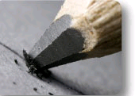
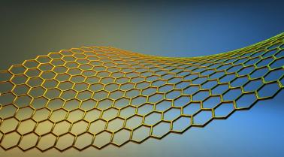
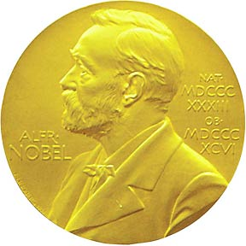
Graphene
Superior Electrical Properties
highest intrinsic mobility (100 times more than in Si)
highest current density at room T (100 times of copper)
longest mean free path at room T (micron range)
lightest charge carriers (zero rest mass)
record thermal conductivity (outperforming diamond)
Geometrical Properties
thinnest imaginable material
largest surface area (~2,700 m² per gram)
Mechanical Properties
strongest material ‘ever measured’ (theoretical limit)
most stretchable crystal (up to 20% elastically)
completely impermeable (even He atoms cannot squeeze through)
What is it?
ISO/TS 80004-13
ISO TC229
Nanotechnology
3.2.1
graphene
graphene layer
single-layer graphene monolayer graphene
single layer of carbon atoms with each atom bound to three neighbours in a honeycomb structure
Note 1 to entry: It is an important building block of many carbon nano-objects.
Note 2 to entry: As graphene is a single layer, it is also sometimes called monolayer graphene or single-layer graphene and abbreviated as 1LG to distinguish it from bilayer graphene (2LG) and few-layered graphene (FLG).
Note 3 to entry: Graphene has edges and can have defects and grain boundaries where the bonding is disrupted.
[SOURCE: ISO/TS 80004-3:2010, 2.11, modified – Notes 2 and 3 added]
Geim and Novoselov, 2010 Nobel Prize
Notes:
Collective magnetic excitations—known as spin waves—can display some key properties analogous to optical light
Ground state of the magnet: All spin are aligned.
Excited state of the magnet: one spin is flipped.
Magnon excited state with a lower energy than in (b): Instead of flipping one spin, the net spin reduction is distributed over the whole system. The spins are rotating (precessing) around their equilibrium, forming a magnon.
measurement techniques and theoretical approaches used to explore physical processes associated with the spin-wave propagation in complex nano- and micro-dimensional magnetic structures.
Two magnon at 2ω – still converses momentum because +k – k = 0
on a quantum level, our spin-wave chirality is proportional to the difference between left- and right- polarized magnon numbers and propose a linear response theory for the spincurrent-induced nonequilibrium magnon chirality density
Using this method, we find a conserving pseudoscalar, which is equivalent to Lipkin’s zilch [4] in antiferromagnetic materials and which we propose as a measure of chirality for spin-wave excitations.
The great strength of Raman scattering
is that it allows the direct observation of lattice, magnetic, and electronic excitations,
and thereby the interplay of these quantities in strongly correlated electron
systems can easily be studied.
2.1

Slide 3
“Graphene+” Materials
Notes:
Collective magnetic excitations—known as spin waves—can display some key properties analogous to optical light
Ground state of the magnet: All spin are aligned.
Excited state of the magnet: one spin is flipped.
Magnon excited state with a lower energy than in (b): Instead of flipping one spin, the net spin reduction is distributed over the whole system. The spins are rotating (precessing) around their equilibrium, forming a magnon.
measurement techniques and theoretical approaches used to explore physical processes associated with the spin-wave propagation in complex nano- and micro-dimensional magnetic structures.
Two magnon at 2ω – still converses momentum because +k – k = 0
on a quantum level, our spin-wave chirality is proportional to the difference between left- and right- polarized magnon numbers and propose a linear response theory for the spincurrent-induced nonequilibrium magnon chirality density
Using this method, we find a conserving pseudoscalar, which is equivalent to Lipkin’s zilch [4] in antiferromagnetic materials and which we propose as a measure of chirality for spin-wave excitations.
The great strength of Raman scattering
is that it allows the direct observation of lattice, magnetic, and electronic excitations,
and thereby the interplay of these quantities in strongly correlated electron
systems can easily be studied.
2.1

Slide 4

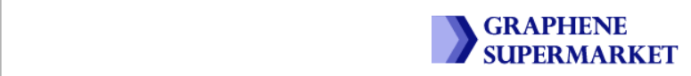
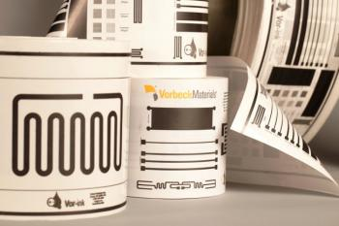
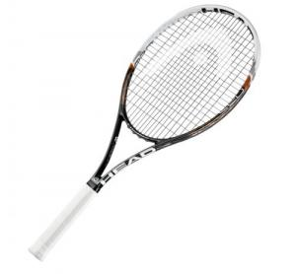
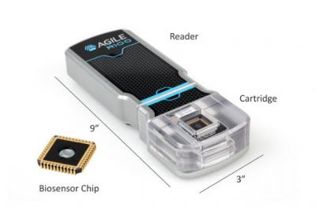


“Graphene+” Industry
touchscreens (for LCD or OLED displays)
transistors
computer chips
batteries
energy generation
supercapacitors
DNA sequencing
water filters
antennas
solar cells
spintronics-related products
Notes:
Collective magnetic excitations—known as spin waves—can display some key properties analogous to optical light
Ground state of the magnet: All spin are aligned.
Excited state of the magnet: one spin is flipped.
Magnon excited state with a lower energy than in (b): Instead of flipping one spin, the net spin reduction is distributed over the whole system. The spins are rotating (precessing) around their equilibrium, forming a magnon.
measurement techniques and theoretical approaches used to explore physical processes associated with the spin-wave propagation in complex nano- and micro-dimensional magnetic structures.
Two magnon at 2ω – still converses momentum because +k – k = 0
on a quantum level, our spin-wave chirality is proportional to the difference between left- and right- polarized magnon numbers and propose a linear response theory for the spincurrent-induced nonequilibrium magnon chirality density
Using this method, we find a conserving pseudoscalar, which is equivalent to Lipkin’s zilch [4] in antiferromagnetic materials and which we propose as a measure of chirality for spin-wave excitations.
The great strength of Raman scattering
is that it allows the direct observation of lattice, magnetic, and electronic excitations,
and thereby the interplay of these quantities in strongly correlated electron
systems can easily be studied.
2.1

Slide 5
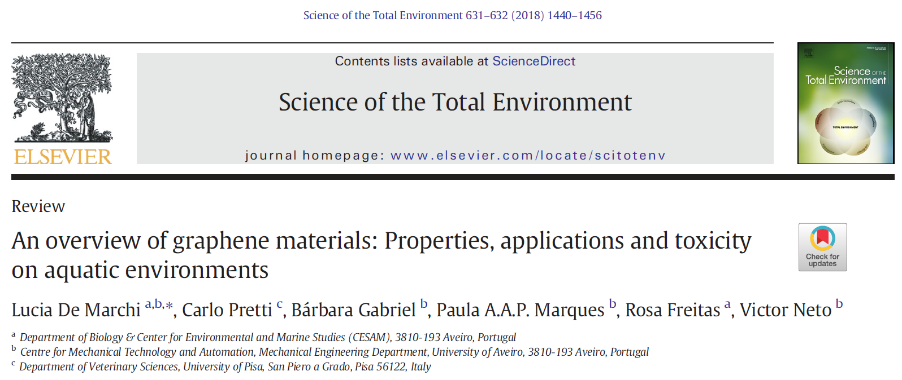
“So far, ecotoxicity of GFMs has been tested on various model and non-model organisms among which bacteria, algae, invertebrates and fish. There are however many questions that still need to be addressed. In fact, many challenges are faced in GFMs studies due to their diversity making difficult to compare the results.”

Slide 6
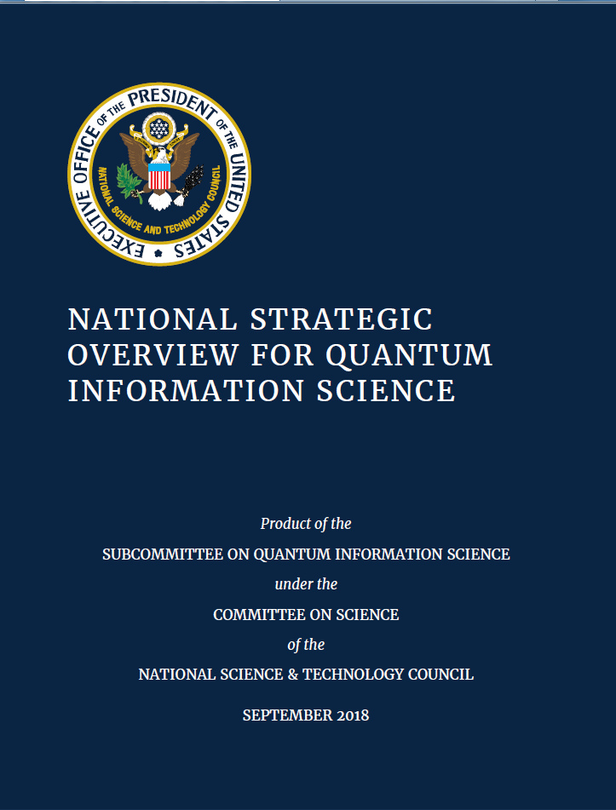
Notes:
Collective magnetic excitations—known as spin waves—can display some key properties analogous to optical light
Ground state of the magnet: All spin are aligned.
Excited state of the magnet: one spin is flipped.
Magnon excited state with a lower energy than in (b): Instead of flipping one spin, the net spin reduction is distributed over the whole system. The spins are rotating (precessing) around their equilibrium, forming a magnon.
measurement techniques and theoretical approaches used to explore physical processes associated with the spin-wave propagation in complex nano- and micro-dimensional magnetic structures.
Two magnon at 2ω – still converses momentum because +k – k = 0
on a quantum level, our spin-wave chirality is proportional to the difference between left- and right- polarized magnon numbers and propose a linear response theory for the spincurrent-induced nonequilibrium magnon chirality density
Using this method, we find a conserving pseudoscalar, which is equivalent to Lipkin’s zilch [4] in antiferromagnetic materials and which we propose as a measure of chirality for spin-wave excitations.
The great strength of Raman scattering
is that it allows the direct observation of lattice, magnetic, and electronic excitations,
and thereby the interplay of these quantities in strongly correlated electron
systems can easily be studied.
2.1

Slide 7
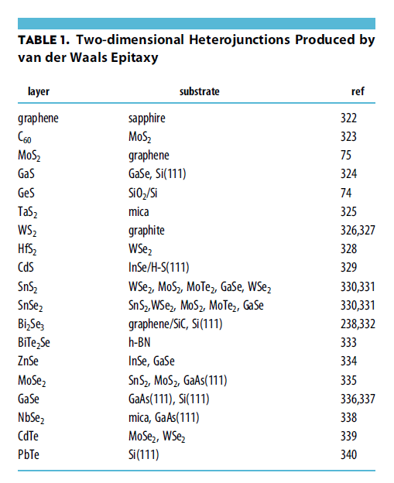
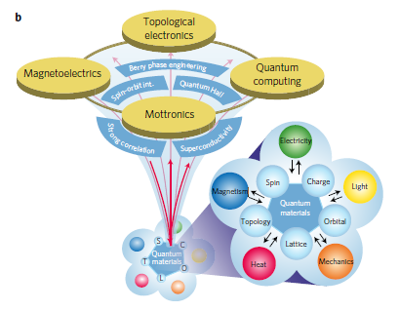
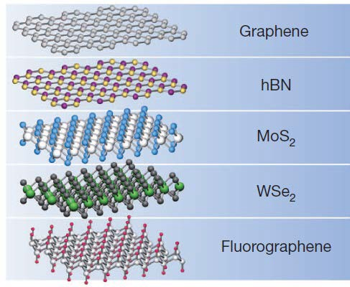
The US Department of Energy (DOE) describes quantum materials as “solids with exotic physical properties, arising from the quantum mechanical properties of their constituent electrons, that have great scientific and/or technological potential.”
Graphene
Conductor
hBN
Insulator
MoS₂
Semiconductor
NbSe₂
Metal
Fluorographene
Insulator
Geim 2013

