Slide 1

Functional assays & nanoinformatics for data sharing
Quantifying Exposure to Engineered Nanomaterials in Manufactured Products (QEEN II)
Wednesday October 10th, 2018
Washington, D.C.
Christine Ogilvie Hendren, PhD
Executive Director, Center for the Environmental Implications
of NanoTechnology (CEINT)
Assistant Research Professor, Civil and Environmental Engineering

Slide 2
The Commons
Notes:
THE WHOLE REASON WE’RE DOING ANY OF THIS IS….

Slide 3
NanoInformatics Knowledge Commons
Notes:
THE WHOLE REASON WE’RE DOING ANY OF THIS IS….

Slide 4

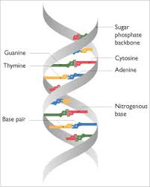
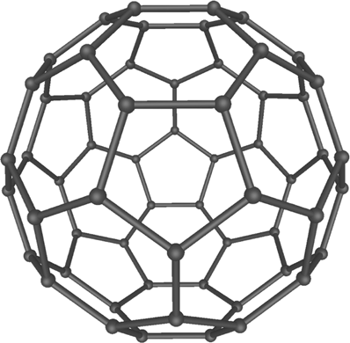

Too early for big data, but critical time for harmonization to generate comparable datasets going forward.
Big Data
Broad Data
Limited number of established parameters
Established protocols
Well understood meta-data
Huge masses of matching datasets
Huge number of possible parameters, inconsistently measured and reported
Complex and disparate meta-data
Masses of mis-matched datasets
Notes:
Problems (too many materials, too many properties, too many material variations, too much proprietary data) sound familiar.

Slide 5
What is needed from nanoinformatics?
Meet data needs of regulators, researchers, and industry
Combine and re-use data
Get these things right:
  Scale
  Sequencing
  Incentives
  Culture of open sharing

Slide 6
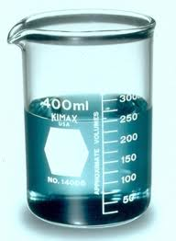


Environmental Complexity: A Necessary Reality
Environmental Systems
Nanomaterials
Nanomaterials
+
Transformations
By-products
Co-contaminants
Effects
Effects
Notes:
Our focus is on RISK, and Risk = Hazard times Exposure
FACT: Exhaustively calculating the risk of all materials, even the sub-set of all nanomaterials is impossible.
THEREFORE: Alternative testing strategies must be employed to allow us to screen, predict, and mitigate risks
One aspect of risk is TOXICITY – (2%(?) of all 70,000 (?) chemicals have exhaustive toxicity tests. Alterative tox testing is necessary, so High Throughput Screening is a good tool for testing many materials against an identical set of biological endpoints to identify those that raise greater or less concern in their pristine form. These are good “hazard screens” if you will. When further developed, perhaps the same assays may eventually be used to test materials with more relevant real-world characteristics down the road.
The other key aspect of risk is EXPOSURE. How much, and exactly what, will the environment and biota be exposed to? These answers depend on the materials and their intrinsic properties, and on the systems into which they are released, and their resulting effects on the materials in terms of system-dependent extrinsic properties.
We already agreed that it would be impossible to calculate the toxicity of all chemicals/nanomaterials. Add this exposure aspect, the transformations, by-products, co-contaminant interactions, etc., and the problem becomes even more intractable. We must therefore intelligently target the RIGHT subsets of materials and environments; this subset must be based on both hazard and exposure information. Reference materials studied in reference systems. We have to get at everything between the lab and what the world actually encounters, study the most relevant and likely transformations in these representative systems, and CEINT is the only center in the world right now doing exactly this with our mesocosms, etc. etc.

Slide 7
How to Address the Complexity?
Collect data
Curators and Researchers Enter Data
…in consistent format
…with consistent language
…to pose new research questions
…to make sure we get enough of the same data that we can compare
…to repositories
App Developers & Researchers Analyze
…to query, combine, compare
?
?
?
…to answer research questions
Notes:
THE WHOLE REASON WE’RE DOING ANY OF THIS IS….

Slide 8
Focus on Shared Methods & Questions
Functional Assay Methods and Data Input Tools for Key Parameters
Environmental Systems
Nanomaterials
+
Dissolution
Rate
Exposure Descriptors
Surface affinity ∝
Dissolution
Other transformations
Established
Developing
UV Reactivity
?
Effects
Parameter modules added one by one via:
  Utilizing existing ontologies & augmenting NIKC dictionaries with new terms only when needed
  Custom template development
Next?
Notes:
With regard to ”next” – this is an example of what we mean by a modular approach. Other partners can/will develop future modules and focal areas as the NIKC grows e.g. release.
Data emerging on release across product life cycle will build on the base module we started with, which include fate and effects

Slide 9
Functional Assays
Intrinsic NM
Properties
Measure
What must you include to define the collective “it” so you can compare it:
Material
Medium
Protocol
Intermediary, semi-empirical parameters that bridge the gap between nanomaterial properties and potential outcomes
Extrinsic NM
Properties
Social &
Engineered
Properties
System
Properties
Functional
Assays
Measure
What does it stick to?
Where does it go?
Fate & Transport
Exposure & Bioaccumulation
Inflammatory Response
Forecast
Biosolubility
Biopersistence
Hazard
RISK
Notes:
What are things we could measure that will tell us how nanoparticles will stick to, move through, change, catalyze, etc., their environments.
Measure those things consistently so we later can back out mechanisms and compare against OTHER systems – perhaps outside lung fluid with other biofluids and abiotic media as well.
Higher attachment efficiency – if it’s stickier – persists
Higher dissolution rates – if it’s releasing ions faster – greater tox

Slide 10
On the NIKC Concept of “Instance”
Temporally Tracking the Path of a Study
Time
“Instance”
Silver powder as received from manufacturer
Silver powder as characterized in house
Silver suspension as prepared for experiment
Silver suspension during experiment:
Raw time series data
What?
Material Properties
Size dist
Size dist
Size dist
ZP
ZP
ZP
Core
Core
Core
Where?
Media Parameters
pH
pH
pH
IS
IS
IS
DOC
DOC
Result?
Functional Assay Measurement?
Exposure Endpoint?
Hazard Endpoint?
Surface Affinity
α

Slide 11
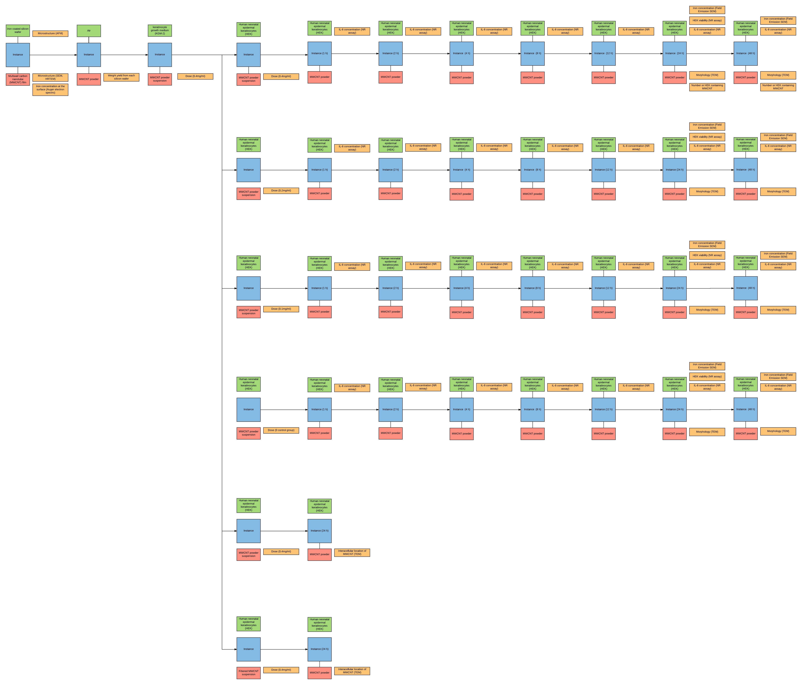
Full Paper Instance Map of Curated Manuscript
Created by Zhao Zhang
NA Monteiro-Riviere et al. Toxicol Lett 155 (3), 377-384. 2005 Mar 15.

Slide 12


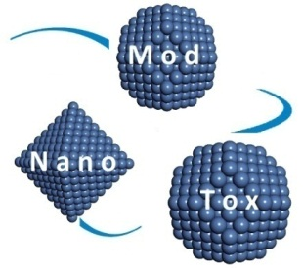
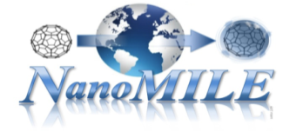
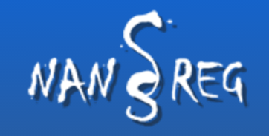

Many Projects, One Repository: A Pilot Integration
Active collaborations: US & EU
External datasets
Expanded dictionaries
Feedback & design reqs
Shared repository
Notes:
Mutually interesting research questions
Desire to avoid parallel public repositories

Slide 13

Premeditated Interoperability Through
Shared Data Curation
Leverage Diverse Datasets
Standard Curation Format
Promote Interoperability
Diverse Data Application
eNanoGrammar
Regulation
Draws on eNanoMapper
Common Dictionary
Fate
Exposure
Risk Assessment
Modelling

Slide 14










Acknowledgments
EU Collaborators
Camille de Garidel-Thoron
Melanie Auffan, Jerome Rose
Claus Svendsen
Marianne Matzke
Iseult Lynch
Tassos Papadiamantis
Joris Quik
Tom van Tuonenbruoek
Egon Willighagen
Nina Jeliaskova
CEINT
Mark Wiesner, Director CEINT
Greg Lowry, Deputy-Director, CEINT
The combined effort of over 150 researchers

Slide 15

Questions?

