Slide 1
Exposure Scenario: Workplace Exposures Kevin L Dunn, MS, CIH National Institute for Occupational Safety and Health Nano and Advanced Materials and Manufacturing Field Team
2nd Quantifying Exposure to Engineered Nanomaterials from Manufactured Products Work Shop
October 9-10, 2018
The findings and conclusions in this presentation have not been formally disseminated by the National Institute for Occupational Safety and Health and should not be construed to represent any agency determination or policy.

Slide 2
12 years in and what do we know?
Traditional industrial hygiene methods can be used to assess potential occupational exposures,
However be careful with data interpretation!
Form matters- Wet is preferred over dry when possible
Engineering control options are available but proper design, installation and maintenance are key in their effective use
Work practices play a large role in exposure potential
PPE is effective against fine and ultrafine particulate
Little evidence of release by mechanical means down stream
Supply chain is a potential weak point in understanding hazard potential
Notes:
We often get questions about nano materials penetrating sampling filters, speciation of particle counts, or relative toxicity of one materials verses another. From an exposure control senarion we cn make things much simpler, avoid unnecessary exposure whenever possible.

Slide 3
Exposure assessment process
Based on Nanomaterial Exposure Assessment Technique (NEAT) 2.0
Collect Basic Workplace Information
Design and Implement the Sampling Plan
Risk Assessment
Risk Management
Notes:
Our exposure process is based on the NEAT 2.0 method. Original NEAT was focused more on emissions of nanomaterial. Since it came out we wanted a more robust sampling strategy with a stronger emphasis on worker exposure to develop a more accurate picture of exposure.
NEAT 2.0 combines traditional industrial hygiene methods and new sampling techniques. I do want to point out that this really is a guideline, and not a prescriptive thing like a NIOSH numbered method. We may go to a site and not perform EM.
NEAT 2.0 is a comprehensive assessment of emission and exposure, and I’ll briefly go through some of the process, with more time spent on implementing the sampling plan. But in general it an evaluation of worker exposures, combined with worker practices, ventilation efficacy, and other engineering exposure control systems and risk management strategies serve to allow for a comprehensive exposure assessment.
The first part is collecting basic workplace information. This would include looking at SDS for print materials, looking at how many workers involved in processes, what is the ventilation setup and engineering controls, frequency, duration of printing, etc.
Then we design and implement a sampling strategy based on that info.

Slide 4
Design and Implement the Sampling Plan
Integrated air sampling
Direct-reading instruments
Sampling strategy
Notes:
Our goal when evaluating exposures to workers is conducting full-shift integrated air sampling, combined with direct reading, real time instrumentation. That combination is the core of our sampling strategy. Full-shift
Task-based
Include non-process areas for process migration

Slide 5
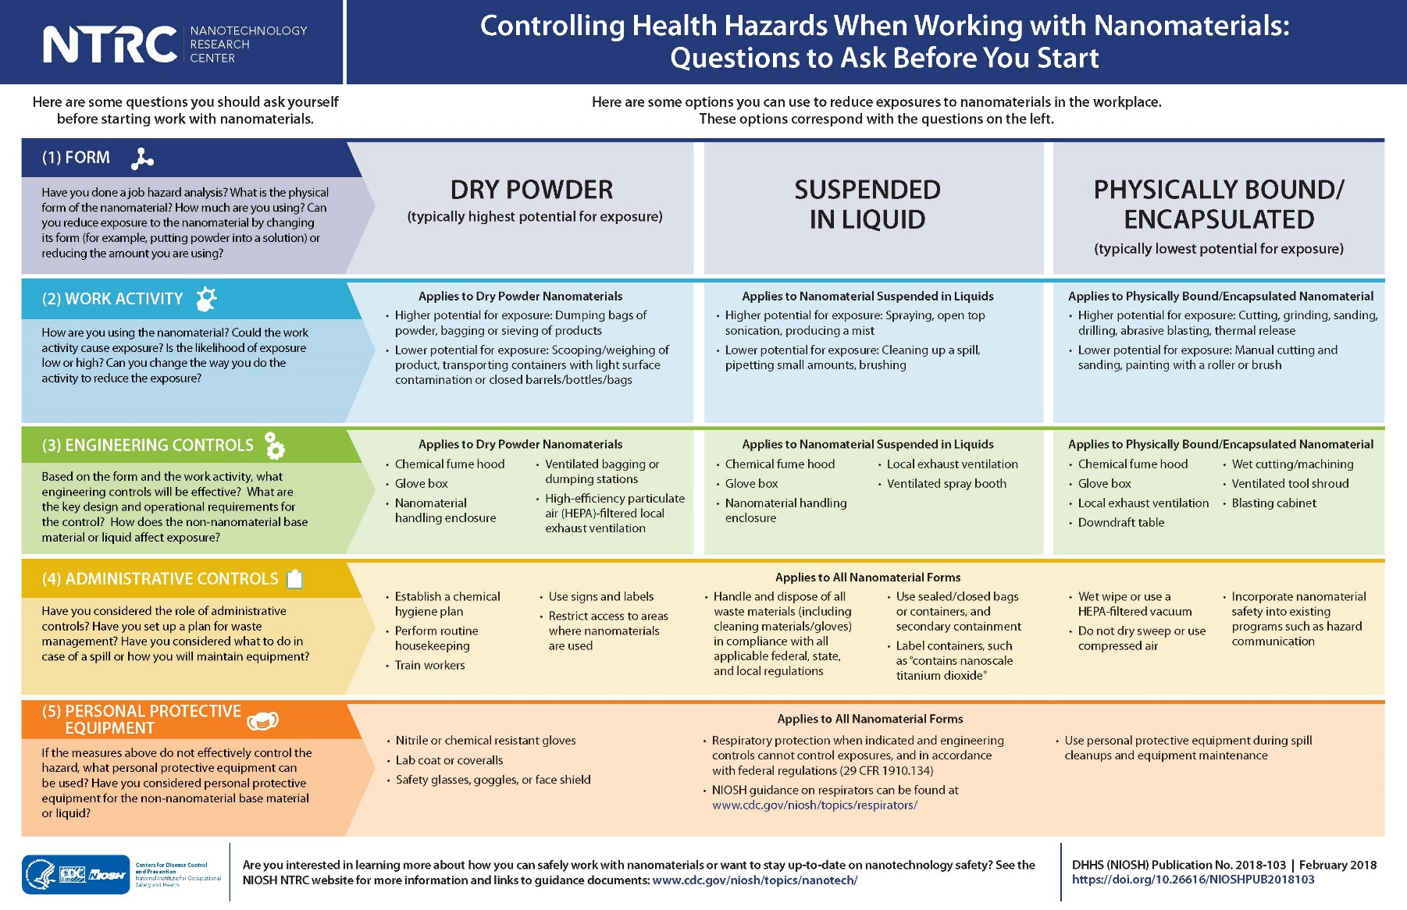
Nano Risk Assessment Tool
Poses questions that employers and workers should consider before starting work with a nanomaterial
For each question, the poster provides options to reduce exposures to nanomaterials based on the physical form
Can be displayed in a lab or work environment
Reminder of the important health and safety considerations for working with nanomaterials

Slide 6
Nano Workplace Design Solutions
Each workplace design solutions document provides key tips on the design, use, and maintenance of exposure controls for nanomaterial production, post processing, and use.
Protecting Workers during the Handling/Weighing of Nanomaterials
Protecting Workers during Nanomaterial Reactor Operations
Protecting Workers during Intermediate and Downstream Processing of Nanomaterials
https://www.cdc.gov/niosh/updates/upd-03-12-18.html

Slide 7
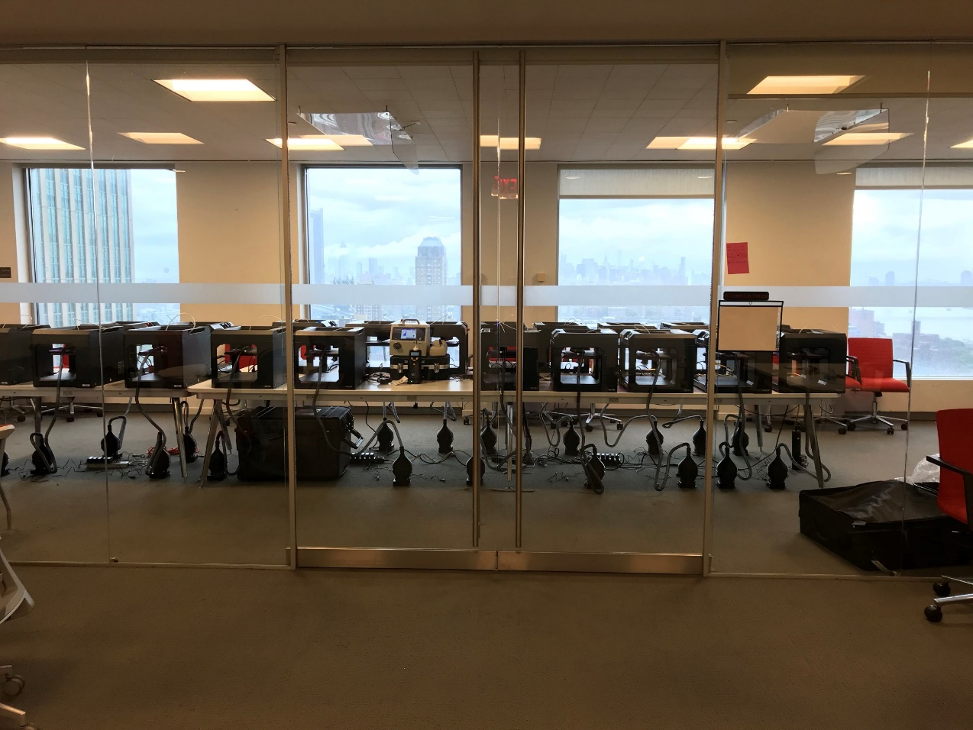
Follow up study at MakerBot Sept 2018 20 MakerBot 3D printers with and without LEV controls
Photo by NIOSH

Slide 8
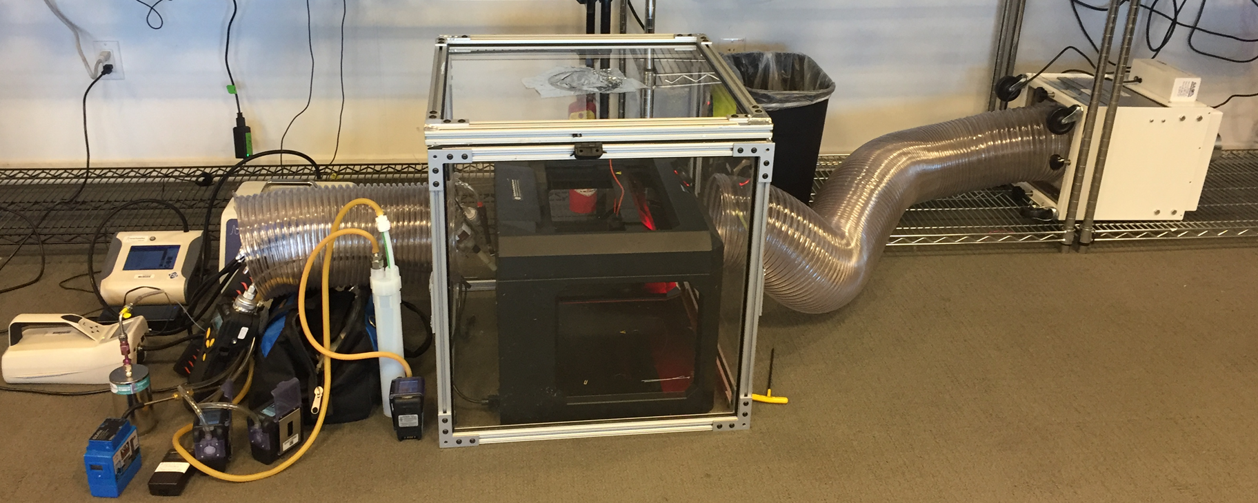
Portable chamber
8 cubic foot (ft³) portable chamber
HEPA-filtered portable floor fan (Model SS-300-PYT, Sentry Air Systems Inc.)
Chamber ventilated at 52 to 55 cubic feet per minute of air (CFM)
Used CPC, DustTrak, OPS, and Nanoscan real-time monitoring instruments as well as filter-based and VOC sampling techniques
Photo by NIOSH

Slide 9
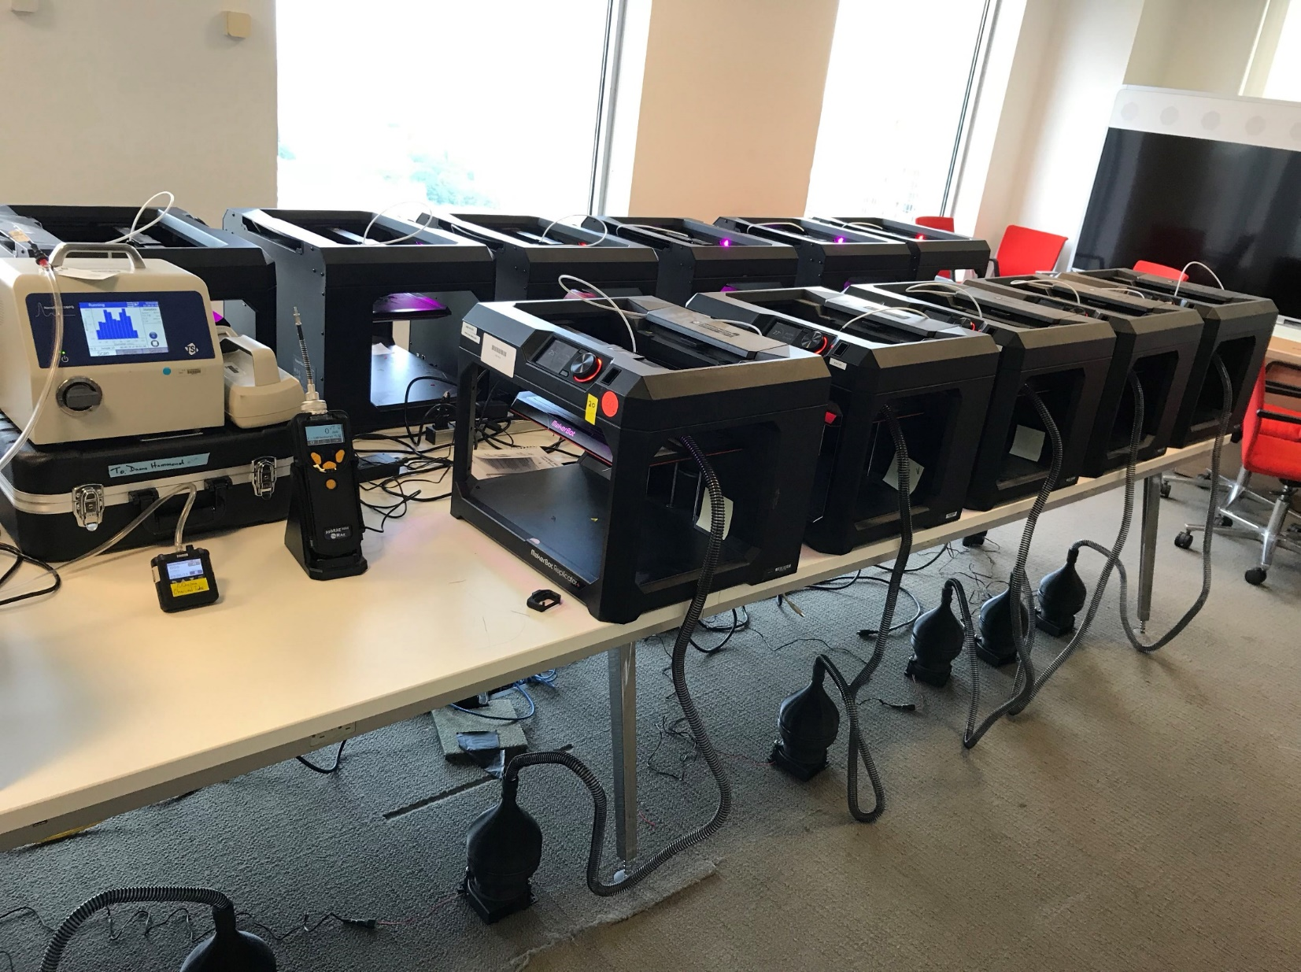
$26 HEPA filter
$10 CPAP hose 6’
$18 radial blower 12V
and 3D printed pieces
Photo by NIOSH

Slide 10
without controls
with LEV controls
without controls
with LEV controls
Notes:
20 Makerbot 3D printers (with and without controls)
8 tests (next slide shows an example of 4 tests)
4 with controls and 4 without as randomized pairs
Slate Gray Tough PLA filament in all tests
Room ventilation measured three times during each test
Between 15-16 air changes per hour during all tests
Instruments
Condensation particle counter (size range 10 nm to 1 um)
Nanoscan SMPS (size range 10 nm to 420 nm)
RAE Systems ppbRAE 3000 (1 ppb to 10,000 ppm) calibrated to isobutylene
TSI Alnor Balometer Capture Hood EBT731

Slide 11
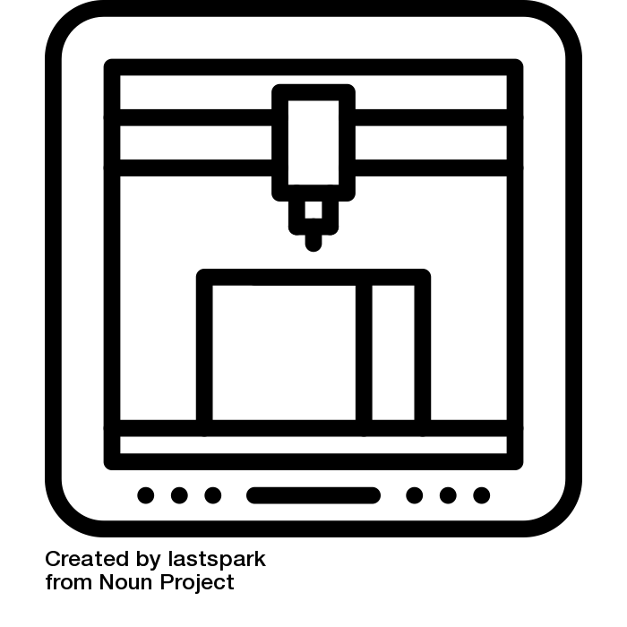
Acknowledgements
NIOSH NTRC
Charles Geraci
Kevin H. Dunn
Duane Hammond
Gary Roth
Laura Hodson
Aleks Stefaniak
Jennifer Tyrawski

