Slide 1
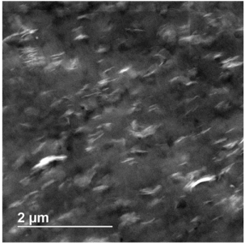
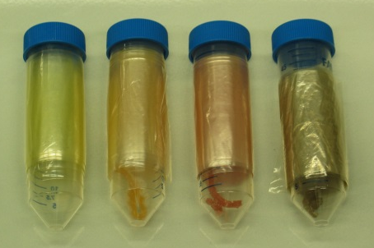
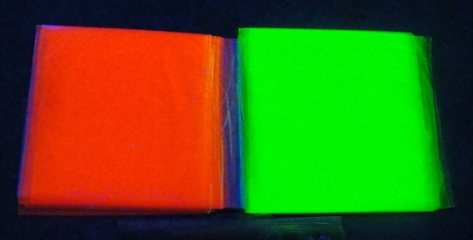
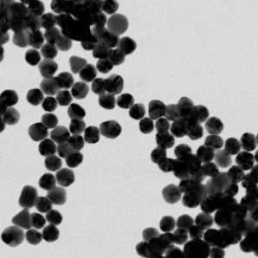
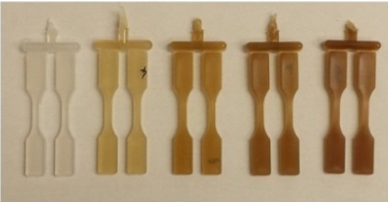

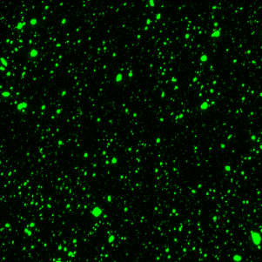
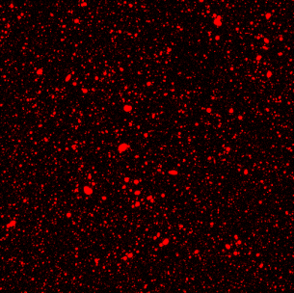
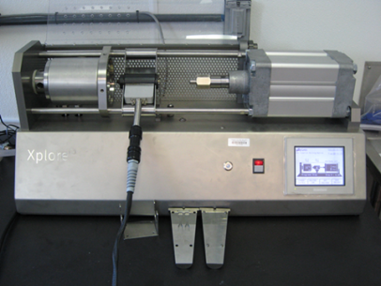
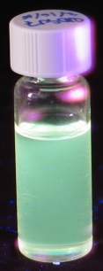
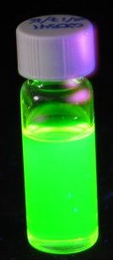
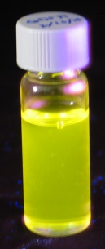
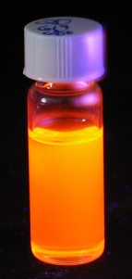
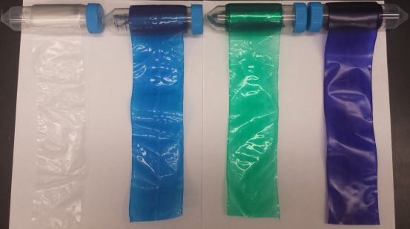
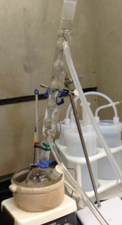
Demystifying dissolution of polymer-embedded nanoparticles: implications for polymer composites intended for use as food contact materials
Timothy V Duncan, PhD
QEEN 2 Workshop, Washington DC, October 2018

Slide 2

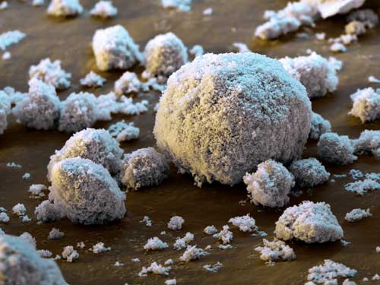
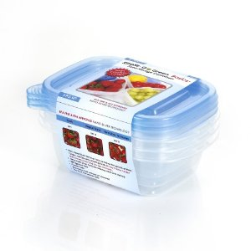
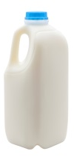


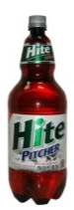
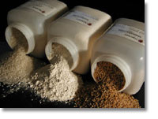
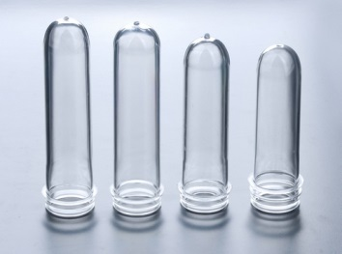



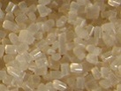
Nanocomposites and food packaging
Sensing Applications
(QDs, AuNPs, etc.)
UV-blockers
(ZnO, TiO₂)
Antimicrobials
(AgNPs, MONPs)
High Barrier Plastics
(Nanoclay, Graphite, etc.)
Anti-Counterfeiting Inks
(Semiconducting NPs)
Processing Aids
(TiN)
www.nanocor.com
Potential worldwide applications; not necessarily authorized in the U.S.

Slide 3
Nanoparticle release mechanisms
Noonan, Whelton, Carlander, Duncan. Compr. Rev. Food Sci. Food Safety. 2014, 13, 679.
Notes:
3

Slide 4


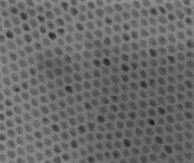
Dissolution as a release paradigm
Host polymer characteristics
Polarity and oxidation
Surface properties
Permeability
Presence of other additives
Density, molecular weight
Processing method
Environmental characteristics
Dispersed particle characteristics
pH
Ionic strength
Composition
Temperature
Light/dark
Humidity
Aggregation state
Capping agent
Size / morphology
Composition
Purity
Age
Notes:
4

Slide 5
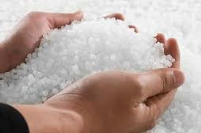
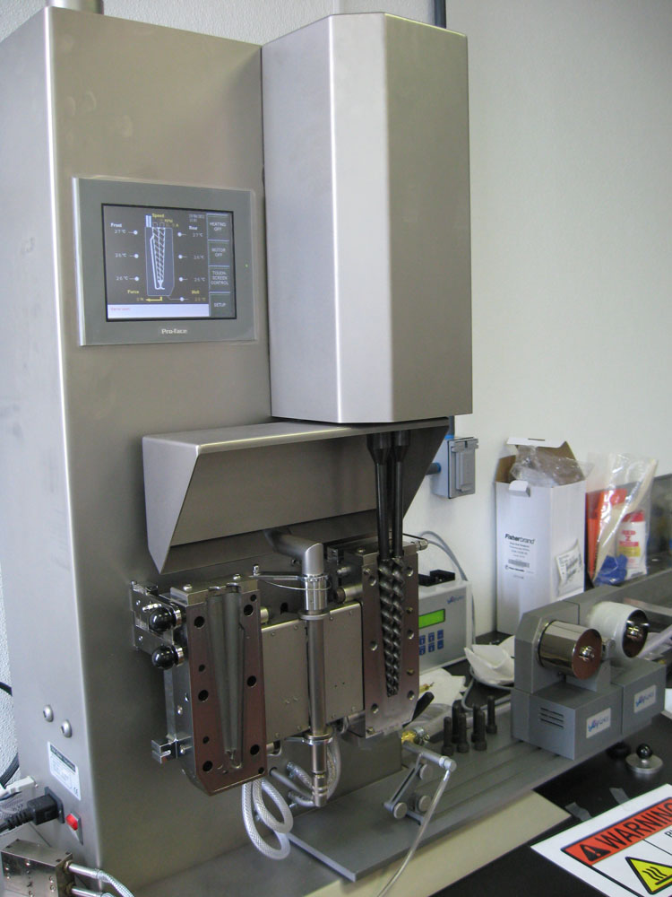
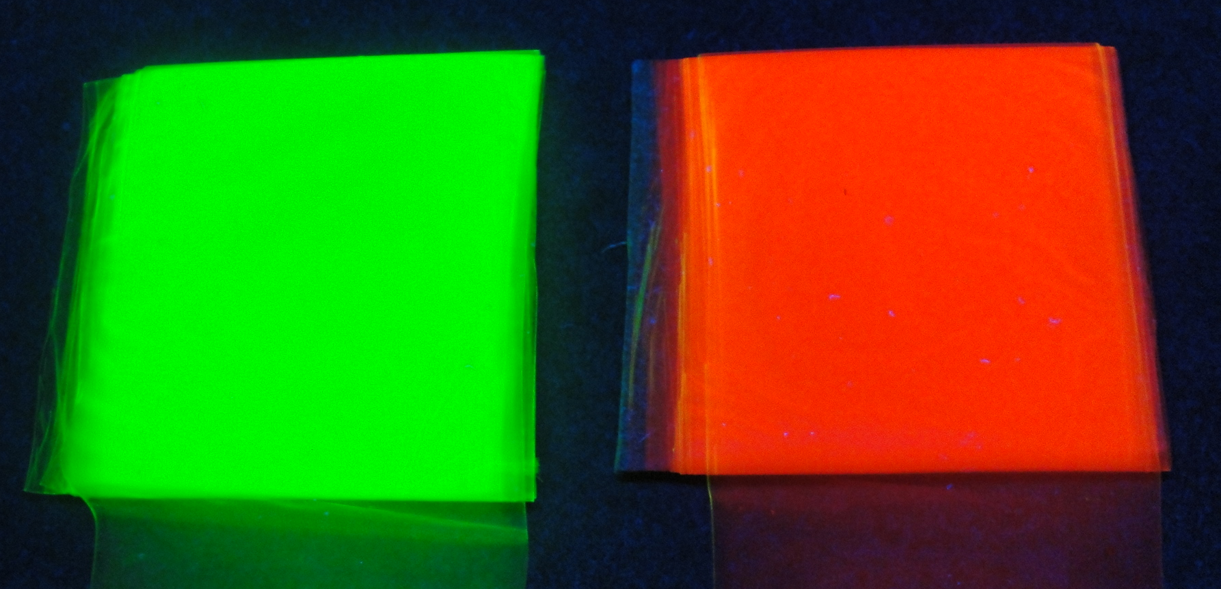
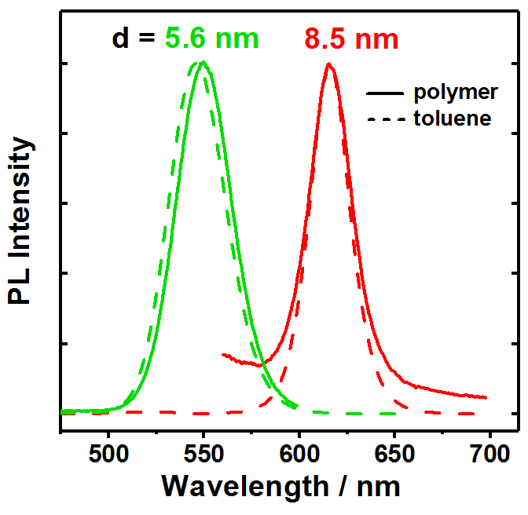

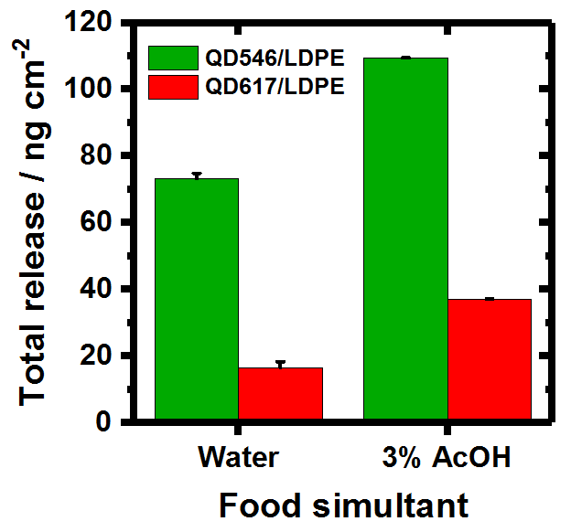
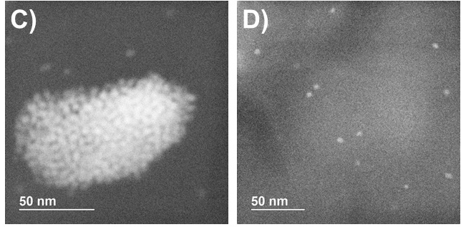
Research strategy
1. System design
2. Materials manufacture
3. Film characterization
Polymer resin
CdSe@ZnS QDs
5. Release experiments
4. Embedded particle characterization
Pillai et al. Environ Sci: Nano 2016, 3, 657-669
Notes:
5

Slide 6
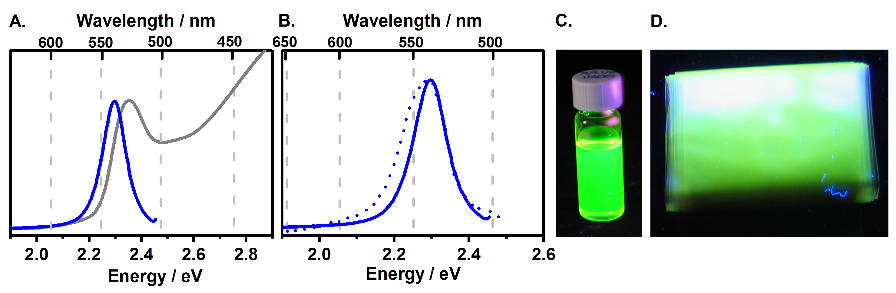
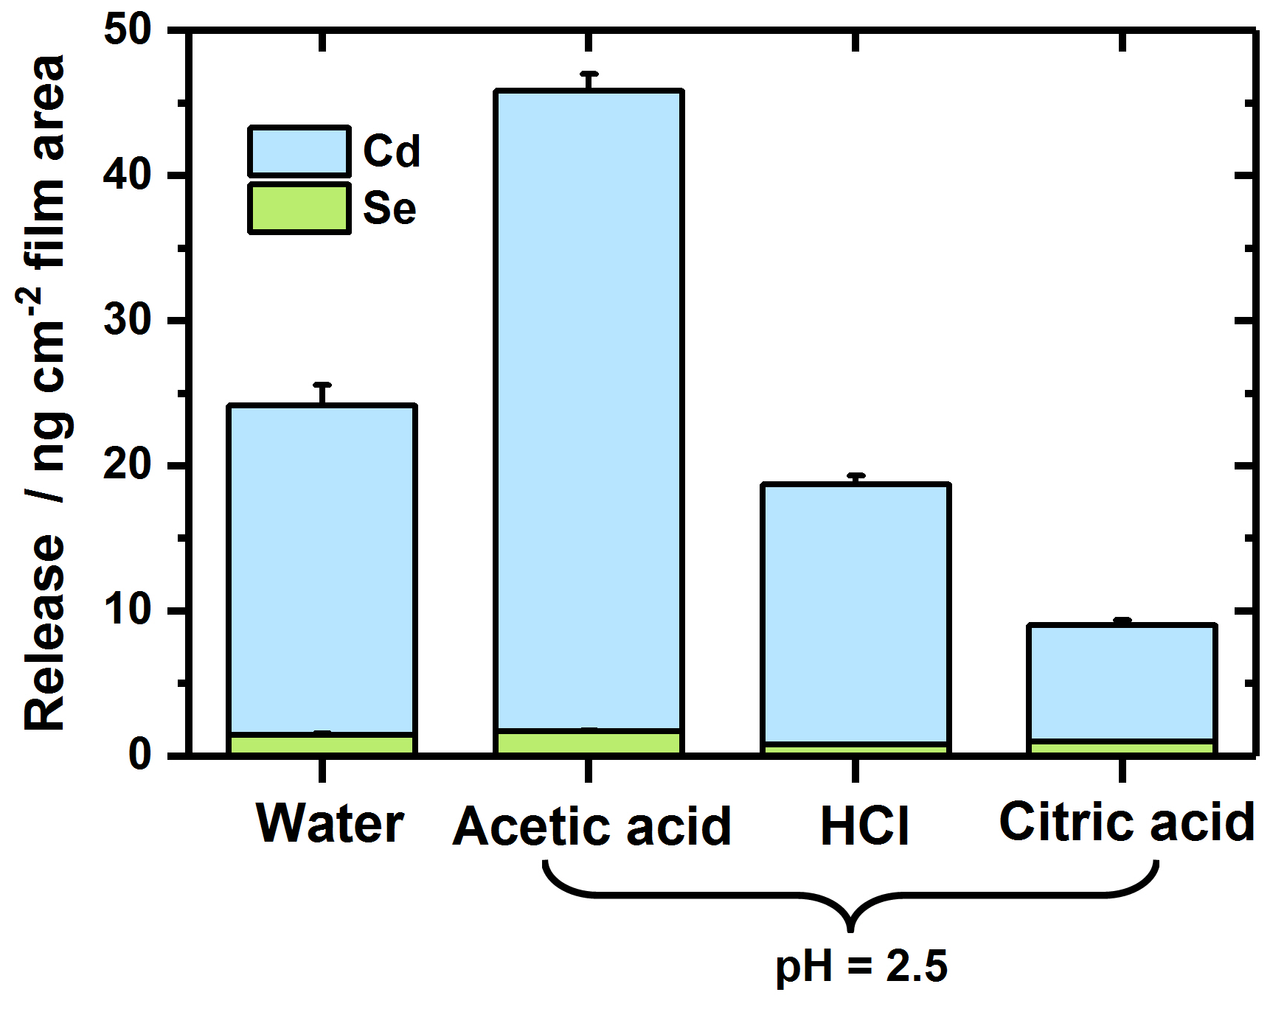
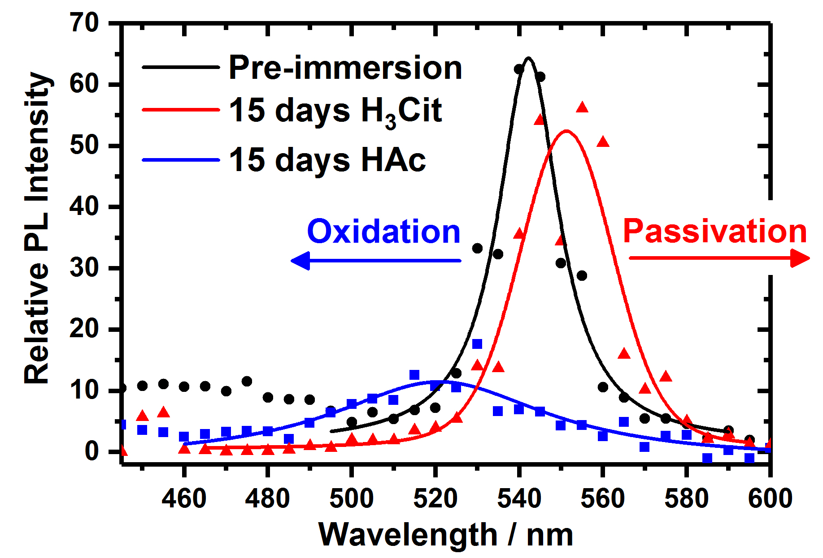
A deeper exploration of solution pH
Core-only QDs are more sensitive to environmental changes
Gray et al. Environ. Sci Technol. 2018, 52, 9468−9477

Slide 7
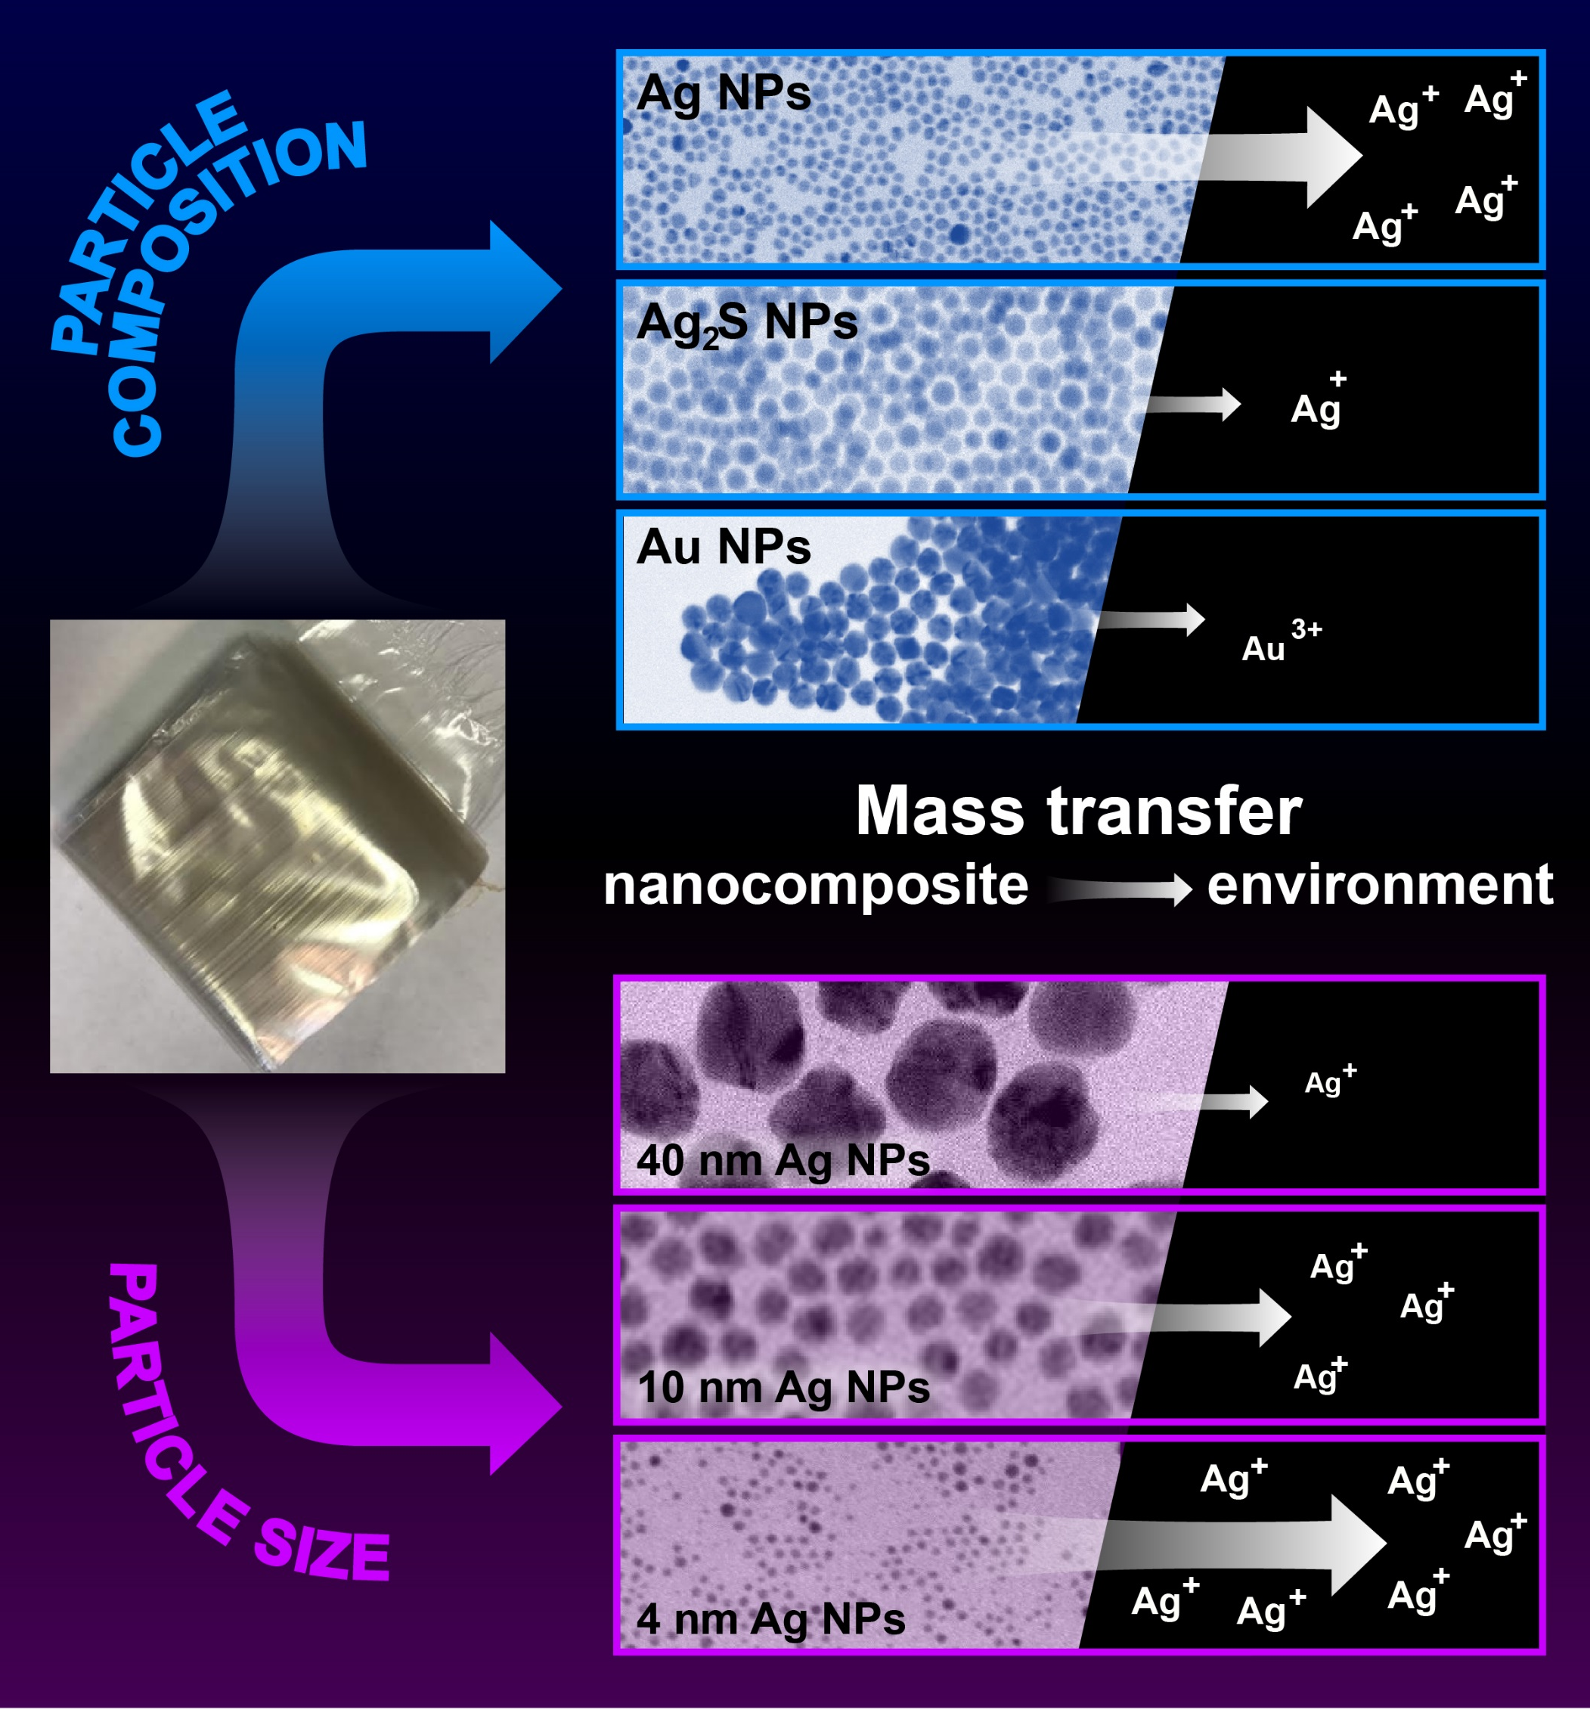
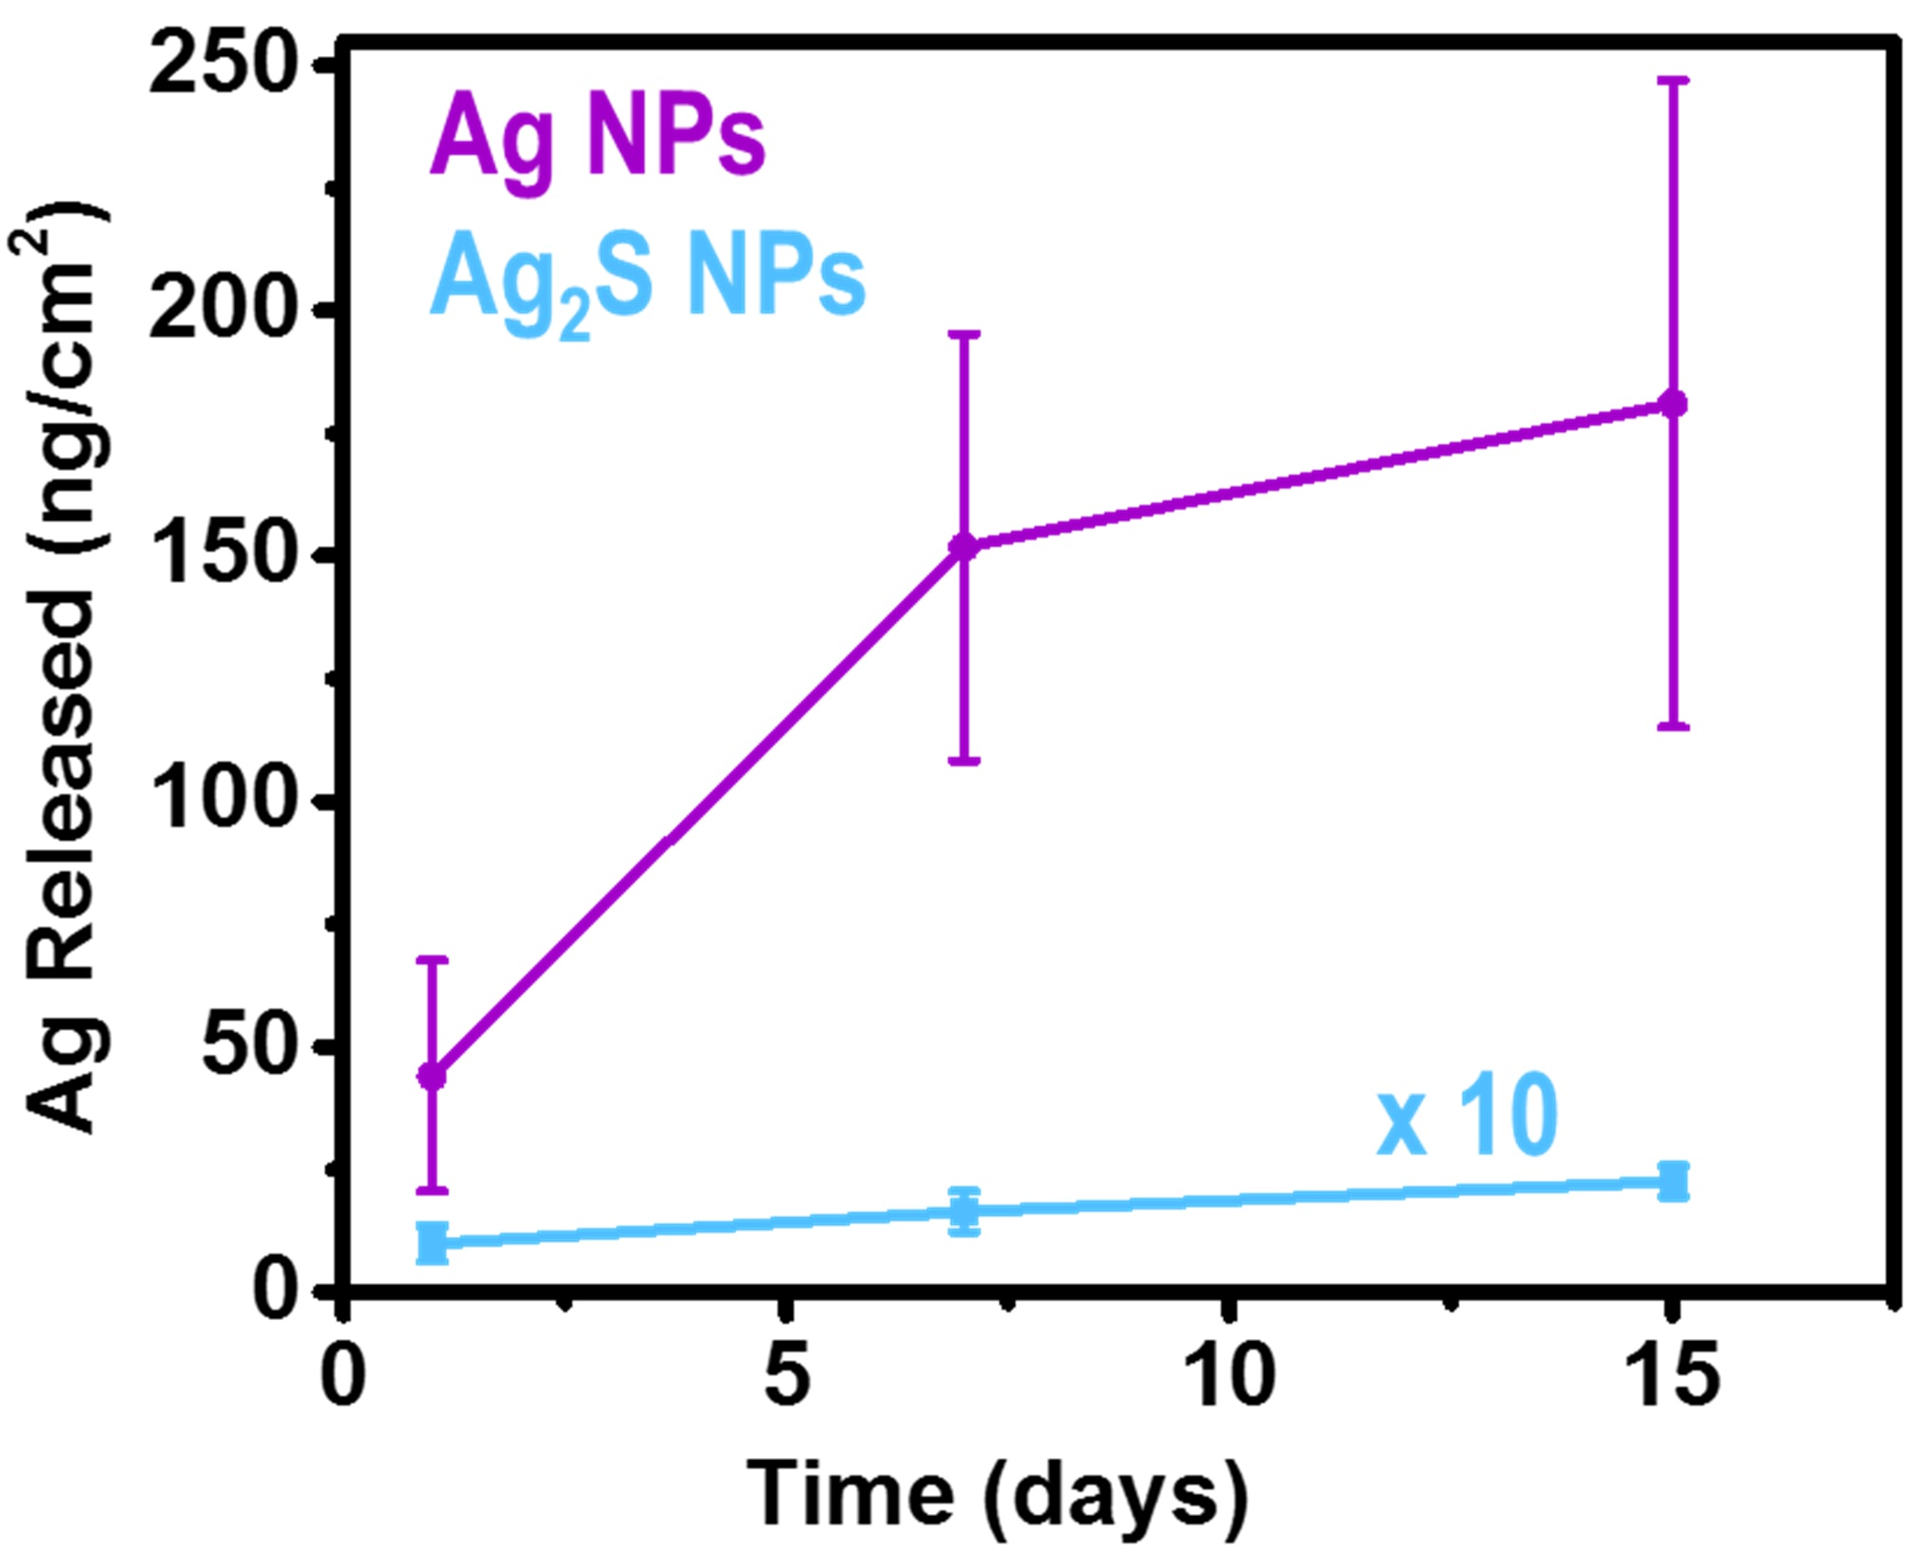
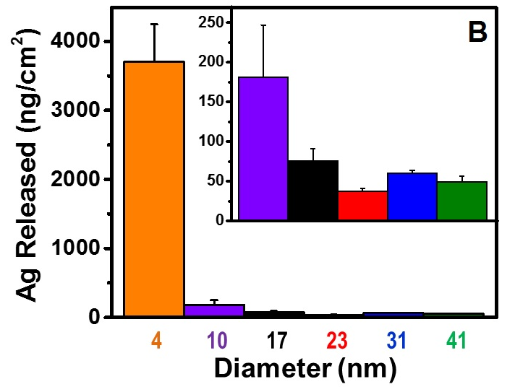
AgNP composition and release
Weiner et al. ACS Appl. Nano Mater. 2018
DOI: 10.1021/acsanm.8b0124

Slide 8
What have we learned?
Most mass transfer from PNCs to liquid media is driven by oxidative dissolution of embedded particles
Possible some release may be due to whole particle diffusion when particle size < a few nm.
Parameters that impact the sensitivity of embedded nanoparticles to oxidation will impact exposure:
Polymer characteristics (barrier properties, processing method)
Particle characteristics (size/shape, composition)
Environmental characteristics (composition, oxygen content)
Need for more studies that explore the complicated landscape of nanoparticle dissolution chemistry in polymers.
The dissolution triangle: 2D and 3D studies needed
Need for analytical methods that can measure the properties of polymer-embedded nanoparticles
Especially surface properties and composition
Notes:
8

Slide 9





Acknowledgments
FDA/CFSAN Process Engineering Branch
John Koontz (packaging chemist)
Karthik Pillai (chemist, ORISE fellow)
Rebecca Weiner (chemist, ORISE fellow)
Lauren Jackson (PEB Branch Chief)
FDA/CFSAN Chemical Contaminants Branch
Patrick J. Gray (ICP-MS)
FDA/CFSAN Office of Food Additive Safety
Mike Adams; Teresa Croce; Allan Bailey
IIT Graduate Students
Akhil Bajaj, Suriya Balasubraman, Richa Sawant, Ashutosh Sharma, Haiqi Xu, Longjiao Yu
Northwestern University
Reiner Bleher, Eric Roth (TEM, EDS)
Jessica Hornick (confocal microscopy)
NIST
Li-Piin Sung, Chen-Chieh Tien
John Pettibone
David Goodman
Notes:
9

Slide 10
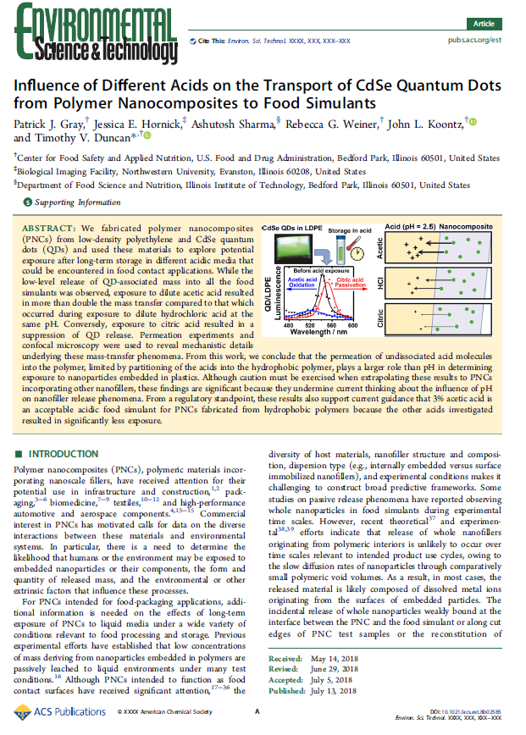
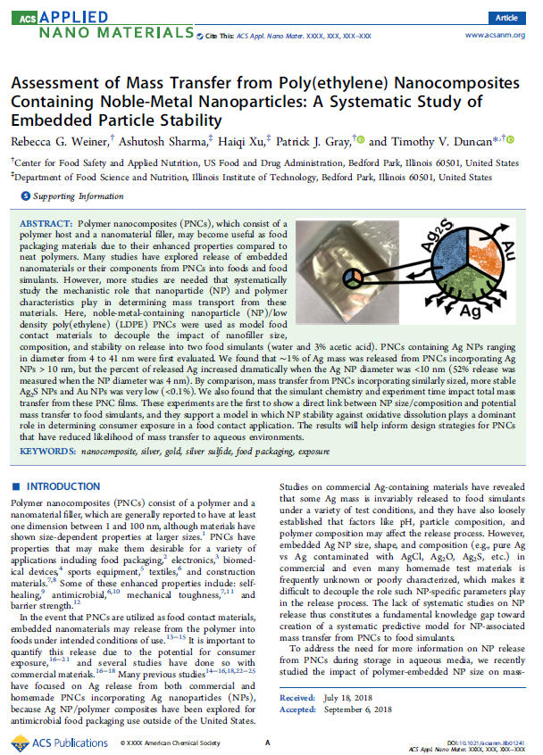
Email: timothy.Duncan@fda.hhs.gov
Gray, et al. Environ. Sci Technol. 2018 52, 9468−9477
Weiner et al. ACS Appl. Nano Mater. 2018
DOI: 10.1021/acsanm.8b0124
Notes:
10

Slide 11


Contact Information
Timothy V. Duncan, PhD
timothy.duncan@fda.hhs.gov
708-924-0607

