Slide 1
Session 2D:
Emerging Technologies and Advanced Materials: Stakeholder Perspectives on Exposure, Hazard, and Risk Assessment
Building trust while navigating risk management planning for emerging materials
Richard Canady, PhD
NeutralScience L3C and NanoRelease

Slide 2
Overall challenge
for risk management of emerging materials?
It’s complicated
Measurement methods may differ from standard practice, be expensive, or not even exist
Material properties and data bases for hazard and exposure may be changing fast
Often too little trust to allow us to generalize

Slide 3
It helps a lot to have structured, detailed discussion of the issues and solutions
NanoRelease was started in 2010 to provide such a discussion forum
http://nanorelease.org/
Notes:
You can read about the outputs

Slide 4
Two independent steering committees (food and non-food)
Support from government, industry, and private foundations
6 workshops and over a dozen task groups to identify challenges and needs
16 publications by more 60 independent experts
Coordinated exploratory methods development in laboratories around the world
http://nanorelease.org/

Slide 5
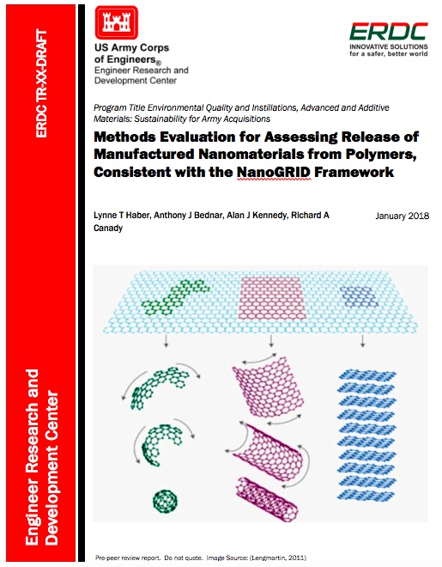
Current draft documents stemming from the dialogue
And
ISO TC 229
WG 3/PG 29: ISO/TR 22293–
Evaluation of methods for assessing the release of nanomaterials from commercial, nanomaterial containing polymer composites (N 914)
The ISO TR is more detailed and has novel content compared to the ERDC TR
The ERDC TR is more problem formulation driven and links NanoGRID to ISO TR content
Notes:
The ISO TR is a joint program between US and Canada and has experts participating from over a dozen countries.

Slide 6
The TR’s are written in a risk management context for real products
Problem formulation first!
Factors affecting measurement methods needs
Understanding effect of product attributes and use on MN release
Conditions of release throughout life cycle
Material attributes that affect release
Effects of release conditions on the form of MN release
Characterizing MN released from products
Identification of parameters that need to be measured
Framing decision support needs addressed in sample collection
Framing decision support needs addressed in sample preparation
Framing decision support needs addressed in analytic methods
(drawn from the ERDC TR document – copies of the draft available)

Slide 7
Four case studies for use of the ISO TR in the current draft
Lightweight parts made of MWCNT-epoxy
Cu-based MNM impregnated into woods that are placed outdoors into soil
Automotive parts made of MWCNT or Fe2O3 in thermoplastics (PP and PA)
3D printing of MNM-containing thermoplastics
Links between NanoGRID decision support framework for product development and use of the detailed ISO TR
Coming soon to a website near you!

Slide 8
Contact the University of Cincinnati Risk Science Center
for details and updates.
Lynne Haber: lynne.haber@uc.edu; 513-558-7631
Jacqueline Patterson: Jacqueline.patterson@uc.edu; 513-558-1908

