Slide 1
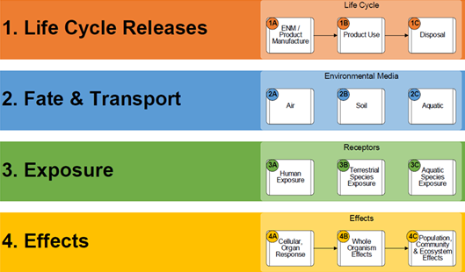
A Framework to Evaluate Environmental Impact of Engineered Nanomaterials
William K. Boyes October 9, 2018
Office of Research and Development

Slide 2
What decisions do we need to make?
Narrow Sense: EPA Registration of Nanomaterials
TSCA – Toxics Substances Control Act
Chemicals are considered as “new” or “existing” based on molecular identity – not particle size
Reauthorized in 2016 as Frank R. Lautenberg Chemical Safety for the 21st Century
Expanded testing authority and promoted alternative testing approaches
Did not change consideration of nanomaterials
FIFRA – Federal Insecticide Fungicide and Rodenticide Act
Chemicals are registered based on intended function as a biocide
Has greater authority than TSCA to require product testing for registration
Broad Sense: Become predictive of environmental behavior of nanomaterials

Slide 3
Transformative Science
Toxicity Testing in the 21st Century: A Vision and a Strategy (NRC, 2007)
Exposure Science in the 21st Century: A Vision and a Strategy (NRC, 2012)
Growing number of ENM; can’t afford to test one-by-one
Need to become predictive:
Behavior of ENM depends complex interactions between chemical and physical properties and environmental and biological factors
Our approach:
Build a framework to help organize relevant information and identify key determining factors
Identify key factors and functional assays that will simplify assessments
Notes:
Refine and revise slide

Slide 4
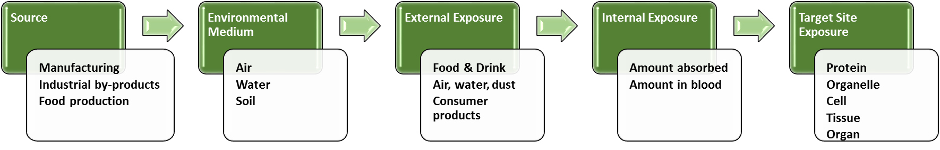
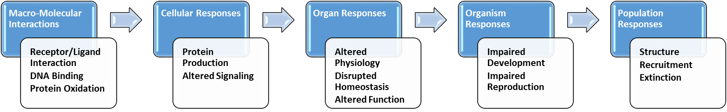
Aggregate Exposure Pathway (AEP)
Teeguarden, et al. (2016), Environ Sci Technol; doi:10.1021/acs.est.5b05311
Adverse Outcome Pathway (AOP)
Villeneuve, et al. Tox Sci., 2014, 142:312-320

Slide 5
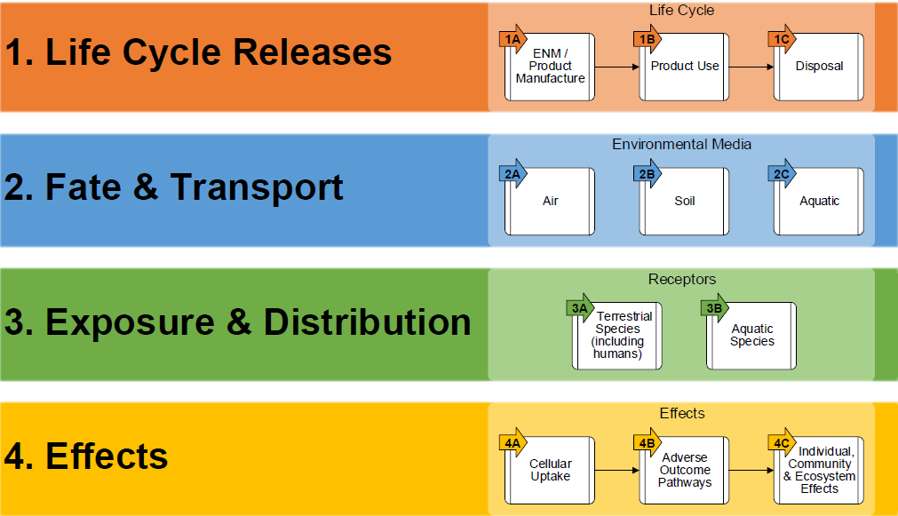
Comprehensive Framework
Boyes et al., CRITICAL REVIEWS IN TOXICOLOGY, 2017

Slide 6
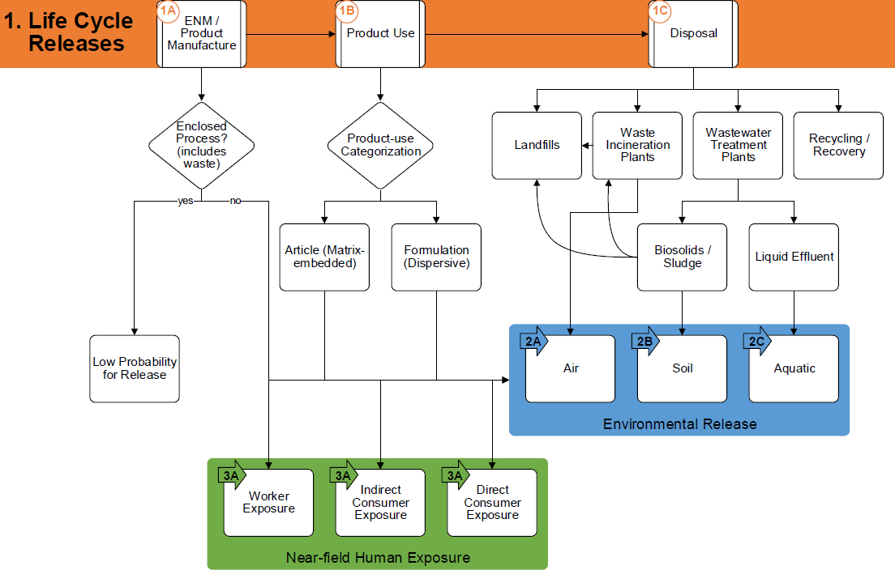
Release Across Product Life Cycle

Slide 7
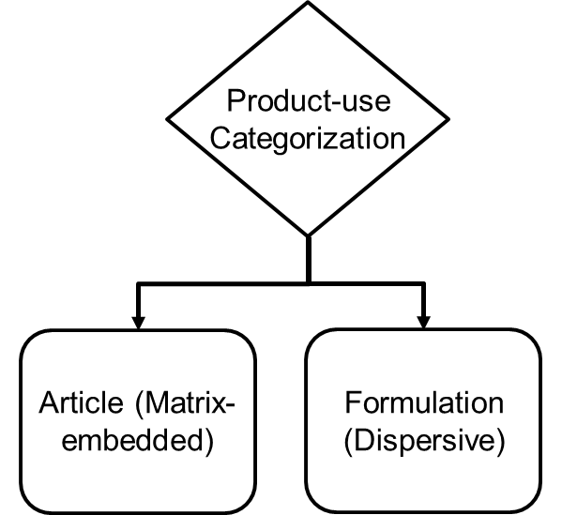
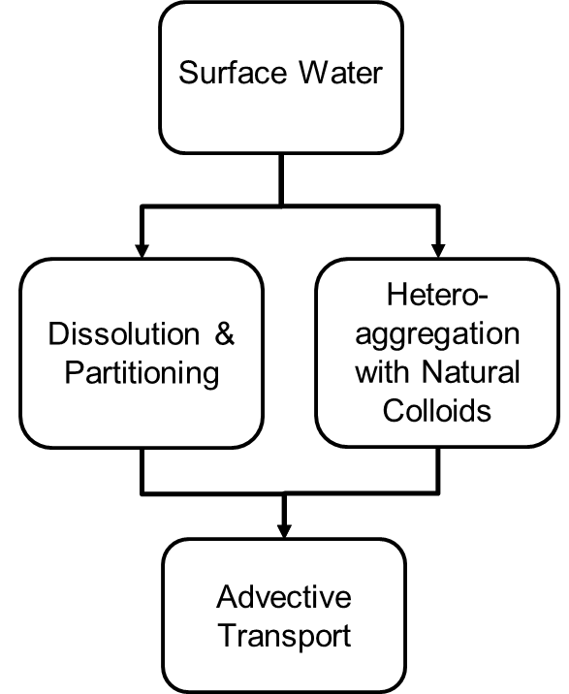
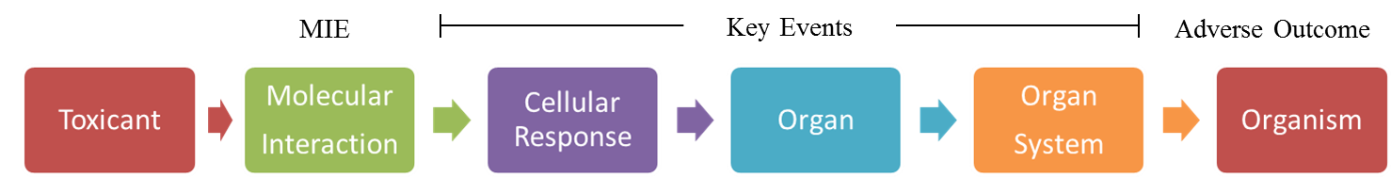
Functional Assays Along Framework
Intrinsic NP Properties
Measure
Social & Engineered Properties
Extrinsic NP Properties
System Properties
Measure
Functional Assays
Forecast
Fate & Transport
Exposure & Biouptake
Hazard
RISK
Hendren et al, 2015

Slide 8
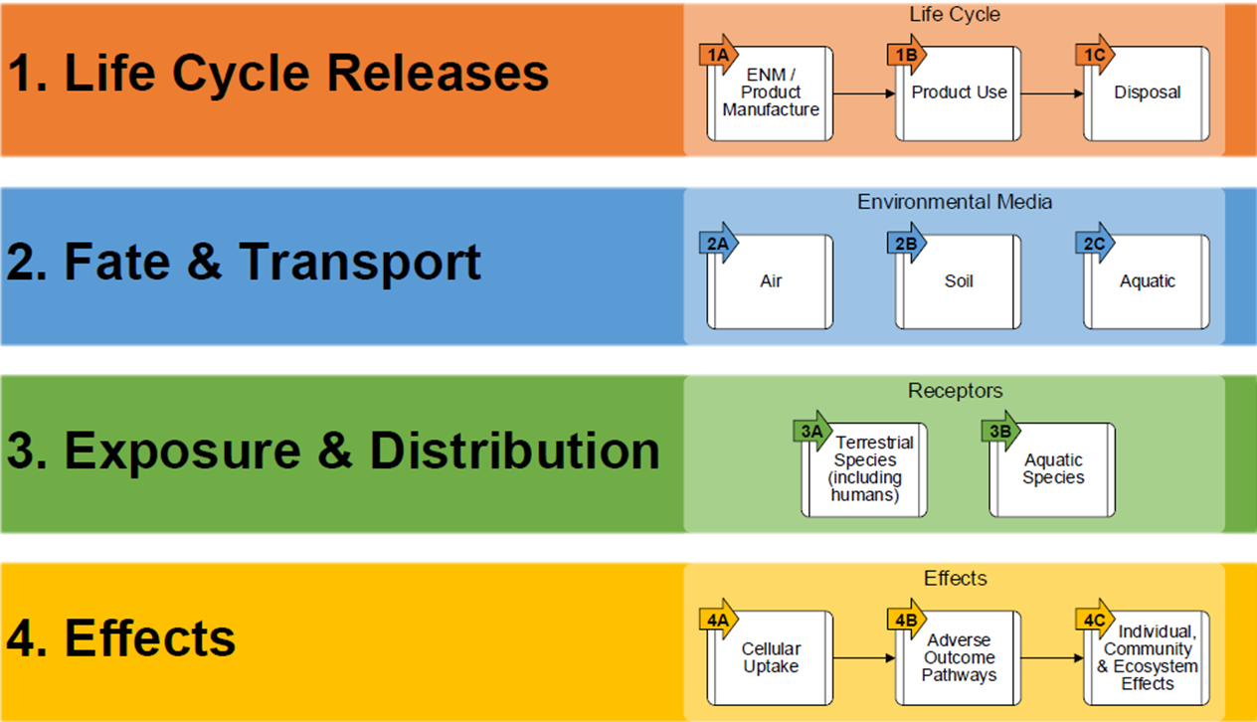
Conclusions
AOP/AEP approach to evaluate nanomaterial risks
A four-component framework with key decision points
Targeted functional assays for the decision points

Slide 9
Thank you!

