Slide 1

Precision-cut Lung Slices (PCLS):
Long-term evaluation of Nanoparticles
Holger P. Behrsing, Ph.D.
Principal Scientist
Respiratory Toxicology Program

Slide 2
Adverse Respiratory Events & Choice of System
Biological systems: Progression of Adverse Events following Exposure
Predictive Tools
Non-cellular test systems
Databases
Known chemistries
Initiating event:
Toxic insult to lung epithelium
E.g.
Oxidative stress
Initiation of signaling pathways
Tissue Response:
E.g.
Cytokines & chemokines
Inflammation
Monocyte recruitment
Protease/ antiprotease imbalance
Tissue Effects:
E.g.
GCH
Impaired Mucociliary clearance
Tissue destruction
Collagen deposition
Pulmonary Effects:
E.g.
Tissue remodeling
Chronic inflammation
Fibrosis
Lung Disease/ COPD:
E.g.
Chronic bronchitis
Emphysema
Small Airways Disease
Increased susceptibility
_{In silico}
_{In chemico}
_{In vitro (2D): Primary cells}
In vitro (3D): Reconstructed tissues
Increasing cost and/or complexity
Ex vivo (3D): Precision-cut lung slices

Slide 3
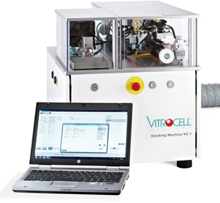
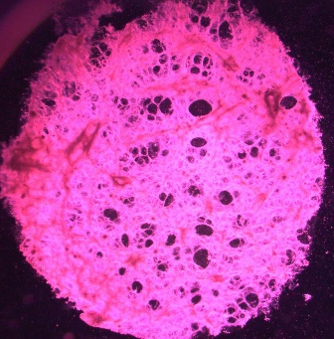

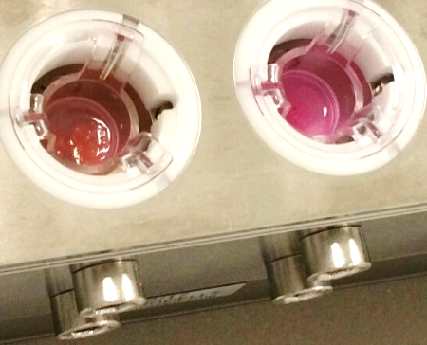
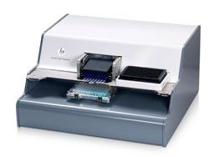
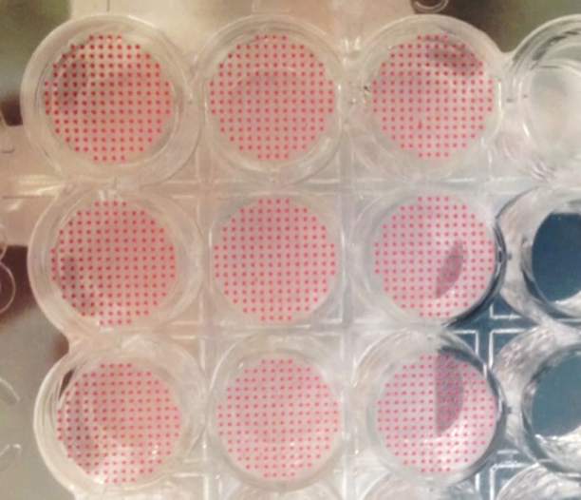
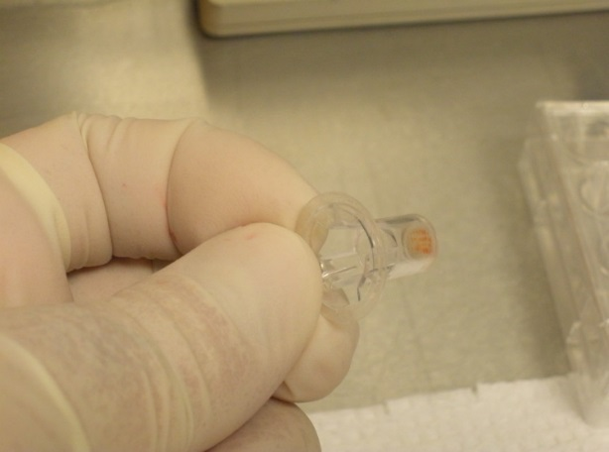
Exposure Methods: Solubles & Aerosols
Solubilized material, applied to PCLS
Smoke/Aerosol /Gas Delivery
Roller culture
ALI/submersion culture
VITROCELL® VC-1
Apical or Basolateral Delivery
Most relevant!
Dosimetry?
Cost!
Medium Delivery
Tissue insert at air liquid interface (ALI)
Novel: Digital Dispensing
ALI/submersion culture
3 nL droplets
Accurate delivery to ALI
Tecan/HP D300
Hybrid technology?
DMSO or aqueous-based solutions
Minimal volume delivery
ALI culture

Slide 4
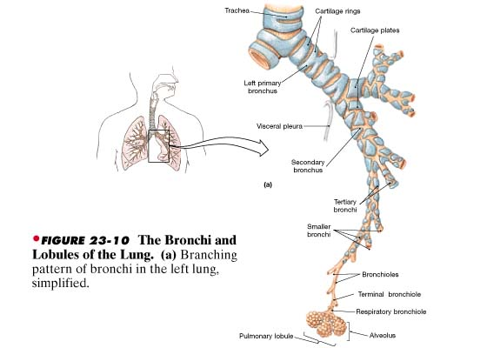
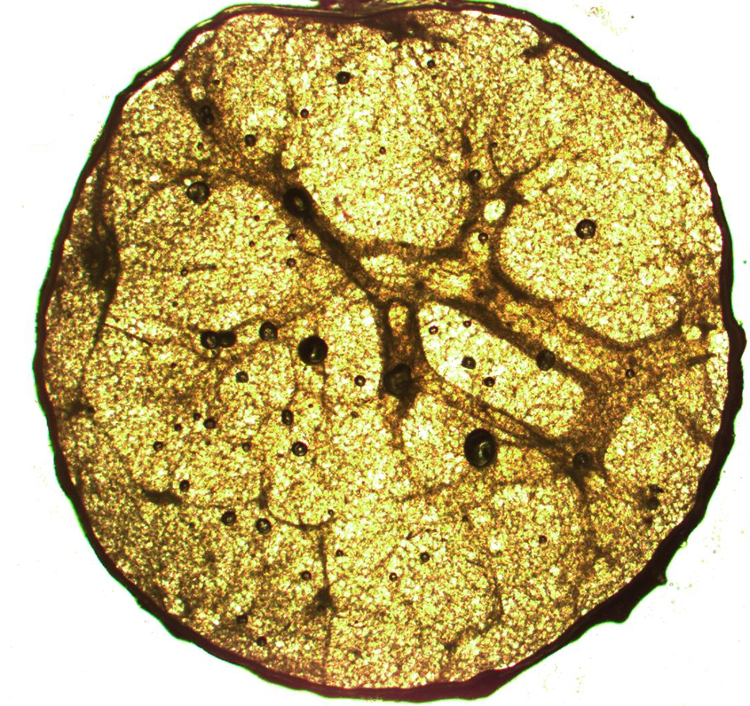
In Vitro/Ex vivo Models: PCLS
PCLS can represent all lung regions present in tissue source

Slide 5
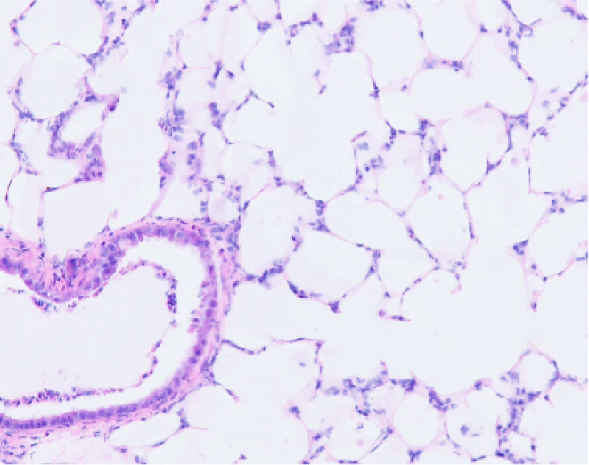
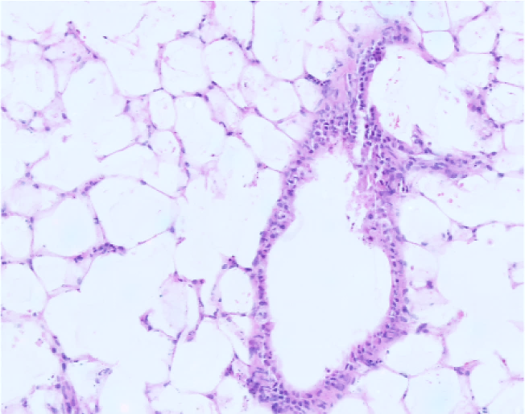
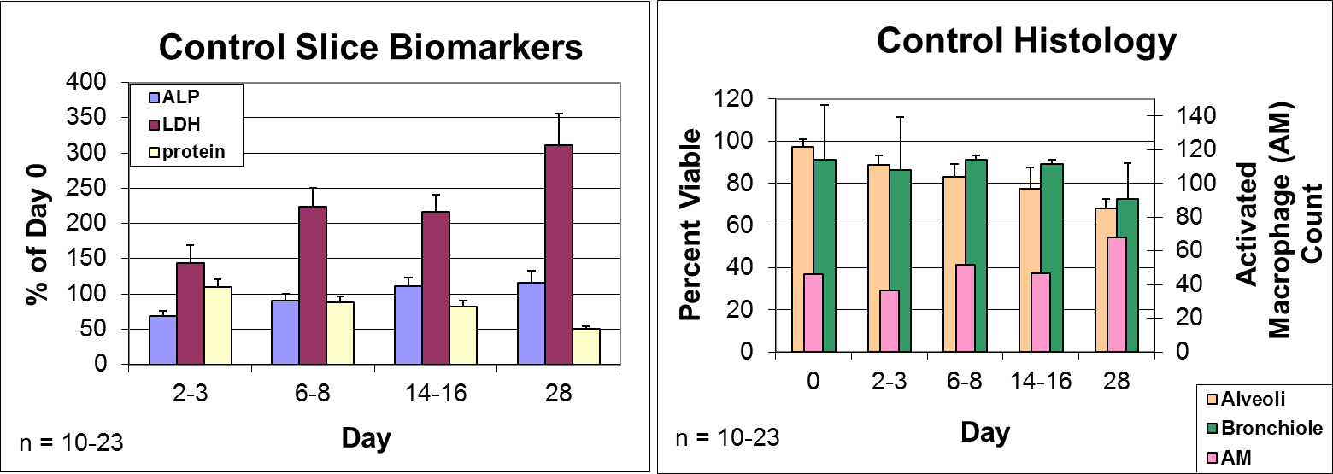
PCLS: Long Term Culture (e.g. rat PCLS)
Control D8
Control D28

Slide 6
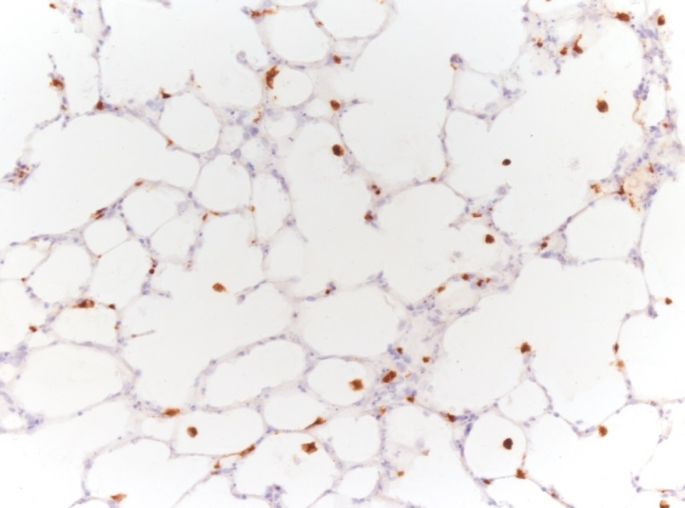
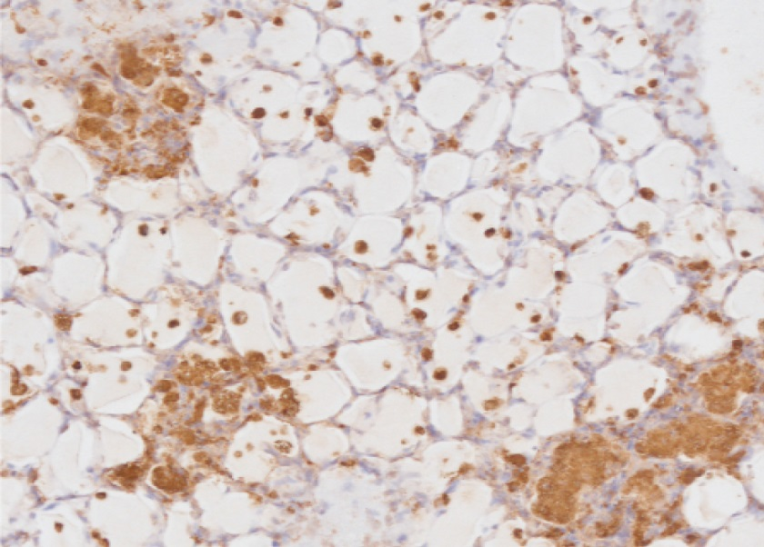
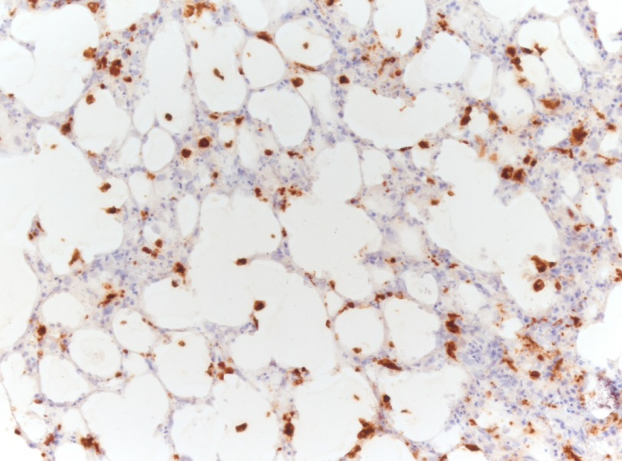
PCLS: Compound-induced Macrophage Activation
macrophages
Control D7
10 mU/ml bleomycin D8
10 µM BCNU D7
Negative control PCLS exhibit a baseline ED-1 staining of macrophages. Macrophages are maintained in cultures for 28 or more days
Bleomycin treatment results in patches of activated macrophages filling alveolar spaces; many solitary macrophages also seen
BCNU (carmustine) exposure shows numerous macrophages, many of which have infiltrated alveolar walls mimicking interstitial pneumonitis
Rat PCLS: ED-1 IHC Stain

Slide 7
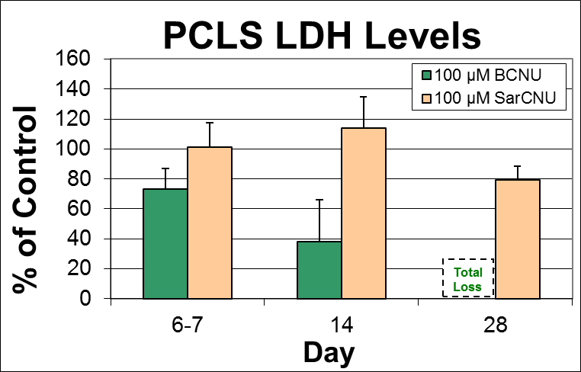
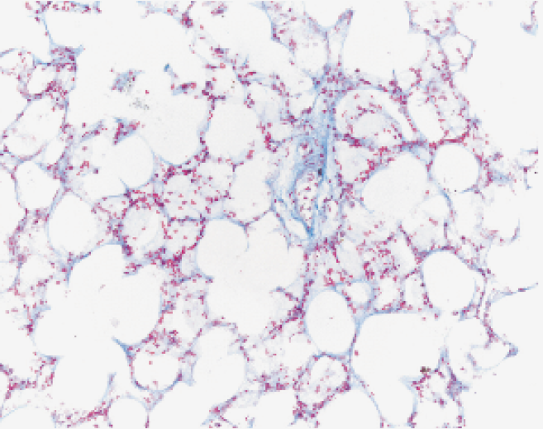
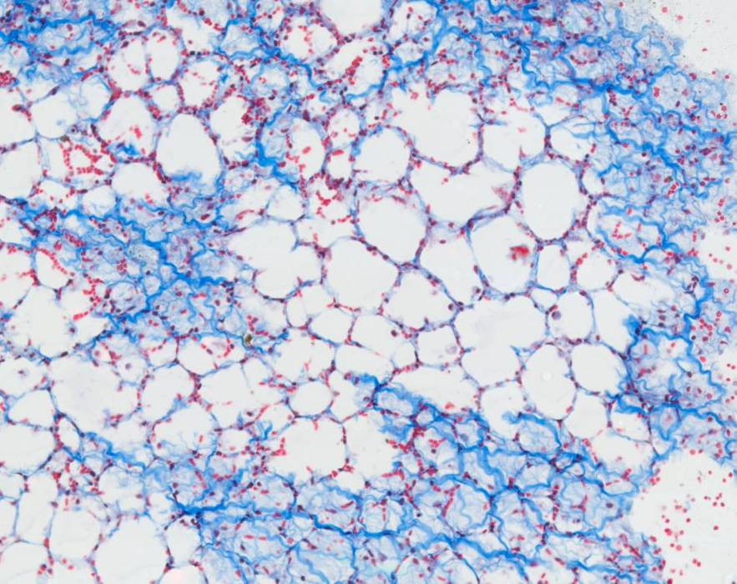
PCLS (rat): BCNU vs SarCNU Comparison
BCNU has been reported to cause lung damage and fibrosis in 20-30% of the patients receiving it (Weiss, Poster et al. 1981)…
More recently an analog of BCNU, 2-Chloroethyl-3-sarcosinamide-1-nitrosurea (SarCNU), has been shown to be well-tolerated, more effective, and less toxic…
100 µM SarCNU D28
100 µM BCNU D28

Slide 8
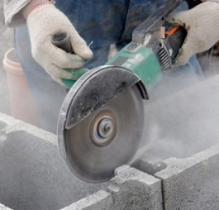
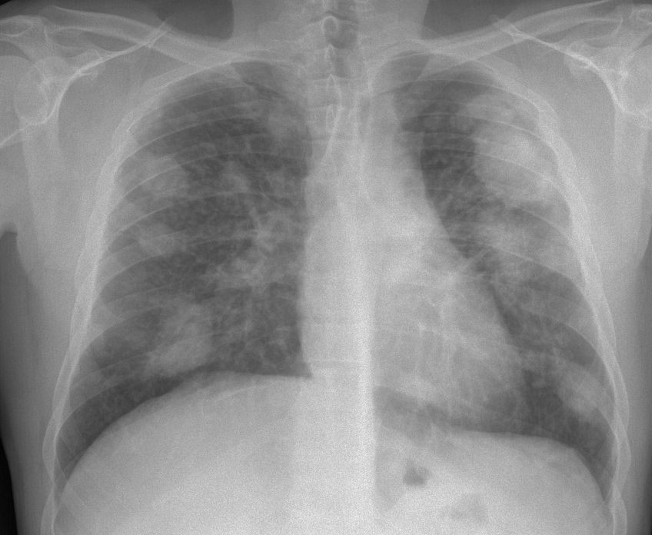
Quartz Silica and Silicosis
Effects of Silicosis
Lung cancer – Silica has been classified as a human lung carcinogen.
Bronchitis/Chronic Obstructive Pulmonary Disorder.
Tuberculosis – Silicosis makes an individual more susceptible to TB.
Scleroderma – a disease affecting skin, blood vessels, joints and skeletal muscles.
Possible renal disease.
Respiratory failure, which may eventually lead to death.
https://www.greenscreenchemicals.org/gs-assessments/chemical/14808-60-7
http://www.wrchem.com/wp-content/uploads/2015/11/MIN-U-Sil-5-Ground-Silica-TDS.pdf
https://www.osha.gov/Publications/silicosis.html
CAS#: 14808-60-7
Chemical Name: Quartz
Primary Applications: Hydraulic Fracturing, Processing Aids and Additives
Quartz is a chemical that has many uses, including in glass manufacturing, ceramics, foundry, abrasives, hydraulic fracturing, furnaces, fillers, paints, and filtration.

Slide 9
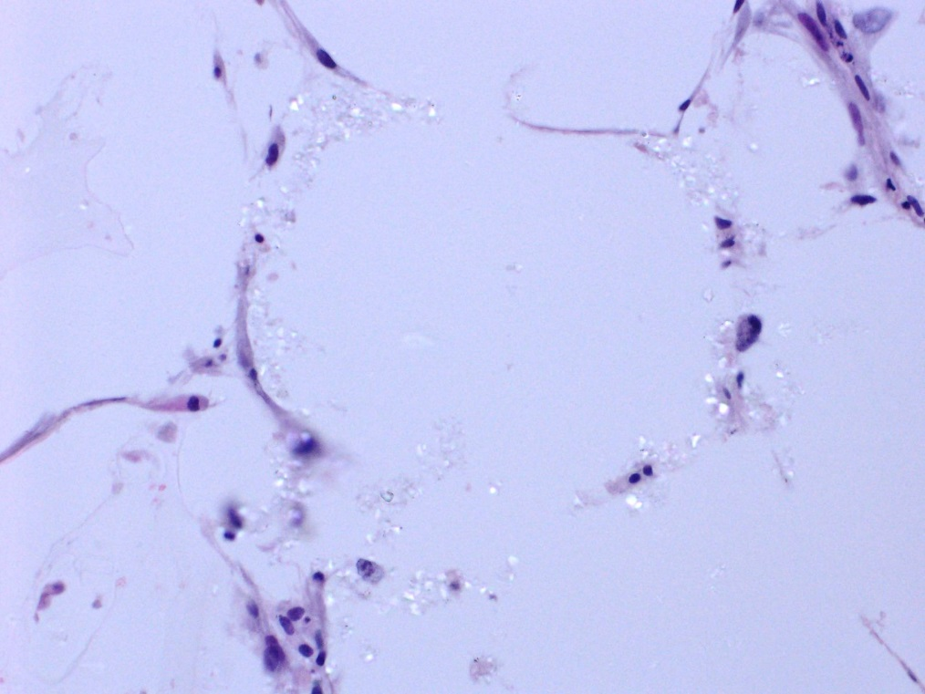
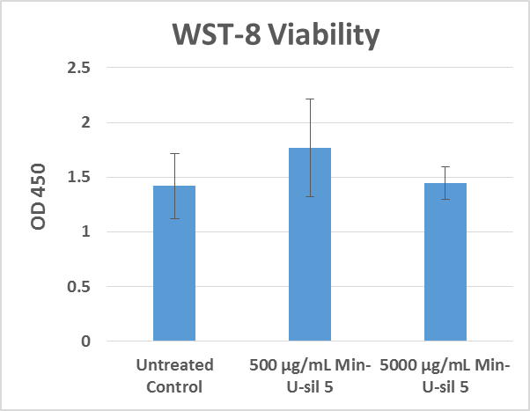
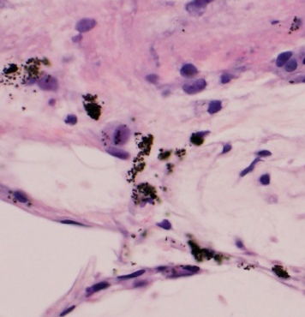
Pilot Study: Min-U-sil 5 Exposure to HuPCLS
500 µg/mL Min-U-sil 5, 16 days (daily refeedings)
Active Macrophages at Day 16
Particles seemingly inert
No macrophages engulfing
No overt toxic events seen
Pathologist:
No overt viability loss

Slide 10
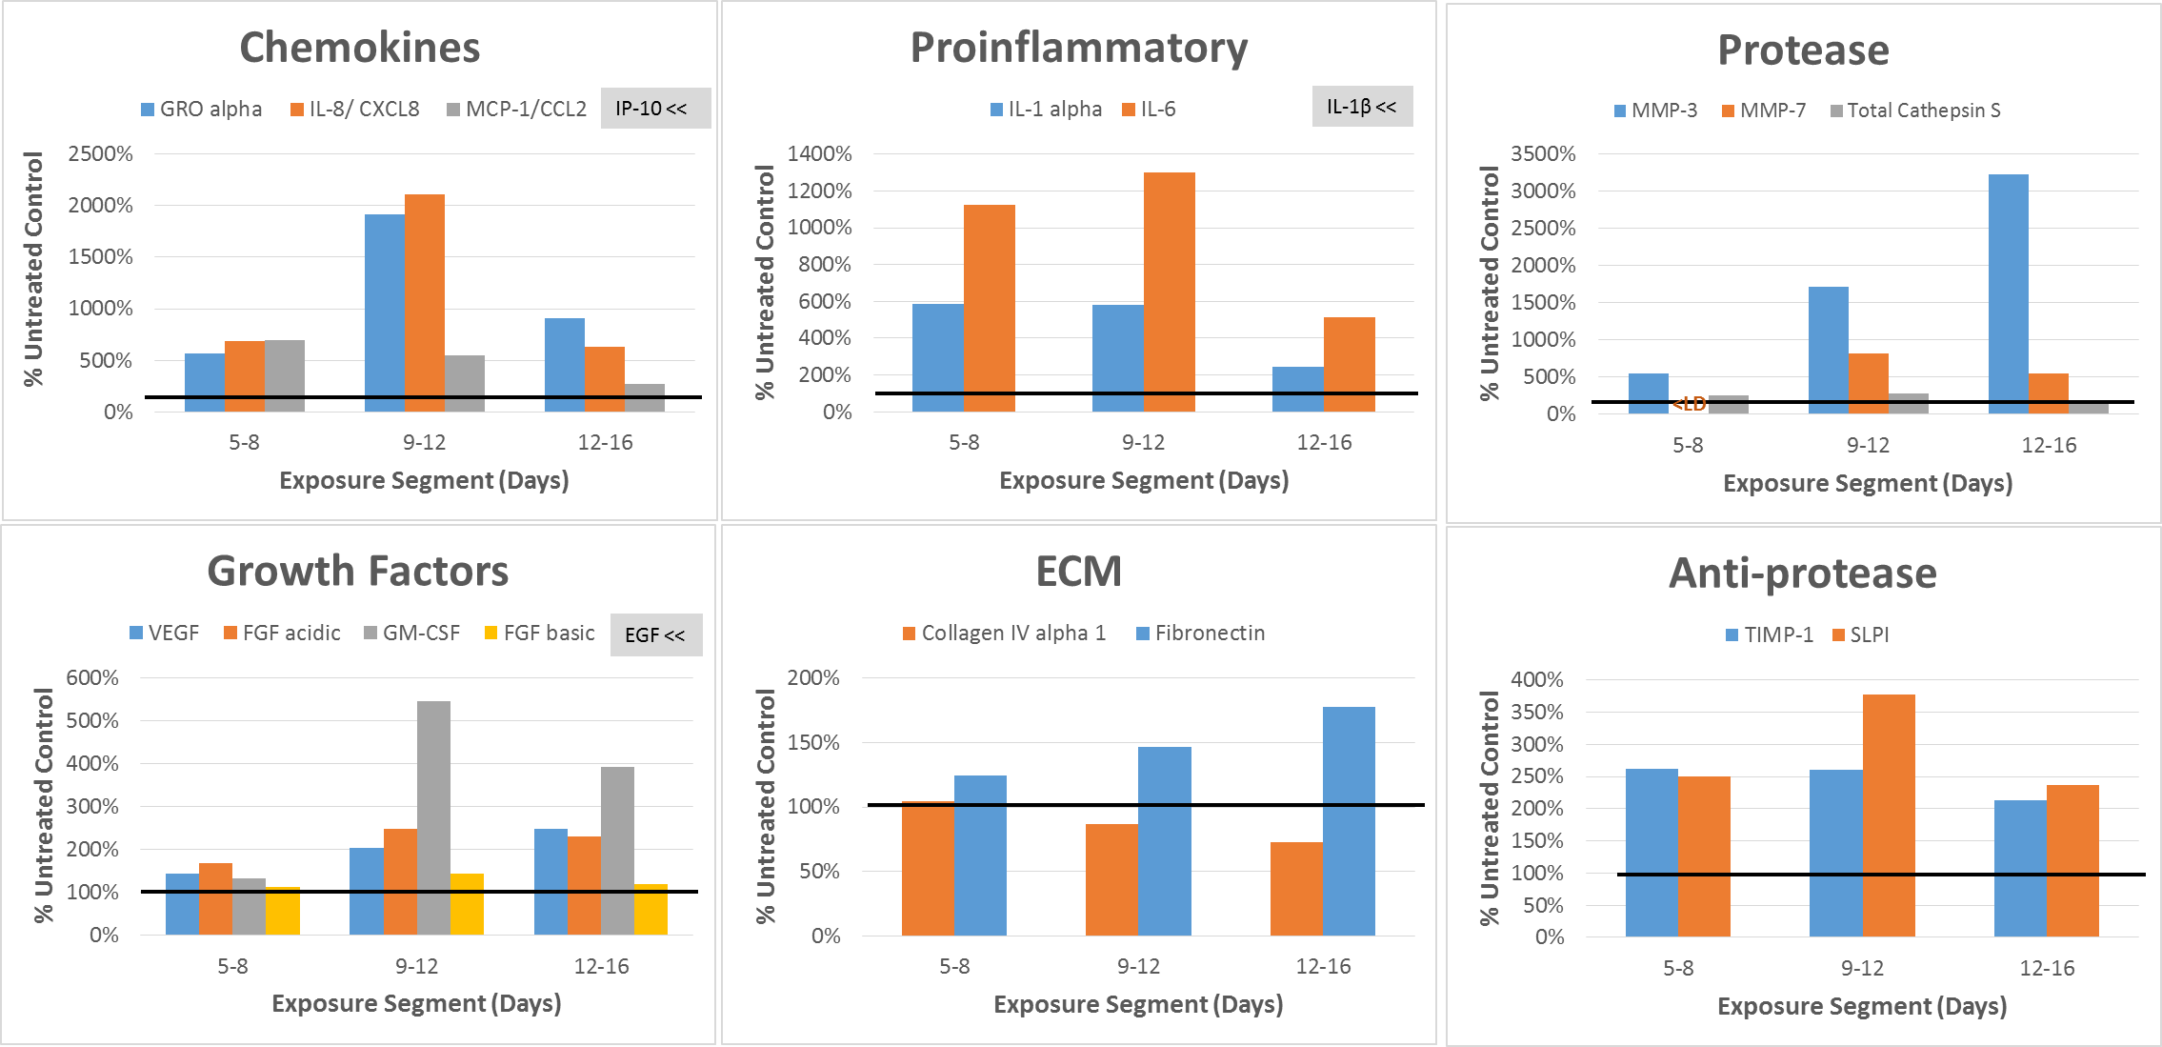
500 µg/mL Min-U-sil 5 Exposure to HuPCLS
Note: values above the highest standard were extrapolated by Luminex xPonent software

Slide 11
Summary
PCLS can be maintained for weeks, allowing chronic exposure and evaluation of long-term effects
  Native architecture for histological observations
Demonstrated utility:
  Differences in species sensitivity (not shown) and analog potency
  Concentration-dependent reversibility of inflammation (not shown)
Response to silica exposure
Prolonged PCLS exposure to MinUsil 5 resulted in prolonged elevation of inflammatory markers, but no loss of overall viability yet offering the processes such as chronic inflammation
Nanoparticle risk scenarios include repeat and/or prolonged exposures that may result in chronic inflammatory states – potentially leading to pulmonary fibrosis.
The PCLS test system offers a long-term culture period during which multiple, immune-competent cell types, and chronic inflammatory processes can be monitored to study the effects of nanoparticles.

Slide 12

Acknowledgements
  IIVS’s staff (supporters & collaborators!
  Simon Fogarty (Tecan) Christi Dudenhofer and David Ochse (HP)
  Questions?
  www.iivs.org
  Holger Behrsing, Ph.D.: hbehrsing@iivs.org
Notes:
Thank you!

