Slide 1
Epidemiological Study of U.S. Carbon Nanotube Workers
John D. Beard, MPH, PhD
Brigham Young University
QEEN II: 2nd Quantifying Exposure to Engineered Nanomaterials from Manufactured Products Workshop
October 9, 2018

Slide 2
Study Objective
Estimate associations between occupational carbon nanotube and nanofiber (CNT/F) exposure and early human health effects
Study conducted by the National Institute for Occupational Safety and Health

Slide 3
Study Design
Industrywide cross-sectional study
12 sites across the U.S.
Primary producers
Secondary users
Hybrid
108 CNT/F workers
75% of recruited workers
From Dahm et al. (2015)

Slide 4
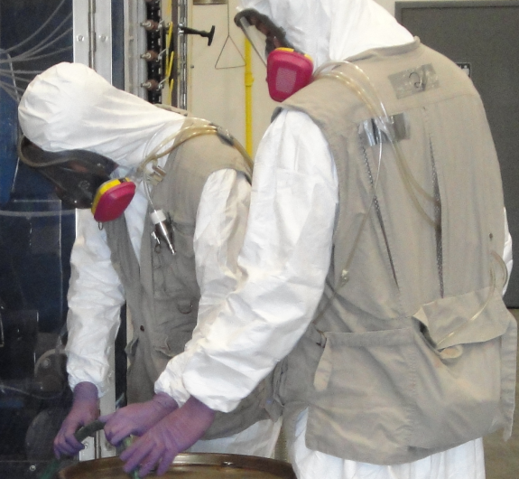
Exposure Assessment
Personal breathing zone, filter-based air sampling
Background-corrected elemental carbon (EC) concentrations (2 variables)
CNT/F structure count concentrations (6 variables)

Slide 5
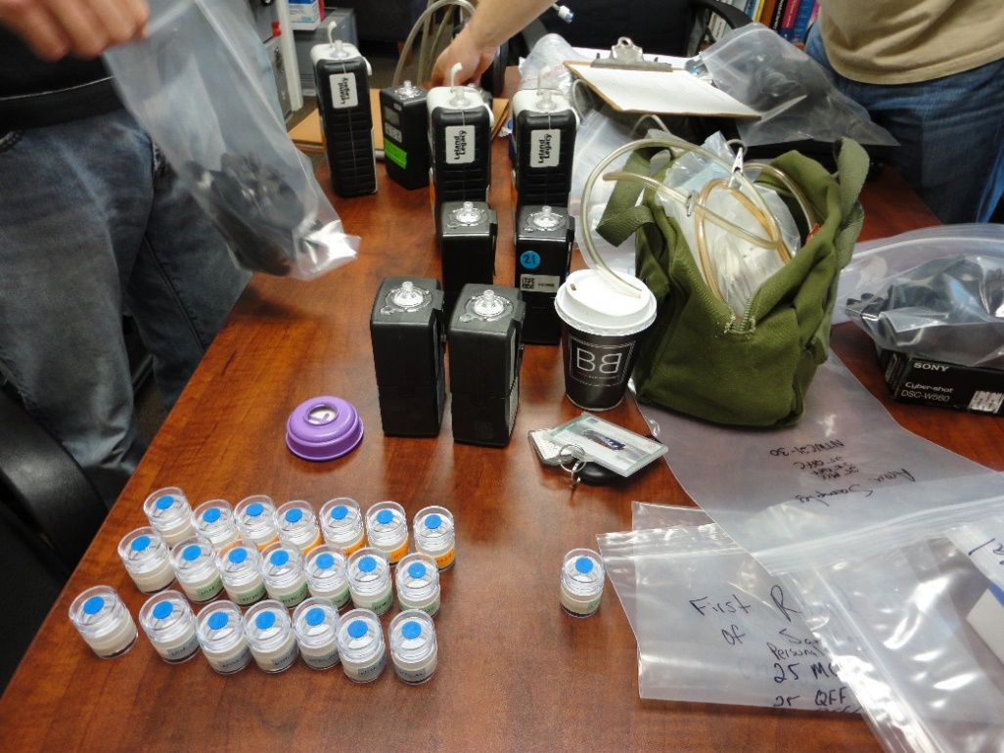
Exposure Assessment
Direct-reading instruments
Fine and ultrafine particulate matter mass and count concentrations (3 variables)
Other (4 variables)

Slide 6
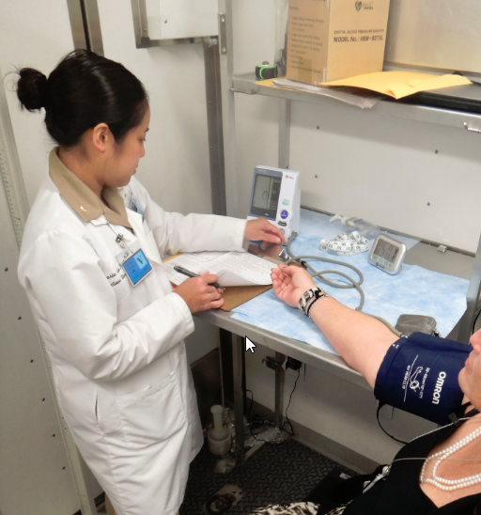
Outcome Assessment
36 sputum biomarkers
37 blood biomarkers
Chest symptoms and respiratory allergies since start of CNT/F work

Slide 7
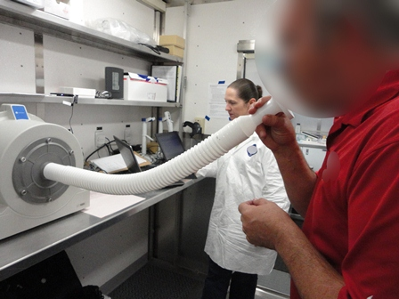
Outcome Assessment
Lung function
Resting blood pressure (RBP)
Resting heart rate (RHR)
Complete blood count (CBC) components

Slide 8
Sputum Biomarker Factor Loadings
 | Factor
Biomarker | 1 | 2 | 3
Cancer/Fibrosis
MUC-1/KL-6 | 0.16 | 0.84 | 0.08
MMP-2 | 0.77 | 0.44 | 0.15
MMP-7 | 0.09 | 0.88 | 0.16
TIMP-1 | 0.65 | 0.54 | 0.25
Inflammation
α-2-M | 0.93 | 0.07 | 0.07
Apo-AI | 0.93 | 0.18 | 0.16
Apo-AII | 0.91 | 0.24 | 0.02
IL-1 β | 0.66 | 0.28 | 0.55
IL-6R-β | 0.43 | 0.65 | 0.27
IL-8 | 0.59 | 0.66 | 0.31
IL-18 | 0.07 | 0.19 | 0.88
Oxidative Stress
8-OHdG | 0.45 | 0.38 | -0.36
MPO | 0.48 | 0.31 | 0.69
Cardiovascular/Coagulation
Fibrinogen | 0.71 | 0.23 | 0.36
PAI-1 | 0.58 | 0.53 | 0.27
VCAM-1 | 0.87 | 0.28 | 0.19
78% of variance explained
Colored loadings have largest magnitudes for each biomarker

Slide 9
CNT/F and Sputum Biomarker Factors
 | Factor
Variable | 1 | 2 | 3
Inhalable EC
Respirable EC
Total CNT/F
Single CNT/F
CNT/F <1 μm
CNT/F <2 μm
CNT/F <5 μm
CNT/F <10 μm
CPC
ELPI
PM_{2.5}
Sputum CNT/F
Any CNT/F
CNT/F duration
Key
 | Positive association p-value < 0.05
 | p-value ≥ 0.05
 | Inverse association p-value < 0.05

Slide 10
CNT/F and Sputum Biomarkers
 | Fibrosis
Variable | KL-6 | MMP-1 | MMP-2 | MMP-7 | MMP-9 | SPP-1 | TIMP-1
Inhalable EC
Respirable EC
Total CNT/F
Single CNT/F
CNT/F <1 μm
CNT/F <2 μm
CNT/F <5 μm
CNT/F <10 μm
CPC
ELPI
PM_{2.5}
Sputum CNT/F
Any CNT/F
CNT/F duration

Slide 11
CNT/F and Sputum Biomarkers
 | Inflammation
Variable | α-2-M | Apo-AI | Apo-AII | CRP | Eotaxin-1 | IL-1 β | IL-2 | IL-4 | IL-5 | IL-6 | IL-6R-β | IL-8 | IL-10 | IL-18 | TNF-α
Inhalable EC
Respirable EC
Total CNT/F
Single CNT/F
CNT/F <1 μm
CNT/F <2 μm
CNT/F <5 μm
CNT/F <10 μm
CPC
ELPI
PM_{2.5}
Sputum CNT/F
Any CNT/F
CNT/F duration

Slide 12
CNT/F and Sputum Biomarkers
 | Oxidative Stress
Variable | 8-OHdG | GPx | MPO | SOD
Inhalable EC
Respirable EC
Total CNT/F
Single CNT/F
CNT/F <1 μm
CNT/F <2 μm
CNT/F <5 μm
CNT/F <10 μm
CPC
ELPI
PM_{2.5}
Sputum CNT/F
Any CNT/F
CNT/F duration

Slide 13
CNT/F and Sputum Biomarkers
 | Cardiovascular
Variable | Fibrinogen | ICAM-1 | PAI-1 | t-PA | VCAM-1 | vWF
Inhalable EC
Respirable EC
Total CNT/F
Single CNT/F
CNT/F <1 μm
CNT/F <2 μm
CNT/F <5 μm
CNT/F <10 μm
CPC
ELPI
PM_{2.5}
Sputum CNT/F
Any CNT/F
CNT/F duration

Slide 14
Blood Biomarker Factor Loadings
 | Factor
Biomarker | 1 | 2 | 3 | 4 | 5 | 6 | 7 | 8 | 9
Cancer/Fibrosis
MUC-1/KL-6 | -0.04 | 0.20 | -0.77 | -0.02 | 0.04 | 0.05 | 0.18 | -0.09 | -0.03
MMP-2 | -0.29 | 0.29 | -0.10 | 0.27 | -0.12 | 0.20 | 0.45 | 0.40 | 0.00
MMP-7 | 0.07 | 0.27 | -0.19 | -0.10 | 0.70 | 0.06 | 0.24 | 0.11 | -0.13
MMP-9 | 0.14 | -0.02 | -0.03 | 0.03 | 0.53 | -0.04 | -0.06 | 0.54 | 0.18
SPP-1 | -0.08 | -0.07 | 0.00 | 0.61 | -0.11 | -0.05 | -0.16 | 0.24 | 0.37
TIMP-1 | 0.20 | 0.30 | 0.02 | 0.56 | 0.20 | 0.32 | 0.12 | -0.15 | -0.22
Inflammation
α-2-M | -0.09 | -0.54 | -0.38 | -0.12 | 0.03 | -0.02 | 0.23 | 0.09 | 0.48
Apo-AI | -0.07 | -0.24 | 0.17 | 0.04 | 0.19 | 0.11 | 0.75 | -0.20 | 0.26
Apo-AII | -0.01 | 0.28 | 0.75 | 0.12 | -0.02 | 0.13 | 0.13 | -0.30 | 0.02
CRP | 0.73 | 0.12 | 0.21 | -0.15 | 0.03 | 0.34 | -0.01 | -0.06 | -0.15
C3 | 0.65 | 0.14 | 0.25 | -0.08 | 0.19 | 0.16 | 0.10 | 0.19 | 0.07
IL-1 β | 0.32 | -0.02 | -0.15 | -0.01 | 0.37 | 0.00 | 0.29 | -0.08 | 0.38
IL-6R-β | 0.11 | 0.29 | 0.19 | 0.60 | 0.00 | -0.28 | 0.24 | 0.09 | 0.15
IL-8 | 0.23 | 0.13 | 0.04 | 0.07 | 0.71 | 0.14 | -0.04 | 0.01 | 0.02
IL-18 | 0.62 | 0.27 | 0.00 | 0.27 | 0.03 | -0.15 | -0.02 | -0.03 | 0.00
MDC | -0.08 | 0.59 | 0.10 | -0.12 | 0.21 | 0.18 | -0.27 | -0.01 | 0.23
Oxidative Stress
8-OHdG | 0.05 | 0.09 | 0.75 | 0.08 | -0.05 | 0.19 | -0.01 | -0.02 | -0.18
GPx | 0.14 | 0.01 | -0.27 | -0.22 | -0.03 | -0.17 | 0.63 | 0.17 | -0.03
MPO | -0.06 | 0.06 | -0.08 | 0.24 | 0.05 | -0.03 | 0.03 | 0.82 | -0.13
SOD | -0.07 | 0.13 | -0.04 | 0.03 | -0.02 | 0.02 | 0.07 | -0.06 | 0.78
Cardiovascular/Coagulation
EDN1 | -0.09 | 0.02 | 0.06 | 0.45 | 0.42 | -0.18 | -0.28 | -0.04 | -0.01
Fibrinogen | 0.46 | 0.09 | 0.08 | 0.00 | 0.14 | 0.71 | 0.17 | 0.26 | 0.10
ICAM-1 | 0.65 | 0.03 | -0.20 | 0.11 | 0.15 | -0.11 | -0.03 | -0.09 | -0.06
PAI-1 | 0.25 | 0.72 | 0.07 | 0.13 | 0.19 | 0.11 | 0.13 | 0.20 | 0.08
t-PA | 0.29 | 0.76 | -0.09 | 0.03 | 0.08 | 0.10 | -0.03 | -0.04 | -0.03
VCAM-1 | 0.09 | -0.09 | 0.09 | 0.75 | -0.01 | 0.17 | -0.08 | 0.19 | -0.14
vWF | -0.12 | 0.27 | 0.22 | 0.06 | 0.05 | 0.79 | -0.12 | -0.17 | -0.01
67% of variance explained
Colored loadings
have
largest magnitudes for each biomarker

Slide 15
CNT/F and Blood Biomarker Factors
 | Factor
Variable | 1 | 2 | 3 | 4 | 5 | 6 | 7 | 8 | 9
Inhalable EC
Respirable EC
Total CNT/F
Single CNT/F
CNT/F <1 μm
CNT/F <2 μm
CNT/F <5 μm
CNT/F <10 μm
CPC
ELPI
PM_{2.5}
Sputum CNT/F
Any CNT/F
CNT/F duration
Key
 | Positive association p-value < 0.05
 | p-value ≥ 0.05
 | Inverse association p-value < 0.05

Slide 16
CNT/F and Blood Biomarkers
 | Fibrosis
Variable | KL-6 | MMP-2 | MMP-7 | MMP-9 | SPP-1 | TIMP-1
Inhalable EC
Respirable EC
Total CNT/F
Single CNT/F
CNT/F <1 μm
CNT/F <2 μm
CNT/F <5 μm
CNT/F <10 μm
CPC
ELPI
PM_{2.5}
Sputum CNT/F
Any CNT/F
CNT/F duration

Slide 17
CNT/F and Blood Biomarkers
 | Inflammation
Variable | α-2-M | Apo-AI | Apo-AII | CRP | C3 | Eotaxin-1 | IL-1 β | IL-6R-β | IL-8 | IL-10 | IL-18 | MDC
Inhalable EC
Respirable EC
Total CNT/F
Single CNT/F
CNT/F <1 μm
CNT/F <2 μm
CNT/F <5 μm
CNT/F <10 μm
CPC
ELPI
PM_{2.5}
Sputum CNT/F
Any CNT/F
CNT/F duration

Slide 18
CNT/F and Blood Biomarkers
 | Oxidative Stress
Variable | 8-OHdG | GPx | MPO | SOD
Inhalable EC
Respirable EC
Total CNT/F
Single CNT/F
CNT/F <1 μm
CNT/F <2 μm
CNT/F <5 μm
CNT/F <10 μm
CPC
ELPI
PM_{2.5}
Sputum CNT/F
Any CNT/F
CNT/F duration

Slide 19
CNT/F and Blood Biomarkers
 | Cardiovascular
Variable | EDN1 | Fibrinogen | ICAM-1 | PAI-1 | t-PA | VCAM-1 | vWF
Inhalable EC
Respirable EC
Total CNT/F
Single CNT/F
CNT/F <1 μm
CNT/F <2 μm
CNT/F <5 μm
CNT/F <10 μm
CPC
ELPI
PM_{2.5}
Sputum CNT/F
Any CNT/F
CNT/F duration

Slide 20
CNT/F and Chest Symptoms
Variable | Chest Symptoms | Respiratory Allergy
Inhalable EC
Respirable EC
Total CNT/F
CPC
ELPI
PM_{2.5}
Sputum CNT/F
CNT/F duration

Slide 21
CNT/F and Lung Function
Variable | FVC | FEV1/FVC | FEF25-75 | PEF
Inhalable EC
Respirable EC
Total CNT/F
Sputum CNT/F
CNT/F duration

Slide 22
CNT/F and RBP and RHR
Variable | Systolic BP | Diastolic BP | Heart Rate
Inhalable EC
Respirable EC
Total CNT/F
Sputum CNT/F
CNT/F duration

Slide 23
CNT/F and CBC Components
Variable | Leukocytes | Neutrophils | Lymphocytes
Inhalable EC
Respirable EC
Total CNT/F
Sputum CNT/F
CNT/F duration
Variable | Monocytes | Platelets | Hemoglobin | Hematocrit
Inhalable EC
Respirable EC
Total CNT/F
Sputum CNT/F
CNT/F duration

Slide 24
Conclusions
Findings support associations between occupational CNT/F exposure and early human health effects
Results need to be confirmed in other exposed populations
Consider recommended exposure limits based on inhalable CNT/F

Slide 25
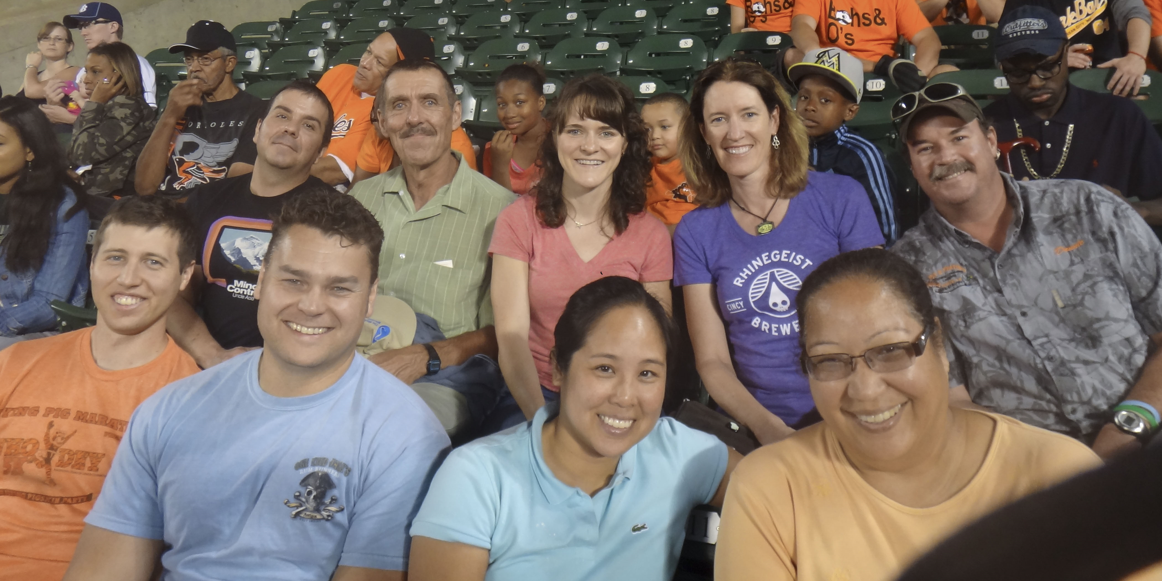
Acknowledgements
Field Studies | Measurement Methods | Toxicology
Mary Schubauer-Berigan | Eileen Birch | Aaron Erdely
Matt Dahm | Joseph Fernback | Linda Sargent
Marie de Perio | Douglas Evans | Robert Mercer
Jim Deddens | Melodie Fickenscher | Dale Porter
Ken Sparks |  | Tracy Eye
Donald Booher |  | Suzan Bilgesu
Veronica Burkel |  | Lindsay Bishop
Chrissy Toennis |  | Lorenzo Cena
Deb Sammons |  | Matt Campen (UNM)
John Clark |  | Andy Ottens (VCU)
Kevin L. Dunn
Kelsey Babik
Steve Bertke

