Slide 1
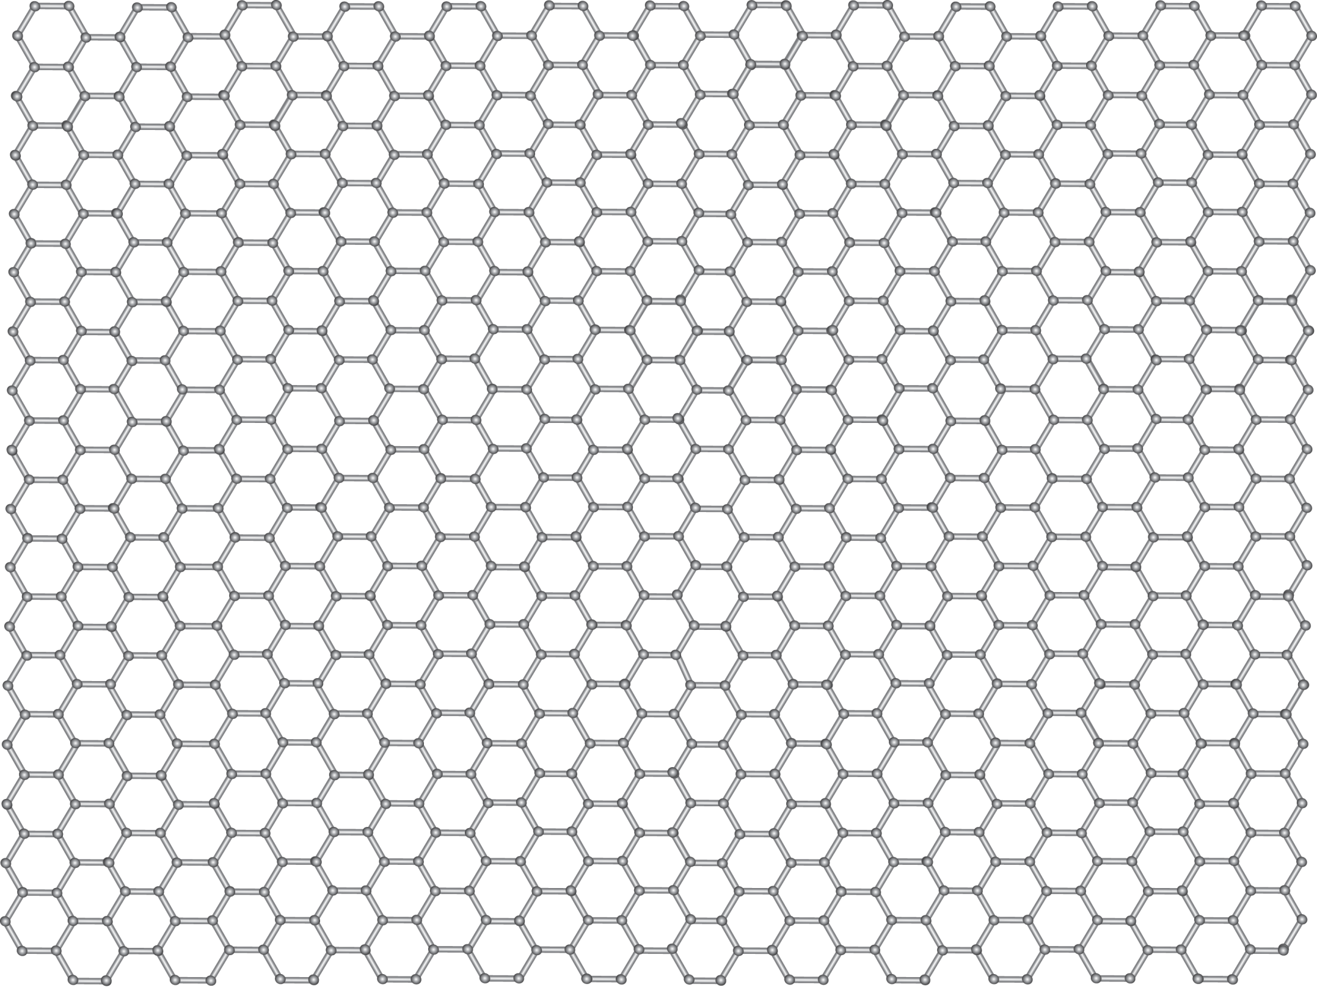
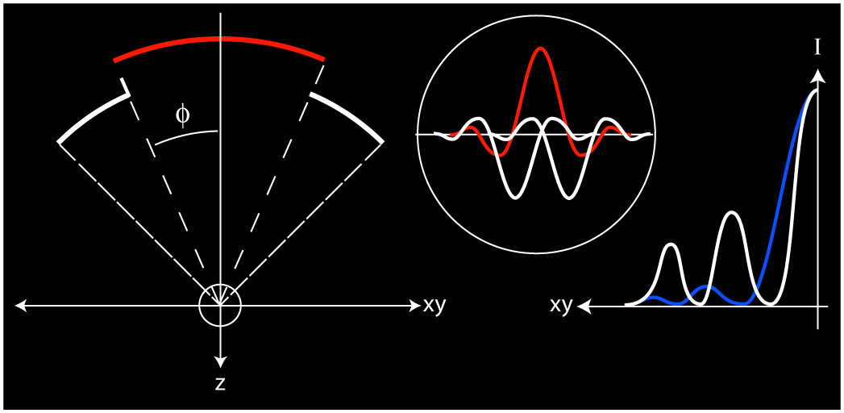
Nano-Material Identification using Fluorescence Lifetime Imaging Microscopy
Delay
(phase)
z₁
z₂
z₂
Ryan Beams
DIDSR, FDA, Silver Spring, MD
Oct 10, 2018
QEEN II Oct 9-10, 2018

Slide 2
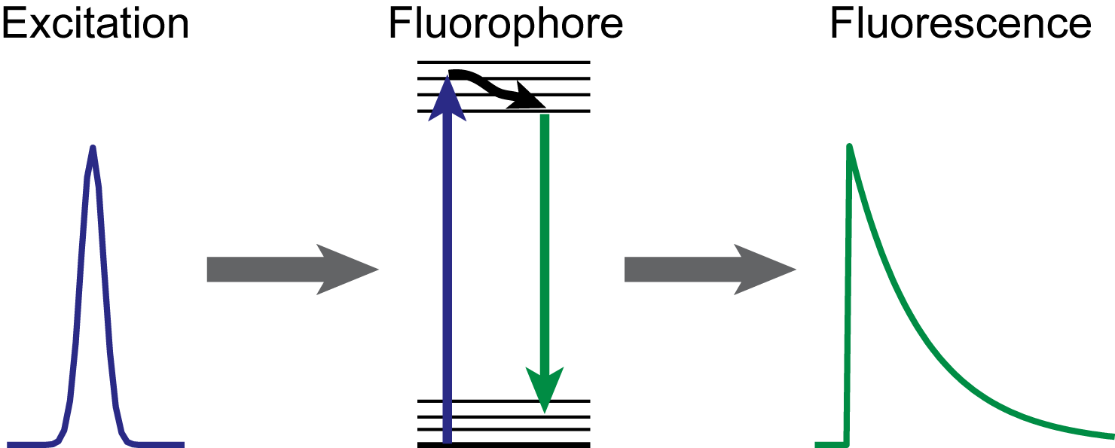
Motivation for Fluorescence Lifetime Imaging
Fluorescence Lifetime
High Resolution Imaging
+
10um
Advantages of Fluorescence Lifetime Imaging Microscopy (FLIM):
Excited state dynamics information
Generally non-destructive and non-contact
Sub-micron lateral resolution
Works in ambient conditions
Robust: Not dependent on concentration, excitation power, or photo-bleaching
Sensitive to the local chemical and environmental changes: pH, degrees of freedom, refractive index.
Notes:
300 nm beads conv. On left and SR on the right. Lots of neat stuff here..seperate beads, couning beads in islands etc..

Slide 3

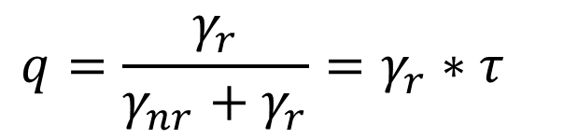
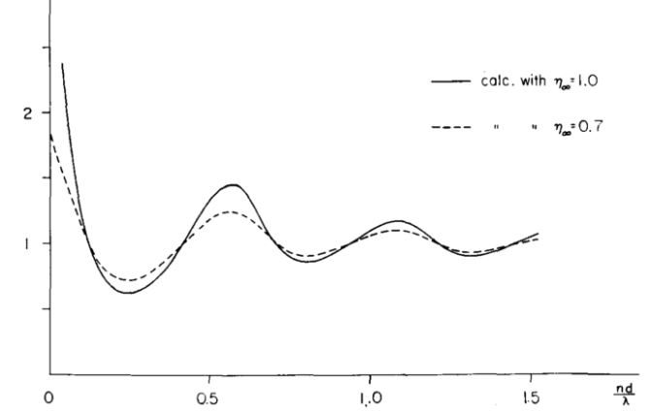
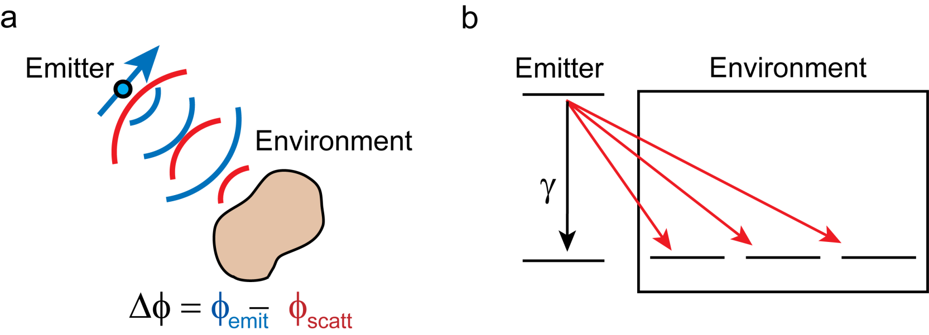
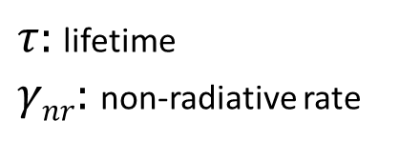


Local Environment and Quantum Yield
Local environment influences the quantum yield of an emitter
Non-radiative Decay
Excitation
Photon
Fluorescence
Emission
Photon
$q:$ quantum yield
$τ:$ lifetime
$γnr:$ non-radiative rate
$γ_{r}:$ radiative rate
Purcell Effect
Fermi’s Golden Rule
Emitter
Decay Rate
Metal Surface
Separation Distance
Drexhage, J. of Lumin. (1970)

Slide 4
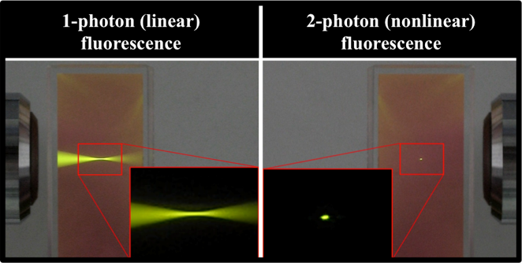
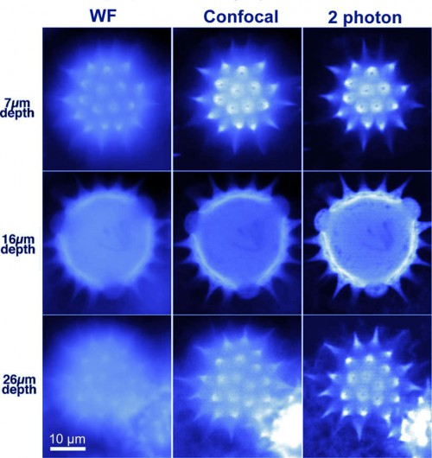
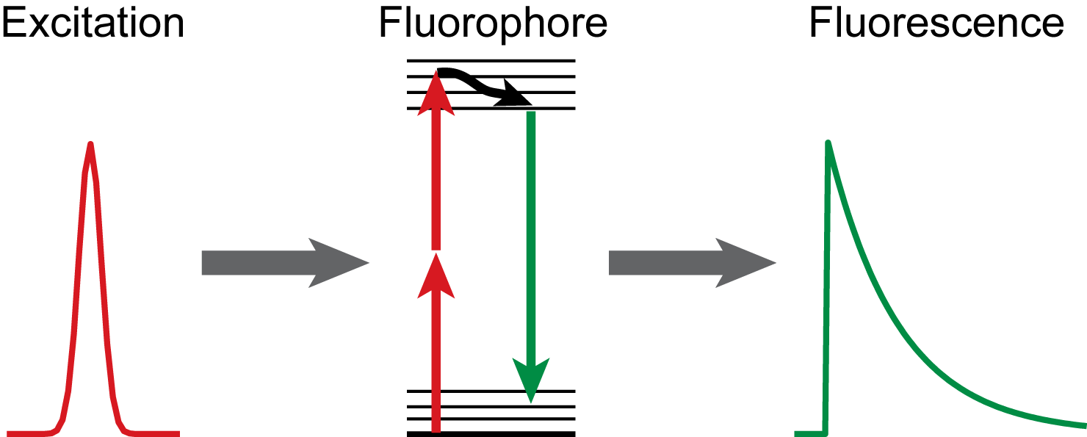


Linear vs Two-Photon Fluorescence
Linear Fluorescence Lifetime
Advantages of Two-Photon Fluorescence
- Less scattering (i.e. deeper penetration)
- Only excite fluorescence in focus (free confocality)
- Less photo-damage
$$I\left(t\right)= η_{1P} I_{0}^{}{ e}^{−t/τ}$$
Courtesy of Tana Villafaña
Two-Photon Fluorescence Lifetime
$$I\left(t\right)= η_{2P} I_{0}^{2}{ e}^{−t/τ}$$
http://candle.am/microscopy
Notes:
300 nm beads conv. On left and SR on the right. Lots of neat stuff here..seperate beads, couning beads in islands etc..

Slide 5
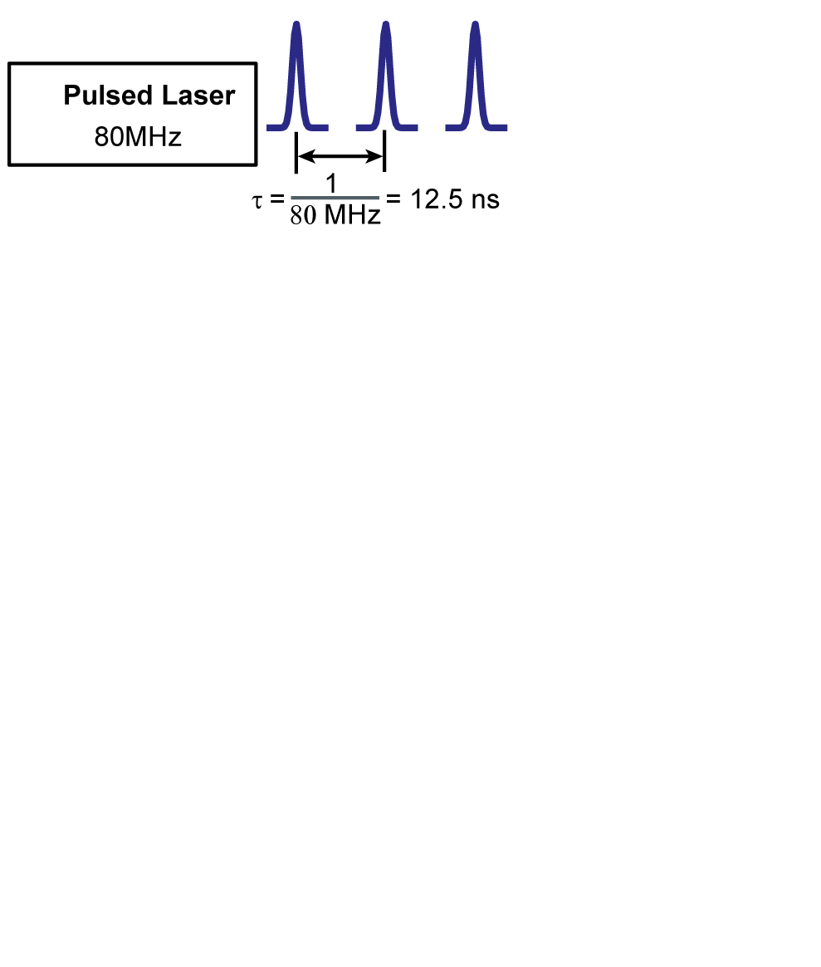
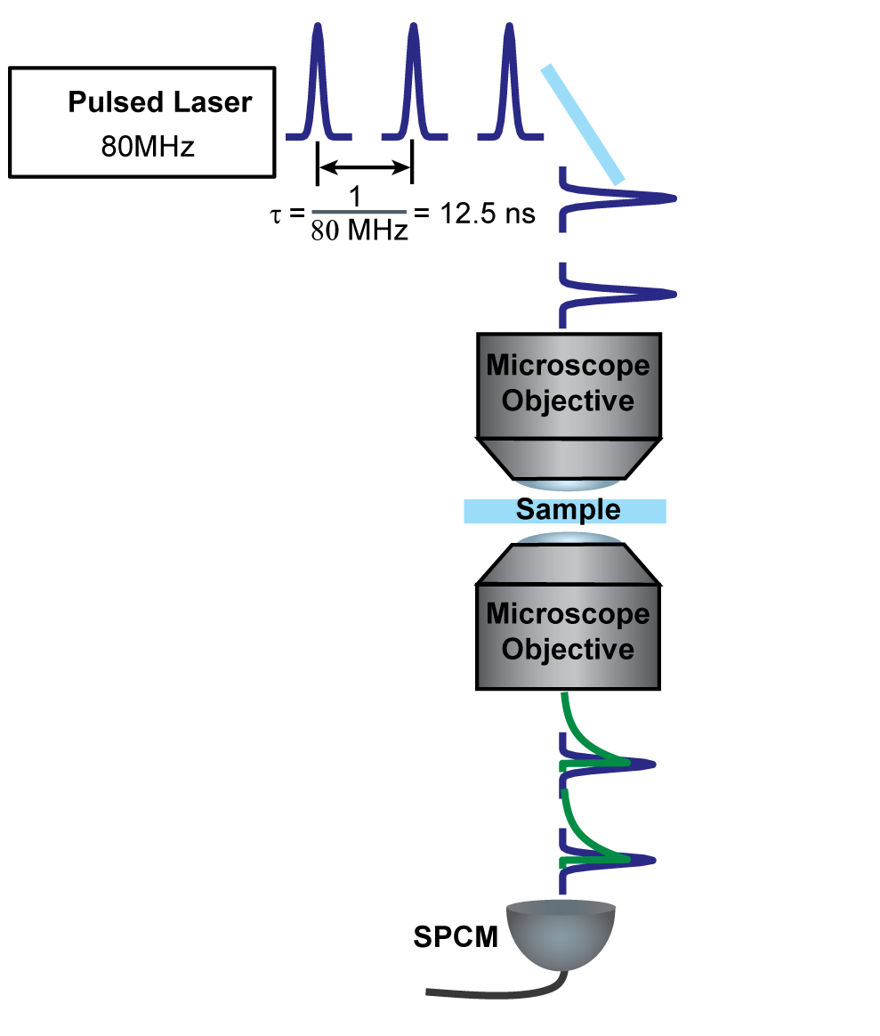
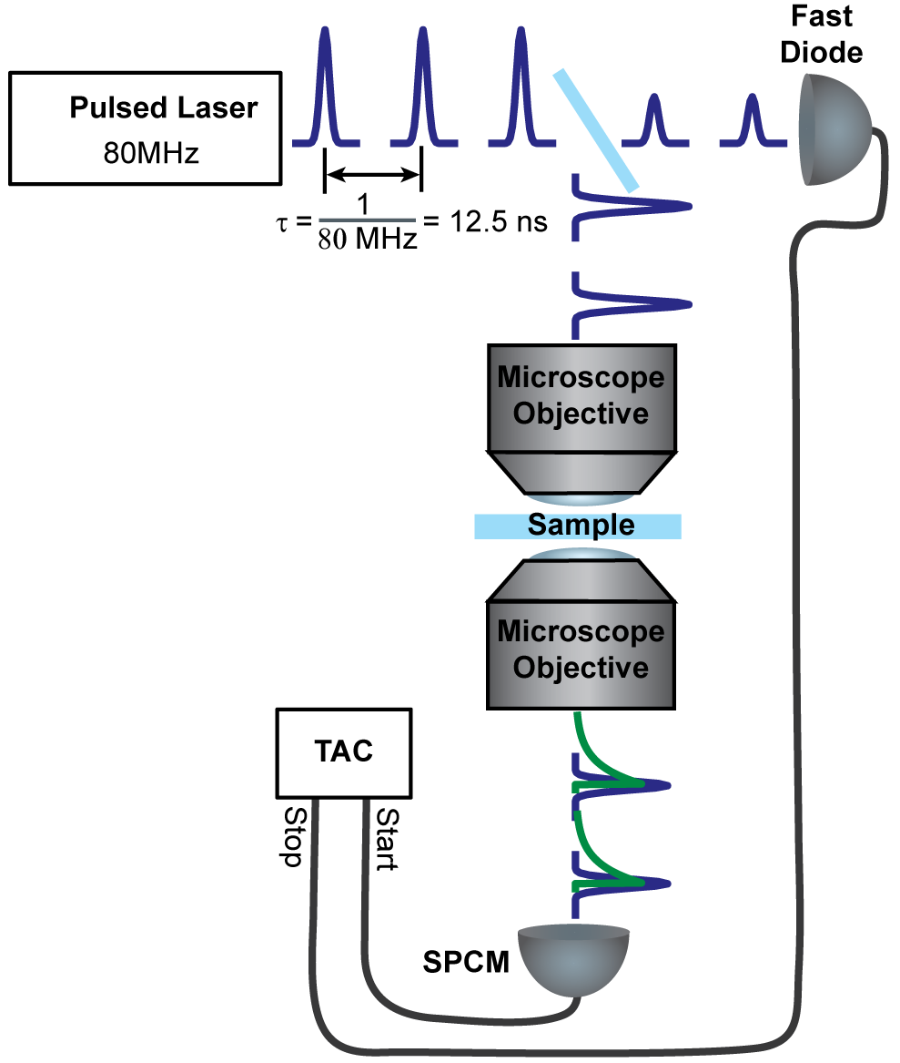
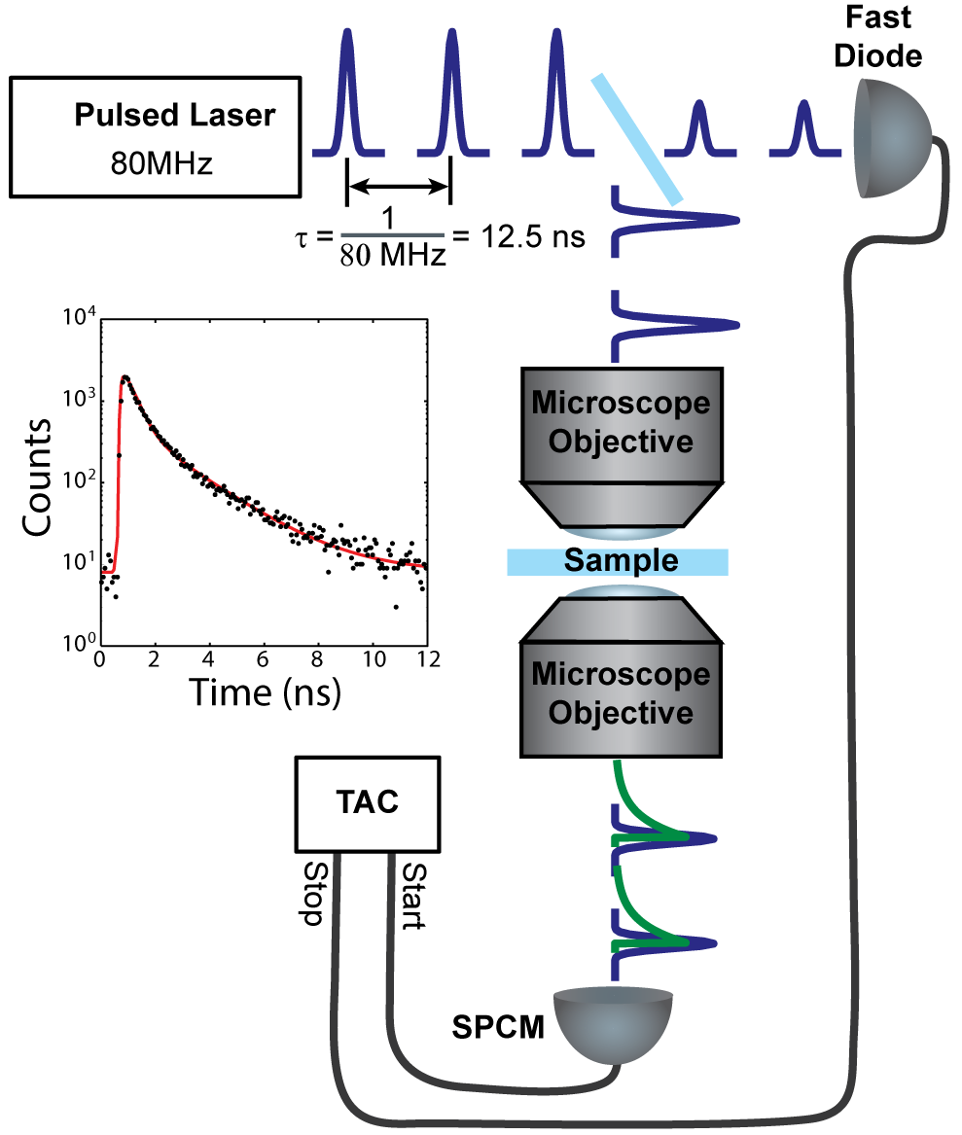
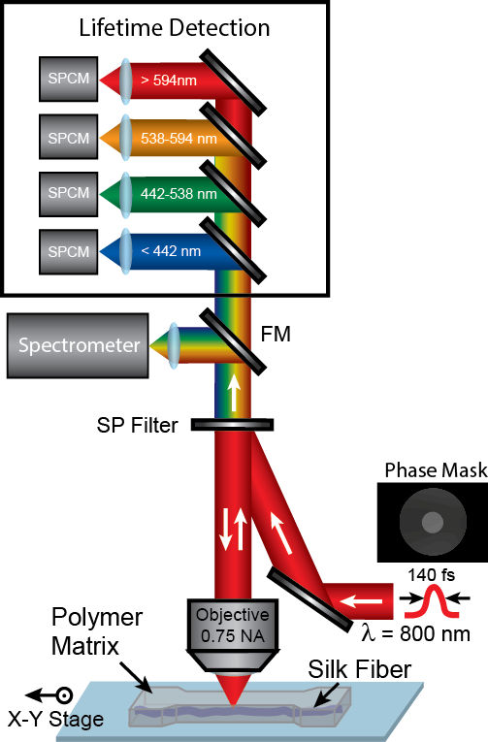
Two Photon Fluorescence Lifetime Imaging
Notes:
300 nm beads conv. On left and SR on the right. Lots of neat stuff here..seperate beads, couning beads in islands etc..

Slide 6
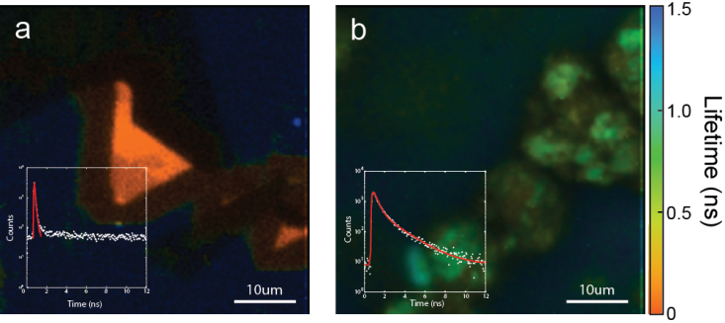
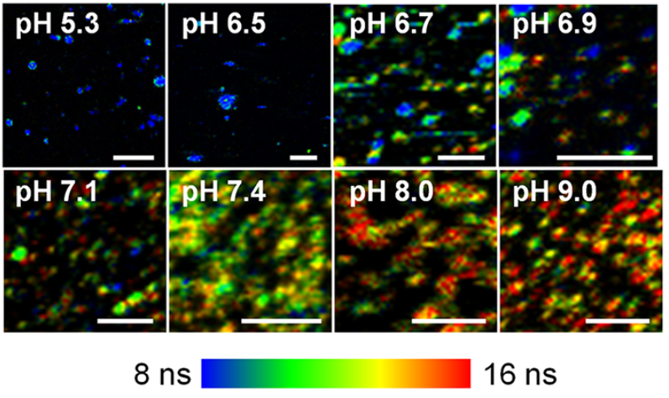
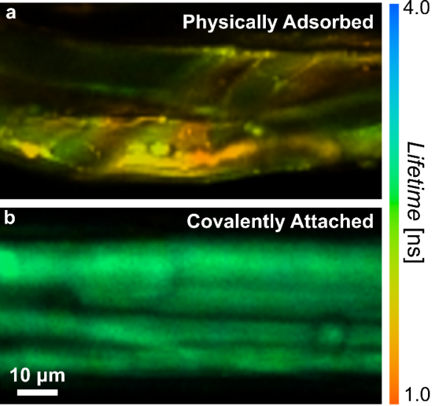

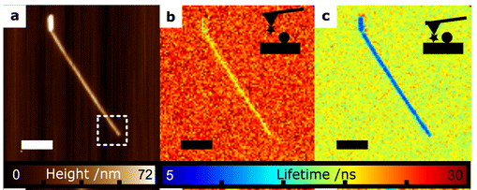
Applications of Fluorescence Lifetime
Intrinsic Lifetime
Lifetime Detection of pH
Semiconductor
Pigments
Orte, et al. ACS Nano (2013)
Chemical Bonds
Local Density of States Imaging
Schell, et al. Nano Letters (2014)
Woodcock, Beams, et al. Adv. Mat. Inter. (2017)

Slide 7
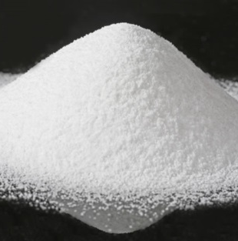
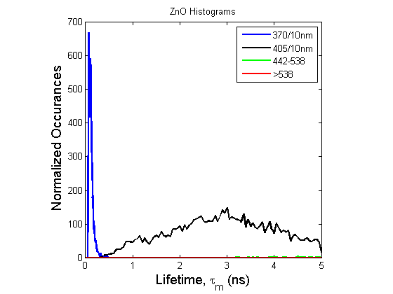
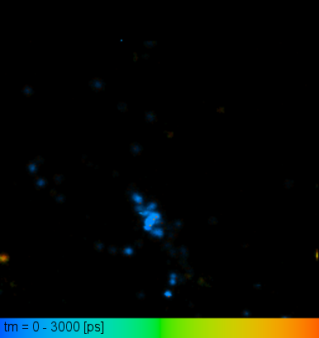
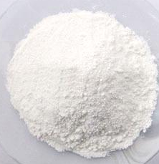
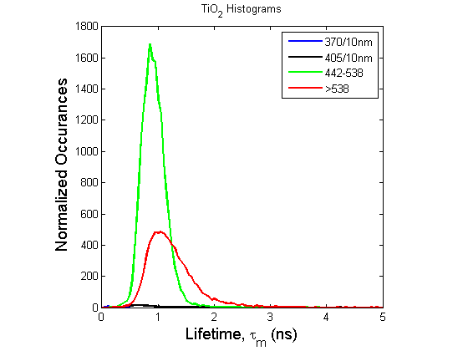
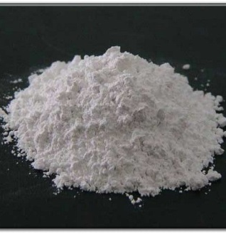
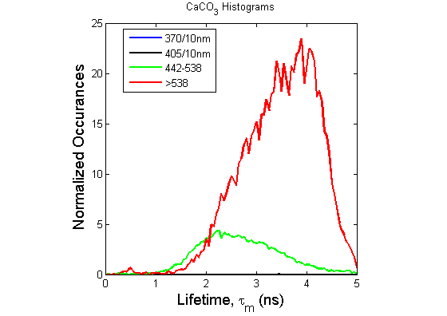
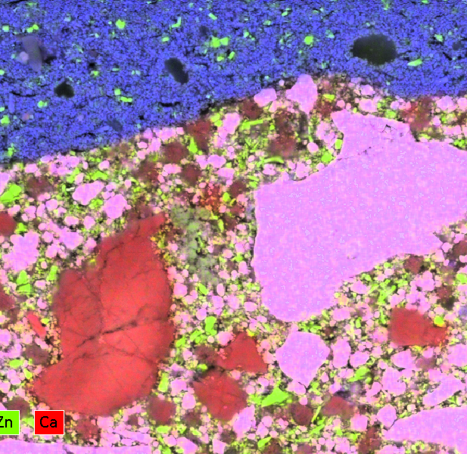
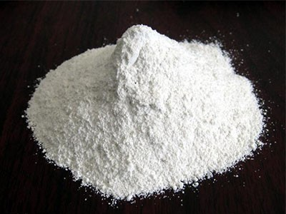
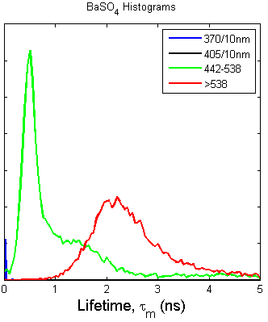
Identifying Nano-Materials
White Pigments and Fillers
Ag Nano-Particles
ZnO
TiO₂
CaCO₃
Metal Oxide Particles
X Ray
FLIM
BaSO₄

Slide 8

Acknowledgements
Stephan Stranick (NIST)
Ed Vicenzi (SI)
Keana Scott (NIST)
Jeff Gilman (NIST)
Jeremiah Woodcock (NIST)
Chelsea Davis (NIST)
Thank you!
Ryan.Beams@fda.hhs.gov

