Slide 1
October 10th, 2018
QEEN II: 2nd Quantifying Exposure to Engineered Nanomaterials from Manufactured Nanomaterials Workshop
Fostering U.S.-International Collaboration in Integrating Exposure in Nanomaterial Risk Evaluation
A European Perspective
Christof Asbach
IUTA – Institut für Energie- und Umwelttechnik e. V.
Air Quality & Filtration

Slide 2


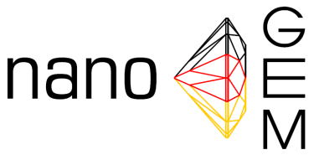







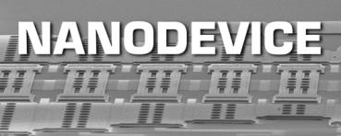








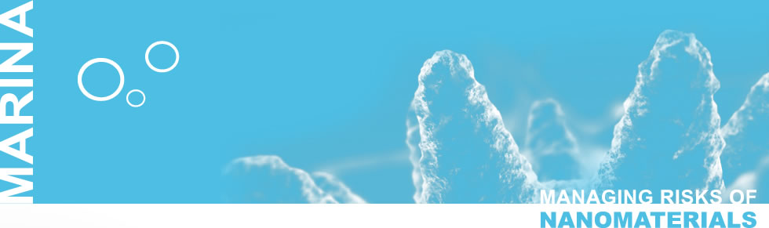





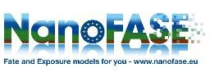






Projects involving exposure assessment

Slide 3

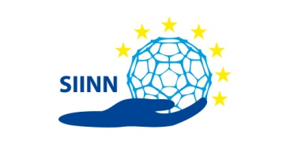

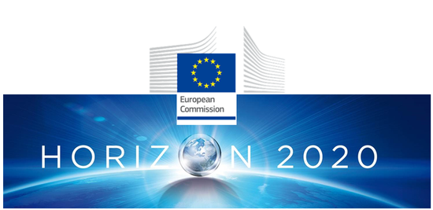
Projects involving exposure assessment
International collaboration within EU has been fostered through research programs
First framework program in 1984
FP7 (2007-2013) with one focus on ENM exposure assessment

Slide 4
Budget of the European Framework Programs

Slide 5

Fostering US - EU collaboration
Seven CoRs have been established (Characterization, Databases and Comutational Modeling, Ecotoxicity, Human Toxicity, Exposure through Product Life, Risk Assessment, Risk Management and Control)
„The U.S.-EU Nanotechnology Communities of Research (CORs) provide a platform for scientists to collaboratively identify and address key research needs”
No funding provided (needs to come from other sources, e.g. H2020 projects)
To enhance collaboration, an umbrella is needed that provides regular funding opportunities for joint projects

